Slide 1

Agriculture Development Assistance Mapping tool
(http://fenix.fao.org:8050/fenix-web/adam/ADAM.html)
Developed and managed by FAO TCSP Division
Coordinators: Dominique Di Biase and Vito Cistulli
Contact: RM-Help-Desk@fao.org
© FAO, 2011

Slide 2
Rational
CPF and RM current practices - time consuming in trying to understand:
  What are the major agricultural challenges and sector development objectives ?
  Who is doing what to address these challenges ?
  What are the specific comparative advantages of FAO in the country?
  Where should FAO focus its activities in the mid-term taking into account what other development partners are doing?
  What results FAO should expect with its country-level activities in the medium term?
  How can funds needed to support those activities be mobilized?
ADAM conceived as a tool to assist in answering these questions
ADAM for the first time provided the possibility to collate all information related to resource partner’s profiles and resource partner matrices

Slide 3
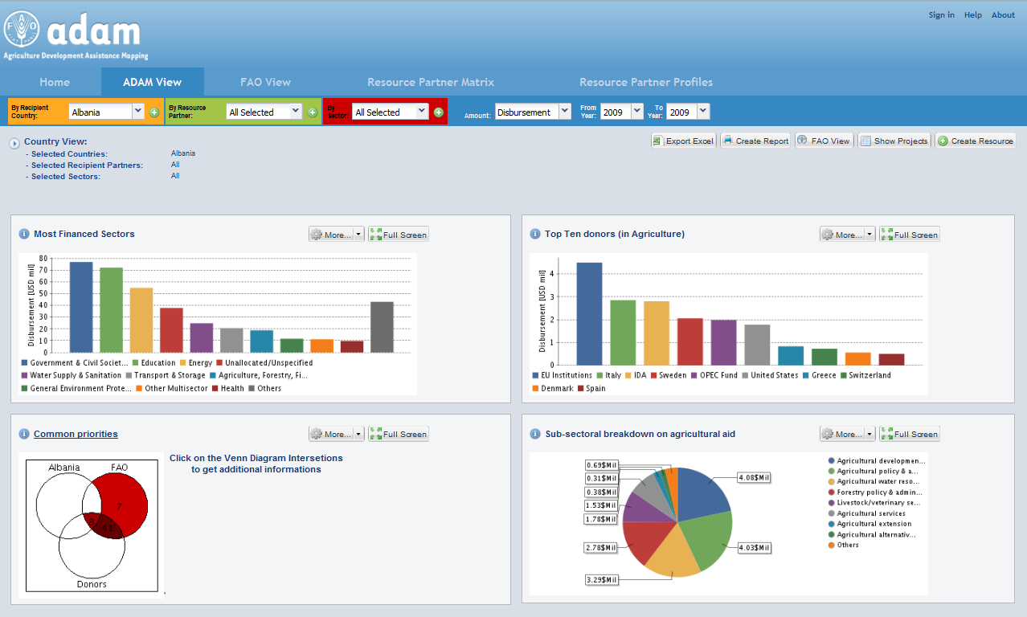
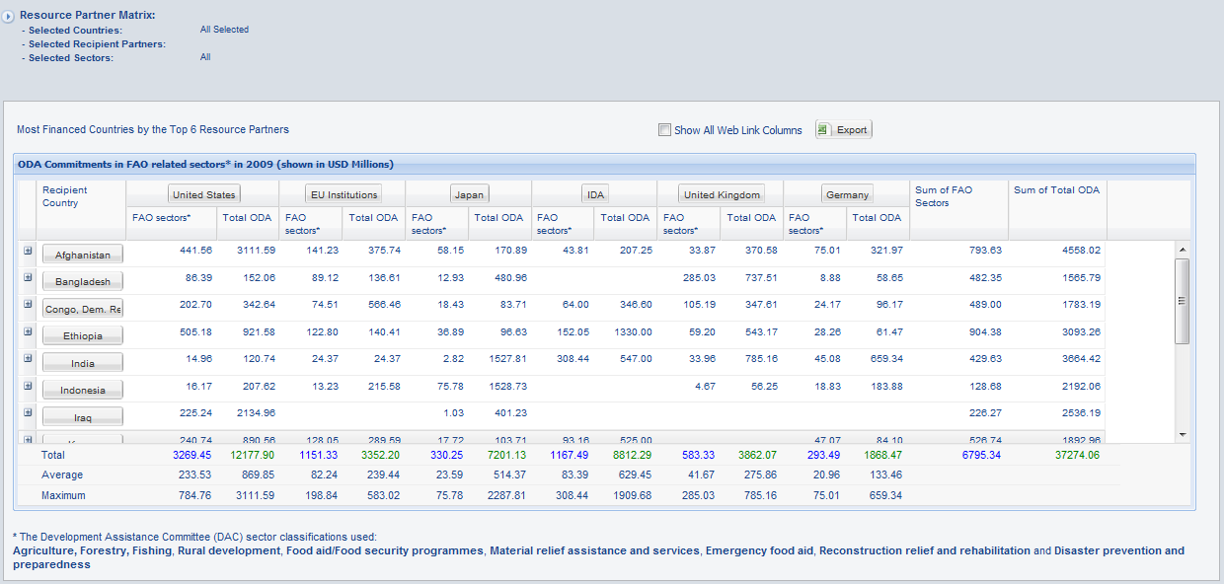
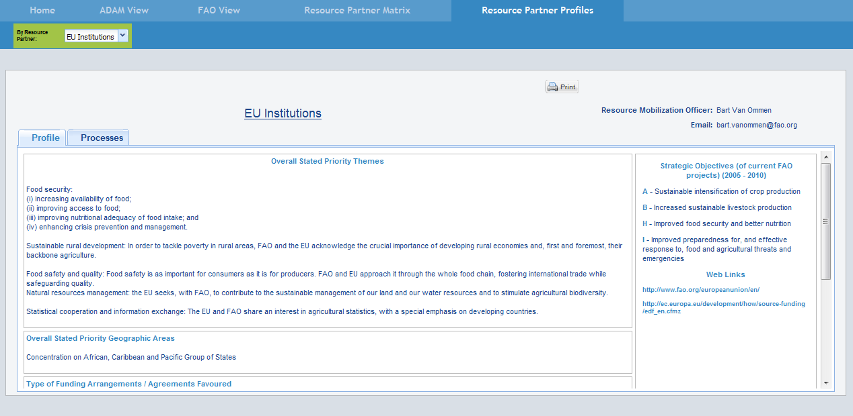
Status of ADAM development
A first full prototype released in February 2011, with following functionalities:
ADAM and FAO view – using DAC and FAO SF/OR classification
Resource partner matrix– country, (sub) regional, global level
Resource Partners profiles

Slide 4
Source of information
Current:
  OECD/DAC covering 62 resource partners and their aid flows [system to system integration];
  Resource partners profiles for 52 resource partners [Manual data input]
Upcoming:
  FAO/FPMIS, NON DAC/AidData [system to system integration]
  National sector priorities, CPF priorities, Resource partners country priorities [manual data input]
    Sources: CPF, National Country Strategies, FAOR annual reports
Other data and sources of information to be identified

Slide 5
ADAM and collaboration with other complementary FAO initiatives
Ongoing discussions
  FS-ATMIS (TCSF)
  Food and Agriculture Policy Analysis Tool (TCSP)
Planned discussion
  IPPC initiative (International Plant Protection Convention, AGP)
  Statistics (ESS)

Slide 6
Approach to testing and feedback on additional user’s requirements
Structured feedback
How:
using the pre-defined template for the identified target groups, addressing usability and data quality (accuracy, completeness of the dataset, staleness, relevance, methodology)
Who:
Selected DOs (FAOR, SRO, RO) through in-country visits and remote feedback
Headquarters technical divisions through meetings and feedback through email
Continuous feedback

Slide 7
Maintenance requirements & responsibilities
Content:
Update of database related to resource partners interventions [Workstation team]
Update of database related to Government, CPF and Resource Partners priorities at country level, and resource partners priorities at global level [DOs/TCS].
Update of resource partners profiles [TCS]
System:
Further customization of the tool, on need basis [Workstation team]
Links/interfaces with other systems as they are identified [Workstation team]

