Slide 1
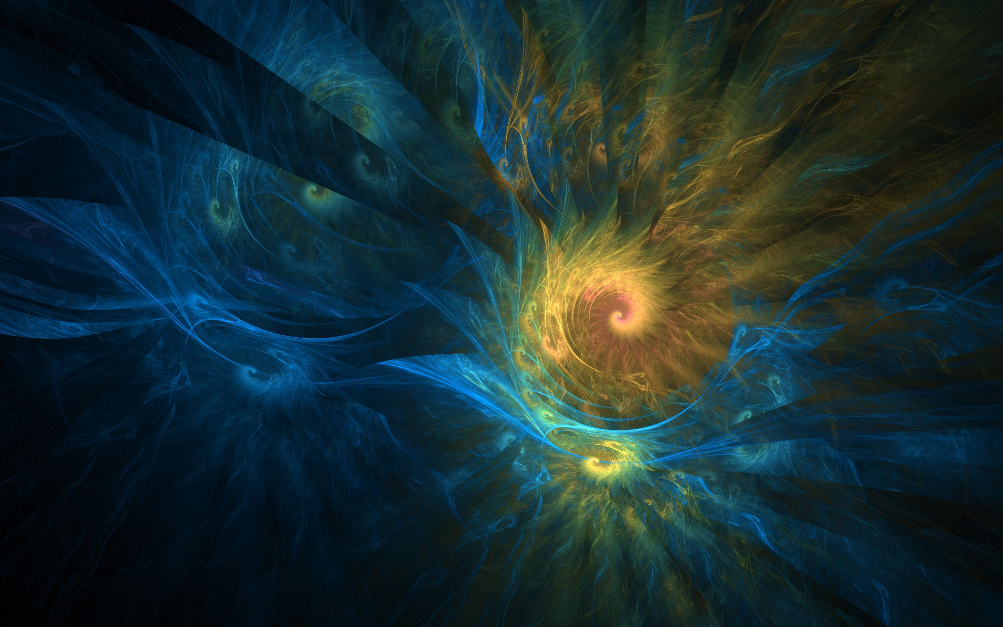
Unlocking Fibonacci: Nature’s Code
From Discovery to Necessity

Slide 2
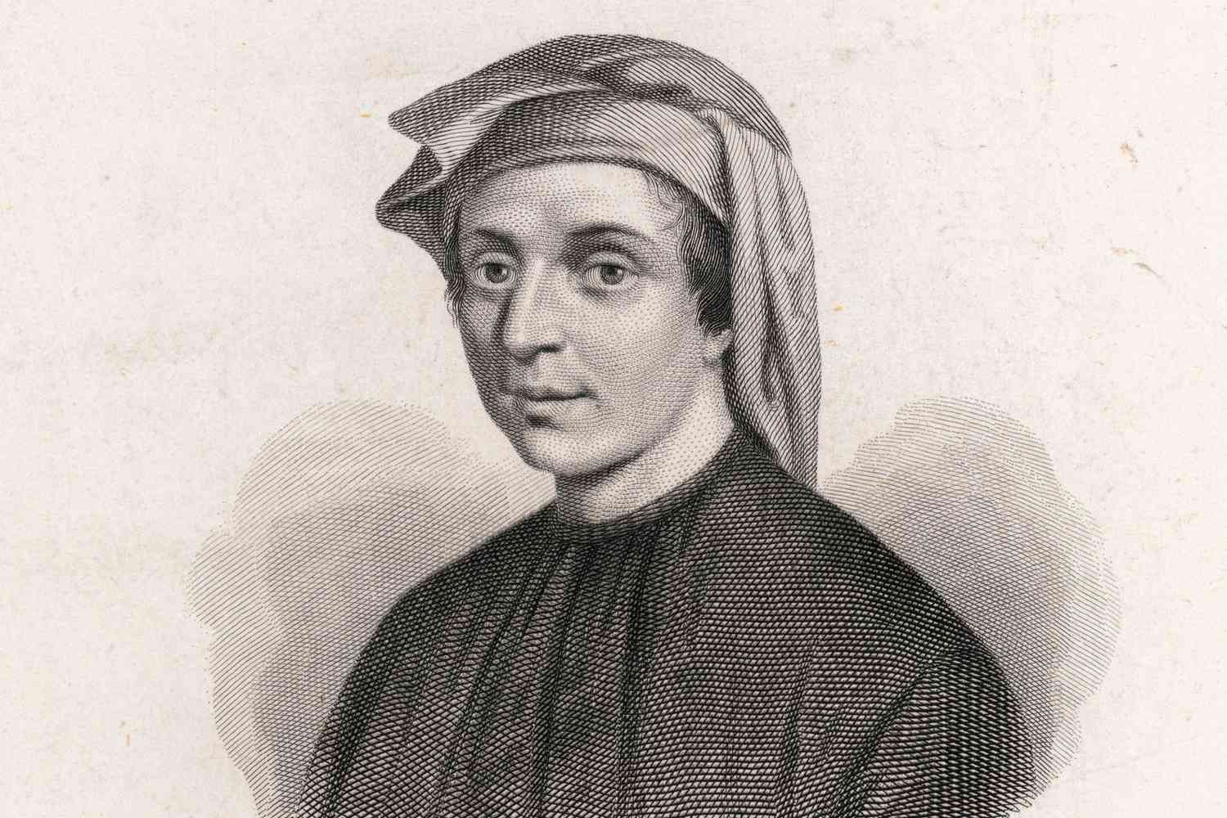
Born in the 12th century, Fibonacci's travels exposed him to diverse mathematical concepts, especially in the Arab world.
Fibonacci, a.k.a. Leonardo of Pisa, brought the captivating Fibonacci sequence to the Western world
In this presentation, we'll delve into how Fibonacci discovered his eponymous sequence and explore its far-reaching impact on various aspects of our world.

Slide 3
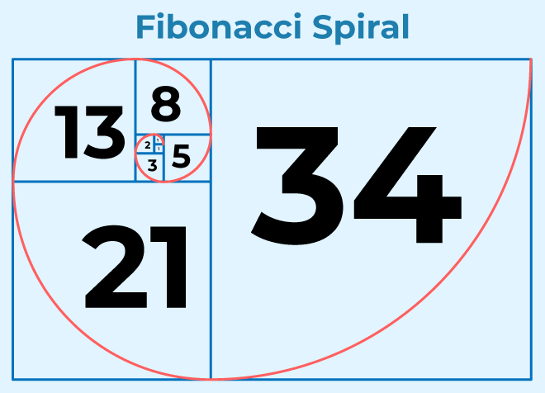
Fibonacci's discovery unfolds in a sequence: 0, 1, 1, 2, 3, 5, 8, 13, 21, ...
These numbers showcase a remarkable pattern where each is the sum of the two preceding ones.
As we delve deeper, we discover the mathematical elegance of the Fibonacci sequence, a captivating series that extends infinitely, influencing various fields.
The sequence also reveals the concept of the golden ratio, a divine proportion found in nature, art, and architecture, amplifying the allure of this mathematical marvel.

Slide 4
Fibonacci's impact is not confined to mathematics alone; its influence resonates across diverse domains.
Explore applications in nature, where the Fibonacci sequence governs the arrangement of leaves, petals, and seeds in plants, showcasing the inherent order in the natural world.
Journey into the world of art and design, witnessing how Fibonacci's sequence shapes masterpieces, from classical architecture like the Parthenon to contemporary works.
Delve into finance, where the Fibonacci sequence plays a pivotal role in technical analysis, aiding in predicting market trends through retracement levels.
Through these applications, witness how Fibonacci transcends mathematics, leaving an indelible mark on the fabric of our world.

