Slide 1

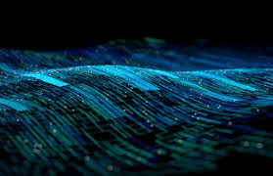
Investigating the revolutionary impacts of Quantum Computing on Artificial Intelligence
Notes:
Good [morning/afternoon], everyone. Today, I’m going to explore the transformative relationship between Quantum Computing and Artificial Intelligence. These two groundbreaking technologies are set to reshape the way we solve problems, process data, and make decisions. By the end of this talk, I hope you’ll have a better understanding of why this intersection is so exciting and impactful.

Slide 2
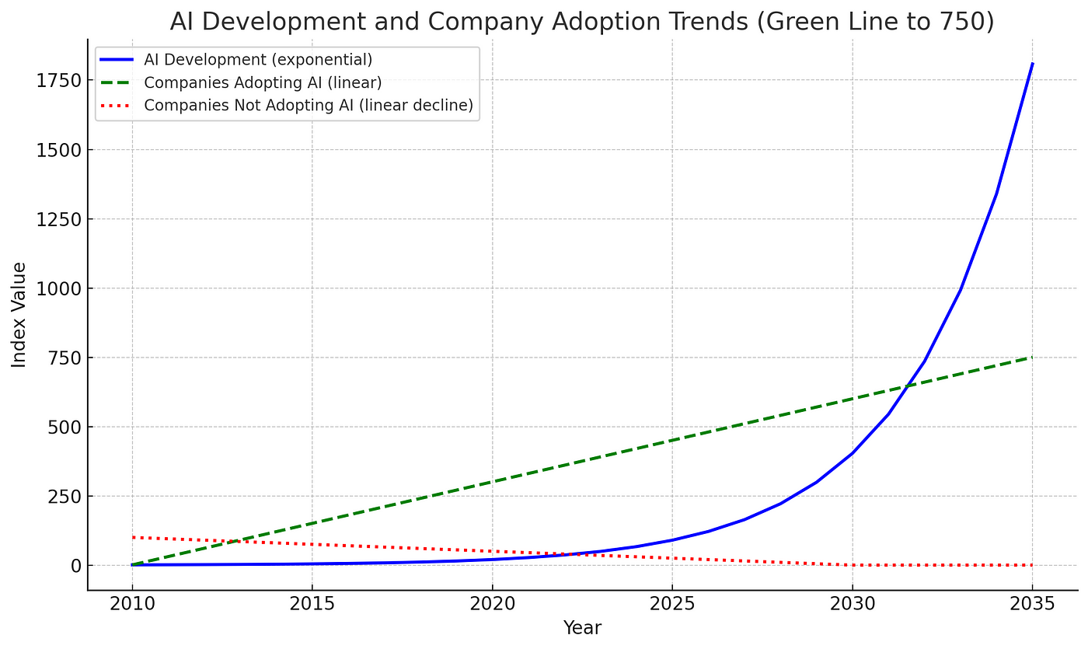
Intro:
The growth of AI in recent years has been exponential
It will continue to grow at a similar rate
When fully developed, Quantum Computing has the capabilities to increase the growth and use of AI even further
But how?
Notes:
Slide 2: Introduction [~50 seconds] Artificial Intelligence has seen exponential growth in recent years, becoming more capable and integrated into our daily lives. This momentum is expected to continue, with AI playing an even greater role in industries like healthcare, finance, and transportation.
But here’s the big question: what could accelerate AI's progress even further? Enter Quantum Computing. Though still in its early stages, Quantum Computing has the potential to revolutionize AI by providing unprecedented speed, efficiency, and problem-solving capabilities. In this presentation, we’ll explore how this works and what makes Quantum Computing so powerful.

Slide 3
The Fundamentals of Quantum Computing:
Qubits and their ability to entangle and be in a state of superposition
Superposition: like a coin that has been flipped - when it is in midair it can either be heads or tails - but you won't know until it lands
Quantum entanglement: just means that the outcomes of each of the bits is mathematically linked
Notes:
Slide 3: The Fundamentals of Quantum Computing [~1 minute] To understand Quantum Computing’s impact, let’s break down two of its key concepts: superposition and entanglement.
Superposition allows a quantum bit, or qubit, to exist in multiple states at once—both 0 and 1, rather than just one or the other. Think of it like flipping a coin. When it’s in the air, it could land as either heads or tails, but until it lands, it exists in a state of uncertainty. This property allows quantum computers to process vast amounts of data simultaneously.
Entanglement is another unique feature. When qubits are entangled, their states are mathematically linked, no matter how far apart they are. Measuring one qubit immediately gives you information about the other. This allows for faster communication and processing.
Together, these principles enable Quantum Computing to handle computations in ways that are simply impossible for classical computers.

Slide 4
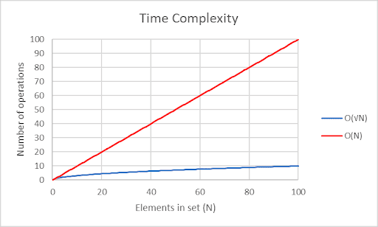
How can this be applied to AI:
One way is through the use of quantum algorithms
An example of one is Grover’s algorithm
It can also generate truly random numbers which is useful in a range of AI tasks
There are many other applications
Grover’s algorithm VS a standard unordered search algorithm:
Notes:
Slide 4: How Can This Be Applied to AI? [~1 minute 30 seconds] So, how does Quantum Computing enhance AI? Let’s look at a couple of examples:
One application is through quantum algorithms, like Grover’s Algorithm. This algorithm can search through large, unordered data sets significantly faster than classical methods. For AI, this means quicker pattern recognition and decision-making—crucial for tasks like facial recognition or recommendation systems.
Another application is the generation of truly random numbers. Unlike classical computers, which rely on pseudorandom numbers, Quantum Computing uses superposition to produce randomness that is completely unpredictable. This is critical for tasks like genetic programming, unsupervised learning, and simulations, where true randomness improves performance and accuracy.
These are just a few examples. The potential applications of Quantum Computing in AI are vast and will likely expand as the technology develops further.

Slide 5

Conclusion:
By taking advantage of the properties of qubits, quantum algorithms can do incredible things
Quantum Computing has a vast range of potential on its own, but when applied with AI it can solve problems that were previously inefficient or even impossible by modern standards
Watch for it in the future - its development will change the way we live, just as AI has already
Notes:
Slide 5: Conclusion [~50 seconds] In conclusion, Quantum Computing leverages the unique properties of qubits—superposition and entanglement—to enable incredible advances in computation.
When applied to AI, it offers transformative possibilities, from faster algorithms to truly random data generation, solving problems that were previously inefficient or impossible with traditional methods.
As both fields continue to grow, their intersection will redefine what’s possible in technology. Just as AI has already changed the way we live, Quantum Computing’s integration with AI will be a game-changer. So, keep an eye on this space—it’s the future.
Thank you for listening!

