Slide 1


Understanding the Formation of Galaxies
.

Slide 2
Aims of this presentation:
Using the Big Bang model of expansion creating cosmic radiation
Deducing common characteristics of Galaxies
Theorising construction/formation based on research and theories of organisations such as NASA and others.

Slide 3
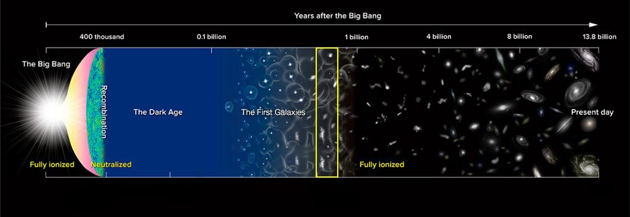
1: The Big Bang and what we can draw from it.
Over 13.8 billion years ago, the universe was in a hot and dense state until (Space.com) states ‘in 1/10000 ths of a second, the pure energy began to expand in an explosion leading to the gradual cooling of the universe over millions of years.
The energy formed quarks and fundamental particles such as electrons and protons and neutrons
Clusters of these fundamental particles began forming further from this “central point” and the cooling of the particles led to fusion
Thus leading these clusters to form clouds of hot Hydrogen and Helium known as Nebula
We have identified the makings of a galaxy. But how do they begin to form a coherent structure?
This Photo by Unknown Author is licensed under CC BY

Slide 4
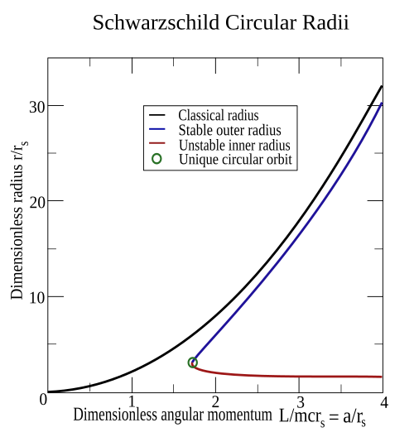
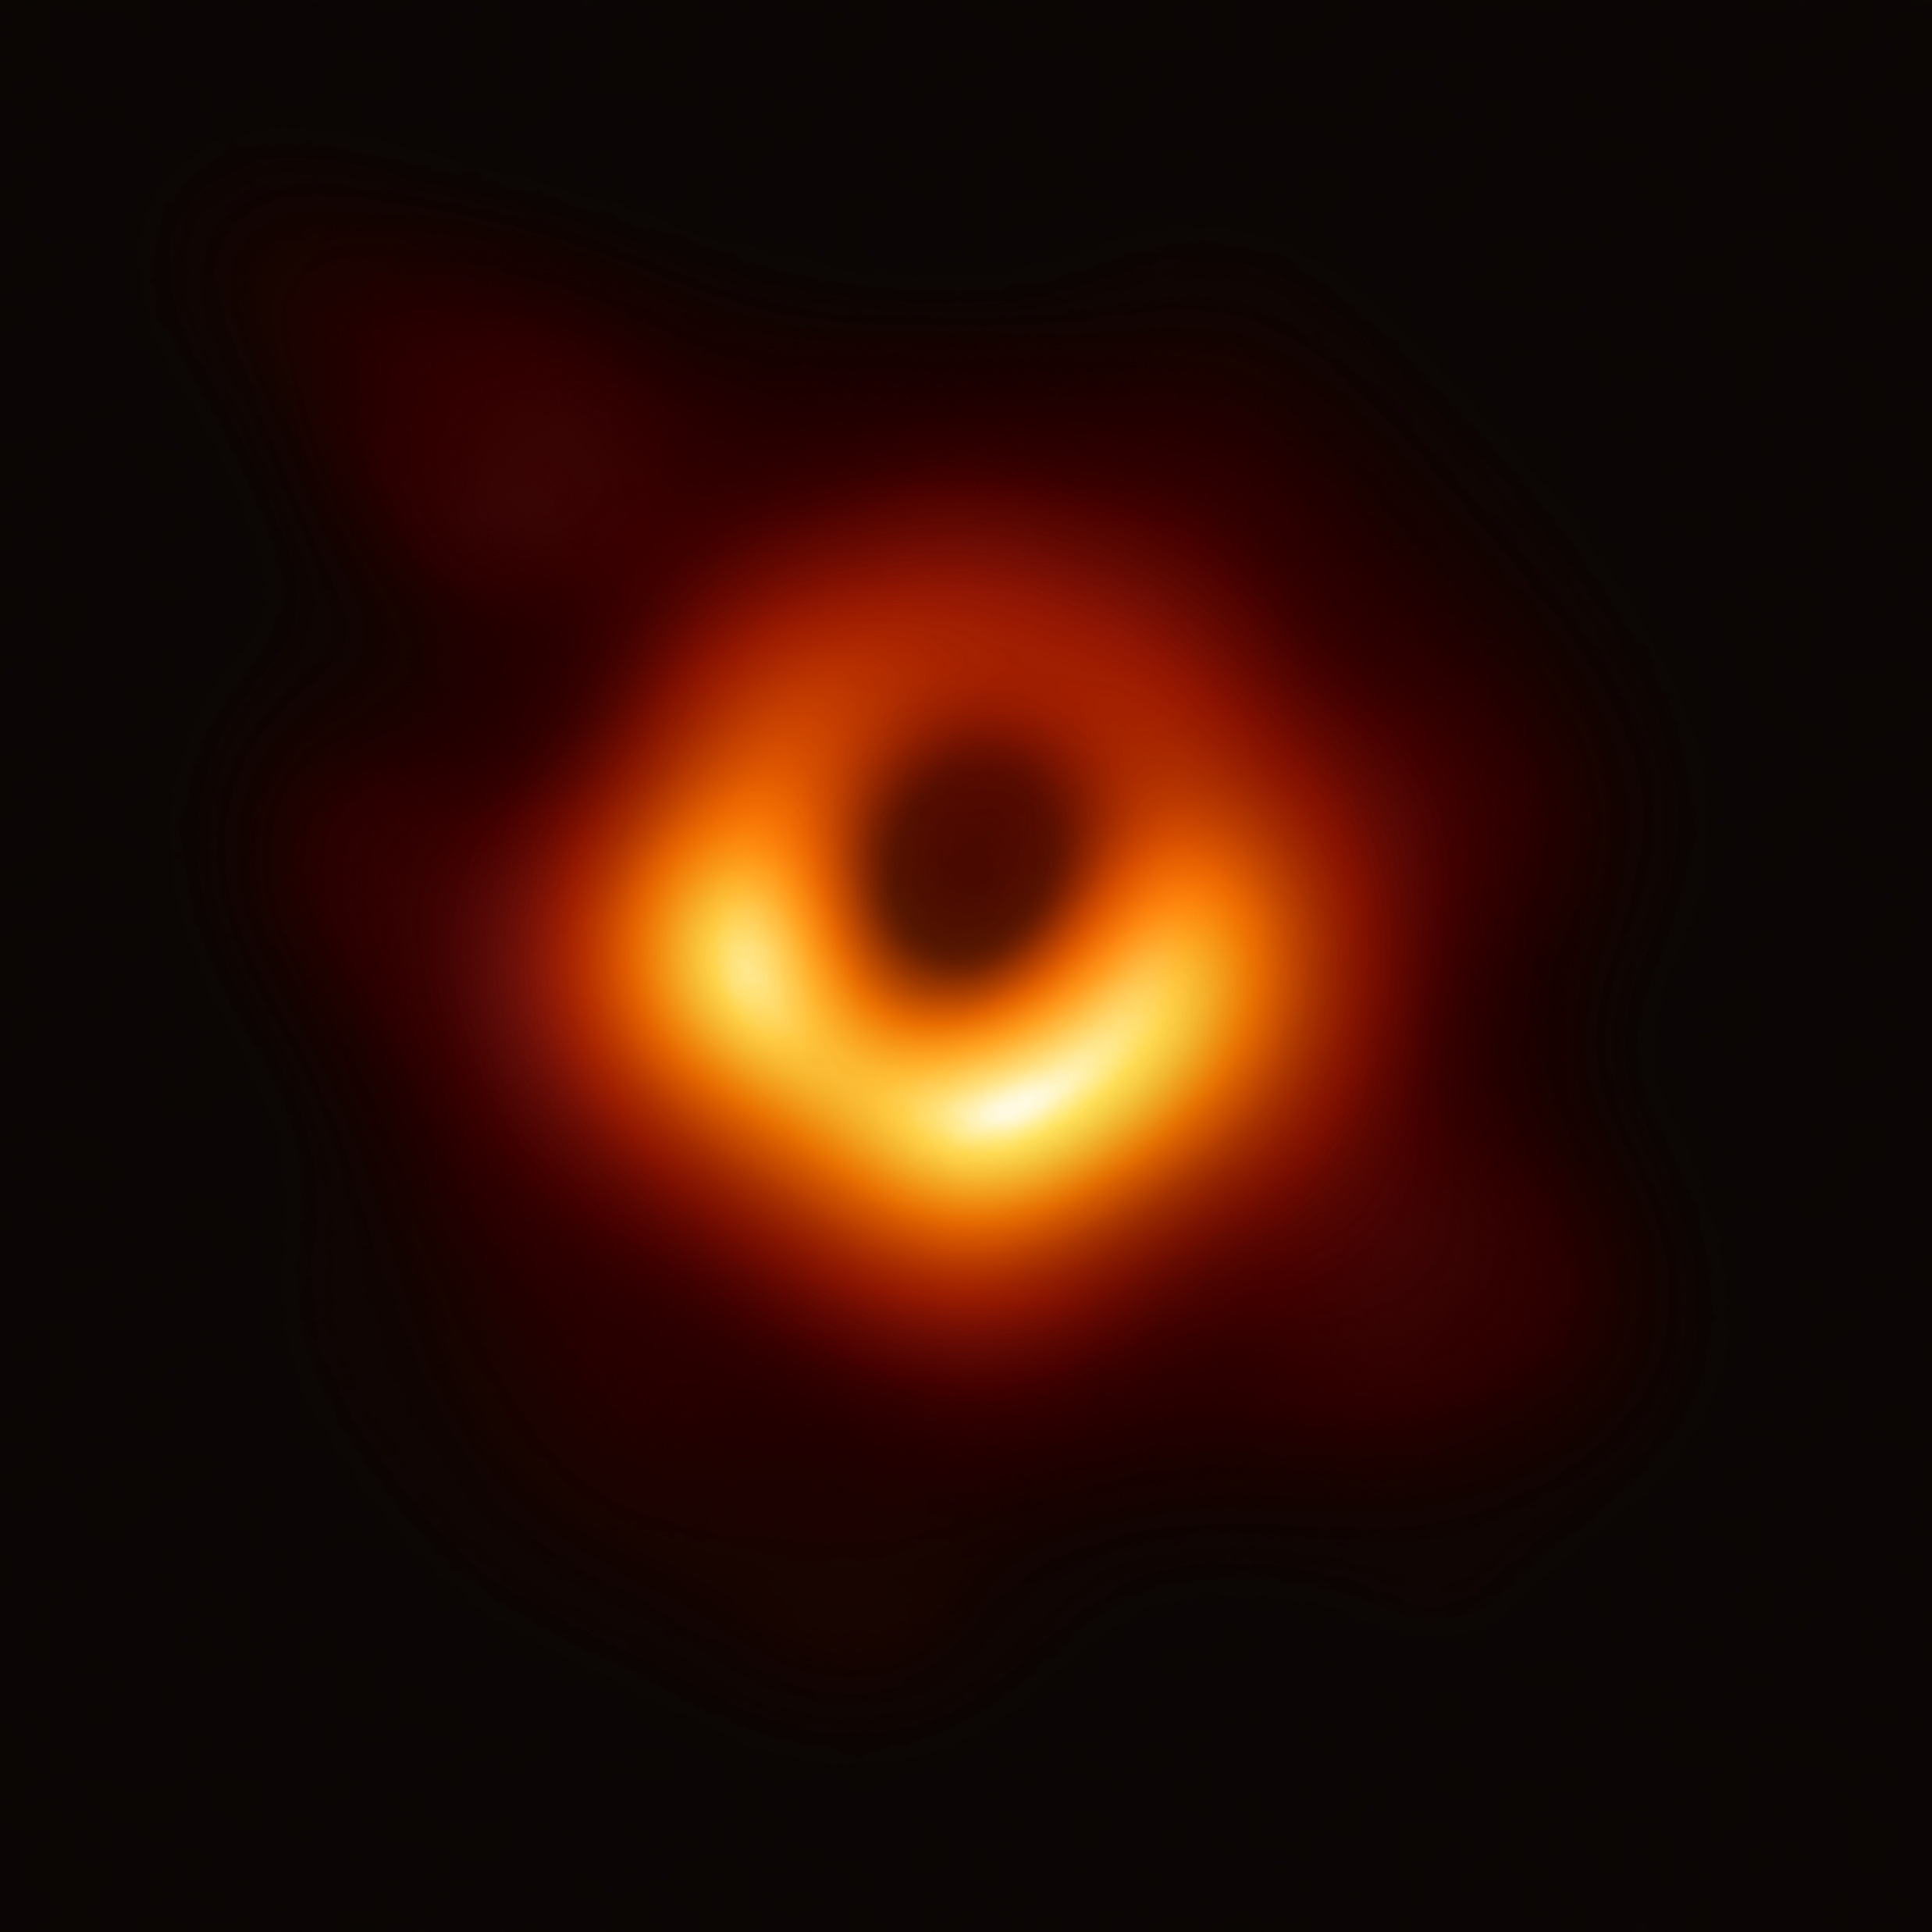
Super Massive Black Holes: Cosmic enigmas
Black Holes are formed when a supermassive star “dies”
Stars require fusion to survive
These stars after millions of years will collapse under its own gravity and create a supernova, an explosion of energy lasting 100s of days and one of 2 possibilities can occur. The most important to our research is that the supernovae can form a black hole due to the bending of space.
Black Holes tend to be much larger and more importantly heavier (the average Black hole has around 10 solar masses, which is 10x the weight of our sun) Which means it gravitational pull is stronger, which if this black hole is “super massive” can pull stellar objects and solar systems towards them which would explain Galaxies’ circular shapes
This Photo by Unknown Author is licensed under CC BY-SA
This Photo by Unknown Author is licensed under CC BY-SA

Slide 5
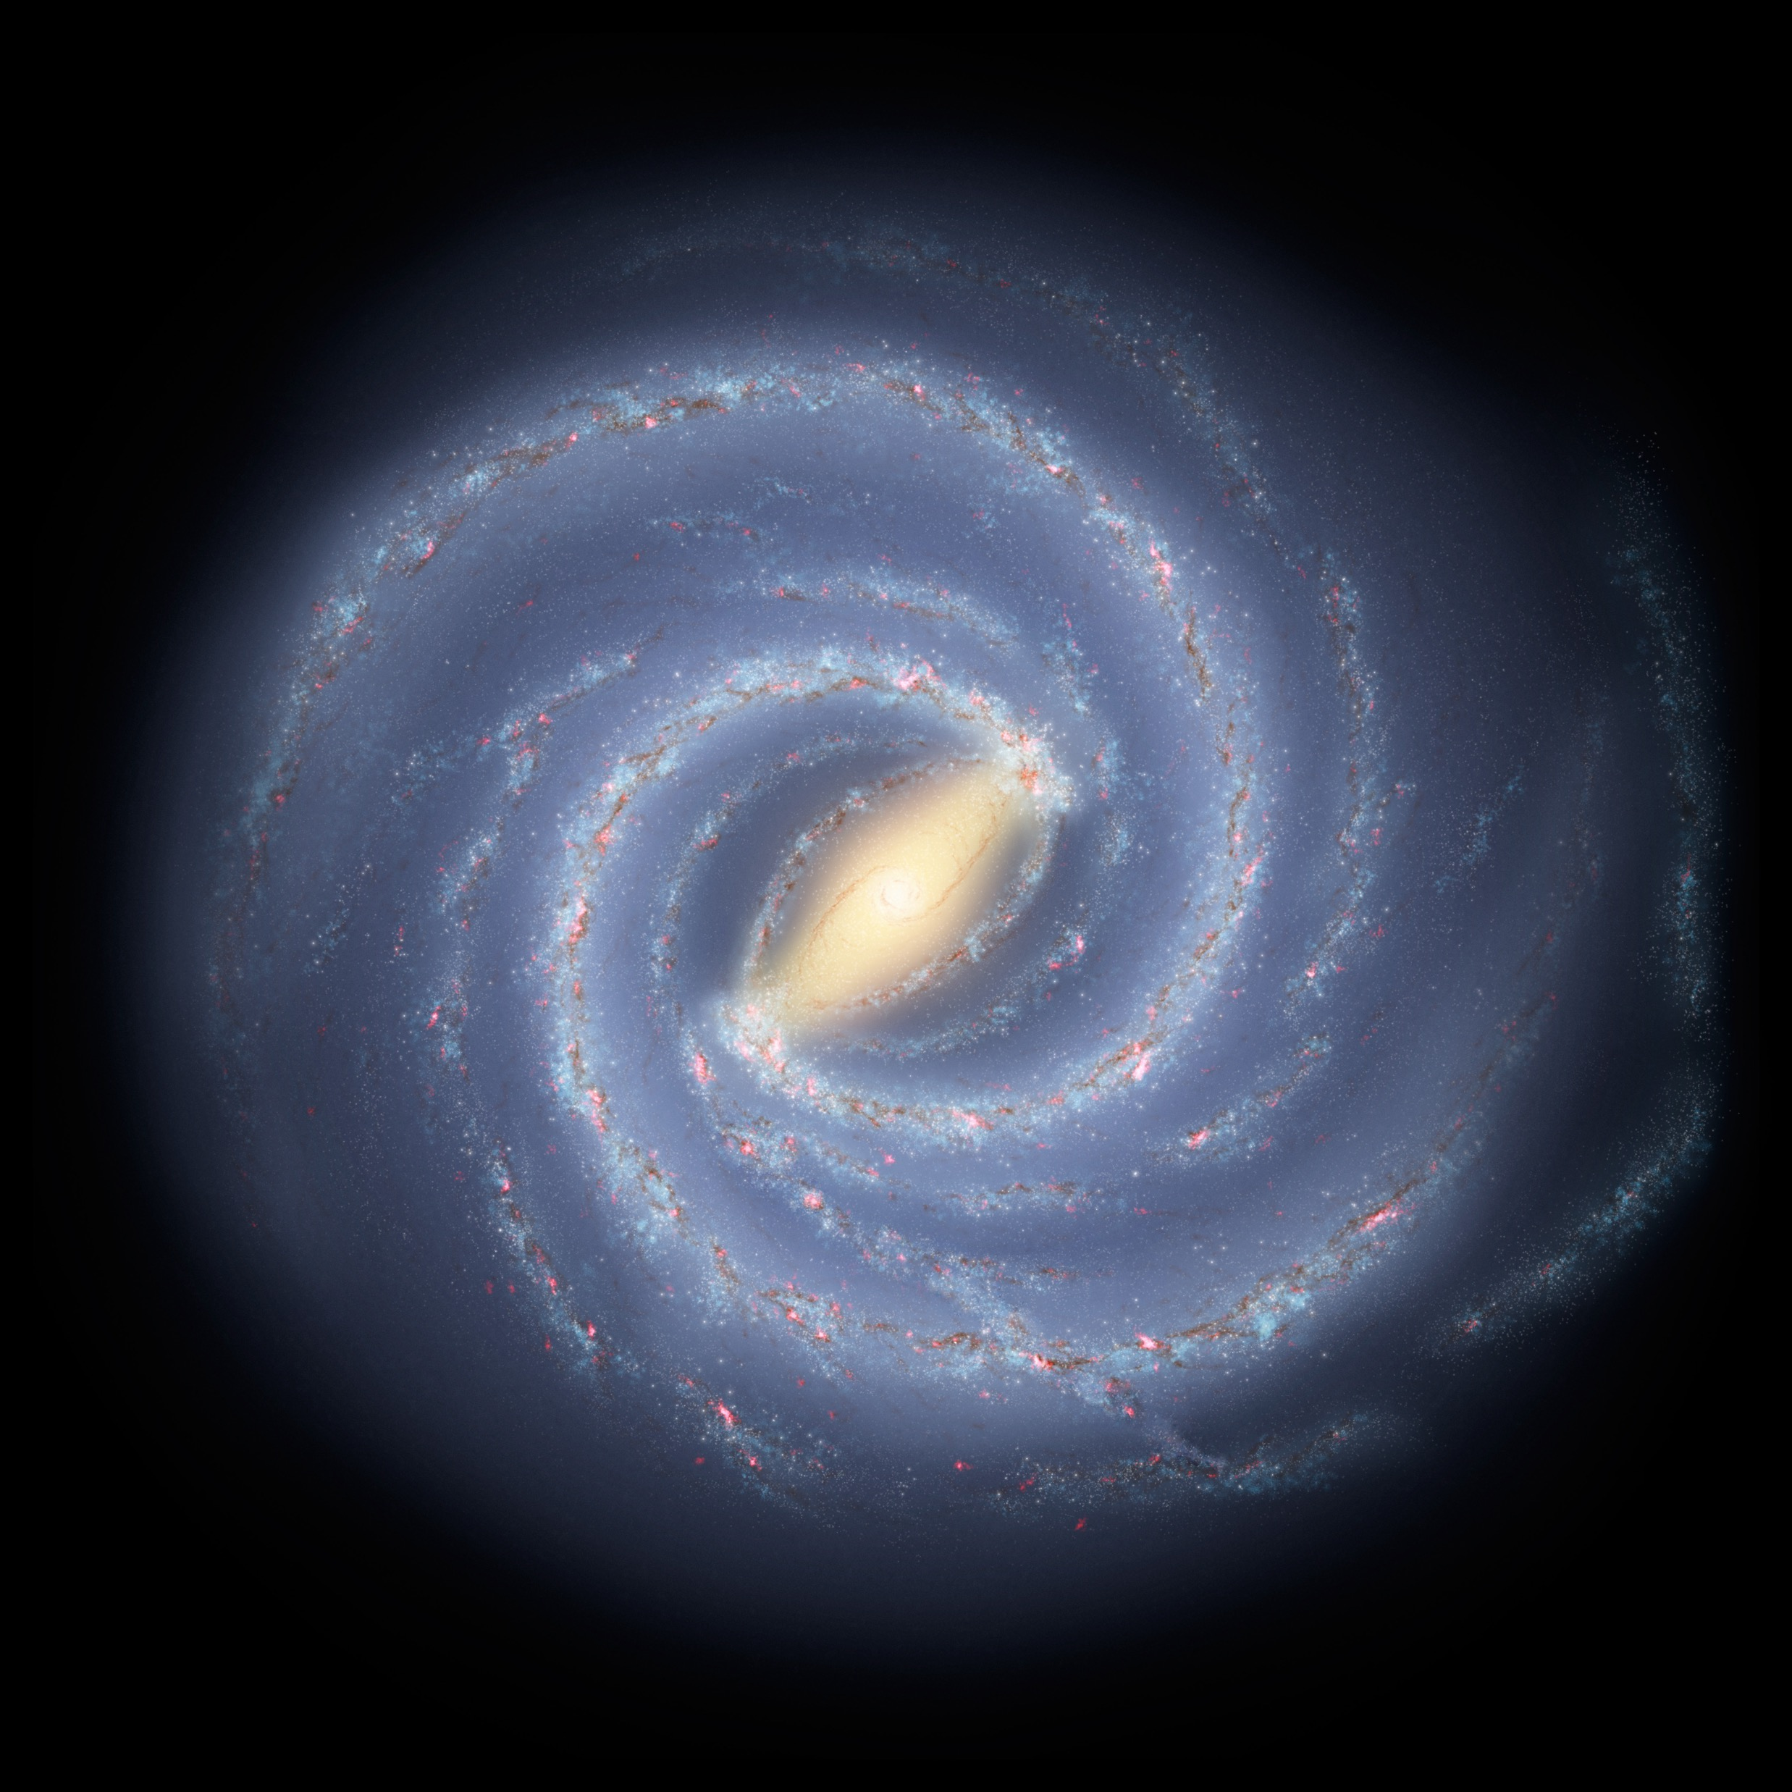
Conclusion: Formation
Following the nexus event aka the Big Bang, particles began to from seemingly instantaneously, these particles moved further from the Bang and the cooling of the universe over millions of years formed clouds of gas known as Nebulas. The Nebulae had the components for the hydrogen, its isotopes, and helium for start fusing and create stars and planets which, when a “red supergiant” dies space folds in on itself and creates a black hole, which pulls solar systems towards it with an intense and wide-spread gravitational pull, creating the makings of an early Galaxy such as the Milky Way, which can be considered a late stage galaxy due to the barred spirals indicating that the centripetal forces increase the velocity of the objects in the Black Holes orbit and will eventually exit its orbit in millions of years.
This Photo by Unknown Author is licensed under CC BY-SA

