Slide 1

Early Diagnosis of Cancer: Why It Matters & How to Measure Progress
By yaara

Slide 2
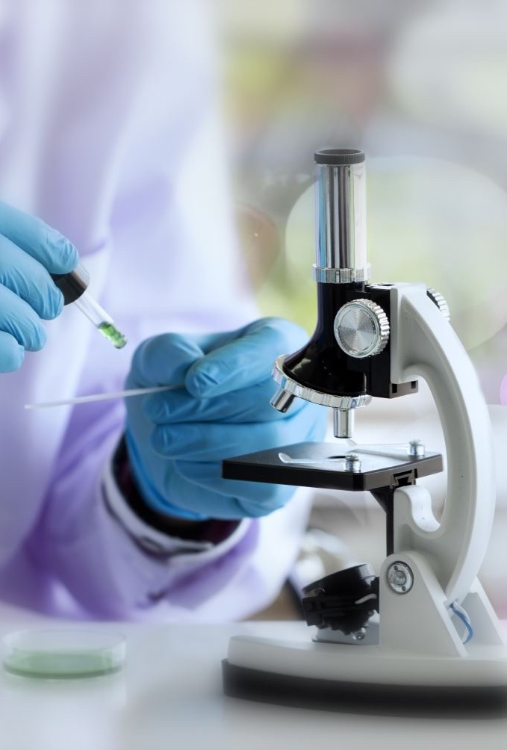
Why Early Diagnosis Matters
Prevents cancer from spreading (metastasis)
Higher survival rates when cancer is caught early
Example: Ovarian cancer detection with blood-based liquid biopsies
Identify cancer proteins, DNA fragments, microRNAs, exosomes
Detects cancer before symptoms appear
Focused screening for high-risk groups

Slide 3
Measuring Progress
Process Measures = what’s done to improve detection
Outcome Measures = actual impact on mortality/quality of life

Slide 4
Overdiagnosis → unnecessary treatment, stress, costs Lead time bias → survival appears longer but outcome unchanged
Challenges in Measuring True Progress

Slide 5
Conclusion & Key Takeaways
Early diagnosis = improved treatment options & reduced mortality
Combination of process + outcome measures essential
Progress made, but challenges like overdiagnosis & bias remain
Continued research & smarter screening needed to improve true outcomes

