Slide 1

Geotechnical and Infrastructural Damages
By Ethan Wong (681013)

Slide 2
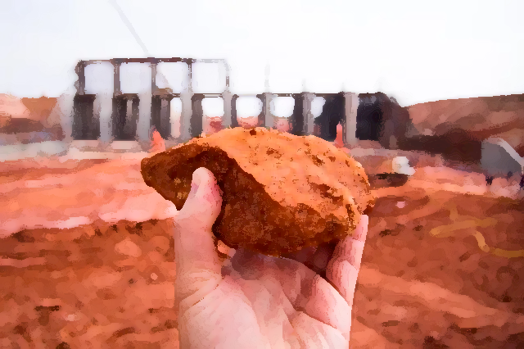
What is Geotechnics?
Study and modification of soil and rocks
Critical aspect (main consideration)
Damages involved with geotechnics (in depth)
Purpose – data analysis – safe, reliable

Slide 3
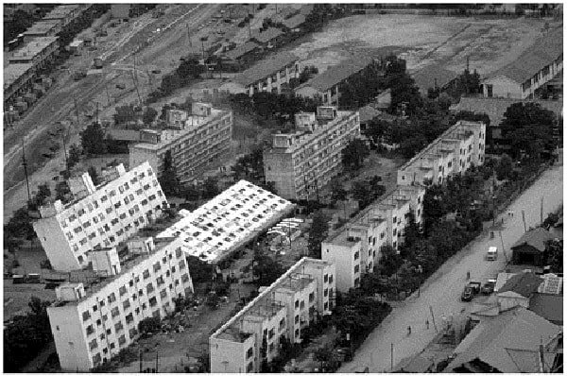
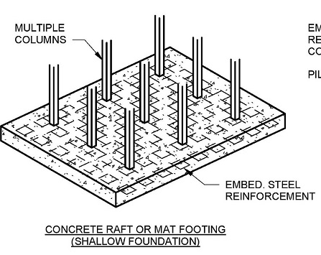
Foundation Failure
Wrong soil, adequate foundation design
Structural instability – unstable settle/collapse
Mat Foundation (heavy)
Spread load (entire building)
Columns rows squares

Slide 4
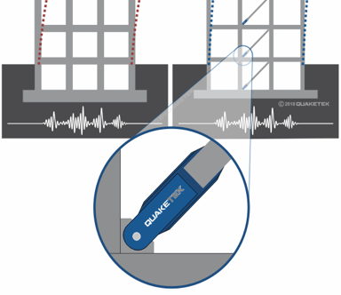
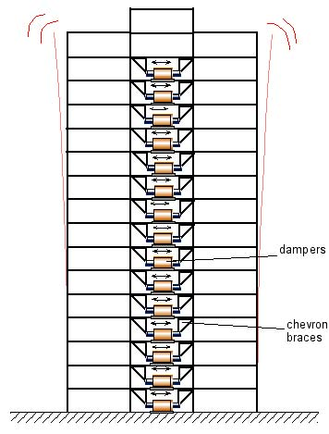
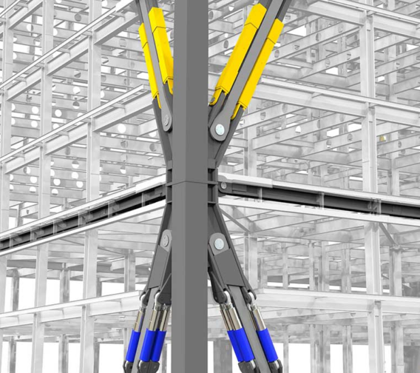
Natural Disasters
Not preventable
Shock absorbers (magnitude and frequency)
Seismic Friction Dampers
Energy transfer
– dissipated hydraulic fluid
Every floor
Impacts on economical stability

Slide 5
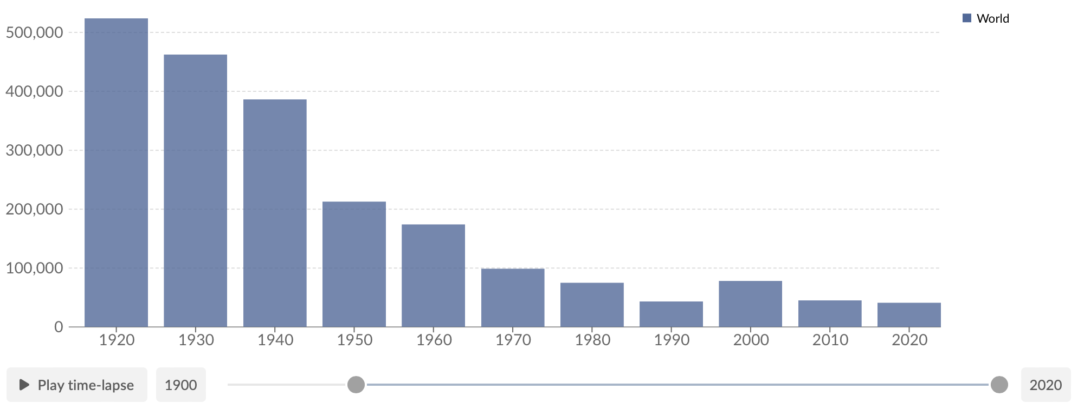
Conclusion
Annual number of deaths from natural disasters
-lists types of damage – solutions
-annual no. decreased
-unpredictable natural disasters
-Cost to Value
-constant problem

Slide 6

Any Questions?
Thank you for listening to my presentation 🤭

