Slide 1
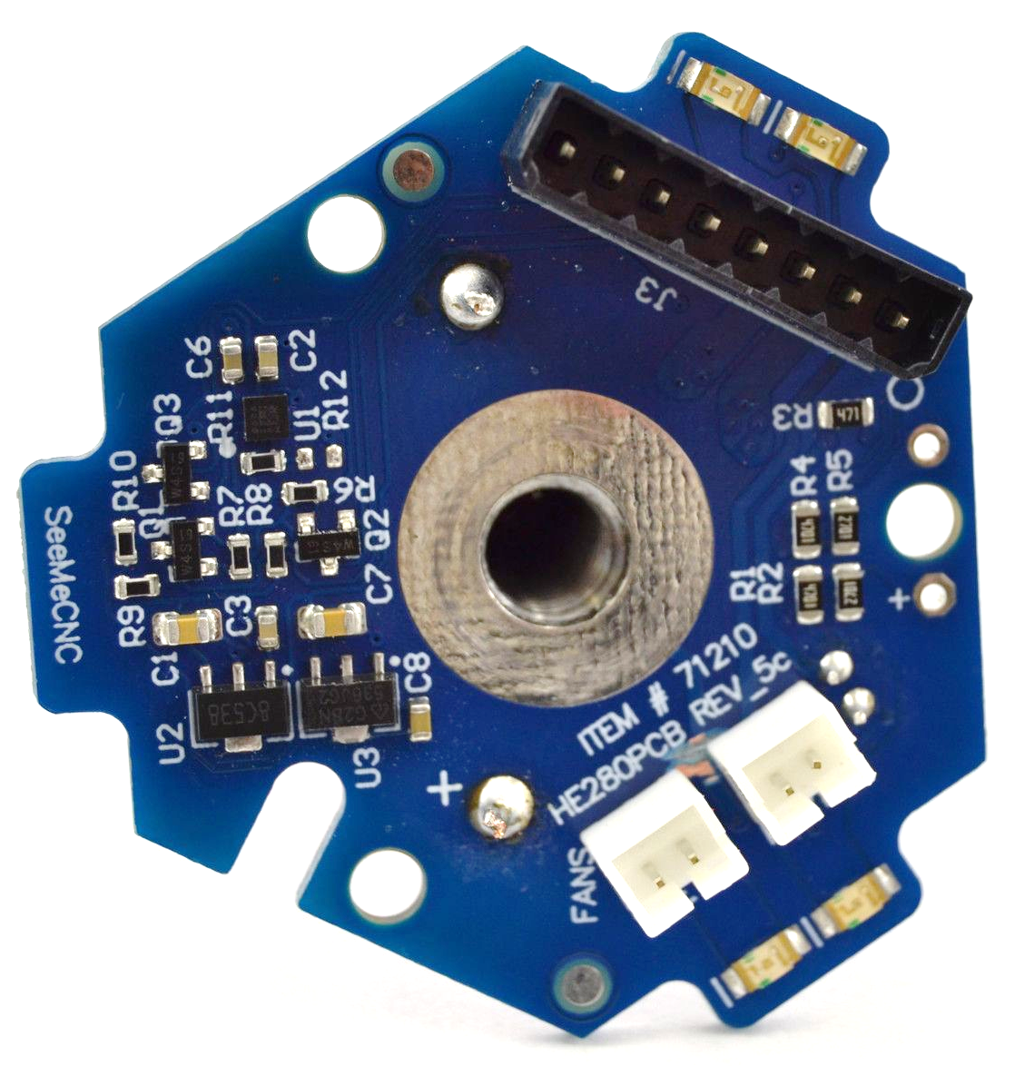
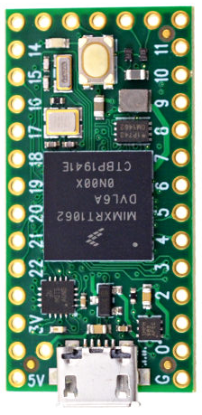
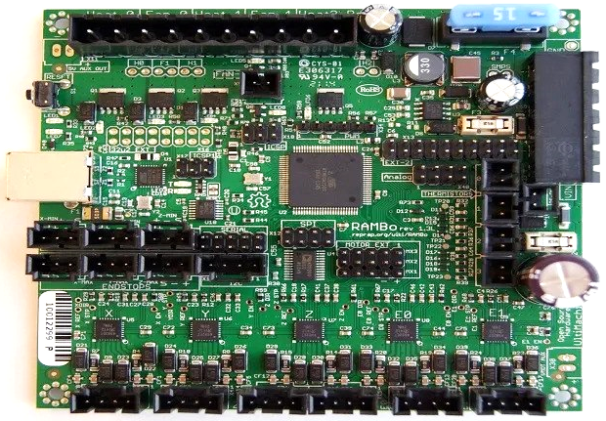
Trigger out to Z-min endstop
Accelerometer trigger to Teensy
Teensy Pin # | Connected to | Purpose
13 | RAMBo Z-min endstop (Arduino pin 10) | High trigger out to RAMBo on nozzle collision
GND | RAMBo Z-min endstop - | Ground
+5V | RAMBo Z-min endstop + | Supply
2 | HE280 pin 1
3 | None | This is the pin used by the Duet2 to ‘arm’ the probe.
18 | HE280 I2C SDA Pin 3 | SDA / SCL are the digital communication lines.
19 | HE280 I2C SCL Pin 4

