Slide 1
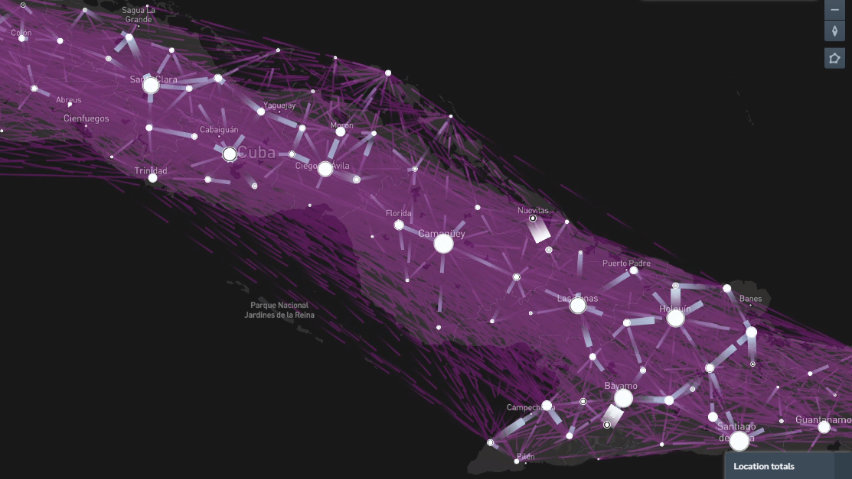

SIR and SIS
Dr. Alejandro Lage
Cuba
Facultad de Física, UH

Slide 2
Epidemics on Networks
1. Mathematical epidemiology, origins, early results. The compartmental model family.
2. The mean field description of SIR models. Short and long time limits in SIR.
3. Monte Carlo simulations of epidemics. Gillespie algorithm.
4. Monte Carlo simulations Practical Python Class.
5. Complex networks. Main results. Types and properties. Famous networks. Benchmarks.
6. Playing with networks in Python. Networkx. Plotting. Nice plotting.
7. Master equation of epidemics on networks. The mean field solution and pair based solution.
8. Simulating epidemics on networks. Python libraries.
9. Inference and belief propagation.
10. The zero patient problem. The contamination source detection problem.
11. The infectious backbone as a cascade process.
12. The effect of contact tracing.

Slide 3
Previously on Epidemics ...

Slide 4
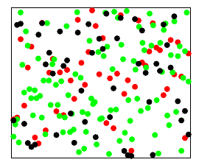

Previously on Epidemics ...
Epidemics are (matheamtically):
Stochastic processes
Discrete states (S,I,R)
Continuous time
Good approximation: Markovian

Slide 5
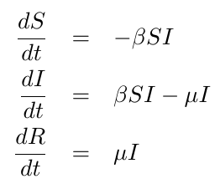
Previously on Epidemics ...
Epidemics are (matheamtically):
Stochastic processes
Discrete states (S,I,R)
Continuous time
Good approximation: Markovian

Slide 6
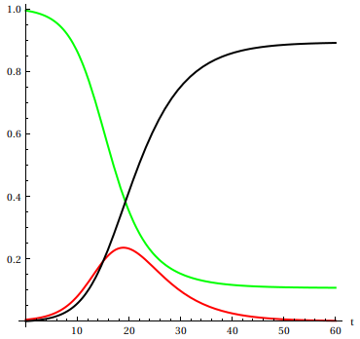




Previously on Epidemics ...
S
R
I

Slide 7
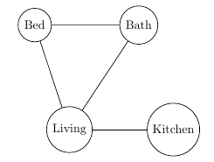

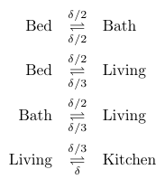
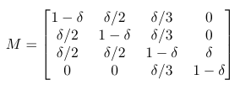
Drunken man problem
Discrete time

Slide 8



Drunken man problem
Discrete time
Stationary state
Continuous time limit
Exponential solutions
Eigenvalue problem:

Slide 9
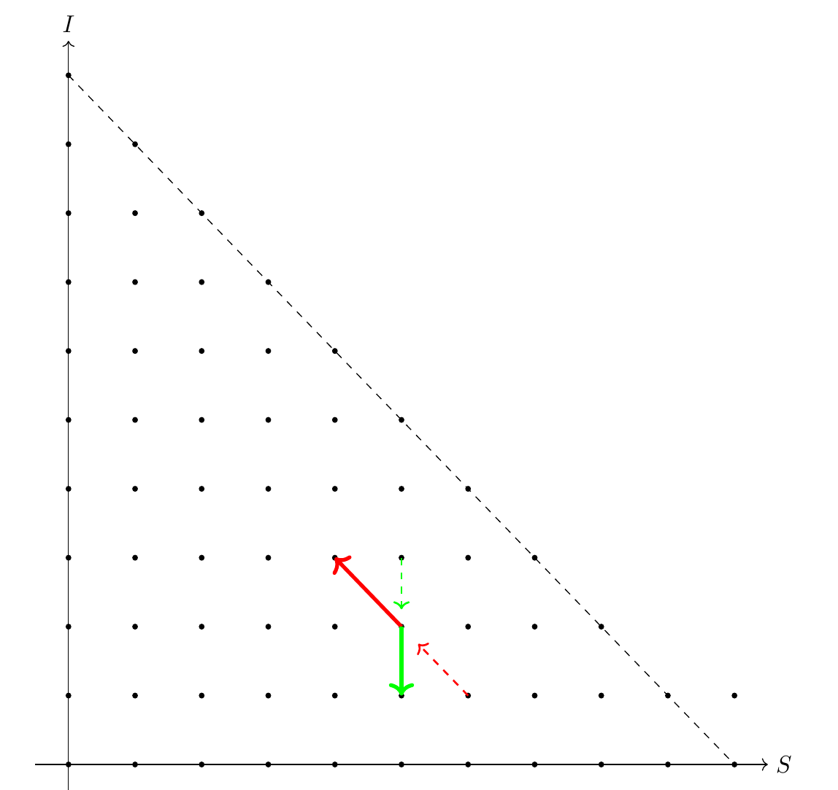
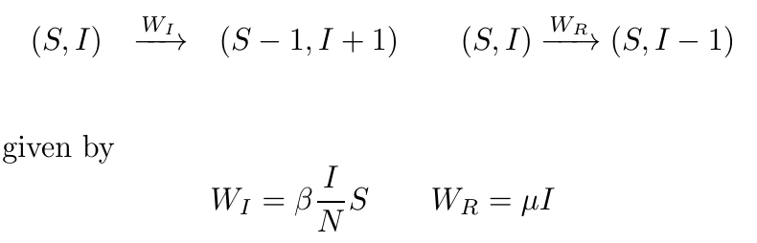
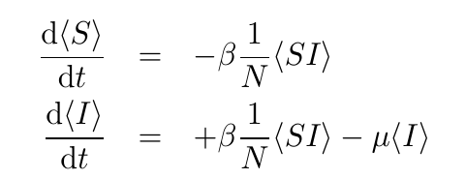
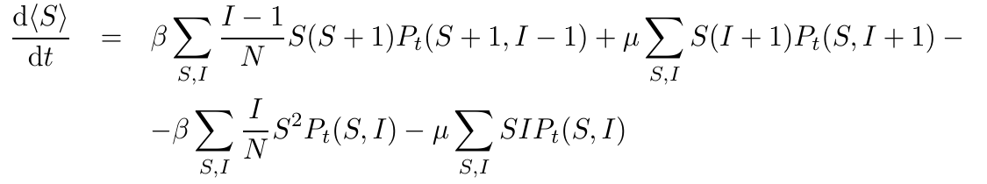
SIR from master equation

Slide 10
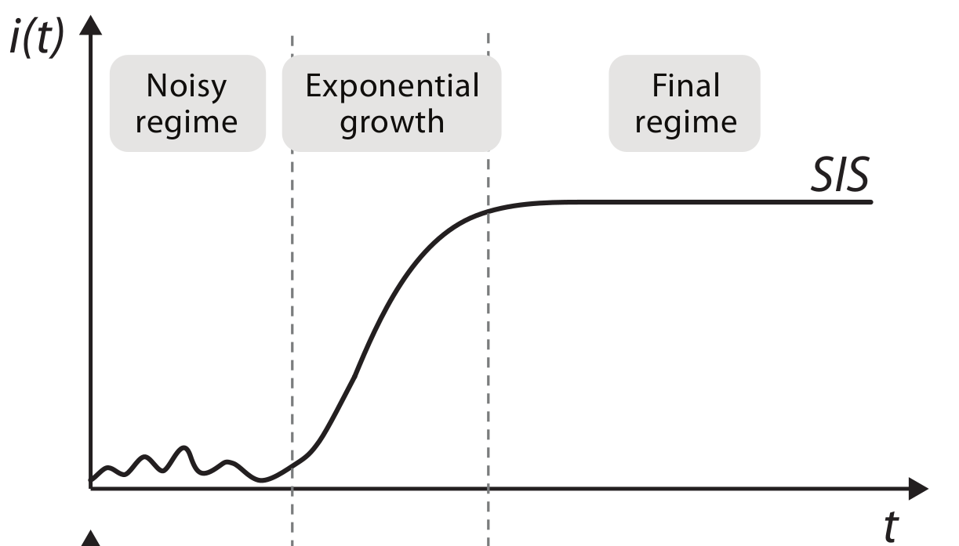
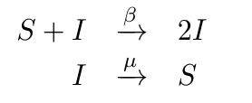
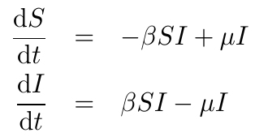
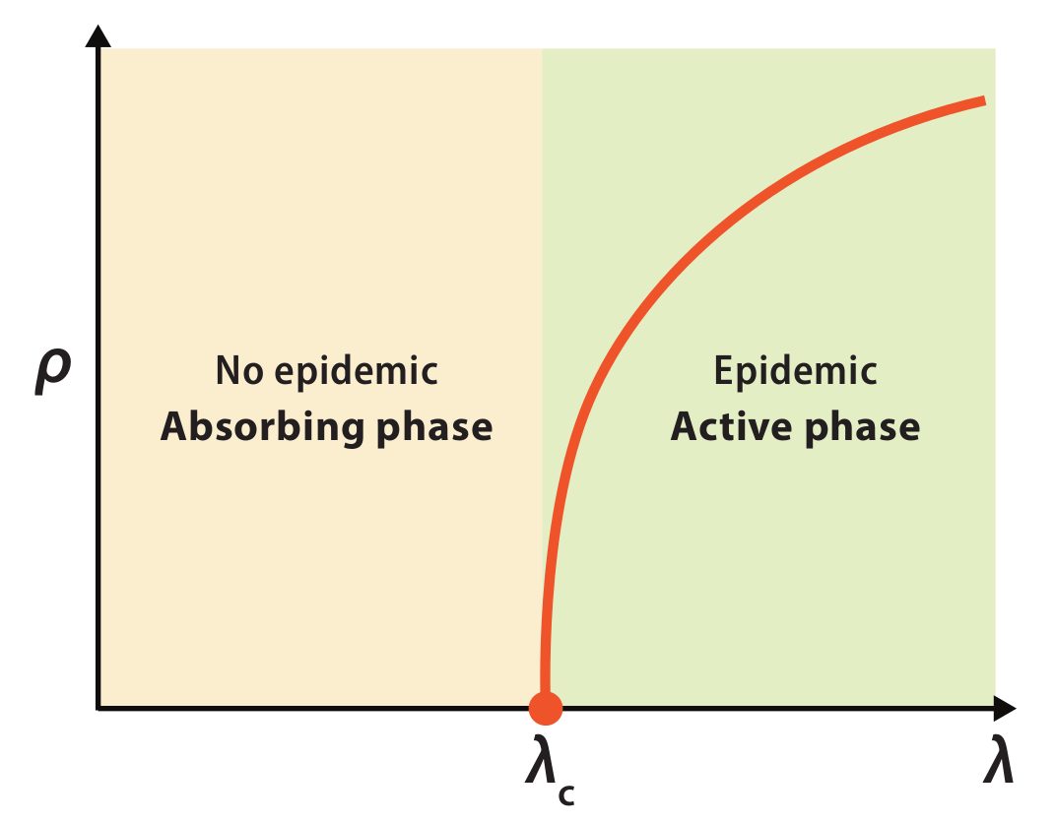

SIS epidemics

Slide 11
Rates and exponentials

Slide 12
Rates and exponentials

Slide 13
Rates and exponentials

Slide 14
Rates and exponentials

Slide 15
Rates and exponentials

Slide 16
Rates and exponentials

Slide 17




Rates and exponentials
Waiting times: geometric distribution
Continuous time limit

Slide 18
Rates and exponentials
When something happens at a rate:
It will happen in exponential time

Slide 19

Rates and exponentials
Properties of exponential distributions
Mean

Slide 20

Rates and exponentials
Properties of exponential distributions
Mean
Cumulative distribution

Slide 21



Rates and exponentials
Properties of exponential distributions
Mean
Cumulative distribution
Memorylessness

Slide 22


Rates and exponentials
Properties of exponential distributions
Mean
Cumulative distribution
Memorylessness
Law of the minimum

Slide 23


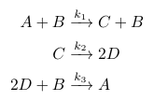

Chemical reactions
Drunken man
SIR
SIRS
Any chemical reaction
How do the rates depend on the state?

Slide 24
Chemical reactions
Drunken man
SIR
SIRS
Any chemical reaction
How do the rates depend on the state?
How to simulate such processes?
Stochastic
Discrete in states
Continuous in time

Slide 25
Chemical reactions
Drunken man
SIR
SIRS
Any chemical reaction
How do the rates depend on the state?
How to simulate such processes?
Stochastic
Discrete in states
Continuous in time

Slide 26
Chemical reactions
State of the system
Any chemical reaction

Slide 27

Chemical reactions
State of the system
Any chemical reaction
Remains unchanged until one of this take place
One occurrence is defined by
Two random values:
Time for jumping
Reaction to use

Slide 28


Chemical reactions
State of the system
Any chemical reaction
Remains unchanged until one of this take place
One occurrence is defined by
Stoichiometric matrix
Two random values:
Time for jumping
Reaction to use

Slide 29

Gillespie SSA
Total rate
State of the system
Any chemical reaction
One occurrence is defined by
Two random values:
Time for jumping
Reaction to use

Slide 30

Gillespie SSA
Total rate
State of the system
Any chemical reaction
Minimum i.i.d exponentials,
Jumping time:
One occurrence is defined by
Two random values:
Time for jumping
Reaction to use

Slide 31

Gillespie SSA
Total rate
State of the system
Any chemical reaction
Minimum i.i.d exponentials,
Jumping time:
Next reaction:
One occurrence is defined by
Two random values:
Time for jumping
Reaction to use

Slide 32
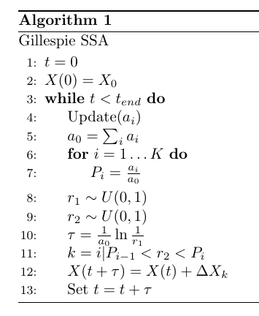
Gillespie SSA
Total rate
Minimum i.i.d exponentials,
Jumping time:
Next reaction:

Slide 33
Practical Python class

Slide 34
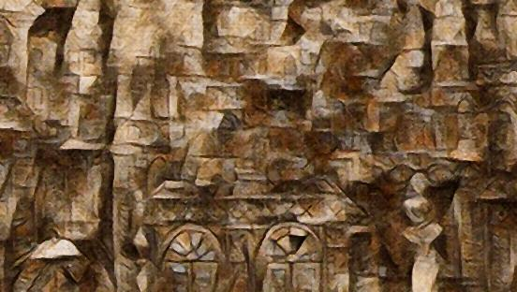

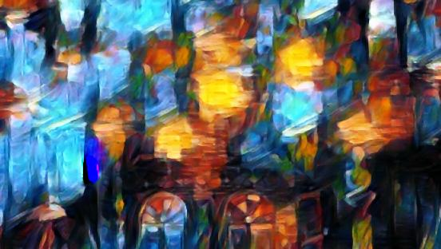
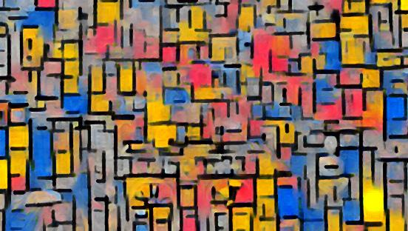
你好
Facultad de Física
Universidad de La Habana

