Slide 1
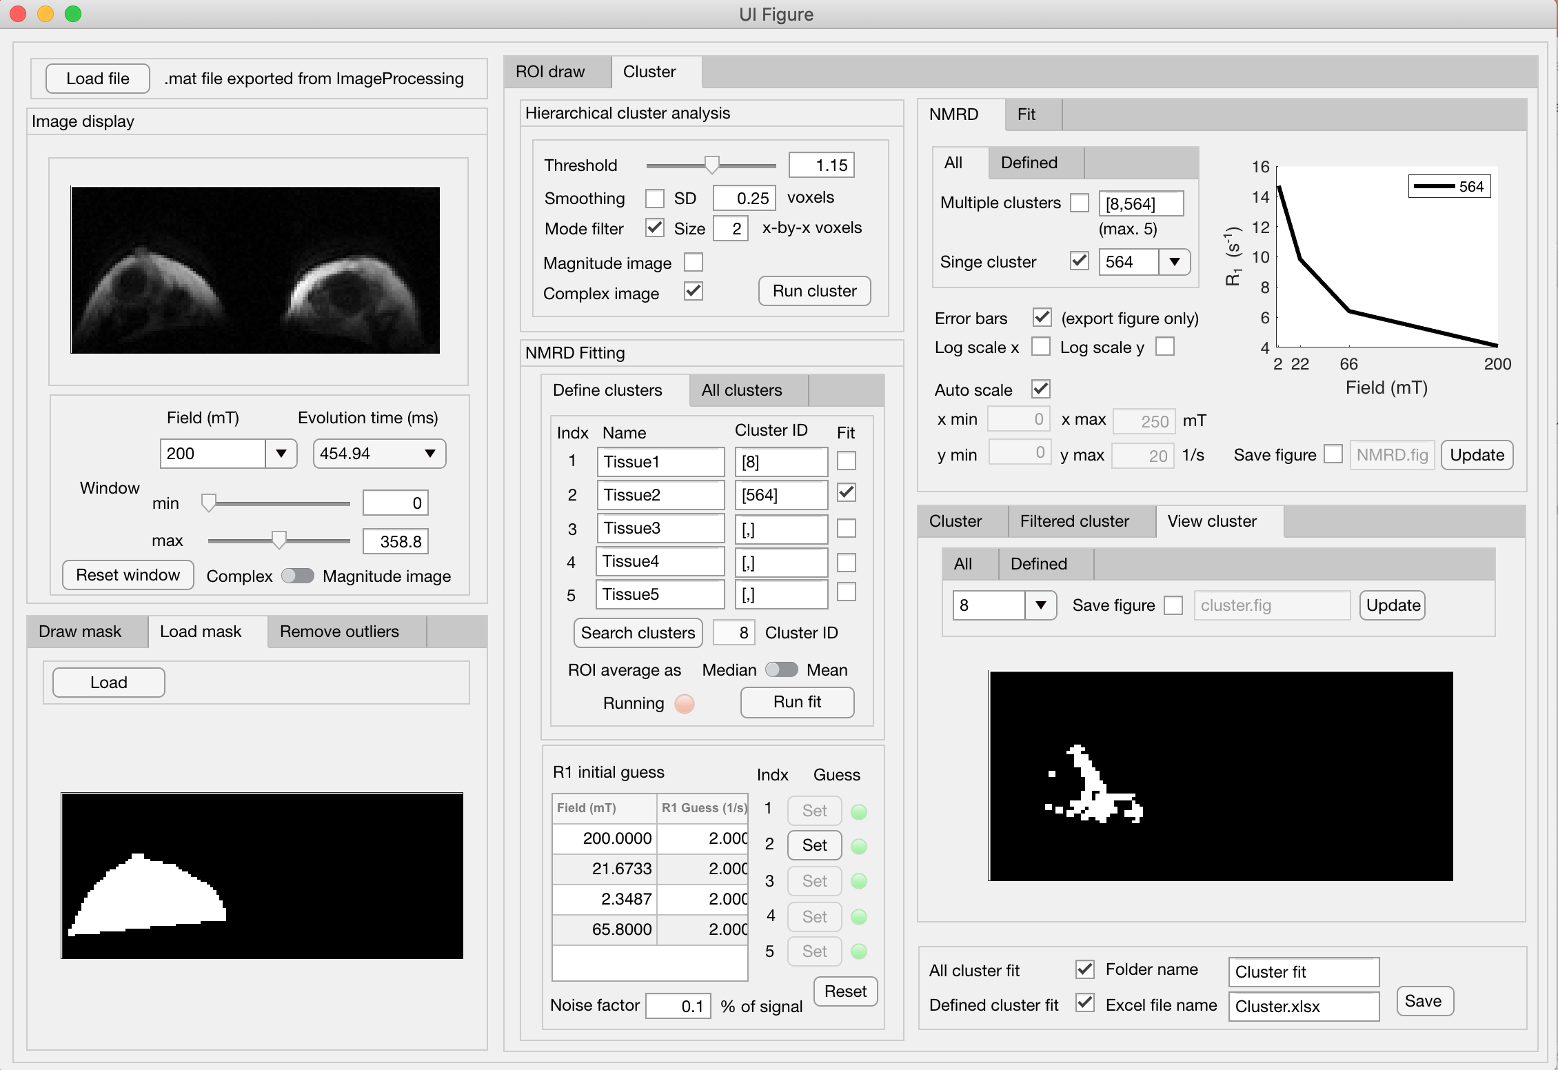
FFC Analysis GUI instruction manual (V3.1)
Nicholas Senn, 2020/05/06

Slide 2
Introduction
This GUI has been constructed to facilitate cluster wise and region-of-interest wise analysis of Fast Field-Cycling MRI data to obtain R₁ NMR dispersion (NMRD). The GUI has been constructed to extract NMRD from Fast Field-Cycling MRI data acquired at multiple evolution magnetic field strengths. The GUI follows the preprocessing of images performed in ImageProcessing. R₁ values are obtained from fitting the inversion recovery samples at each evolution field strength across multiple evolution times. In addition, the fitting is performed simultaneously for all acquired evolution field strengths using a surface fit detailed in Appendix A. Voxels within either a drawn ROI or cluster region are averaged prior to performed the simultaneous fitting procedure.
Hierarchical cluster analysis is implemented through MATLAB [1]. All images acquired at each evolution field and evolution time are used to inform the cluster analysis. The user can set the Threshold value to determine the level of clustering that is appropriate for each data set. The GUI allows for the user to 2D Gaussian smooth each image prior to cluster analysis and to implement a 2D mode filter of the output cluster image. The GUI shows an updated display of cluster output to allow the user to find the most appropriate cluster parameters. In addition, the user can combine individual clusters to specify defined tissue regions.
Fitting is performed for each cluster. Two options are included in the GUI. The user can either fit all clusters above a minimum size or fit defined cluster regions. For each cluster, the image data is averaged as the median before fitting. The GUI allows the user to construct figures of NMRD and fit result. Finally, the GUI allows for the NMRD to be saved as excel sheet.
[1] https://www.mathworks.com/help/stats/hierarchical-clustering.html

Slide 3
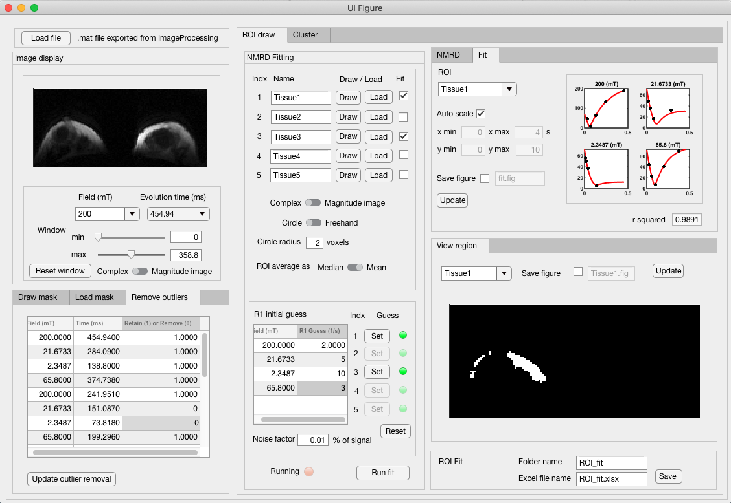
R₁ NMRD from drawn ROI
1
Load file from ImageProcessing.
1
4
6
2
Image display.
2
3
Draw or Load mask. Remove outlier images.
4
Draw ROI. Place circle ROI. Load ROI.
5
Initialise fit parameters.
6
Display R₁ NMRD, fit result, and ROI.
7
Save data to Excel sheet and MATLAB structure.
3
5
7

Slide 4

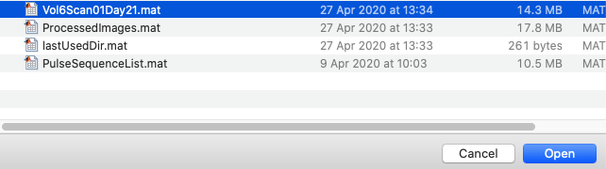
1
Load file from ImageProcessing.
Load the fast field-cycling data set exported from ImageProcessing. Press the “Load File” button to open the user interface.
Data exported from ImageProcessing is typically named “H9_se_nav_v9”.

Slide 5
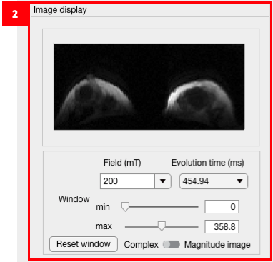
2
Image display.
Select from the dropdown menus the evolution field (mT) and evolution time (ms) of acquired image to be displayed.
The contrast window can be changed using the sliders or input directly.
Either the absolute of the complex image can be displayed or the magnitude image can be displayed. The magnitude image will have the reconstruction filters applied from ImageProcessing.

Slide 6
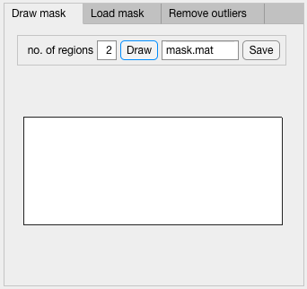
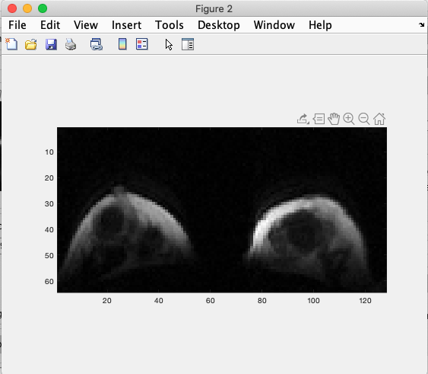
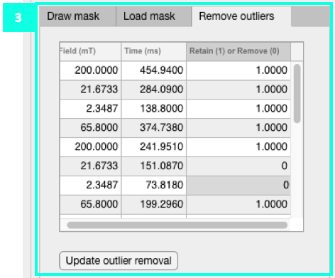
3
Draw or Load mask. Remove outlier images.
Draw mask
Select the number of individual regions to be drawn to make up the mask. Press the “Draw” button. Draw the first region in the external figure, complete by double clicking, draw each subsequent ROI. Mask can be saved.
Load mask
Alternatively change tab to “Load mask” and press the “Load” button. The loaded mask must have the same image dimensions as the data set. It must be 1s in region of mask and 0s outside of the mask. It must be a .mat file.
Remove outlier images
Images can be designated in this tab to be removed from both cluster analysis and NMRD fitting. Images can be viewed in the “Image display” panel. Enter “0” to designate an image to be removed from subsequent analysis. The example shown has two images removed from analysis. Enter “1” to re-designate the image to be included in subsequent analysis. The “Update outlier removal” button must be pressed for the changes made to be incorporated in subsequent analysis.

Slide 7
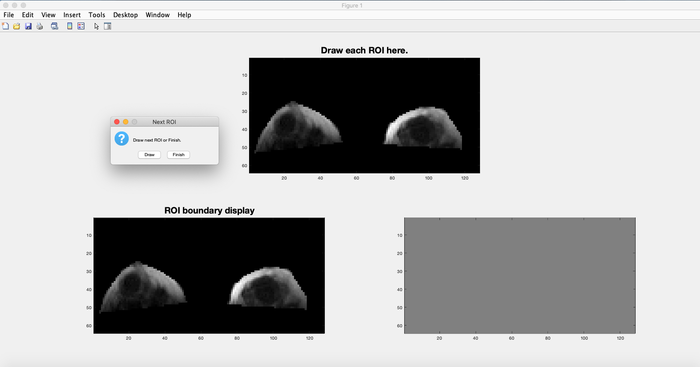
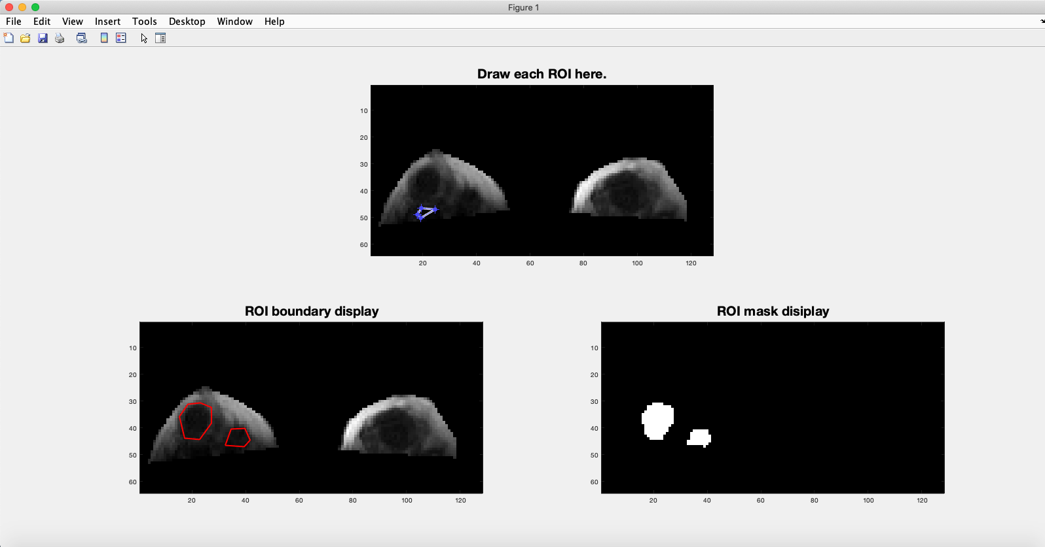
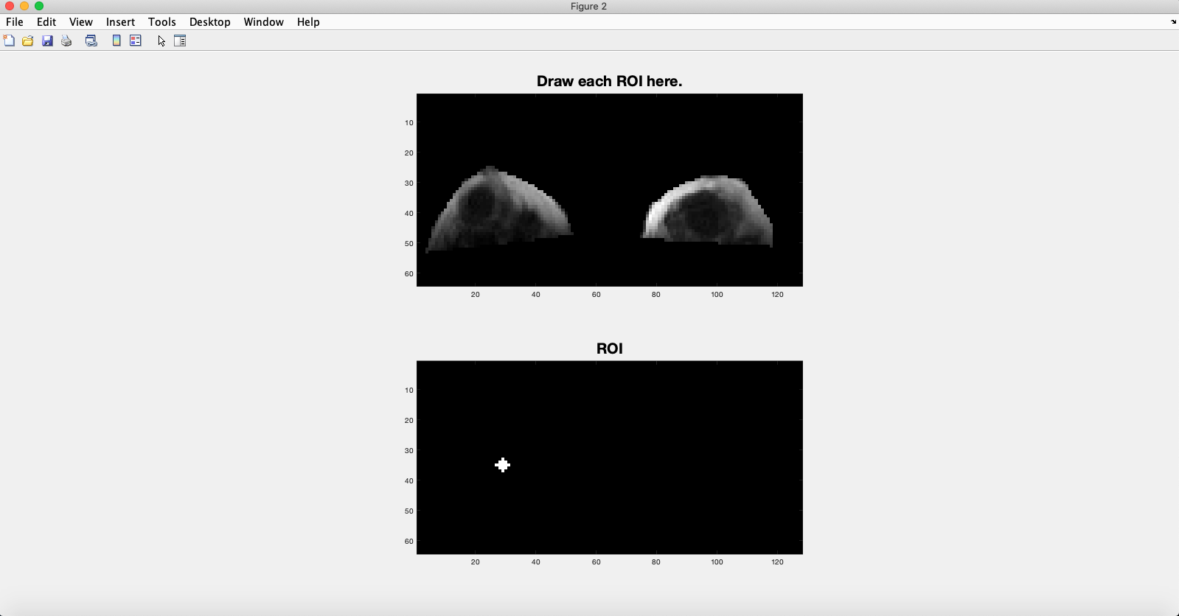
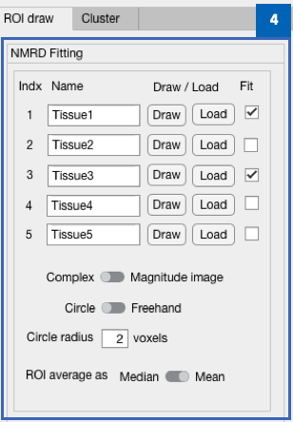
4
Draw ROI. Place circle ROI. Load ROI.
Load ROI
Five regions-of-interest can be analysed using the GUI. The name of each ROI can be changed as desired (i.e. “Tissue1” > “Fibroglandular”). For each ROI, press the “Load” button to load a region of interest saved as .mat file.
Draw ROI
To draw a ROI, first change the switch from “Circle” to “Freehand” and then press the “Draw” button. Draw the ROI in the external MATLAB figure. Multiple ROI can be drawn to produce a final ROI.
Place Circle ROI
First change the switch from “Freehand” to “Circle”. Enter the radius of the circle ROI. Press the “Draw” button. Select point for the centre of the circle to be drawn in the external MATLAB figure.
ROI averaging
Voxels within each ROI will be averaged for subsequent NMRD fitting. Change the “ROI average as” switch to “Median” for median averaging of ROI, or “Mean” for mean averaging of ROI.
Complex / Magnitude image switch
This switch dictates whether either the absolute of the complex image data or magnitude image data is used for subsequent NMRD fitting. Magnitude image data has filters applied from ImageProcessnig.

Slide 8
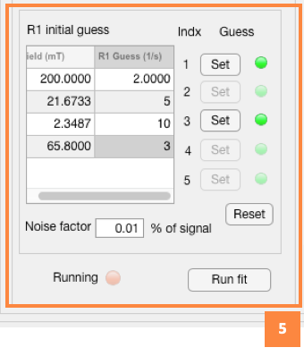
5
Initialise fit parameters.
This panel enables the initial guess of fitting parameters to be defined individually for each defined ROI indexed 1 to 5. If a poor fit is obtained, it may be improved by changing the initial guess parameters.
Set R₁ guess
Enter R₁ guess for each evolution field in the second column of the table.
Set noise factor
Enter the noise factor as a percent of signal acquired.
Set for each ROI
Press the “Set” button for each ROI in turn to assign the initial guesses entered. By pressing the “Set” button the adjacent light will light up. Press the “Reset” button to reset the lights before redefining the initial guesses for each ROI. You can change an individual ROI initial guess by pressing “Set” button multiple times.

Slide 9
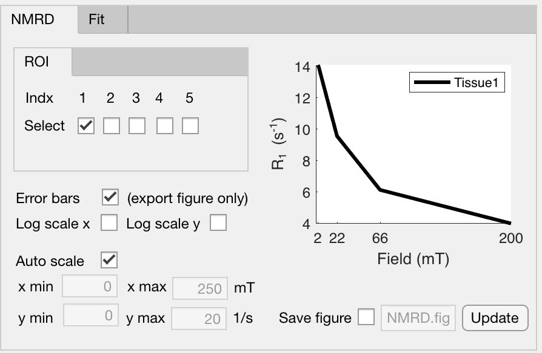
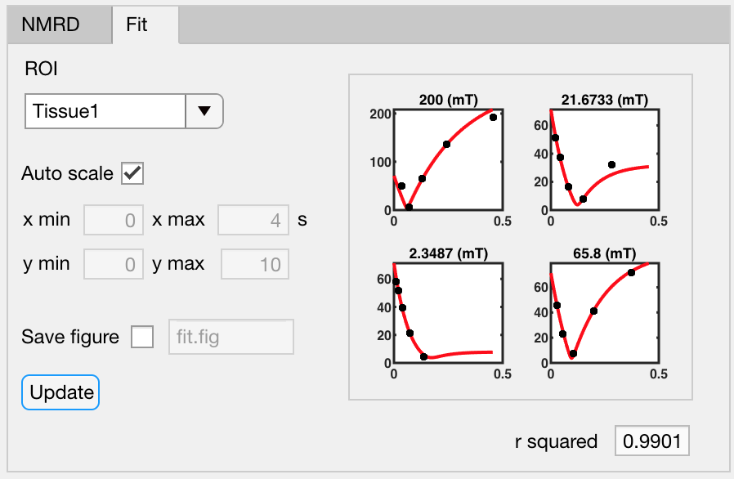
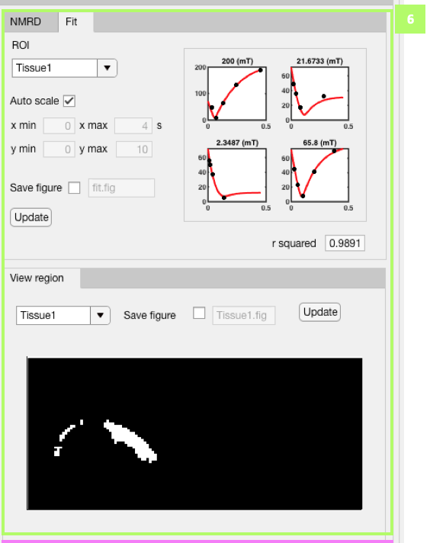
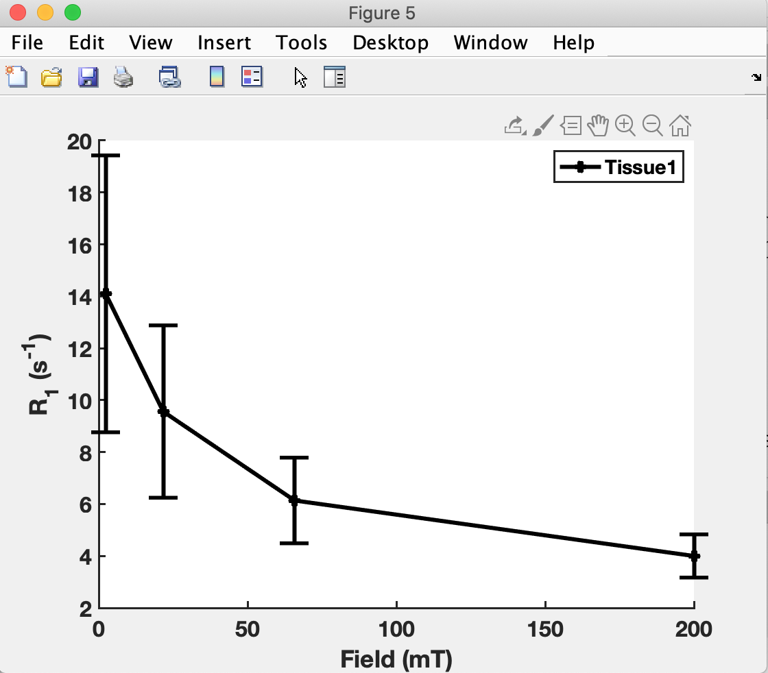
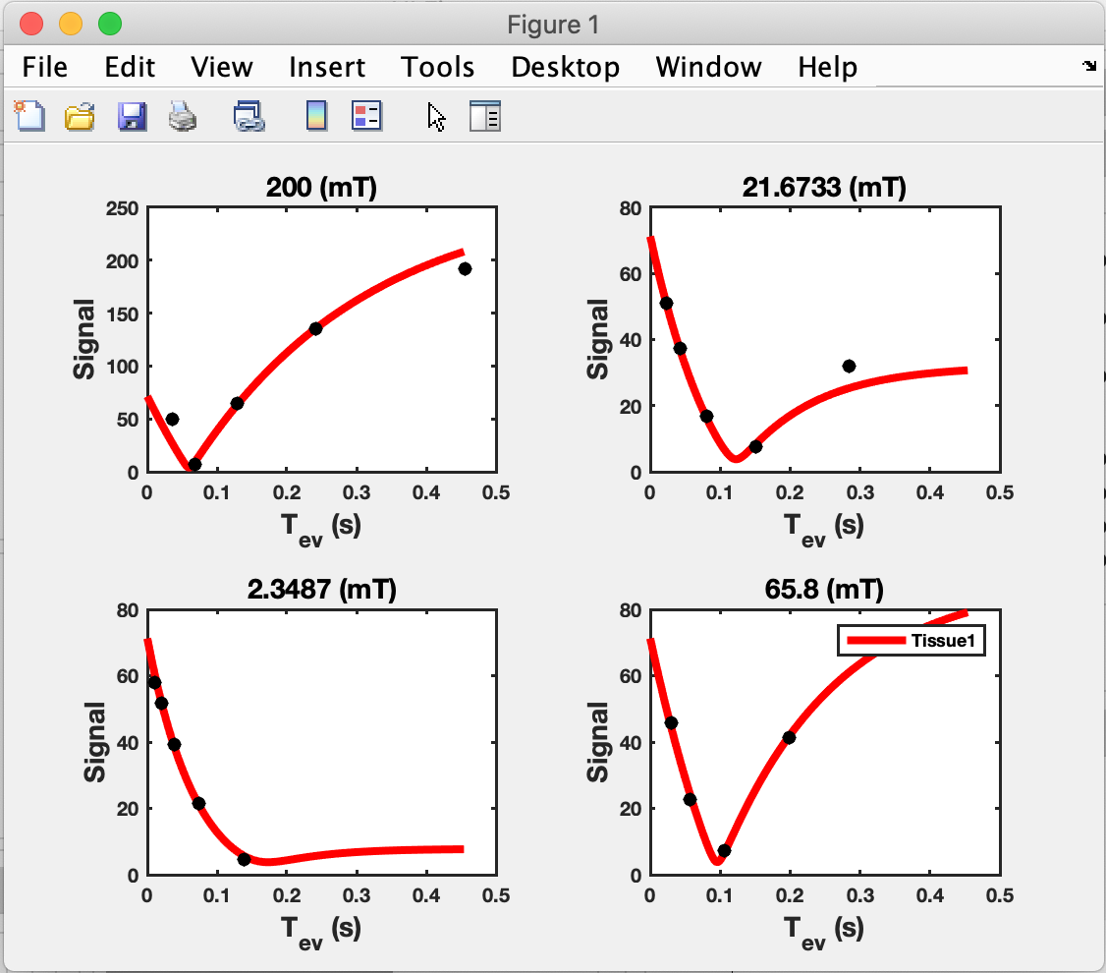
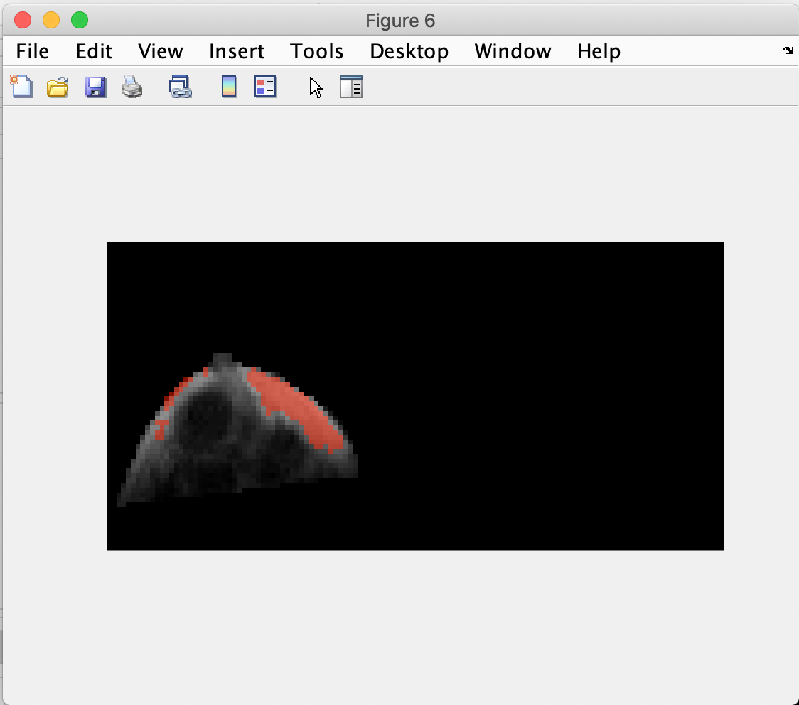
6
Display R₁ NMRD, fit result, and ROI.
R₁ NMRD
Select by check box the NMRD to be plotted. Select by check box whether error bars representing the 95% confidence interval should be plotted in the external MATLAB figure. Select whether the x and y axis is plotted on log scale. By deselecting auto scale the axis range can be modified.
Fit Result
Select which ROI to plot. By deselecting auto scale the axis range can be modified. The r² of the fit result is displayed.
Display ROI
Each ROI can be displayed and saved as .Fig MATLAB file. ROI is shown overlaid over the image shown in the Image display panel.

Slide 10
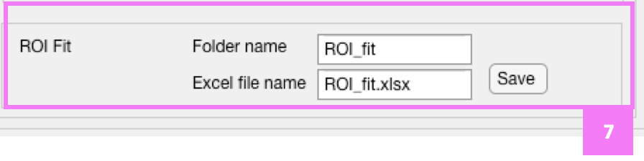
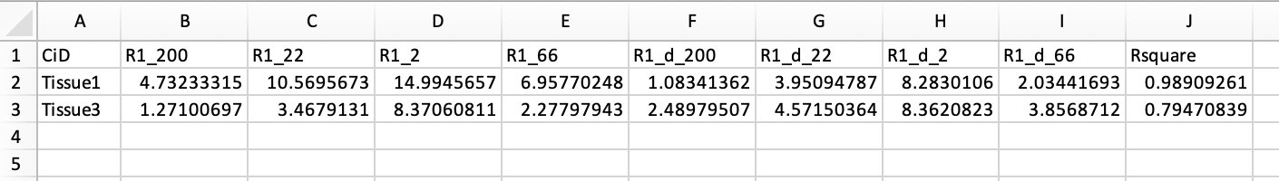
7
Save data to Excel sheet and MATLAB structure.
Data will be saved in the current MATLAB window. Enter a Folder name. Enter a file name for the saved Excel spreadsheet. Press the “Save” button.

Slide 11
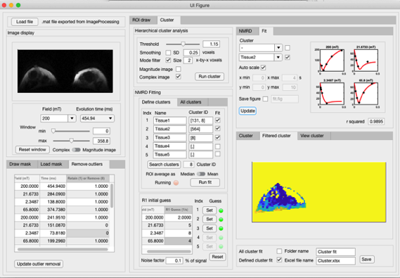
R₁ NMRD from cluster analysis ROI
1
Load file from ImageProcessing.
1
4A
2
Image display.
2
6
3
Draw or Load mask. Remove outlier images.
4A
Cluster analysis.
4B
Define cluster regions. Run fit.
5
Initialise fit parameters.
6
Display R₁ NMRD, fit result, and clusters.
7
Save data to Excel sheet and MATLAB structure.
3
4B
5
7

Slide 12
1
Load file from ImageProcessing.
Load the fast field-cycling data set exported from ImageProcessing. Press the “Load File” button to open the user interface.
Data exported from ImageProcessing is typically named “H9_se_nav_v9”.

Slide 13
2
Image display.
Select from the dropdown menus the evolution field (mT) and evolution time (ms) of acquired image to be displayed.
The contrast window can be changed using the sliders or input directly.
Either the absolute of the complex image can be displayed or the magnitude image can be displayed. The magnitude image will have the reconstruction filters applied from ImageProcessing.

Slide 14
3
Draw or Load mask. Remove outlier images.
Draw mask
Select the number of individual regions to be drawn to make up the mask. Press the “Draw” button. Draw the first region in the external figure, complete by double clicking, draw each subsequent ROI. Mask can be saved.
Load mask
Alternatively change tab to “Load mask” and press the “Load” button. The loaded mask must have the same image dimensions as the data set. It must be 1s in region of mask and 0s outside of the mask. It must be a .mat file.
Remove outlier images
Images can be designated in this tab to be removed from both cluster analysis and NMRD fitting. Images can be viewed in the “Image display” panel. Enter “0” to designate an image to be removed from subsequent analysis. The example shown has two images removed from analysis. Enter “1” to re-designate the image to be included in subsequent analysis. The “Update outlier removal” button must be pressed for the changes made to be incorporated in subsequent analysis.

Slide 15
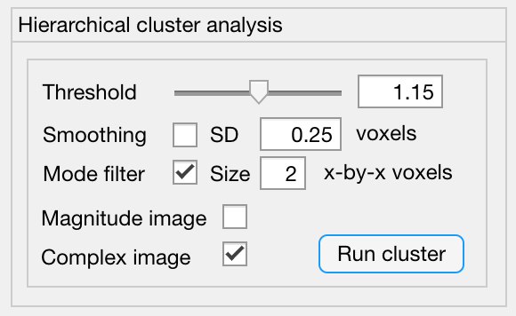
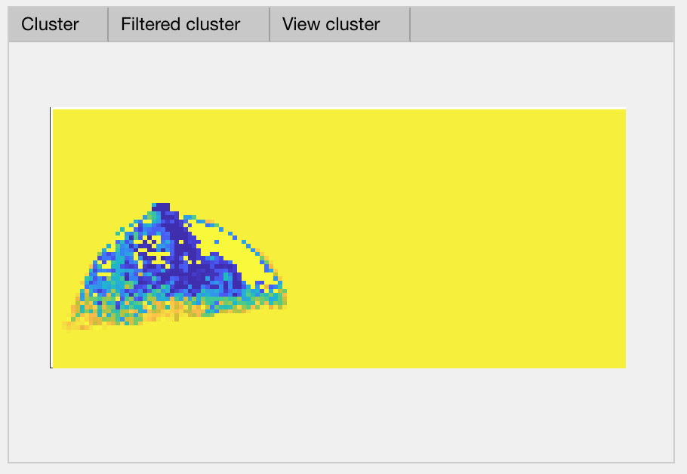
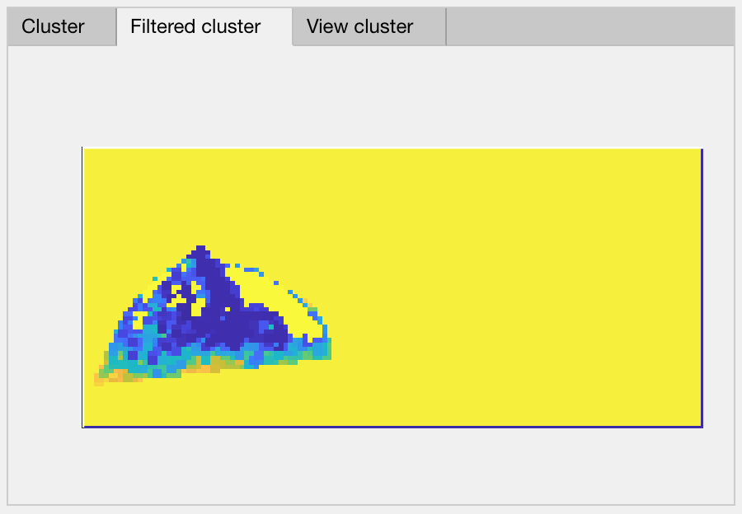
4A
Cluster analysis.
Hierarchical cluster analysis is performed in MATLAB.
https://www.mathworks.com/help/stats/hierarchical-clustering.html
Analysis can be selected to be performed on the magnitude or complex image output from ImageProcessing. Magnitude image has ImageProcessing filters applied.
Threshold value sets the level of partitioning between clusters.
Smoothing is an option to apply a 2D Gaussian filter with kernel SD size in voxels. Smoothing is performed before cluster analysis. https://www.mathworks.com/help/images/ref/imgaussfilt.html
Mode filter is applied post cluster analysis to the output cluster image. Each voxel is replaced by the mode of x-by-x surrounding voxels.
Cluster image is shown separately from the filtered cluster image (post mode filter).
Hierarchical cluster analysis input parameters will likely need to be optimized for each data set. This can be done by changing parameters, running cluster analysis, checking results and repeating the process. Hierarchical cluster result is sensitive to the mask used.

Slide 16
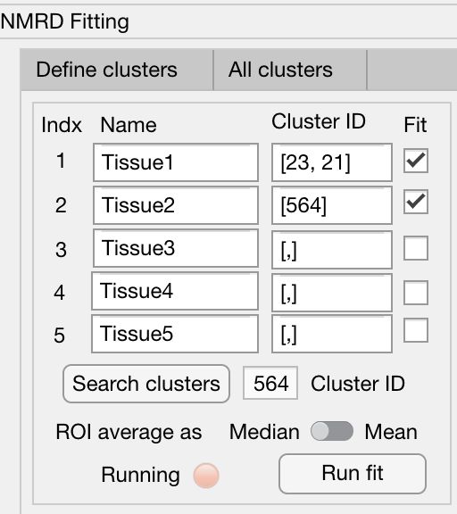
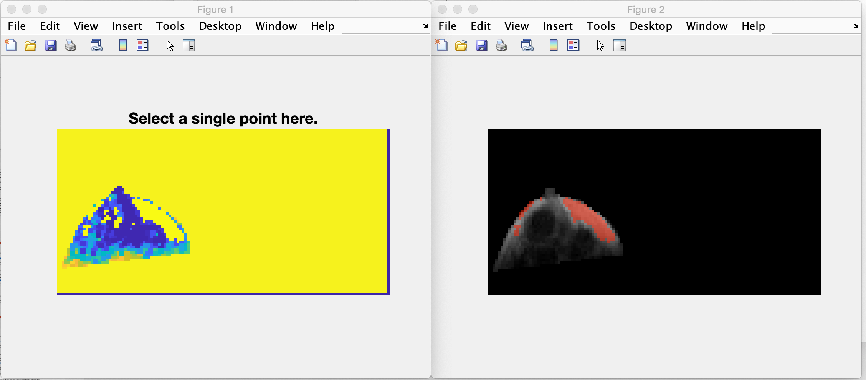
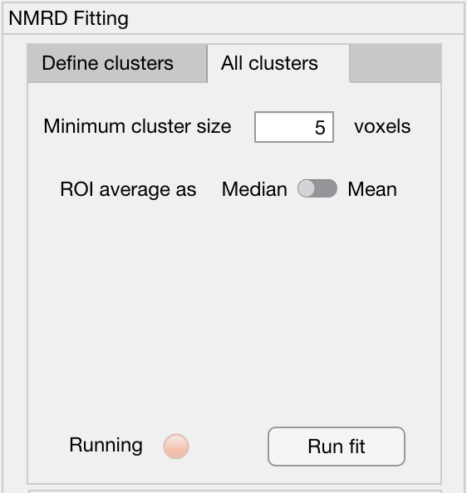
4B
Cluster analysis.
The NMRD can be obtained for up to 5 defined tissue regions. Each tissue region is defined by entering a list of cluster IDs to combine individual clusters to form a single tissue region. Alternatively a single cluster can be assigned to a tissue region. The name of each tissue region can be manually changed.
To identify individual cluster IDs, press the ”Search clusters” button. Follow the instructions on the external MATLAB figure to select a single point on the cluster image and press enter. A second figure will show all image voxels belonging to the cluster ID displayed in the NMRD Fitting panel.
Voxels within each defined region will be averaged prior to NMRD fitting. Change the “ROI average as” switch to “Median” for median averaging of ROI, or “Mean” for mean averaging of ROI.
Instead of defining individual tissue regions using defined clusters, the NMRD can be fitted for all individual clusters. Enter the minimum cluster size to be fit as the number of total voxels in each cluster.

Slide 17
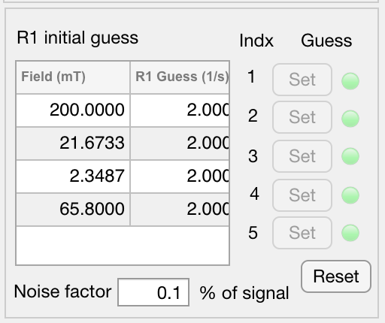
5
Initialise fit parameters.
This panel enables the initial guess of fitting parameters to be defined individually for each defined cluster indexed 1 to 5. If a poor fit is obtained, it may be improved by changing the initial guess parameters.
Set R₁ guess
Enter R₁ guess for each evolution field in the second column of the table.
Set noise factor
Enter the noise factor as a percent of signal acquired.
Set for each ROI
Press the “Set” button for each ROI in turn to assign the initial guesses entered. By pressing the “Set” button the adjacent light will light up. Press the “Reset” button to reset the lights before redefining the initial guesses for each ROI. You can change an individual ROI initial guess by pressing “Set” button multiple times.
All clusters option
If fitting all clusters, the values entered into the table and noise factor will be used for all clusters.

Slide 18
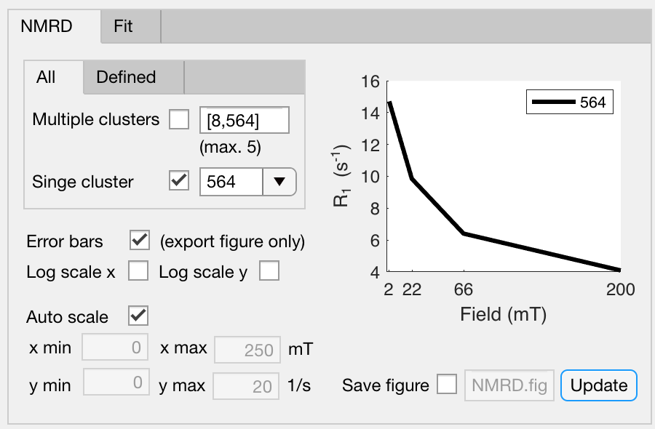
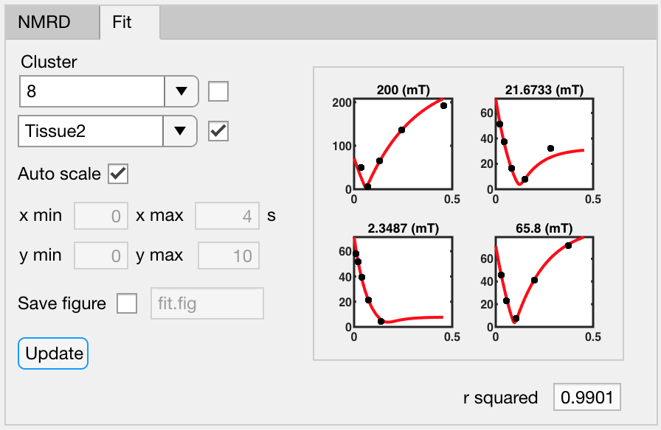
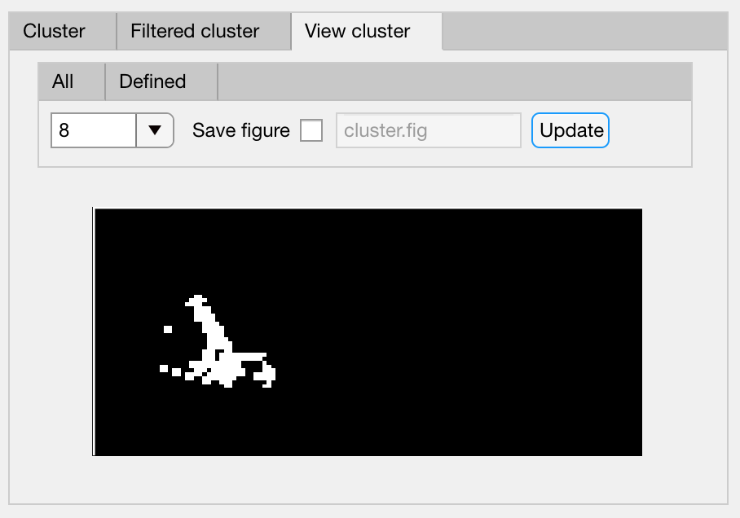
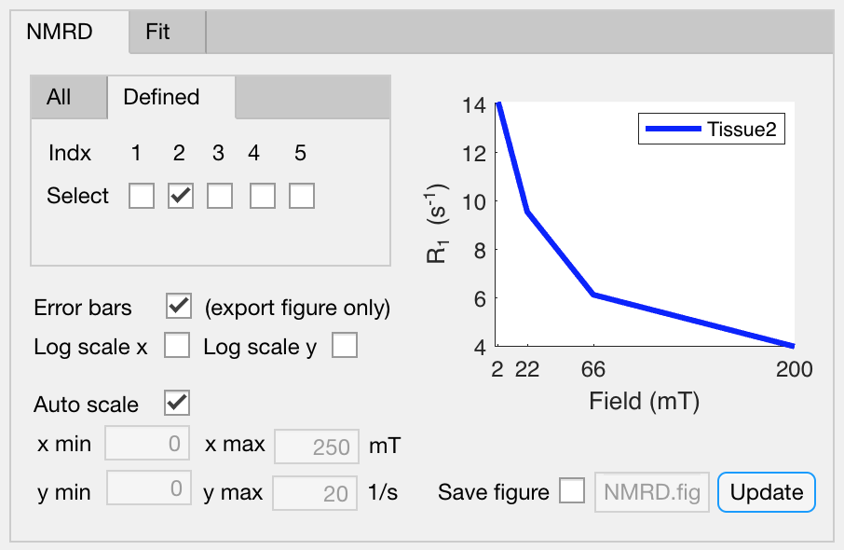
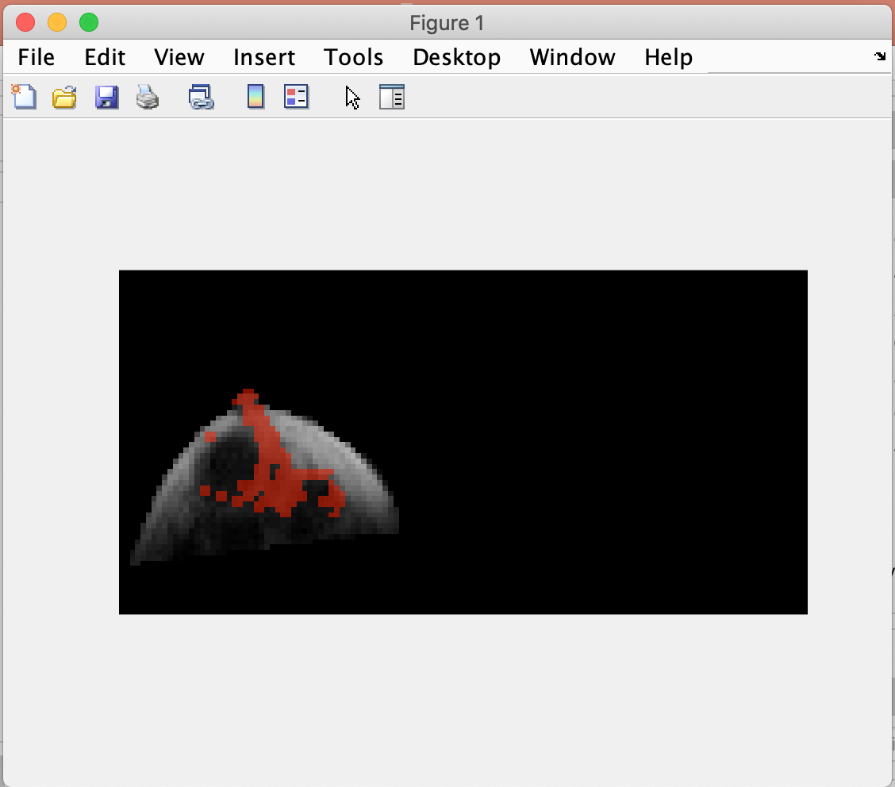
6
Display R₁ NMRD, fit result, and cluster.
R₁ NMRD
All: Select by check box either to plot multiple clusters or a single cluster. Type list of clusters or select single cluster from drop down menu.
Defined: Select by check box the defined regions to be plotted.
Select by check box whether error bars representing the 95% confidence interval should be plotted in the external MATLAB figure. Select whether the x and y axis is plotted on log scale. By deselecting auto scale the axis range can be modified.
Fit Result
Select which cluster to plot either the dropdown corresponding to all clusters or defined cluster fit. Select the appropriate check box. By deselecting auto scale the axis range can be modified. The r² of the fit result is displayed.
Display cluster
Each cluster can be displayed and saved as .Fig MATLAB file. ROI is shown overlaid over the image shown in the Image display panel.

Slide 19
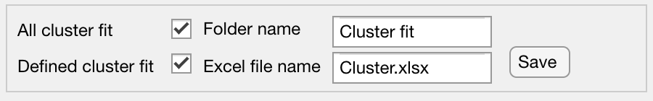
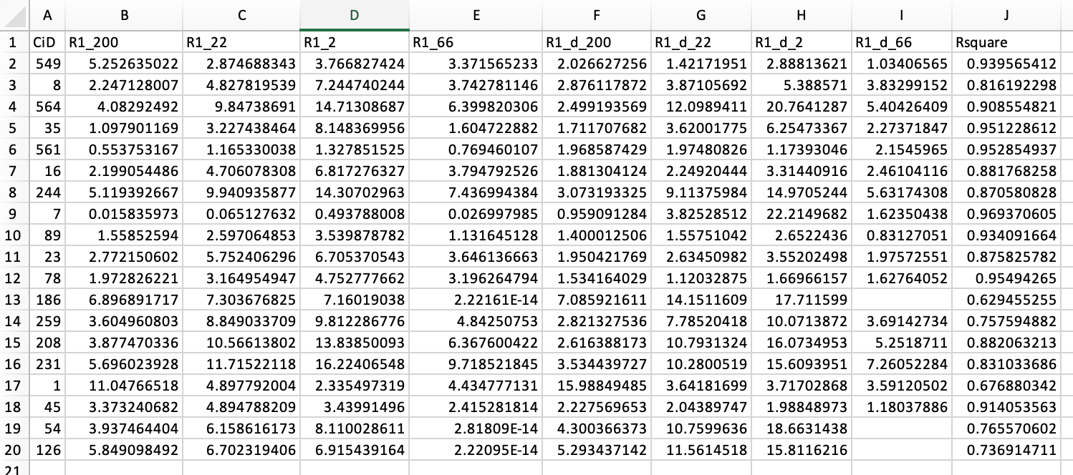
7
Save data to Excel sheet and MATLAB structure.
Select which analysis to be saved via each check box.
Data will be saved in the current MATLAB window. Enter a Folder name. Enter a file name for the saved Excel spreadsheet. Press the “Save” button.

Slide 20
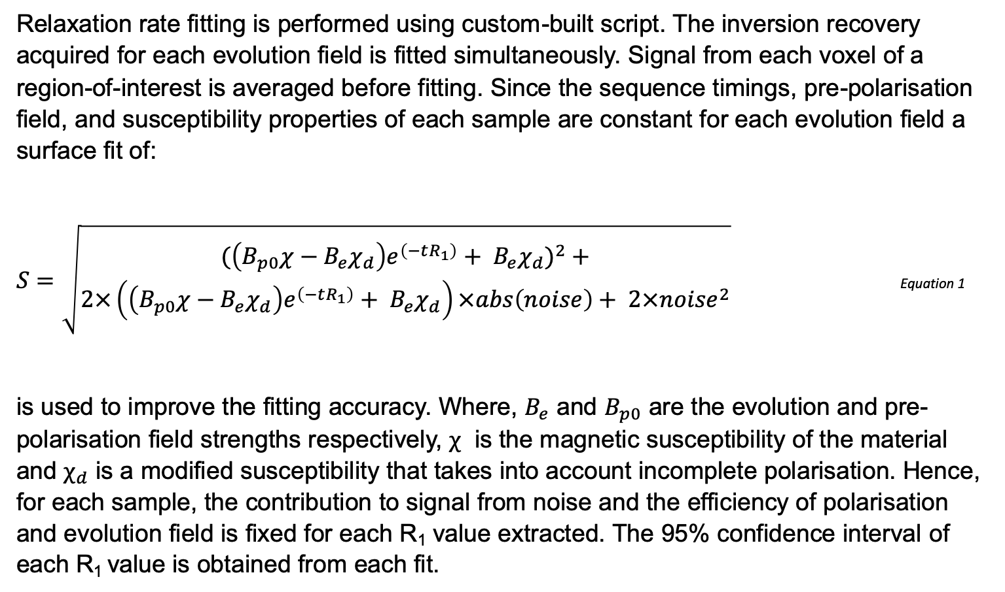
Appendix A
Relaxation rate fitting is performed using custom-built script. The inversion recovery acquired for each evolution field is fitted simultaneously. Signal from each voxel of a region-of-interest is averaged before fitting. Since the sequence timings, pre-polarisation field, and susceptibility properties of each sample are constant for each evolution field a surface fit of:
$S=\sqrt{\begin{aligned}({\left(B_{p0}χ−B_{e}χ_{d}\right)e^{\left(−tR_{1}\right)}+ B_{e}χ_{d})}^{2}+ \\ 2×\left(\left(B_{p0}χ−B_{e}χ_{d}\right)e^{\left(−tR_{1}\right)}+ B_{e}χ_{d}\right)×abs\left(noise\right)+ 2×{noise}^{2}\end{aligned}}$ Equation 1
is used to improve the fitting accuracy. Where, $B_{e}$ and $B_{p0}$ are the evolution and pre-polarisation field strengths respectively, $χ$ is the magnetic susceptibility of the material and $χ_{d}$ is a modified susceptibility that takes into account incomplete polarisation. Hence, for each sample, the contribution to signal from noise and the efficiency of polarisation and evolution field is fixed for each R₁ value extracted. The 95% confidence interval of each R₁ value is obtained from each fit.

