Slide 1
Domain Analysis Big Data Analytics
21.09.2021
Frachtwerk GmbH HTW Berlin
Group 4
Fabio Cosimo Andriulo s0558214
Felix Frömel s0558420
Lucas Larisch s0558070

Slide 2
AGENDA
Big Data Analytics, HTW Berlin – September 21, 2021 – Slide 2/19
PROBLEM
What did we work on?
IT-ARCHITECTURE
Which architecture did we build to solve the task?
DATA PROCESSING
From raw data to valuable Information
FINDINGS
Let’s have a look at our dashboard!

Slide 3
Problem
What did we work on?

Slide 4
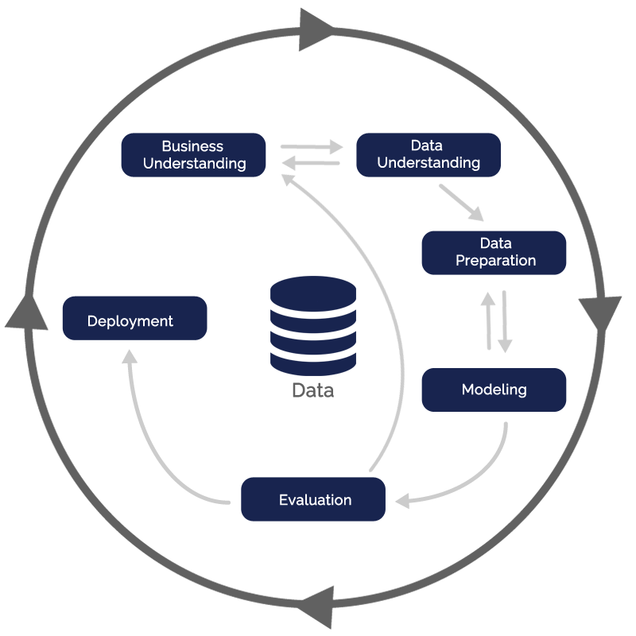
Problem: What Did We Work On?
Big Data Analytics, HTW Berlin – September 21, 2021 – Slide 4/19
Work following CRISP-DM cycle
Business Understanding
Top-Level-Domain data (valid SSL certificate at the time of request)
About 5 Million datasets
Information not up to date
Analyses of the information required
CRISP-DM cycle: https://miro.medium.com/max/1200/1*2NajmK58hJf8lJQm25iXWw.png [04.07.2021]

Slide 5
Problem: What Did We Work On?
Big Data Analytics, HTW Berlin – September 21, 2021 – Slide 5/19
Data Understanding
Available Data (TLD, IPv4, MX-Servers and Timestamp)
Data preparation
ETL process (CSV => PostgreSQL-DB)
Enhancements (counts)
Collect further information (IPv6, Nameservers, Companies including location and country)

Slide 6
IT-Architecture
Which architecture did we build to solve the task?

Slide 7








IT-Architecture: What Services Did We Build?
Big Data Analytics, HTW Berlin – September 21, 2021 – Slide 7/19
Angular Dashboard
Asynchronous data visualization
Node Statistics Service
Service for asynchronously passing data to be displayed
Node/Debian Dig Microservice
Service for performing dig requests using
Postgres DB
Database for storing information
Jupyter / PySpark
Data processing and evaluation
Docker/Docker Compose
Container and Network Management

Slide 8
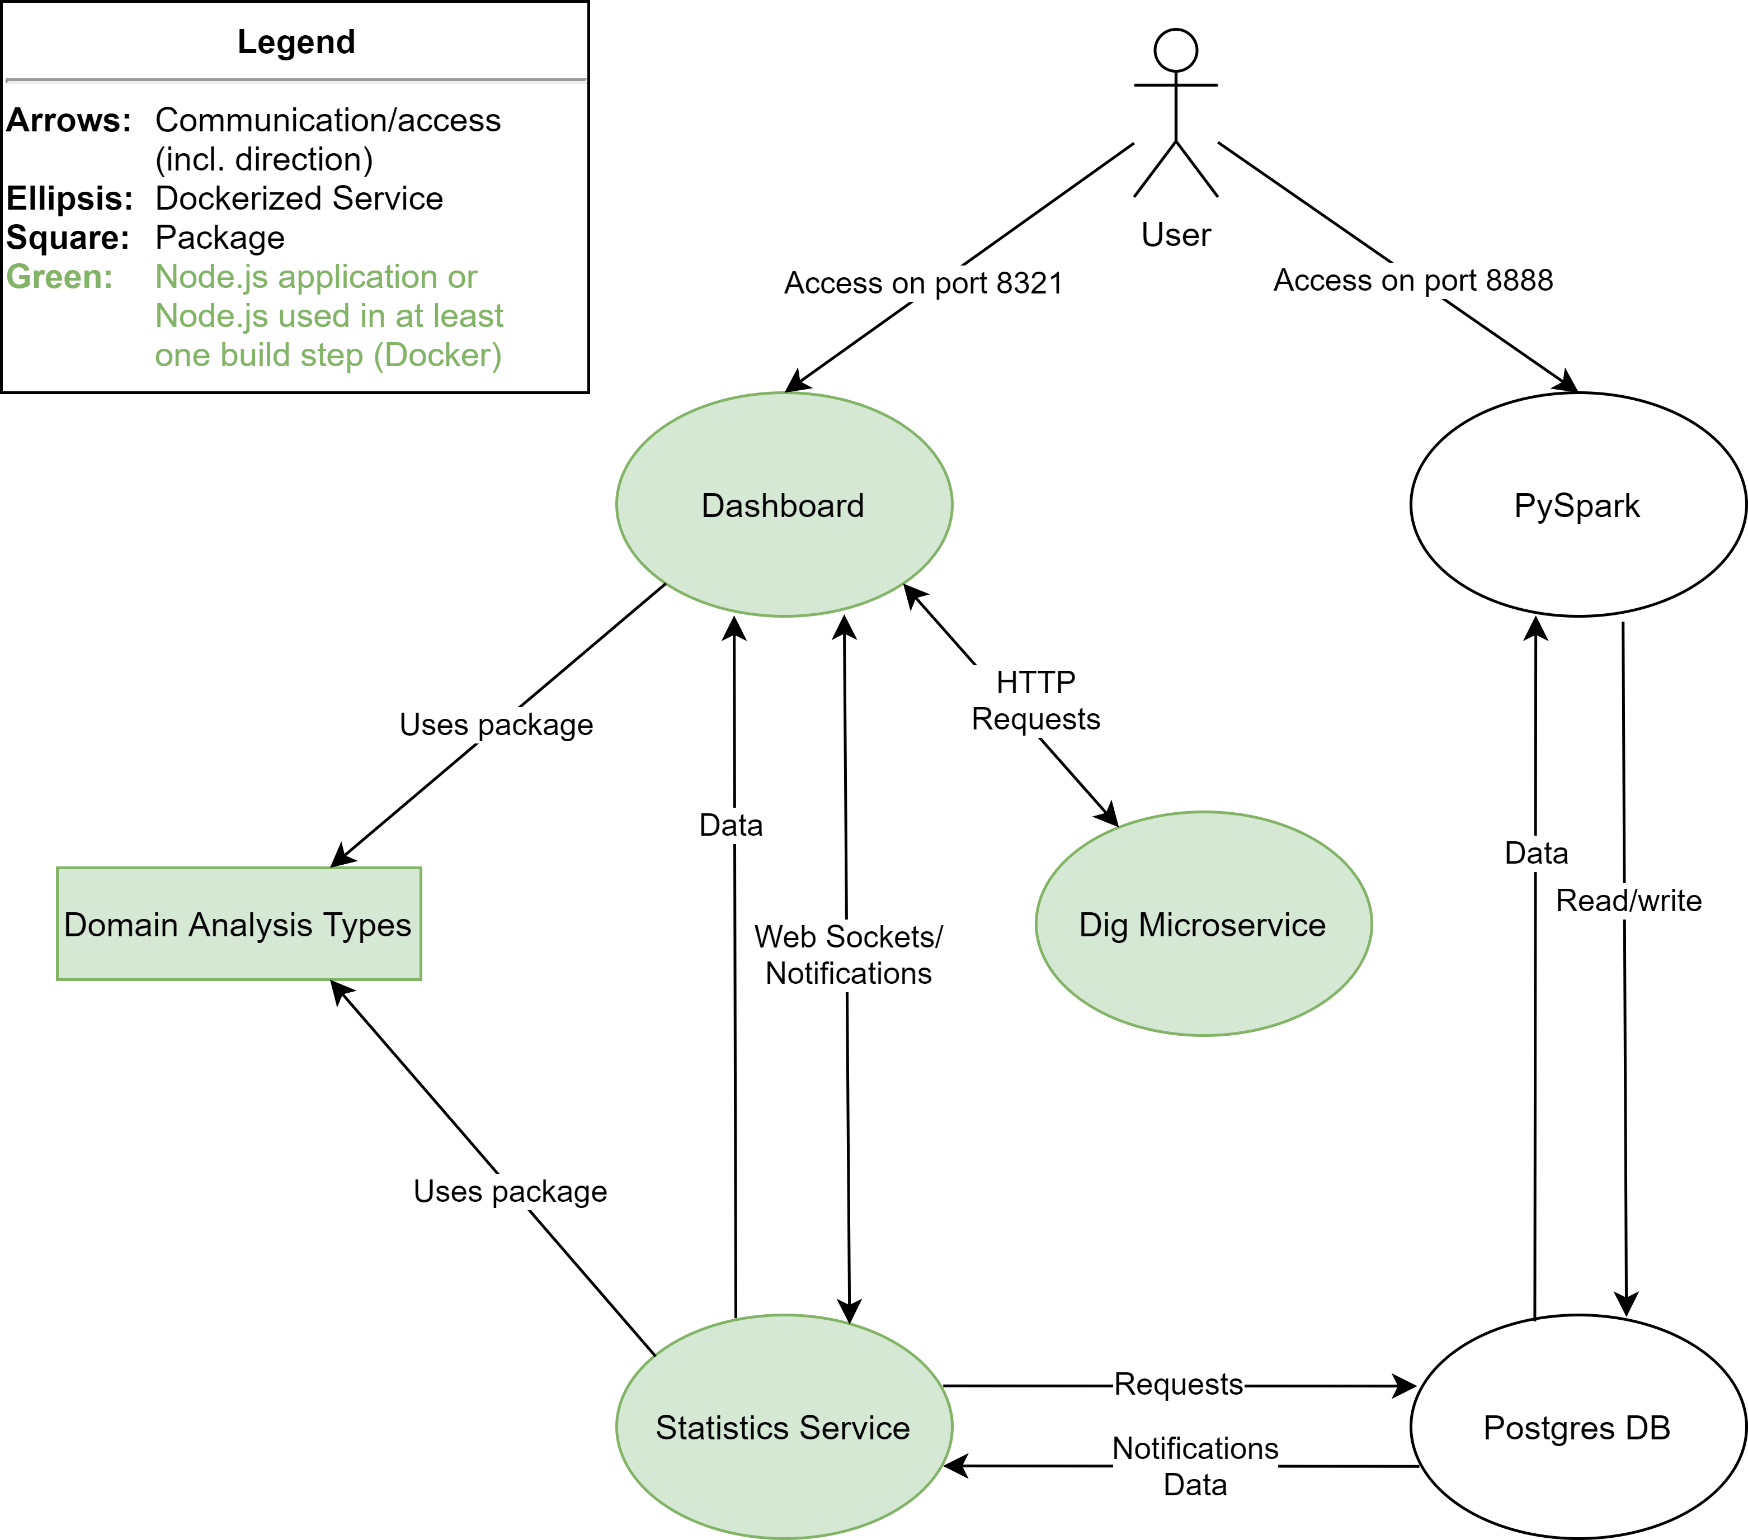
Big Data Analytics, HTW Berlin – September 21, 2021 – Slide 8/19
IT-Architecture:
How are the services connected?

Slide 9
Big Data Analytics, HTW Berlin – September 21, 2021 – Slide 9/19
Benefits of Using Node.js
Concept of Microservices
Shared Packages
Only solve one task
New application logic → new microservice
Programming language is not relevant as long as the service works
Possibility to implement package shared by all services written in TypeScript (Dashboard, Statistics Service, Dig Microservice)
In this project: Dashboard and Statistics Service share a package for using centrally defined event names → minimized complexity
Improved Image Building
Docker Images are downloaded once and referenced by each container
All our Node-based services use node:16-alpine in at least one build step
→ Reduction of used disk space and initial build time

Slide 10
Big Data Analytics, HTW Berlin – September 21, 2021 – Slide 10/19
Event-driven Architecture
Asynchronous Services
How to Maintain Performance?
The following services were designed to communicate asynchronously:
Database and Statistics Service
Statistics Service and Dashboard
Database:
Only emit payload NULL
Prevents sending an unnecessary amount of data
Statistics Service:
Notified something has changed, but not what
After 2 seconds without new notifications: send request to the database
Emit the data received in the previous step to the client
Benefit: Improved user experience due to real-time dashboard

Slide 11
Data Processing
From Raw Data To Valuable Information

Slide 12

JUPYTER PROCESS
STEP 2
STEP 1
STEP 3
Big Data Analytics, HTW Berlin – September 21, 2021 – Slide 12/19
Enhancement of existing data
ETL process on basis data
Collection of further information

Slide 13
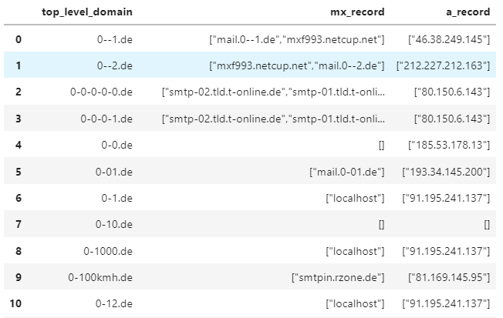
ETL Process on Basis Data
Big Data Analytics, HTW Berlin – September 21, 2021 – Slide 13/19
Extraction: Reading the data into Spark DataFrame
Transformation: Cleaning the DataFrame from special characters and empty lines
Loading: Saving the cleaned DataFrame into database
Representation of imported basis data

Slide 14
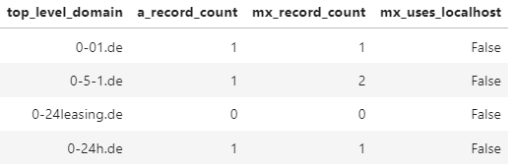
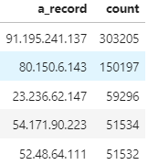
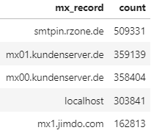
Enhancement of Existing Data
Big Data Analytics, HTW Berlin – September 21, 2021 – Slide 14/19
A- & MX-Records
Counting A and MX records per TDL
TOP 10 A-Records
Counting frequency of A records
TOP 10 MX-Records
Counting frequency of MX records

Slide 15
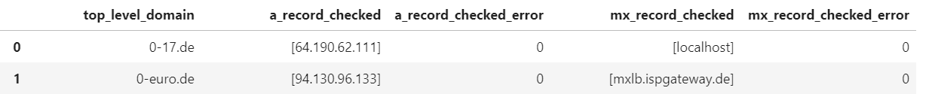
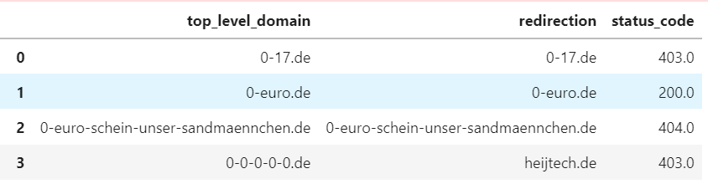
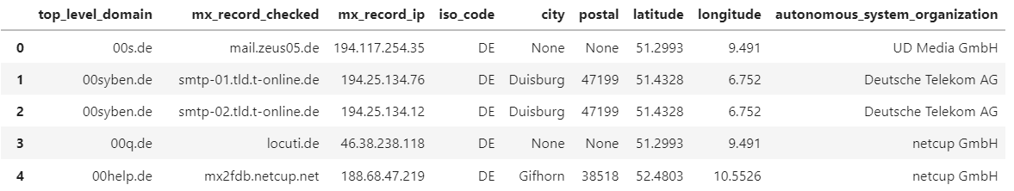
Collection of Further Information
Big Data Analytics, HTW Berlin – September 21, 2021 – Slide 15/19
A- and MX-Records
Checking of A and
MX-Records
Redirects and Status Codes
Per Top Level Domain
MX-Records Location/Provider
And company details

Slide 16
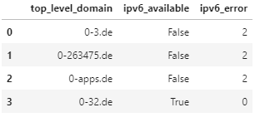
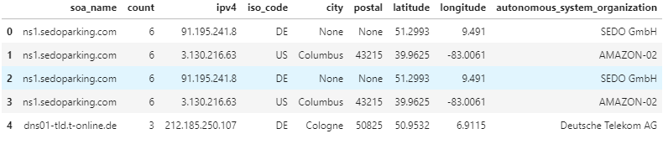
Collection of Further Information
Big Data Analytics, HTW Berlin – September 21, 2021 – Slide 16/19
IPv6-Availability
Returns boolean and error code
Name Servers per TLD
And secondary nameservers
TOP 10 Primary Nameservers
And company details

Slide 17
Findings
Let’s have a look at our dashboard!

Slide 18
THANKS
Any questions?

