Slide 1

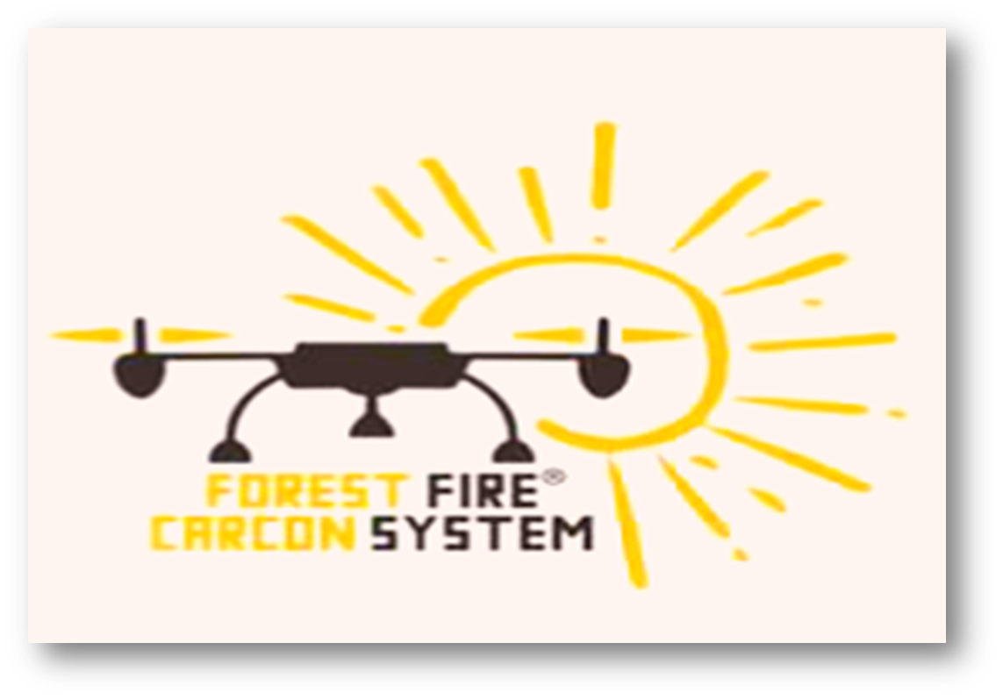
forest fire carbon system
Spot that fire
ffcs

Slide 2
What is the mission of FFCS?
it’s abbreviated for forest fire carbon system. We will provide a system that will help in early detection of forest fires.
The quadcopter is a main part in our project.it will be connected with fire extinguisher rockets full of co2 that will fight the fire in an early stage.
There will be different sensors help in detecting different conditions of the forest as the temperature, wind and humidity sensors. As if the temperature exceeds a specific limit, it will be detected that a fire is about to start. The website is a great part in our project.
Public will take part in this website by providing any information they observe about forest fires and that will make a great impact ppin our project.

Slide 3
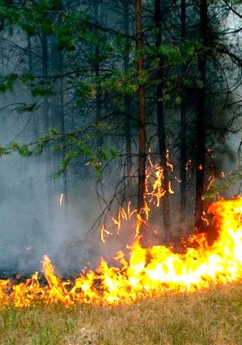
Challenges
More than 100,000 wildfires occur in forests in US every year.
Heavy bad impacts of wildfires on the ecosystem and the environment.
Global warming.
Latency of action.
High of losses.
It can’t be predicted when the fire starts.

Slide 4
Our solution is

Slide 5
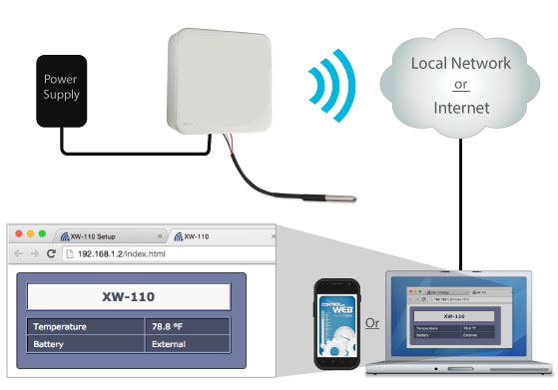
Solution
Smart, fast act, monitoring and informing platform, it works in real-time state, it contains more than one sensor to sense the abnormal actions and inform the nearest smartphones, tablets or computers via web application to show all the parameters.

Slide 6
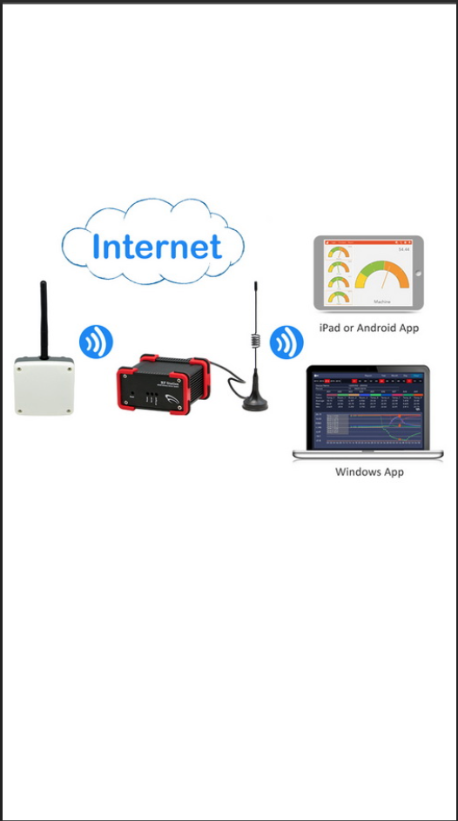
We Will save lives
By this way

Slide 7
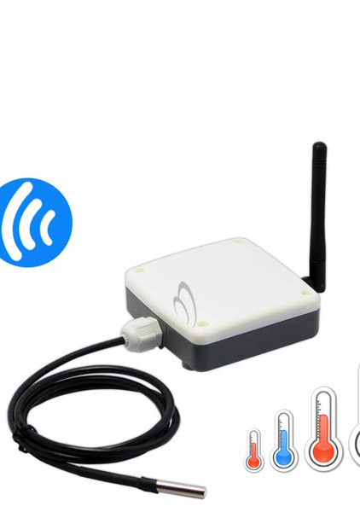
Add-on value for our project
Real-time monitoring.
Super fast act with Alarms and notifications.
Able to predict the fire before it happens.

Slide 8
DEMo

Slide 9
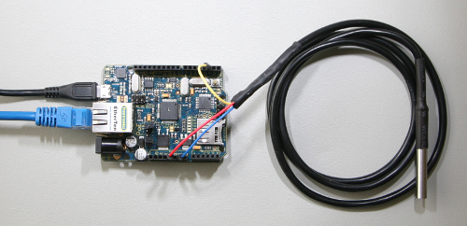
Temperature sensor + Arduino + GPS SENSOR
First step in our prototype is making an Arduino with temperature sensor that will detect the abnormal changes in temperature.
GPS sensor will also point to the location of these changes by detecting its latitudes and longitudes.

Slide 10
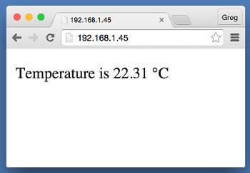
Sensor uploads data on the web site
The data detected by the sensor will be sent directly to the web site we established to be showed in public.

Slide 11
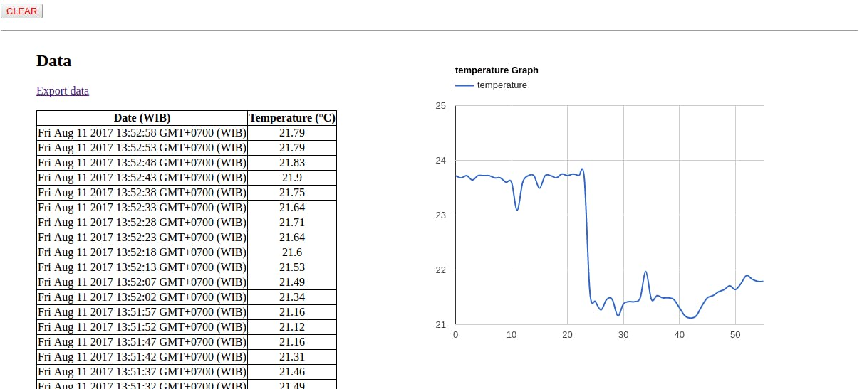
Arrange data on server to be monitored easily

Slide 12
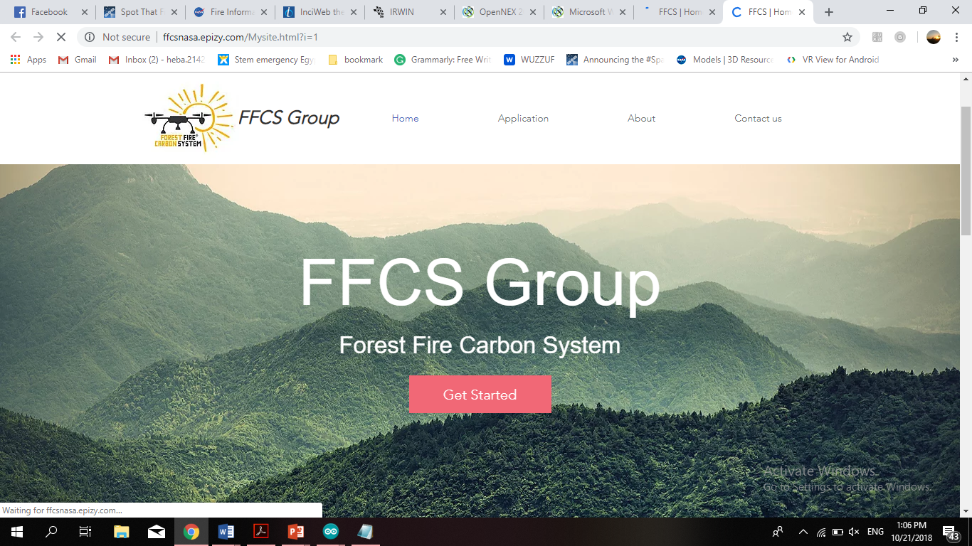
website
http://ffcsnasa.epizy.com/Mysite.html?i=1

Slide 13
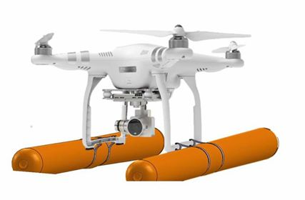
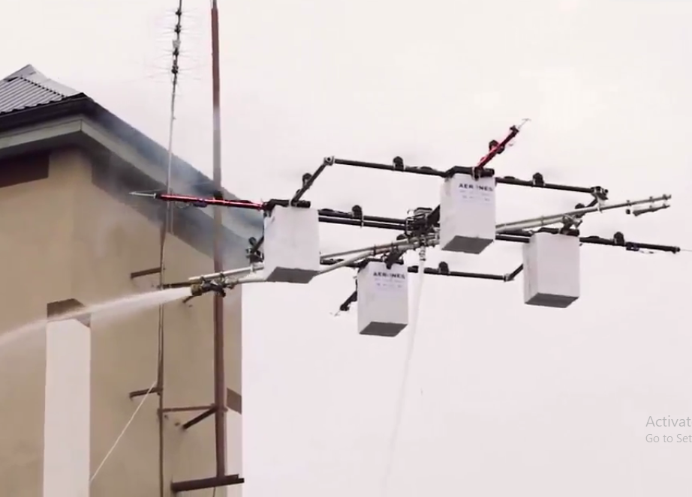
Quadcopter mission
First The quadcopter will survey the places likely more exposed to fires.
When the quadcopter gets the data , it will directly follow the location and go the place of action and will early resolve the situation.
If the fire was enormous and the quadcopter can`t fight it by pumping CO2, it will send an alert to the site requesting for help.

Slide 14
FUTURE ADDITIONS IN OUR PROJECT:
We will make our project more effective by adding cameras to the quadcopter filming what is happening and the current status.
We will add the VR property, which will play the situation via 3D, to be easily showed on all smart devices to increase the awareness around the world.

Slide 15
INFORMATION RESOURCES
https://www.popsci.com/global-wildfire-maps
https://www.nationalgeographic.com/environment/natural-disasters/wildfires/?user.testname=none
https://stateoftheworldsplants.org/2017/report/SOTWP_2017_8_global_land_cover_change_wildfires.pdf
https://www.britannica.com/technology/gyroscope
https://earthdata.nasa.gov/earth-observation-data/near-real-time/firms
https://inciweb.nwcg.gov/
https://irwint.doi.gov/
https://nex.nasa.gov/nex/static/htdocs/site/extra/opennex/

Slide 16
The end

