Slide 1


RISC-V Core Instruction Extension
for sets M and F
Francisco Javier Fuentes Diaz
(FranciscoJavier.Fuentes@e-campus.uab.cat)
Master in Telecommunication Engineering 2020/21
Universitat Autònoma de Barcelona
Notes:
Welcome. My name is Francis Fuentes, and thank you for coming to my project presentation about the hardware design of the core expansions to support the extension sets M and F from RISC-V.

Slide 2
Contents
What is RISC-V and why use it.
Goals of this project.
Project methodology.
RV32I pipeline core.
RV32IM core.
MULDIV component.
RV32IMF core.
FPU component.
Developed RISC-V cores comparison.
Validation process.
Conclusions.
Notes:
We'll start the presentation by introducing what is RISC-V about and the reasons to use it, followed by the objectives of this project.
Then, the methodology used at the design of the components, that are next explained, is presented.
Finally, we have a comparison between the different developed RISC-V cores, the validation process they've passed and the conclusions of the project.
But first, what is RISC-V?

Slide 3
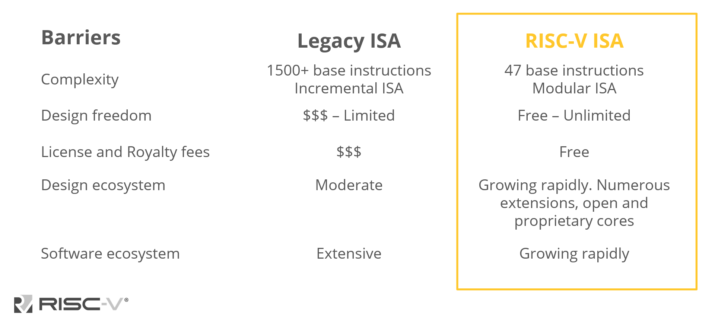
RISC-V ISA
Instruction Set Architecture ~ Standard on HW design
Originated University of Berkley, 2010
Source: “RISC-V Introduction” slide 3, riscv.org/about/
Notes:
RISC-V is an Instruction Set Architecture or ISA. A hardware design standard for processors, used as the foundation that enables compatibility among the digital systems of the same kind.
The RISC-V ISA, originated in 2010 in the University of Berkley, has been on development ever since.
However, the ISA has gone independent from the university to be international.
The main point of the RISC-V ISA is to create a hardware ecosystem driven by a community of partners; be it individuals, companies or university projects like this one.

Slide 4
RISC-V ISA
Open market, expand the hardware ecosystem
Originated University of Berkley, 2010
OPEN SOURCE
Source: “RISC-V Introduction” slide 3, riscv.org/about/
Notes:
This is achieved by making the ISA to be open source and non-proprietary.
Meaning that there are no restrictions to design a RISC-V compatible product, contrary to the actual processors on the market, and also allows the designer to hold all their rights from the product they've developed.
Free of licenses and royalty fees, which decreases costs.

Slide 5
RISC-V ISA
Modular ISA = + flexibility = - costs, + performance
Originated University of Berkley, 2010
Source: “RISC-V Introduction” slide 3, riscv.org/about/
Notes:
Moreover, the ISA is modular in a number of subsets, allowing product customization for particular uses, which in turns decreases costs even further.

Slide 6
RISC-V ISA
Originated University of Berkley, 2010
Source: “RISC-V Introduction” slide 3, riscv.org/about/
Notes:
These features made the RISC-V ecosystem to grow rapidly in the recent years, and it is expected to keep growing.
Primarily because of the ratification of the main extension sets, meaning they are frozen on the ISA and will not be modified in the future.
Following the same customization philosophy, this project takes shape by the next objectives.

Slide 7
Project objectives
Global objetives:
Deliver a RV32I, RV32IM and RV32IMF cores based on RISC-V.
Validate the cores at RTL level (simulation).
Port and validate the core onto a FPGA (DE0 prototyping board).
Specific objectives:
Generate the components required to implement the support for the extension sets M and F (MULDIV, FPU, MUL, DIV, FADD/FSUB, etc).
Understand the provided RV32I pipeline core and adapt it to expand the instruction set support to RV32IM and RV32IMF core models.
Verify the designs in a testbench setting to confirm RISC-V compatibility.
Analyze performance data between the components and core models.
Port to the FPGA platform to verify bare metal operation.
Open source project.
Online repository: github.com/FFD-UAB/RISC-V-Instruction-sets-M-and-F
Notes:
The main goal of the project is to deliver 3 cores, the RV32I core, supporting basic integer operations, the 32IM core, expanding its capabilities to integer multiplication and division operations, and the 32IMF core, that adds support to single-precision floating-point operations.
These must be validated at a simulation environment to ensure they are RISC-V compliant and confirm the components can be ported on a bare-metal platform, like the FPGA from the DE0 prototyping board.
These main objectives are executed following this...

Slide 8
Project methodology - V-model
ISA's reinterpretation
Implement on a higher hardware level and verify it is RISC-V compliant
Extract operations from the RISC-V ISA
Optimization or specification change
Set a requirement
list from the diverse components
to design
Verify the components meet specifications
ISA understanding and component definition
Validation of the implementation
DESIGN
Notes:
V-model procedure.
First, we start by analysing the operations to be supported by the subset.

Slide 9
Project methodology - V-model
ISA's reinterpretation
Implement on a higher hardware level and verify it is RISC-V compliant
Extract operations from the RISC-V ISA
Optimization or specification change
Set a requirement
list from the diverse components
to design
Verify the components meet specifications
ISA understanding and component definition
Validation of the implementation
DESIGN
Notes:
Then, we set the components to be designed and the list of specifications they must meet.

Slide 10
Project methodology - V-model
ISA's reinterpretation
Implement on a higher hardware level and verify it is RISC-V compliant
Extract operations from the RISC-V ISA
Optimization or specification change
Set a requirement
list from the diverse components
to design
Verify the components meet specifications
ISA understanding and component definition
Validation of the implementation
DESIGN
Notes:
We design them, but...

Slide 11
Project methodology - V-model
ISA's reinterpretation
Implement on a higher hardware level and verify it is RISC-V compliant
Extract operations from the RISC-V ISA
Optimization or specification change
Set a requirement
list from the diverse components
to design
Verify the components meet specifications
ISA understanding and component definition
Validation of the implementation
DESIGN
Notes:
here is a cyclic process of refining the designs, modifying the requirements, and even performing optimizations where necessary.

Slide 12
Project methodology - V-model
ISA's reinterpretation
Implement on a higher hardware level and verify it is RISC-V compliant
Extract operations from the RISC-V ISA
Optimization or specification change
Set a requirement
list from the diverse components
to design
Verify the components meet specifications
ISA understanding and component definition
Validation of the implementation
DESIGN
Notes:
Once the components have met specifications, we implement them on the core and validate their operation at RTL simulation and bare-metal synthesis.
However, the core must be modified to accommodate these components. That is why first we must present the RV32I core.

Slide 13
RV32I 5-stages pipeline core
Stage: Instruction Fetch (IF) Instr. Decode (ID) EXEcution (EXE) MEMory access Write-Back (WB)
Decoder set I
ALU
Instruction
word
CSR
ID's
Regfile
Instruction Memory
address
Regfile
PC
Higher frequency of operation compared to
the core without pipeline structure.
Forwarding system
Notes:
This core supports the basic integer operations from the set I, while following this 5-stages pipeline topology to achieve a higher frequency of operation, as we'll be seeing at the cores comparison further in the presentation.
This pipeline is distributed by the instruction fetch, decode, execution, memory access and write-back stages.
Additionally, in order to avoid pipeline stalls caused by operand dependency between the stages, a forwarding system that calls operands from further stages has been set. Avoiding the decrement in throughput which stalling the pipeline would, otherwise.

Slide 14
RV32IM core
Stage: Instruction Fetch (IF) Instr. Decode (ID) EXEcution (EXE) MEMory access Write-Back (WB)
Decoder set I
ALU
Instruction
word
set M
MULDIV
CSR
MUL
DIV
ID's
Regfile
Instruction Memory
address
Regfile
PC
Subset M includes 8 new instructions.
Forwarding system
Notes:
The RV32IM adds support for integer multiplication and division operations by expanding the decoding logic to include the 8 instructions from the subset M, and adding an extra component on the EXE stage, the MULDIV.
However, the multiplication and division operations are intensive arithmetically, thus...

Slide 15
MULDIV
Intensive arithmetical operations require a trade-off analysis = Figure of Merit score
FoM priority order:
Frequency > Resource
> Latency Perf. at div. op.
8 division models
2 incompatible multiplier IPs
16 module combinations
Higher Max. Freq. of Operation and Latency Performance and lower Resource usage ratios, the better.
Notes:
we have developed 8 division models and used 2 distinct IP multipliers, making a total of 16 possible combinations to allow customization by trading area for speed.
To rate these, we used this Figure of Merit that prioritizes frequency of operation, over resource usage, over the latency performance on division operations.

Slide 16
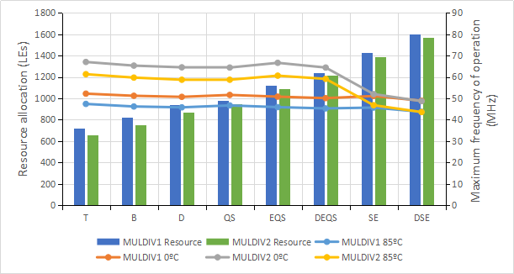
MULDIV
Frequency and resource data from FPGA synthesis:
Latency of division operations from
benchmark simulation:
Intensive arithmetical operations require a trade-off analysis and optimizations = Figure of Merit score
Higher Max. Freq. of Operation and Latency Performance and lower Resource usage ratios, the better.
Notes:
By extracting the frequency and resource data from the synthesis on the FPGA model to port to, and the latency performance on division operation from the benchmark for each division model, we conclude that...

Slide 17
MULDIV
Frequency and resource data from FPGA synthesis:
Latency of division operations from
benchmark simulation:
Intensive arithmetical operations require a trade-off analysis and optimizations = Figure of Merit score
Higher Max. Freq. of Operation and Latency Performance and lower Resource usage ratios, the better.
Notes:
the MULDIV2 with the DEQS divider is the module combination with the best performance, which will be used at further cores supporting the subset M.
However, this holds only true at our target FPGA and our Figure of Merit priorities. These must be adapted if they change, but the latency, however, since it's a logic requirement that doesn't depend on the target platform, it doesn't change.
Further in the presentation we'll be comparing these cores, but before that, let's present the last core on the queue,

Slide 18
RV32IMF core
Stage: Instruction Fetch (IF) Instr. Decode (ID) EXEcution (EXE) MEMory (MEM) Write-Back (WB)
Decoder set I
ALU
Instruction
word
set M
set F
MULDIV
CSR
FCSR
MUL
DIV
FP
Regfile
ID's
Regfile
or
FP
Regfile
Instruction Memory
address
FPU
Regfile
FADD/FSUB
PC
Round
Subset F includes 27 new instructions.
Forwarding system
Notes:
the RV32IMF that adds support for single-precision operations.
This is achieved by increasing the decoding logic to support the 27 instruction from the subset F, plus a number of additional components.
We have the Regfile specific for floating-point operands, a new register on the Control and Status Registers or CSR, and the Floating-Point Unit, or FPU, at the EXE stage.
This last however...

Slide 19
Floating-Point Unit
Core infrastructure
FPU framework
FADD/FSUB components
Components to be added.
Data path of a regular FADD/FSUB operation:
Pipeline register
Pipeline register
Pipeline register
Pipeline register
Special case filtering
Exponent alignment
mantissa
addition/
subtraction
mantissa
alignment
Rounding
Special case filtering
Notes:
it is not fully operational yet, since only the required logic for addition and subtraction operations has been implemented.
The FPU framework has been set up in a way that allows the incorporation of the lacking components, such as FMUL, FDIV and so on to be easier, by putting them on parallel to the FADD/FSUB module.
Down here we have the data path of a regular single-precision addition through the FPU.
We see that it follows a pipeline structure of 3 stages, setting the latency of the operation to be 3 clock cycles.
Furthermore...

Slide 20
Floating-Point Unit
3 times the max. freq. with pipeline
latency = 3 clock cycles
Well balanced pipeline
Core infrastructure
FPU framework
FADD/FSUB components
Components to be added.
Data path of a regular FADD/FSUB operation:
Pipeline register
Pipeline register
Pipeline register
Pipeline register
Special case filtering
Exponent alignment
mantissa
addition/
subtraction
mantissa
alignment
Rounding
Special case filtering
Notes:
the segmentation has been done optimally, tripling the frequency of operation respect the pipeless version at cost of adding a low number of resources.
We say that it has been optimal, due to the frequency gain matches the latency, meaning that the pipeline structure is well balanced, a feature found on high performance designs.
Let's continue with the comparison between the developed cores.

Slide 21
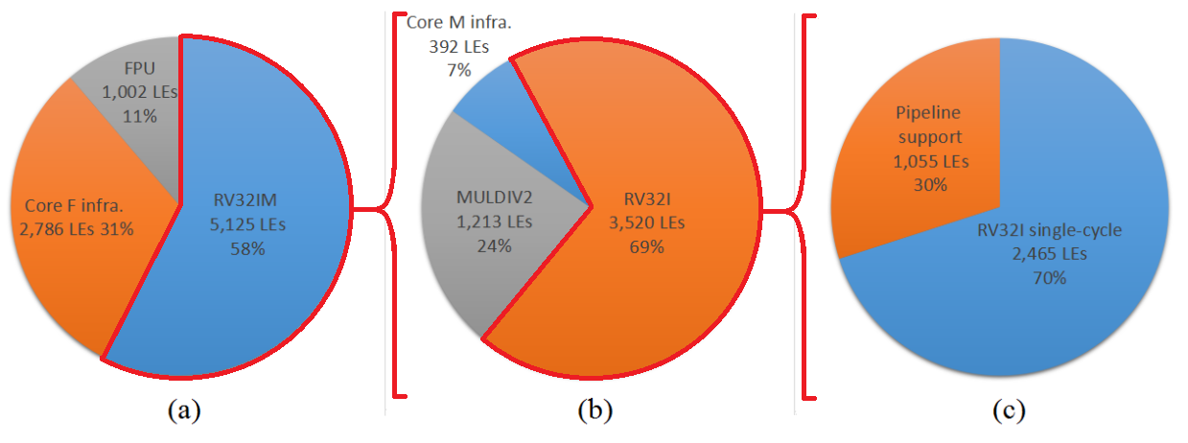
Core comparison
1800% frequency increase at cost of 43% more resources
*: Using the best performance recommendation from the subset M module combination.
RV32IMF RV32IM RV32I pipeline
Notes:
Starting by the original pipeless RV32I with the pipeline version cores, we see an increment of 1800% on frequency at cost of only 43% more resources.
This is a clear example of a good trade-off exchange, since the throughput has been increased near to 18 times by just adding half of a core.

Slide 22
Core comparison
13MHz lower because of the multiplier
*: Using the best performance recommendation from the subset M module combination.
RV32IMF RV32IM RV32I pipeline
Core F infrastructure resources >> original RV32I core without pipeline
Notes:
Continuing with the set M expansion, the frequency has been limited by 13MHz, due to the incorporation of the multiplier.
This, however, is barely decreased on the set F expansion, thanks to the pipeline balance of the FPU.
In terms of resources, each expansion adds more logic, thus, requiring a higher resource allocation than its predecessors.
A curious fact is that the core modifications made to accommodate the set F components require more resources than the original RV32I pipeless core.
Nonetheless, all these designs must pass through a validation process to ensure they work as expected. Let's start by the validation of the components at RTL simulation.

Slide 23
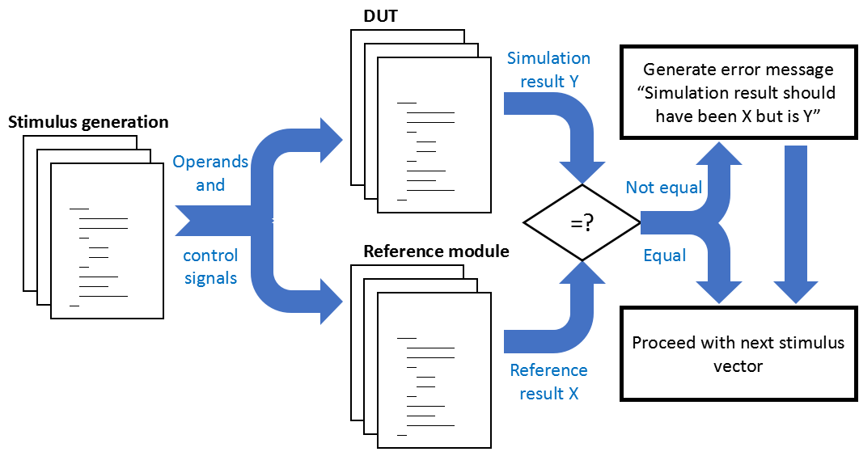
Validation process - automation
Notes:
Since this process is repeated many times at the design stage of the project, this step has been automated.
First, we have the generation of stimulus, operands and control signals, that pass through the Device Under Test or DUT and a reference module, that is easier to program and ensure its correct operation.
If both elements produce the same outcome, all is great. However, if the DUT doesn't produce the correct result, an error message is generated with the corresponding information to...

Slide 24
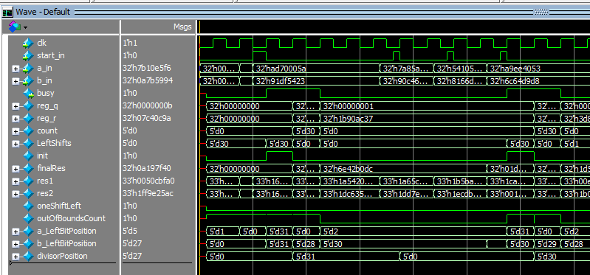
Validation process - manual
Notes:
perform manual validation through wavegraphs, like this one, and a lot of time.
The cores, however, are a completely different story, since the inputs they only accept are coded instructions. That's why...

Slide 25
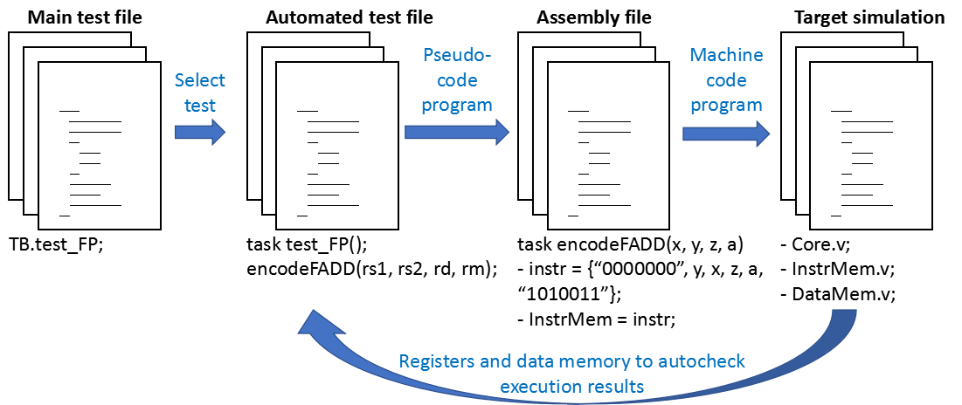
Validation process - core
Notes:
this process specific to the cores is followed.
We create a pseudo-code test program that passes through a compiler, writing the instructions in RISC-V machine language.
This program, saved on the instruction memory during the initialization of the simulation or synthesis, is executed by the DUT core, validating the operations at this hardware level.
Fully validation it's not complete yet, and on these type of systems never actually are due to their complexity. However, there're “torture” tests that prove near total validation.

Slide 26
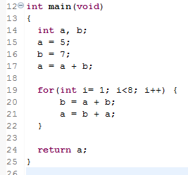
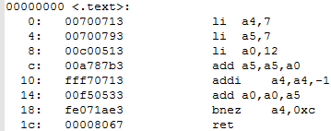
Validation process - C program
Eclipse IDE
xPack RISC-V
embedded compiler
assembly
RISC-V code
RISC-V program
Possibility to execute high level programs on our cores, enabling “torture” tests for an increased validation of the developed cores.
Notes:
That's the reason we tried and achieved executing C programs on these cores through the open source xPack compiler and the Eclipse programming environment.
However, due to time constrains, only the tools and procedure have been found and not actual torture tests have been executed yet, leaving them for a future project.
With this, we end our validation process at RTL. Let's see the porting of these components on bare-metal hardware.

Slide 27
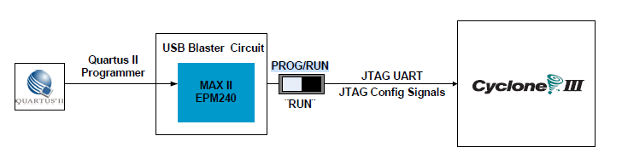
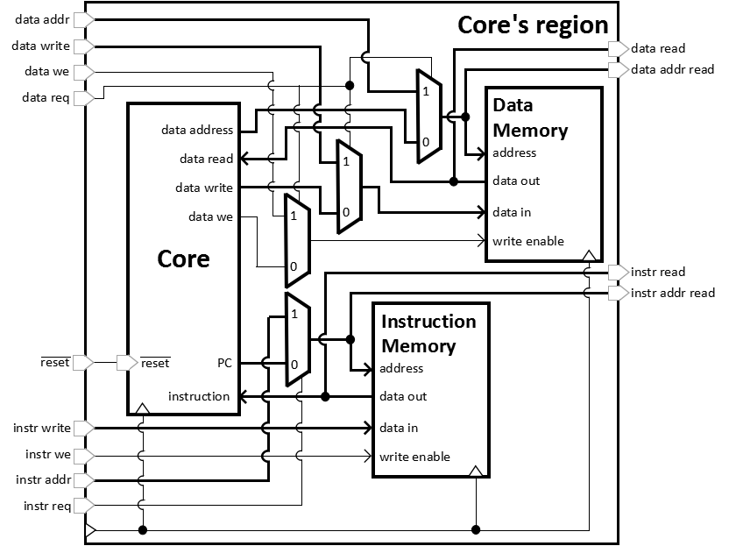
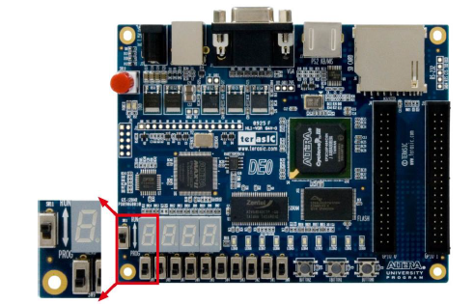
Validation - FPGA porting
DE0 development board
Synthesis tool
FPGA
16KB
32KB
Notes:
For that, we used this DE0 development board that contains as a core component this FPGA from the Cyclone III family.
The porting is a relatively easy step, since the synthesis tool is also used to port the project onto the DE0 board.
However, here is where physical hardware limitations are found. For example, the memories have required the use of embedded memory blocks of the FPGA, and even then we've been only able to allocate 16 and 32KB for the data and instruction memories respectively.
These could be expanded with the use of the on-board FLASH and DRAM memories, but for that it is required an AXI communication bus left for future implementation.

Slide 28
Conclusions
Specific objectives:
Generate the components required to implement the support for the extension sets M and F (MULDIV, FPU, MUL, DIV, FADD/FSUB, etc). Slides 15, 16, 17, 19, 20.
Understand the provided RV32I pipeline core and adapt it to expand the instruction set support to RV32IM and partial RV32IMF core models. Slides 13, 14, 18.
Validate the designs in a testbench setting to confirm RISC-V compatibility. Slides 23-26.
Analyze performance data between the components and core models. Slides 22, 23.
Port to the FPGA platform to verify bare-metal operation. Slide 27.
Implementation options at the divider circuit, maintaining the frequency of operation set by the single-cycle multiplier. Slides 15, 16, 17.
Prove that high level software programming on these processors is possible. Slide 26.
Online repository: github.com/FFD-UAB/RISC-V-Instruction-sets-M-and-F
Notes:
With that, we have delivered all three cores, mostly validated and ported on bare-metal hardware.
While also allowing customization of the set M assets and setting the validation tools for future projects.
These components and further documentation can be found at the project repository. I also accept any questions at the end of the presentation and at my e-mail address.
Still, we only have achieved partial support for the subset F, with its respective validation process. That's why...

Slide 29
Future work
Implement full subset F support and its particular validation tests.
Use the established tools to perform “torture” tests on the cores for further validatation.
Expand the master-slave communication protocol between core and DE0 on-board peripherals by implementing an AXI bus (enable reprogram of the instruction memory on bare metal without requiring resynthesis of the whole project).
Add a debug ring to allow external hardware taping on the internal resources of the core, adding monitoring support useful for future priviligiated expansions of the core.
Notes:
We have envisioned work for possible future projects.
First, full support for the set F can be added and validate it.
Second, perform torture tests on these cores to validate them even further.
Third, set the communication infrastructure with external elements to the FPGA with an AXI bus. This is important since will allow to re-program the instruction memory without requiring to re-synthesize the whole project.
Fourth, add a debug ring to allow tapping on the internal registers of the core on bare-metal hardware. Now, the acknowledgements.

Slide 30
End of presentation
Thanks to...
Intel (Altera) and Siemens (Mentor Graphics) for providing free licenses on its legacy software Quartus II 13.1 and ModelSIM student edition.
Eclipse IDE and xPack developers for providing the programming enviroment.
The MiSE department for providing the DE0 development board.
My supervisors Raimon Casanova and Lluis Teres for providing training and support.
And you for watching my presentation.
Online repository: github.com/FFD-UAB/RISC-V-Instruction-sets-M-and-F
Contact: FranciscoJavier.Fuentes@e-campus.uab.cat
Notes:
I have to thank Intel and Siemens for providing free licenses for its legacy software for students like myself,
Eclipse and xPack developers for providing the programming environment for C code validation,
the “Microelectrònica i Sistemes Electrònics”department for providing the DE0 prototyping board,
my supervisors, Raimon and Lluis, for the training and support on this project,
and thank you for hearing me out. Any questions?

Slide 31
Subset F instructions
Types of instruction format
Already fully operational.
Implemented but not validated yet or relatively easy to implement.
May require some weeks.
A full algorithm design is required.
“Volume I: RISC-V Unprivileged ISA V20191213,” page 133.
Notes:
Q: How much support has been given respect the set F?
A: Well, on that matter, this is the list of the 27 instructions that supports the set F.
Only load, store, addition and subtraction operations are fully operational.
However, the multiplication and move operations have been implemented, but not validated yet.
Full design and validation, for me that I'm already trained and I'm familiar with these cores and the RISC-V ISA, it would take two months and a half if the validation goes without too many problems.
Why I didn't do it during these 6 months after the first TFM period? The writing of the dissertation. Let's say it has been rough for me, and specially, for my supervisors.
But I think we end up with a great dissertation, even if the initial project goals have not been fully achieved.
Mainly because we explored all the steps of hardware design; study, design, debug, implementation and validation, while also making custom solutions where most were needed.
Much better than just following what books say or others have done in my opinion.

Slide 32
Validation process - core automation
DUT core
Simulation result Y
Generate error message
“Simulation result should have been X but is Y”
Torture test after RISC-V compiler
Instructions
Not equal
=?
SPIKE core
Equal
Proceed with next stimulus vector
Reference result X

Slide 33
AXI bus
DE0 board
CORE REGION
AXI bus
JTAG
GPIO
VGA
DRAM
PC
Microphone, camera,
sensors
Monitor

Slide 34
MULDIV models
MULDIV1
MULDIV2
Conversion signed to unsigned
Conversion signed to unsigned
LPM_MULT multiplier IP
Divider model (T, B, D, QS, EQS, DEQS, SE, DSE)
ALTMULT multiplier IP
Divider model (T, B, D, QS, EQS, DEQS, SE, DSE)
Conversion unsigned to signed
Conversion unsigned to signed

Slide 35
MULDIV models
MULDIV1
MULDIV2
Conversion signed to unsigned
Conversion signed to unsigned
LPM_MULT multiplier IP
Divider model (T, B, D, QS, EQS, DEQS, SE, DSE)
ALTMULT multiplier IP
Divider model (T, B, D, QS, EQS, DEQS, SE, DSE)
Conversion unsigned to signed
Conversion unsigned to signed

Slide 36
DIV models benchmark

Slide 37
MULDIV models

