Slide 1
PYCOACH
Python clicks
when you build it.
def is_palindrome(text):
clean = text.lower()
return clean == clean[::-1]
print(is_palindrome(input()))
Adaptive practice, immediate feedback, and an instructor-ready view of learning.
✓ All tests passed
FDE + AI RESEARCH ENGINEER
DEPLOYED MVP

Slide 2
THE PRODUCT
One learning loop. Two clear surfaces.
Students get immediate coaching and mastery updates; instructors get cohort signal without digging through raw submission noise.
01
02
03
Practice
Reflect
Review
Open a focused Python assignment, write code in Monaco, and grade it in place.
See score, feedback, mistakes, hint, mastery change, and the recommended next step.
Instructors see one row per student, then drill into mastery and submission history.
AUTH
Email/password login, student self-signup, and clearly labeled demo accounts
RECOMMENDATION
Start here → next unattempted skill → weakest mastery after evidence exists

Slide 3
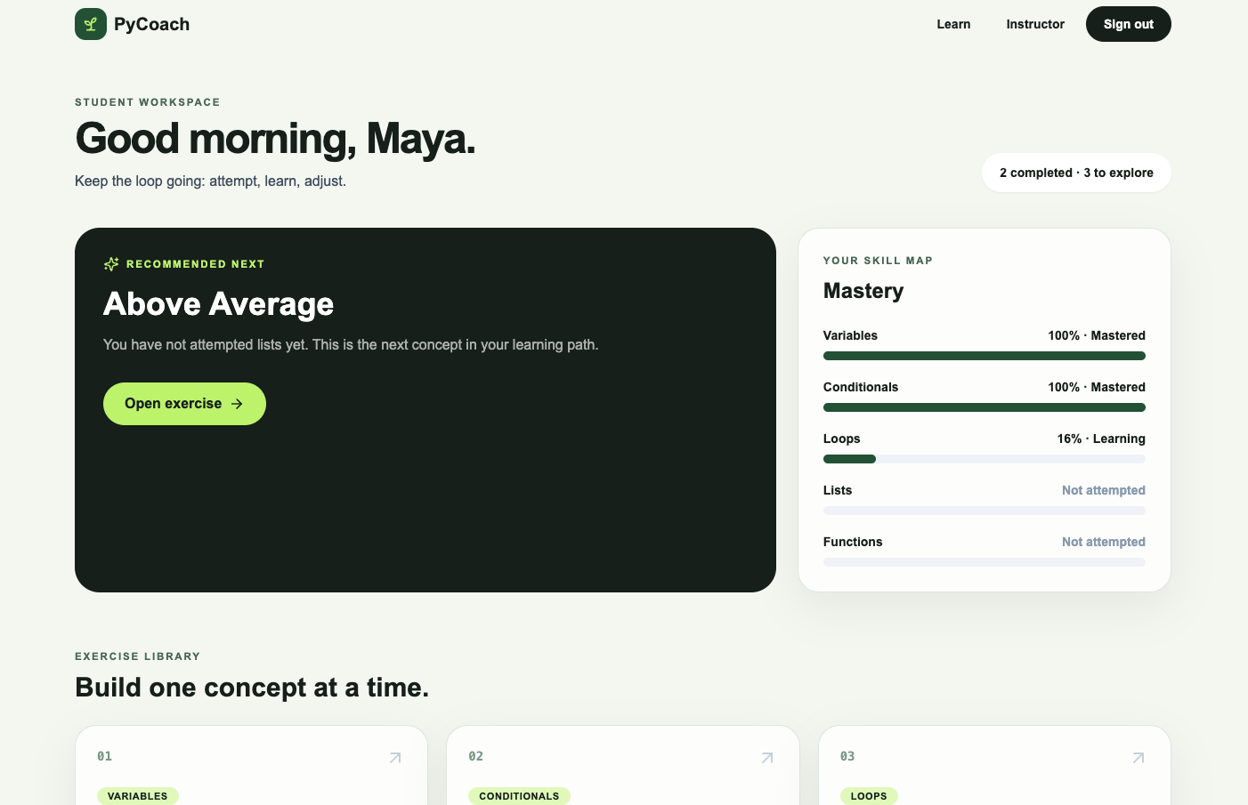
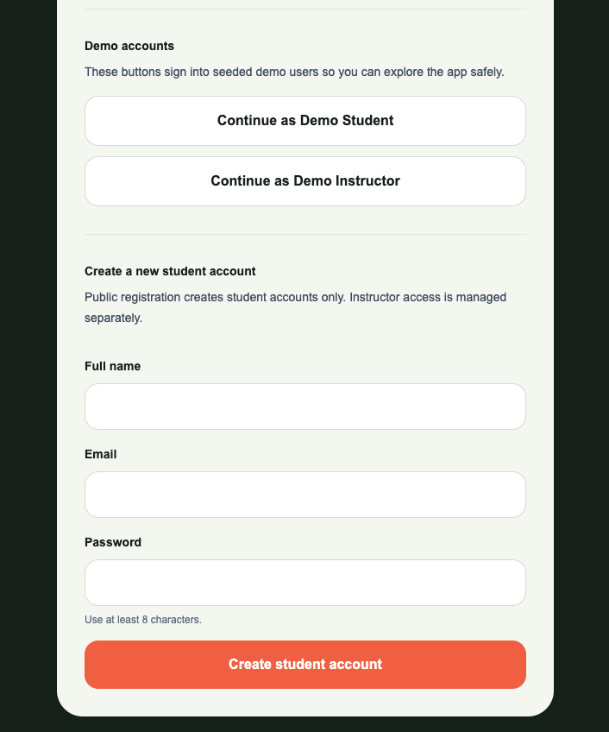
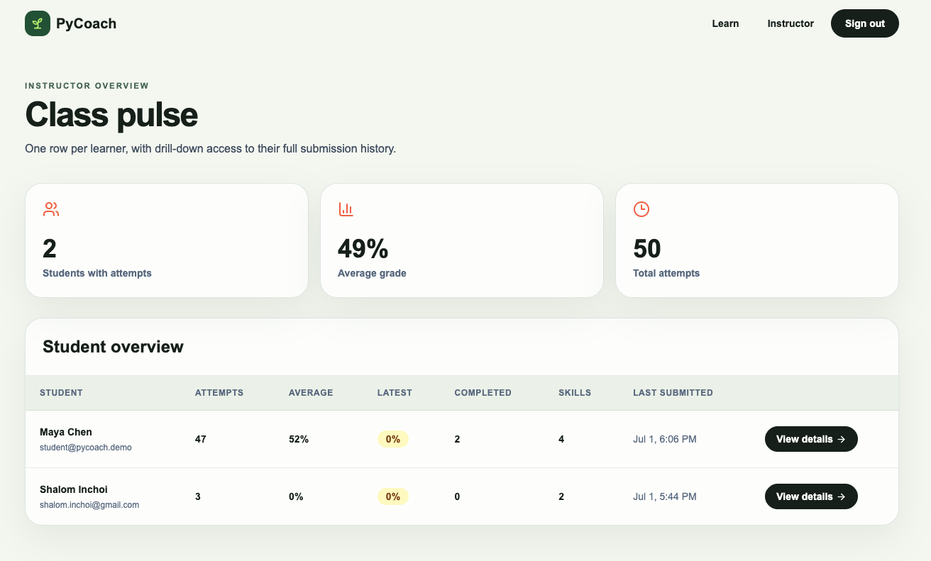
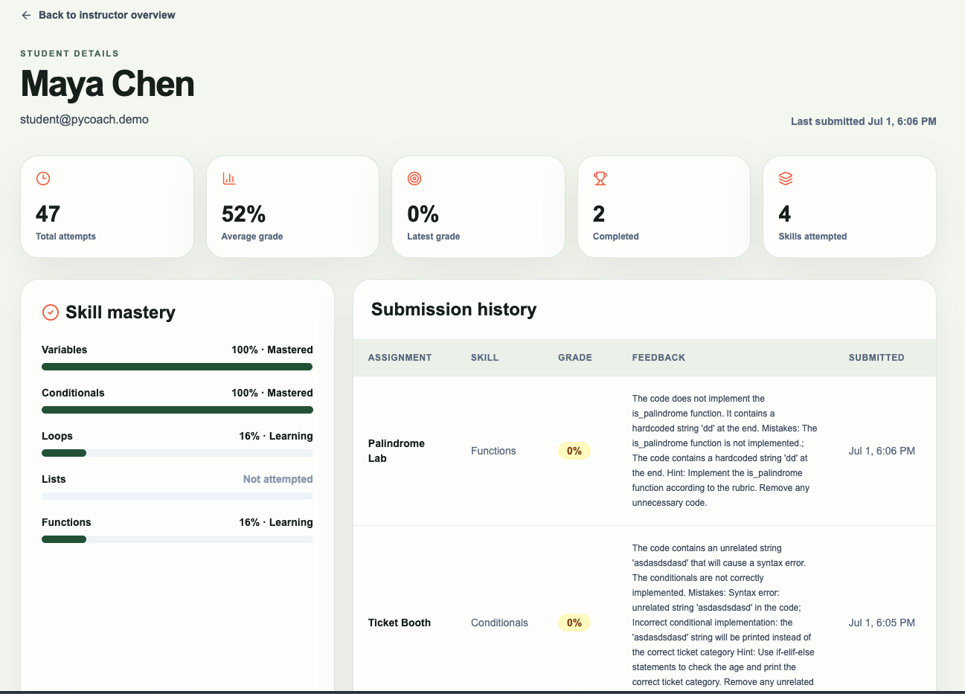
BUILT, NOT MOCKED
The current product surface
Screens below come from the deployed app and reflect the latest login, student, and instructor flows.
LOGIN + SIGNUP
INSTRUCTOR DETAIL
STUDENT DASHBOARD

Slide 4
ARCHITECTURE
A deliberately small MVP surface
One Next.js codebase, Supabase for auth and persistence, and Groq for fast grading feedback.
Browser
Route handlers
Supabase
Next.js App Router
Monaco editor
Grade · mastery
recommendations
Auth · PostgreSQL
RLS policies
Groq LLM grader
CURRENT MVP
Assignment + tests + rubric + reference solution
• No arbitrary Python runs inside Next.js or the browser
• Grading uses prompt-based evaluation with strict JSON output checks

Slide 5
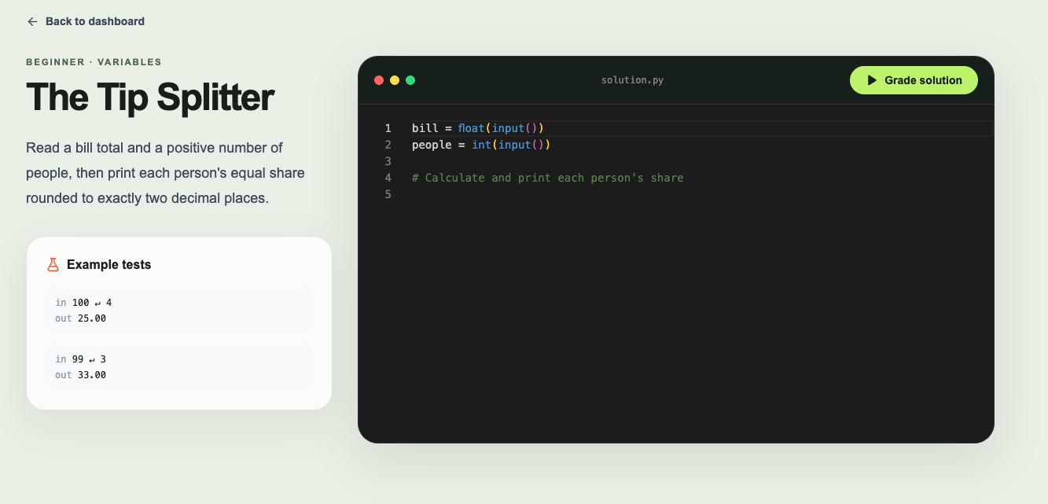
AUTO-GRADING
Prompted for correctness, completeness, and useful feedback
Current MVP uses Groq with richer grading context; deterministic execution is the production upgrade.
• Prompt includes title, description, skill, starter code, public tests, hidden tests, rubric, and backend-only reference solution
• The grader is asked to check every required branch or case, not just the easiest visible example
• If syntax issues and missing logic both exist, feedback should mention both
• Output must be valid JSON before any grade is saved
PRODUCTION UPGRADE
Deterministic sandbox execution plus LLM explanation remains future work, not a current claim.

Slide 6
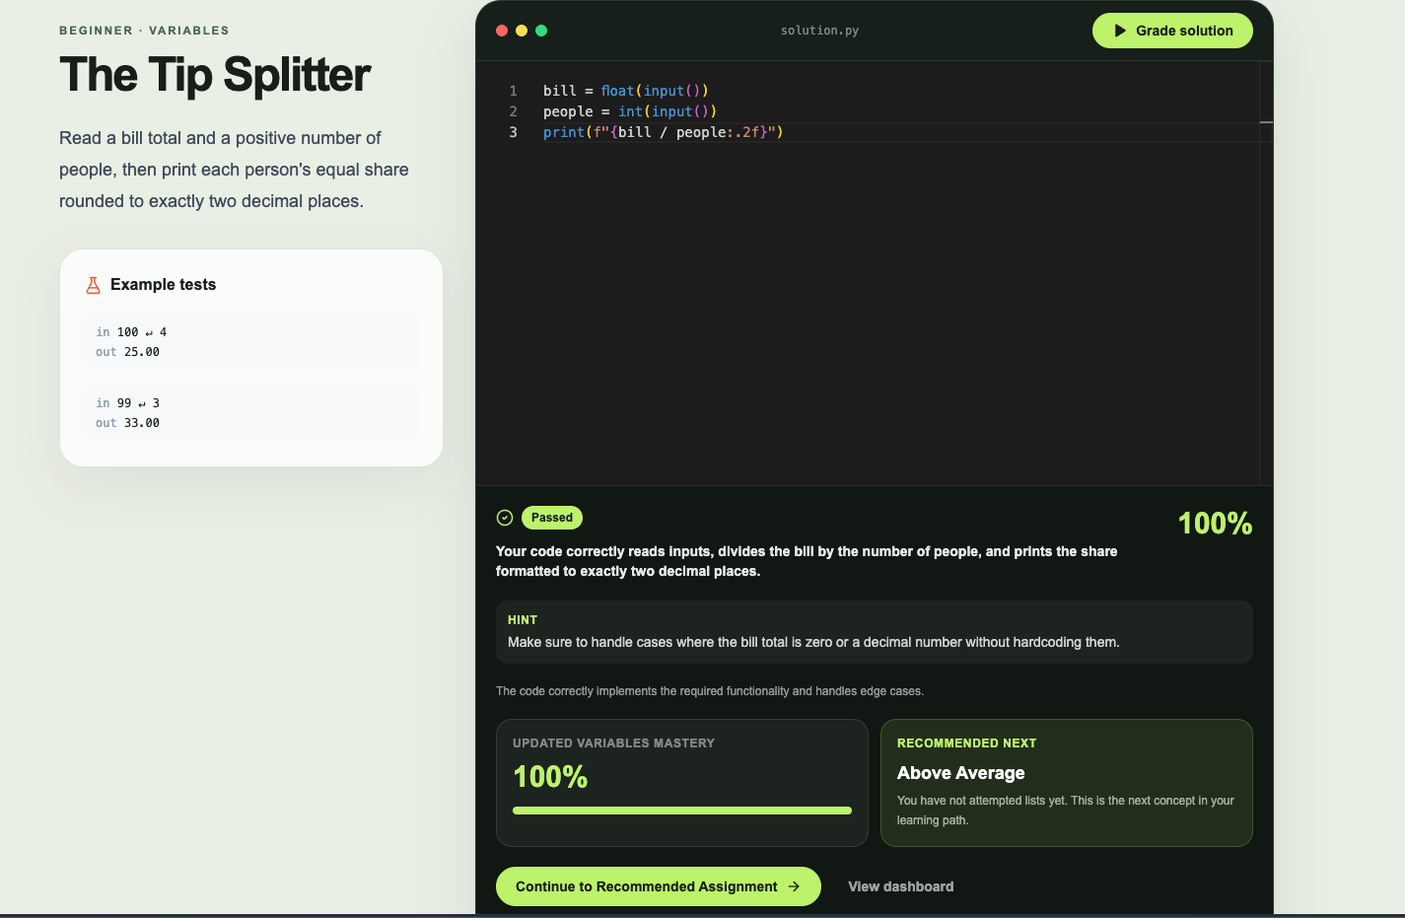
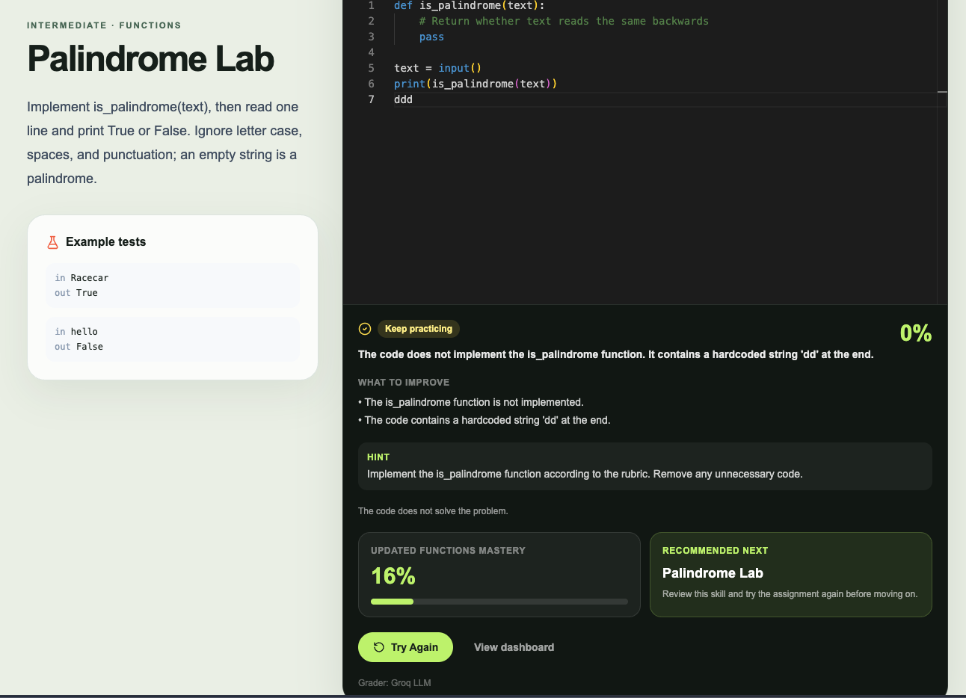
PERSONALIZATION
BKT is simple, interpretable, and honest about sparse data
The UI hides the 0.30 prior until a skill has evidence, then recommends what to do next based on observed work.
P(L₀)
0.30
P(T)
0.12
P(G)
0.20
P(S)
0.10
Recommendation behavior
• Brand new student: start with Variables
• Partially attempted path: recommend the next
unattempted concept
• All skills attempted: recommend the weakest mastery
• Score below 80 after grading: retry the same
assignment first

Slide 7
EVIDENCE & HANDOFF
What is real today, and what comes next
The app is deployed, tested through build, and documented with clear next steps for production hardening.
LIVE
AUTH
GRADE
OVERVIEW
VERCEL APP
LOGIN + SIGNUP
GROQ + RUBRIC
INSTRUCTOR DRILL-DOWN
Research basis
NEXT
Corbett & Anderson (1995) · Open PDF via ACT-R archive
Pardos & Heffernan (2010) · Open PDF via WPI archive
Piech et al. (2015) · Deep Knowledge Tracing (arXiv:1506.05908)
Add deterministic sandbox execution, per-test feedback, and calibrated BKT from real learner sequences.

