Slide 1
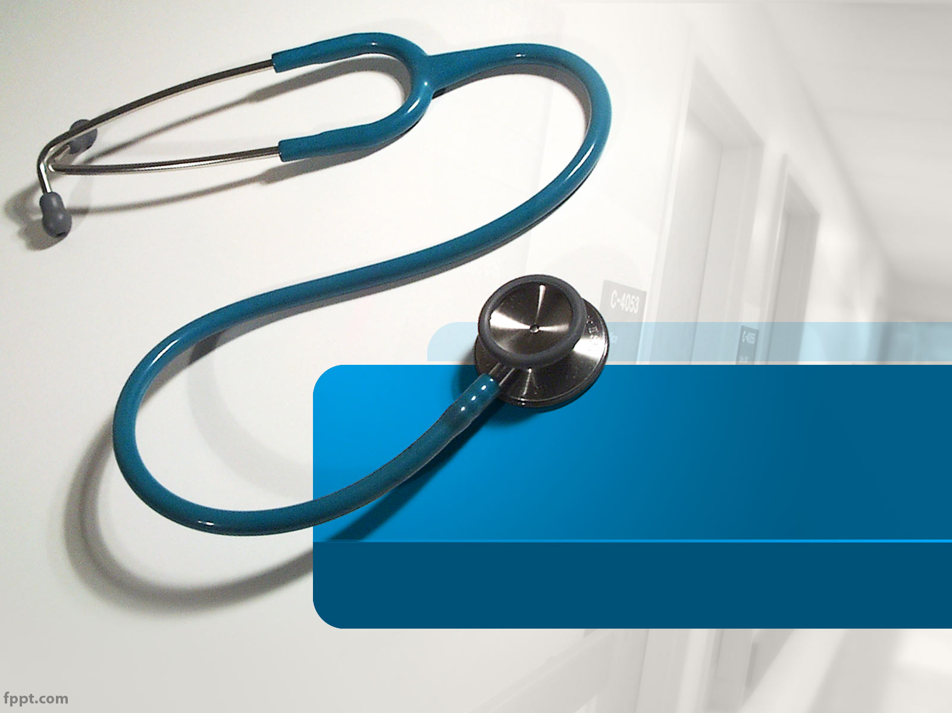
Urinary Incontinence
By No.61 Robin

Slide 2
Vocabulary
Urinary incontinence 尿失禁
Vaginal 陰道的
Urologic 泌尿科的

Slide 3
Vocabulary
Urethral sphincter 尿道括約肌
Urge incontinence 急迫性尿失禁
Contraction 收縮

Slide 4
Vocabulary
Detrusor muscle 迫尿肌
Pelvic floor muscle 骨盆底肌
Intra - abdominal 腹部內的

Slide 5
Vocabulary
Urinary incontinence 溢漏性尿失禁
Benign 良性的
Autonomic neuropathy 自主神經病變

Slide 6
Vocabulary
Prostatic hyperplasia 前列腺增生
Spinal cord 脊髓

Slide 7
Vocabulary
Absorbent 能吸收的
Morbidity 發病 ; 罹病率
Mortality 死亡率

Slide 8
Vocabulary
Urinary retention 尿滯留
Foley catheter 導尿管
Intermittent catheterization 間歇性導尿

Slide 9
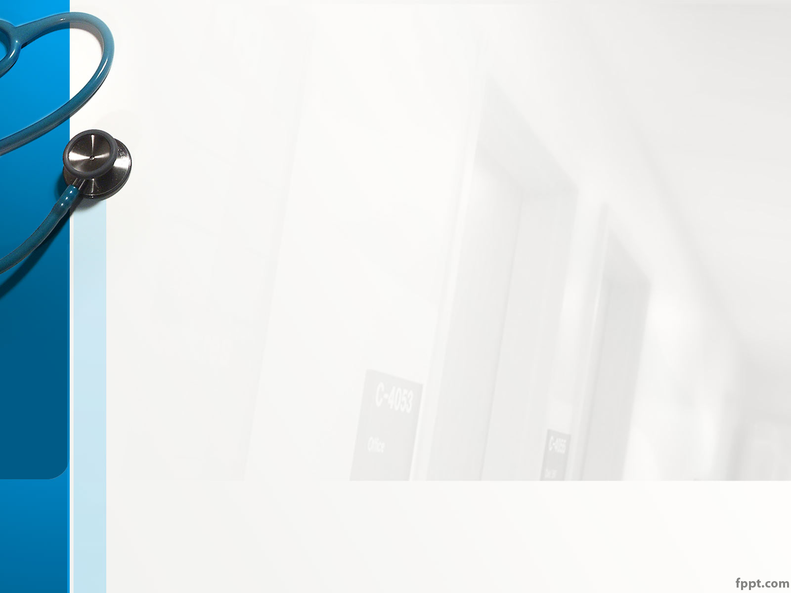
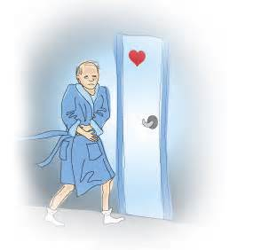
OK ! So ,
what is Urinary Incontinence ??

Slide 10
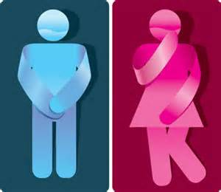
Overview - Introduction
Urinary incontinence is :
the uncontrolled loss of urine

Slide 11
Overview – A neglected Problem
People are too embarrassed to get help ,
But :
Urinary incontinence is a very common problem :
-> Statistics shows that 26000000 adults
have been affected along in America
It indeed can be easily treated and cured
Even more , it sometimes indicates more serious medical conditions
Therefore , they should not be ignored !!

Slide 12
Overview – the Symptom
It’s a symptom rather than a disease
Relate to Urologic & Neurological system
Causes for temporary incontinence :
urinary tract infection , vaginal
infection , constipation , etc .
Causes for persistent incontinence :
weakness of the urethral sphincter ,
overactive bladder , hormone
imbalance in women , etc .
Again , most of them can be easily treated !!

Slide 13
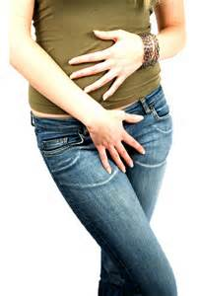
More deeper :
How many kinds of incontinences
are there around our lives ?

Slide 14
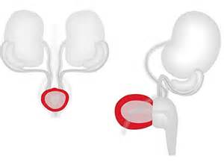
More deeper – Urge incontinence
It usually makes people involuntary loss of urine especially when people want to go to the bathroom
Caused by detrusor muscle contractions
(迫尿肌收縮)

Slide 15
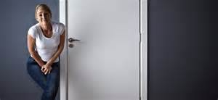
More deeper – Urge incontinence
Those who get it will leak urine when :
1. can’t arrive bathroom in time
2. drink a small amount of liquid
3. hear or touch running water

Slide 16
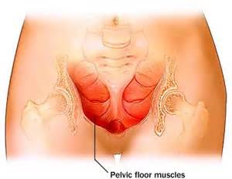
More deeper – Stress incontinence
It usually makes people loss small amount of urine when intra – abdominal pressure (腹部內的壓力) increases
Caused when pelvic floor muscle (骨盆底肌) is weak

Slide 17
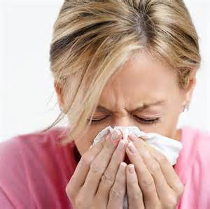
More deeper – Stress incontinence
Those who get it will leak urine when :
1. sneeze , cough , or laugh
2. get up from chair or get out of bed
3. walks or does other kinds of activity

Slide 18
More deeper – Overflow incontinence
It usually makes people feel that they never completely empty their bladder (膀胱)
People may experience constant dribbling(流口水) when passing urine
Decreased detection of overfilling and weakened detrusor muscle:
-> caused by automonic neuropathy or spinal cord injury
Increase outlet resistance and blocked urethra
-> caused by tumors , kidney stones , and benign prostatic hyperplasia (良性前列腺增生)

Slide 19
More deeper – Overflow incontinence
Those who get it will :
1. lose small amount of urine often
2. get up often to go to bathroom
3. feel the need to empty the bladder often
4. have difficulty emptying the bladder
5. spend a long time on the toilet
6. produce a weak , dribbling stream of urine

Slide 20
Conclusion
Urinary Incontinence shouldn’t be ignored by people !

Slide 21
Discussion
Engage your Audience
Capture Audience Attention

Slide 22
Discussion
For problem 1 , we could :
For problem 2 , we could:
Feature 1
Feature 2
Feature 3
Feature 1
Feature 2
Feature 3

