Slide 1
Antivaccination
By B0202061 Robin Lan

Slide 2
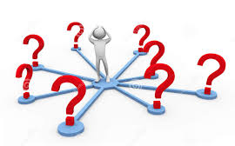
Antivaccinationists ???

Slide 3
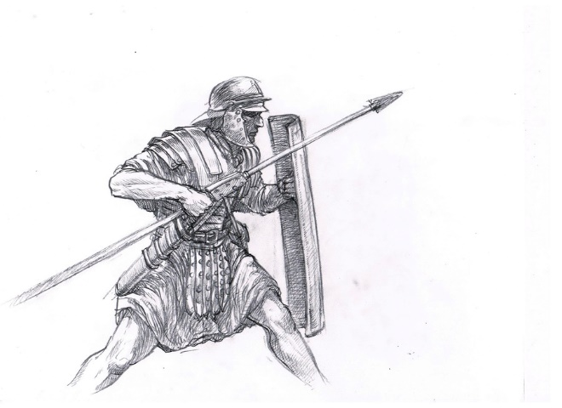
Just like the word telling us , they are a group of people who view all vaccines as evil extreme enemies . Or maybe more precisely , they are Warriors , fighting against all vaccines until they are all disappear from the whole world !

Slide 4
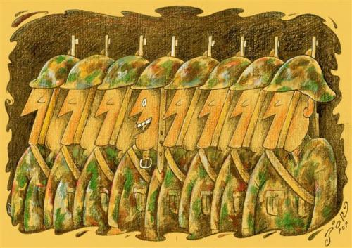
Once upon the time , when there are variety of vaccines exit in the world . They are solders , protecting people from devil diseases .
One day …

Slide 5
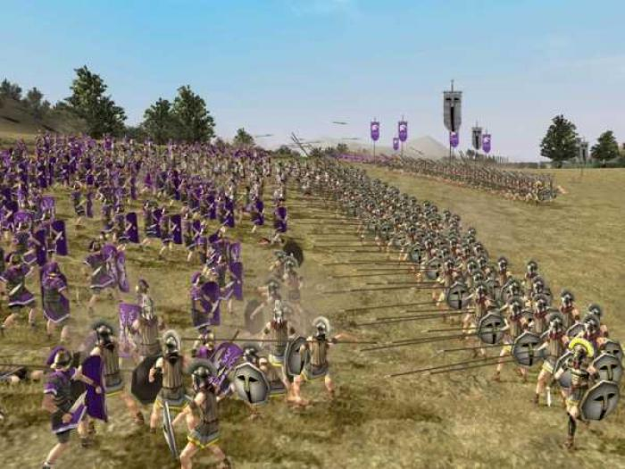
Because of a scandal , vaccines failed to protect a few people . Fear to believe vaccines again , a group of people started fighting against them , electing the swords and begin the war .
Those people , are completely
warriors !

Slide 6

Eventually , the people got the final victory !
However ,
The tragedy began ……

Slide 7
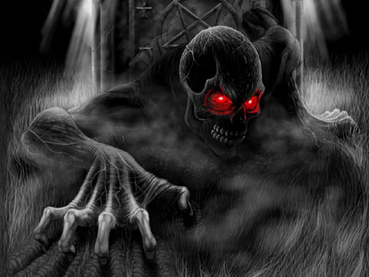
After their victories , disasters also visited . Diseases started to torture people , taking away lots of innocent lives ……
Until long period after…

Slide 8

People finally started to find help from vaccines again . Diseases were gradually defeated , people finally could live a safe life .

Slide 9
The story temporary comes to an end . Now , let’s take a little looks at what happen in the real world …

Slide 10
The fact is :
People never get the real lesson from the tragic history , even including now …
Since the introduction of the first vaccine, there has been opposition to vaccination ……
-- From "The Age-Old Struggle against the antivaccinationists"

Slide 11
Outline
Background information
History of Antivaccinationists
Today’s Antivaccinationists
How to hasten the Antivaccinationists’ funeral
Conclusion
Reference

Slide 12
The History

Slide 13
The early Antivaccinationists
Since the 18th century , fear and mistrust have arisen every time a new vaccine has been introduced .

Slide 14
The early Antivaccinationists
In the 19th century, despite clear evidence of benefit, routine inoculation with cowpox to protect people against smallpox was hindered by a burgeoning antivaccination movement.
The result , was ongoing smallpox outbreaks and needless deaths.

Slide 15
The good news is :
This event wasn’t so big to affect the
acceptance of vaccines to the public .

Slide 16
The golden age
Between 1940s to 1980s , the antivaccination movements used to be nearly disappear for some reasons :

Slide 17
The golden age
a boom in vaccine science, discovery, and manufacture

Slide 18
The golden age
public awareness of widespread outbreaks of infectious diseases (measles, mumps, rubella, pertussis, polio, etc) and the desire to protect children from these highly prevalent ills

Slide 19
The golden age
a baby boom, accompanied by increasing levels of education and wealth

Slide 20
The golden age
These events led to :
public acceptance of vaccines and their use ,
and significant decreases in disease
outbreaks , illnesses, and deaths

Slide 21
All sounds good however :
The short-lived golden age came to an end
in 1970s , with few highly visible disease
outbreaks impaired the world ……

Slide 22
Re-flourishing of the antivaccinationists
In 1970s , accompanying with few disease outbreaks , poor scientific knowledge was constantly conveyed by media , swayed the public opinion , and distracting the scientific researches .

Slide 23
Antivaccinationists began flourishing again !
People gained more and more fear to the use of vaccines .

Slide 24
Tragedy as it was , though , it was still not the end …

Slide 25
The DPT event

Slide 26
The DPT event - Beginning
In 1982 , a television names “DPT: Vaccine Roulette” reported a litany of unproven claims , which launched a huge debate to the use of DPT vaccine .

Slide 27
The DPT event - Society
The public became more focus about the risks of the disease and usually focused on adverse events associated with vaccination
Countries dropped their programs of universal DPT vaccination in the face of public protests

Slide 28
The DPT event – Vaccine Manufacturers
In the United States , vaccine manufacturers cease vaccine production , leading to a program called Vaccine Injury Compensation Program (VICP)

Slide 29
The DPT event – A little survey
In the 1970s and 1980s , countries that
dropped routine pertussis vaccination had
suffered 10 to 100 times more the pertussis
incidence than those maintained high
immunization rates

Slide 30
The MMR vaccine controversy

Slide 31
The MMR vaccine controversy - Beginning
In February 1998 , a research group led by Andrew Wakefield published a paper , which has been proved to be fraudulent now , in a British medical journal – The Lancet .

Slide 32
The MMR vaccine controversy - Beginning
The research said that there are connection between behavioral symptoms and MMR vaccination .

Slide 33
The MMR vaccine controversy - Momentum
About between 2001 and 2002 , the controversy began to become momentum because of the consecutive supporting researches gradually released by some famous journals .

Slide 34
The MMR vaccine controversy – A Little Survey
It was the biggest science story of 2002, with 1257 articles mostly written by non-expert commentators .

Slide 35
The MMR vaccine controversy – The True
Since 2003 , the antivaccination movements of MMR vaccine generally decreased because of a series of scandals about Wakefield’s research .

Slide 36
The MMR vaccine controversy – The True
Reason 1 :
the request of retraction of interpretation
Reason 2 :
the report of manipulating of data
Reason 3 :
a complete investigation led by GMC
(General Medical Council) , which
formally proved that Wakefield’s research
was fraudulent

Slide 37
The MMR vaccine controversy – The Impact
According to AOL’s survey in 2011 , huge disease outbreaks includes :
A 2002–2003 outbreak of measles in Italy
A 2004 outbreak of measles from India
A 2006 outbreak of mumps in Chicago
A 2007 outbreak of mumps in Nova Scotia cost
$3,511 per case
A 2008 outbreak of measles in San Diego,
California cost $177,000, or $10,376 per case

Slide 38
Nowadays

Slide 39
Today, the spectrum of antivaccinationists has ranged from people who are simply known little about science to radical fringe people who use deliberate mistruths, intimidation, falsified data, and threats of violence in efforts to prevent the use of vaccines .

Slide 40
The H1N1 vaccine controversy

Slide 41
The H1N1 vaccine controversy - Report
In 2009 and 2010 , when H1N1 Influenza virus were widely torturing the whole world , a strong public fear of vaccination was again revealed by antivaccinationists , added with the Wakefield’s demonstration , the public was steered away from the vaccine

Slide 42
The H1N1 vaccine controversy - Result
Parents and their children grew up afraid of vaccines
The outbreaks of measles and mumps appeared again

Slide 43
Who is the most to be blamed ?
The Media !!

Slide 44
How to Hasten the
Antivaccinationists’
Funeral ?

Slide 45
Here , the author introduced us several referent ways to improve the problem :

Slide 46
Hasten the Antivaccinationists’ funeral
Step 1 :
Publish high-quality studies to investigate
concerns about vaccine safety

Slide 47
Hasten the Antivaccinationists’ funeral
Step 2 :
Launch monitoring programs

Slide 48
Hasten the Antivaccinationists’ funeral
Step 3 :
More strict profession education and media
ethics

Slide 49
Hasten the Antivaccinationists’ funeral
Step 4 :
Proper education to public

Slide 50
Conclusion

Slide 51
Despite hundreds of thousands of antivaccination movements having occurred so far , the true is that the diseases that we now seek to prevent with vaccination have been proved to pose far less risk to antivaccinationists than smallpox did before . A long history of stunning triumphs, such as the eradication of smallpox and control of many epidemic diseases have proved this perspective .

Slide 52
We believe that antivaccinationists have done significant harm to the public health. Ultimately, society must recognize that science is not a democracy in which the side with the most votes or the loudest voices gets to decide what is right.
-- From "The Age-Old Struggle against the antivaccinationists"

Slide 53
Reference

Slide 54
Hasten the Antivaccinationists’ funeral
Gregory A. Poland, M.D., and Robert M. Jacobson, M.D. The Age-Old Struggle against the Antivaccinationists N Engl J Med 2011; 364:97-99 DOI: 10.1056 / NEJMp1010594
Homeopathy Safe Medicine The DPT Vaccine. Do doctor's really know it is dangerous? And if so, why are they not telling us? - http://safe-medicine.blogspot.tw/2013/04/the-dpt-vaccine-do-doctors-really-know.html
Wikipedia Vaccine controversies –
http://en.wikipedia.org/wiki/Vaccine_controverises
Wikipedia MMR vaccine controversy - http://en.wikipedia.org/wiki/MMR_ vaccine_controversy
Flaherty DK The vaccine-autism connection: a public health crisis caused by unethical medical practices and fraudulent science 2011 Oct;45(10):1302-4. doi: 10.1345/aph.1Q318. Epub 2011 Sep 13.

Slide 55
Thank You

