Slide 1
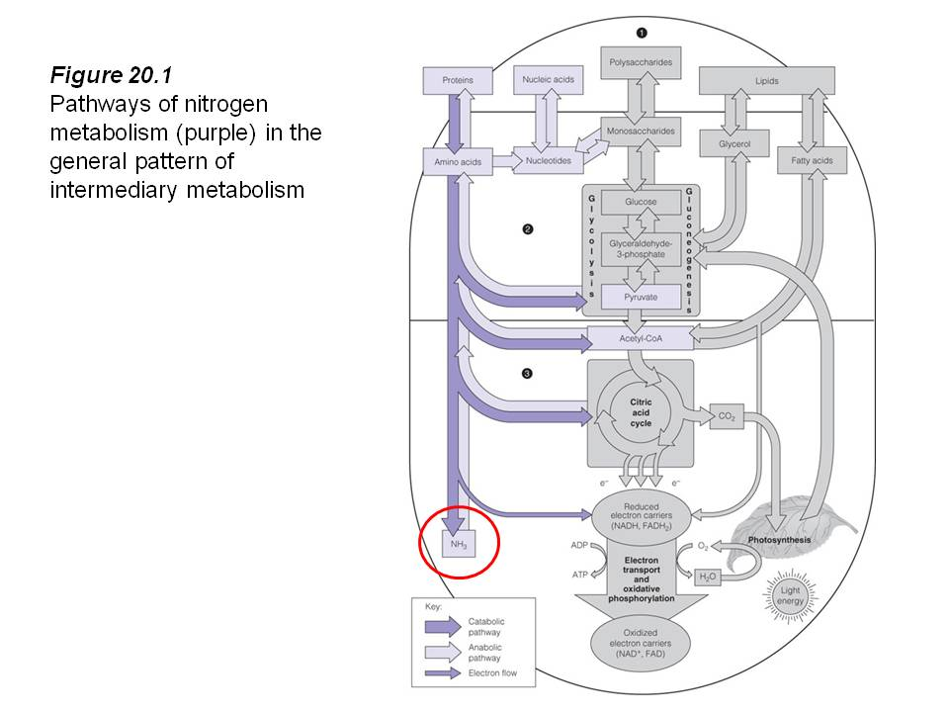

Slide 2
Muscle metabolism
During relaxing time –
90% energy comes from free fatty acid

Slide 3
Muscle metabolism
When exercising–
1. In the beginning : from ATP-CP stored in
muscle
2. 2~3 mins after : from blood sugar
3. 15 mins after : from liver glycogen
( extremely little comes from protein )
4. 30 mins (long term) after : from fat

Slide 4
Kwashiorkor – Vit.A deficiency
Very often seen with VAD is protein energy malnutrition (PEM).
With PEM the synthesis of retinol binding protein (RBP) is decreased, consequently the uptake of retinol is reduced (Combs, 1991).
This leads to an inability to utilise any vitamin A present as the RBP is absent and so the retinol cannot be transported to the liver maximising the VAD (Ikekpeazu 2010)
- From Wikipedia

Slide 5
瞳孔擴張
起因 (推測)：第三對腦神經受壓迫 ：
1. 動脈瘤
2. 頭顱損傷
3. 動脈硬化等血管相關疾病

Slide 6
瞳孔擴張
治療：
需針對個別病因
高壓氧
飲食控制
避免過度焦慮

