Slide 2
Questions 1
What is the basic biochemistry behind the Ethiopian children 's emaciated appearance?

Slide 3
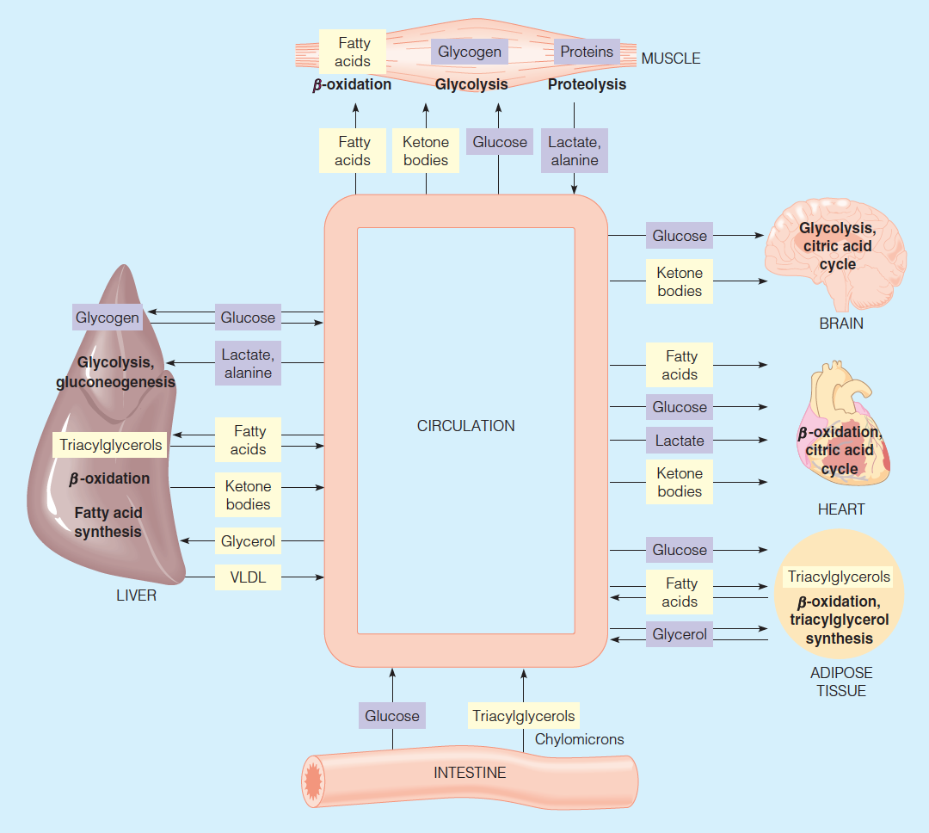

Slide 4
為了維持身體血糖的恆定 , 身體會尋找其他的物質來進行醣質新生的動作。
儘管脂肪是身體所能獲取最重要的能量來源 , 然而 , 由代謝過程可知 , 脂肪事實上並不能作為醣質新生所用的原料 (pyruvate -> acetyl-CoA是單向的) , 因此 , 身體在逼不得已的情況下會開始動用到組成肌肉的蛋白質 , 先將其分解為glucogenic amino acids再用來做糖質新生

Slide 5
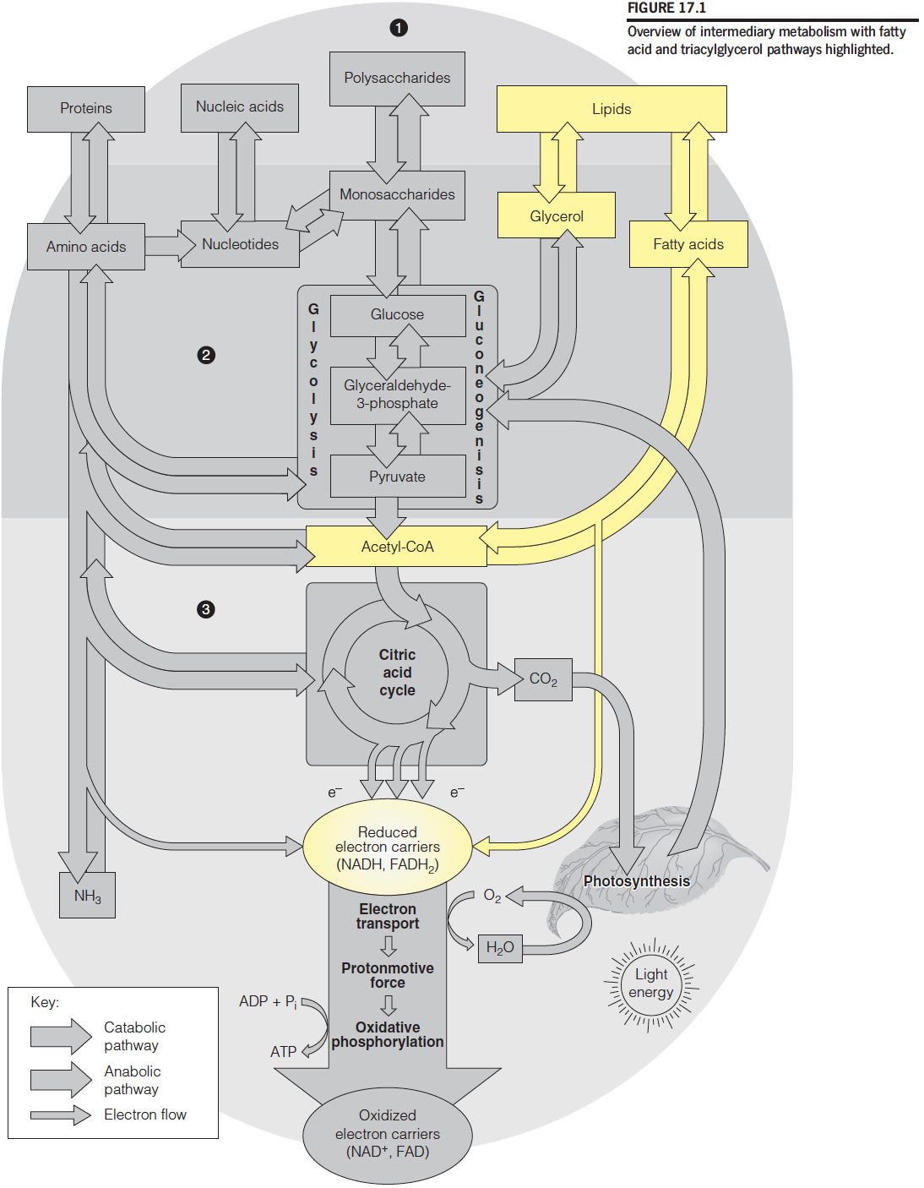

Slide 6
As a result of the widespread famine, the Ethiopian children are suffering from a severe dietary deficiency of protein and energy foodstuffs known as marasmus (from Greek, meaning ‘to waste'). Occurrence of marasmus is not related to climate and used to occur in industrialised areas of Europe.
In the absence of adequate food intake, the body mobilises its fat stores. However, fatty acids cannot be used to maintain blood g1ucose, which is vital for a variety of organs ,particularly the brain, and erythrocytes. Liver glycogen stores are rapidly exhausted, and so muscle protein must be catabolised to provide amino acid carbon sources for gluconeogenesis.

Slide 7
Questions 2
Why do the Sudanese children have oedema?

Slide 8
Serum Albumin
Brief Introduction
(1)Mr 66,000 (2) makes up about half of the total serum protein (3) soluble protein (4) synthesized by liver (5) most abundant plasma protein Function (1) Maintain colloid osmotic pressure (2) Transports thyroid hormones (3) Transports other hormones, in particular, ones that are fat-soluble (noncovalently binds as many as 10 fatty acids per protein monomer)
(4) insoluble fatty acids are carried to tissues such as skeletal muscle, heart, and renal cortex. In these target tissues, fatty acids dissociate from albumin and are moved by plasma membrane transporters into cells to serve as fuel. (5) Transports many drugs; serum albumin levels can affect the half-life ofdrugs (6) Competitively binds calcium ions (7) Buffers pH (8) Prevents photodegradation of folicacid

Slide 9
白蛋白功能？
維持血液滲透壓的恆定:
白蛋白是血漿中含量最多、分子最小、溶解度大、功能較多的一種蛋白質。血液滲透壓的維持主要依靠血漿中的白蛋白，滲透壓是使靜脈端組織間液重返回血管內的主要動力。當血漿白蛋白因病理條件引起下降時，血漿的膠體滲透壓也隨之下降，會導致血液中的水份過多進入組織液而出現水腫。
運輸功能:
血漿白蛋白能與體內許多難溶性的小分子有機物和無機離子可逆地結合形成易溶性的複合物，成為這些物質在血液循環中的運輸形式。由此可見白蛋白屬於非專一性的運輸蛋白，在生理上具有重要性，與人體的健康密切相關。
其它生理功能
對球蛋白的膠體保護穩定作用---
血漿中白蛋白的含量遠比球蛋白多，親水作用又比球蛋白大。當肝臟功能障礙引起白蛋白合成不足時，可使血漿球蛋白失去膠體保護作用，穩定性下降。血漿球蛋白的穩定性下降，將嚴重影響這些物質在體內的代謝、利用，引起相應的症状。
人體內一種重要的營養物質---
白蛋白在血漿中也不斷地進行著代謝更新，血漿白蛋白分解產生的胺基酸，可用於合成組織蛋白，氧化分解以供應能量或轉變成其它含氮物質。
調節激素和藥物的代謝---
具有活性的激素或藥物當與白蛋白可逆結合時，可以不表現其活性，而視為其動態平衡的儲存形式。
d.人血白蛋白是血液製品的一種---
俗稱「生命製品」、「救命藥」。從健康人的血液中提煉加工而成，直接靜脈注射到病人體內，其主要功能是增強人的免疫力和抵抗力。臨床上主要用於失血創傷和燒傷等引起的休克、腦水腫，以及肝硬化、腎病引起的水腫或腹水等危重病症的治療，以及低蛋白血症病人。
e.解毒---
白蛋白是具有黏性、膠質性的物質，在人體內遇到重金屬離子時，會自動與重金屬離子結合，由排泄系統排出體外。因此，食用含白蛋白豐富的食物，可避免重金屬離子的吸收而中毒。
f.對胃壁的保護作用。

Slide 10
Questions 3
Consider the ways in which fats are transported around the body. What does the fatty infiltration of the Sudanese children 's livers suggest about their liver function?

Slide 11
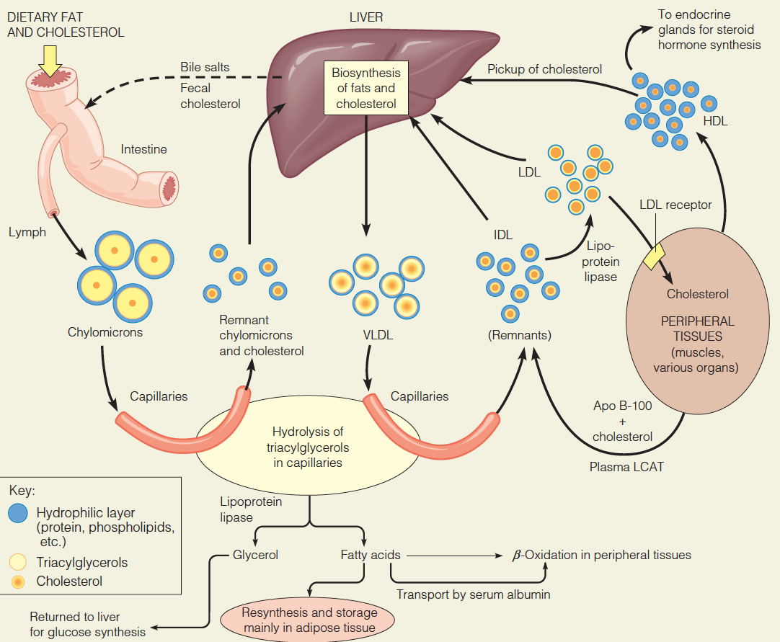

Slide 12
由於肝臟所製造的白蛋白是脂溶性的 , 因此除了可維持血液滲透壓平衡之外 , 期常被用來製造運輸triglycerol所用的apolipoproteins
本案例下 , Sudan孩子們體內缺少製造apolipoprotein的原料 , 因而造成triglycerol無法運出累積在肝臟

Slide 13
Another important biosynthetic role for the liver is to provide apolipoproteins for the formation of serum lipoprotein complexes. These are responsible for the transport of lipids, especially triglycerides, around the body. When lipoprotein synthesis is compromised, lipids accumulate in the liver.

Slide 14
Questions 4
What are microsomes? What do the laboratory tests indicate about the metabolism of aflatoxin B1 in the liver?

Slide 15
In cell biology, microsomes are vesicle-like artifacts re-formed from pieces of the endoplasmic reticulum (ER) when eukaryotic cells are broken-up in the laboratory; by definition, microsomes are not ordinarily present in living cells.
Microsomes are a valuable tool for investigating the metabolism of compounds (enzyme inhibition, clearance and metabolite identification) and for examining drug-drug interactions by in vitro-research. Researchers often select microsome lots based on the enzyme activity level of specific CYPs.

Slide 16
Questions 5
What might be the consequences of the aflatoxin metabolites binding to the DNA of liver cells?

Slide 17
Aflatoxin B1被一個酵素cytochrome-P450 enzymes 代謝成一個較有活性的中間產物Aflatoxin B1-8, 9 epoxide (AFBO)這個中間產物會和肝臟細胞的DNA結合，造成DNA adducts. DNA adducts 會和肝臟細胞DNA的guanine bases反應P53 tumor suppressor gene的突變( at the codon 249 hotspot in exon 7)，並可能導致肝癌。

Slide 18
Questions 6
What could explain the high level of aflatoxin contamination of local foodstuffs in the Sudan?

Slide 19
(非洲因氣候和衛生食物儲存比較容易被黃麴毒素污染可解釋為何肝癌在非洲比較流行)
(1) AFB1 is agenotoxichepatocarcinogen that presumptively causes cancer by inducing DNA adducts, leading to genetic changes in the target cells, which then cause DNA strand breakage, DNA base damage and oxidative damage that may ultimately lead to cancer….Approximately half of human cancers are due to a mutated Tp53 gene
(2) Studies in areas with high exposure to AFB1 have demonstrated that AFB1-related HCC is due to p53 gene mutation;
(3)在paper中也有提到apiaceous vegetables（carrots, parsnips, celery and parsley）可以抑制cytochrome-P450 1A2，間接防止黃麴毒素被活化而形成DNA adduct 、造成p53 mutation…非洲不易取得這些食物應該也是原因之一
5.b型肝炎和肝癌的關係
(1)It was estimated that liver cancer represents approximately 4% of all new cancer cases diagnosed worldwide and that more than 50% of liver cancers were attributable to HBV
(2)The highest age-adjusted incidence rate (> 20 per 100 000) was reported from Southeast Asian and Sub-Saharan African countries that are endemic for HBV infection.
(3)HBV最常見的傳染途徑是垂直傳染和體液交換，而最有效地預防方式則是打疫苗～～這可能是非洲國家HBV較盛行的緣故

Slide 20
Questions 7
Why was feeding large amounts of protein-rich food paradoxically detrimental to the Sudanese children?

Slide 21
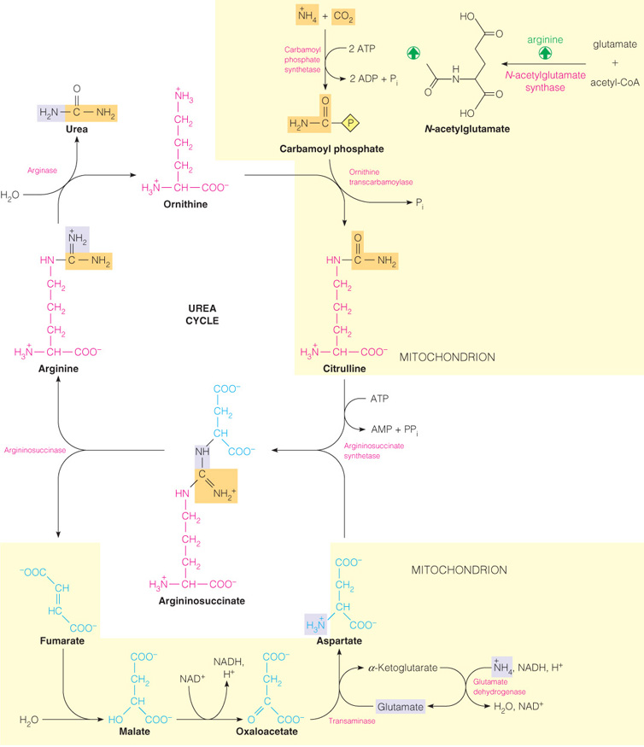

Slide 22
造成紅孩兒症的其中一項可能原因是黃麴毒素造成肝功能受損，而肝臟又是蛋白質進行代謝（deamination ,urea cycle…）的地方當給予過量的蛋白質時,肝臟負荷過重，加速肝臟衰竭
學術一點的說法（生化課本）是肝臟無法負荷過多protein代謝，因此過量的ammonia，而ammonia之所以有毒是因為身體為了代謝它（ 利用deamination , oxidative aminotransferase 的方式）因此會deprive TCA cycle的中間產物和NAD(P)H來固定ammonia ,但這會造成TCA cycle運作效率下降，ATP嚴重不足，此即為氨中毒

Slide 23
Questions 8
How would you recommend the Sudanese relief workers modi their feeding procedures in the future?

Slide 24
紅孩兒症除了蛋白質嚴重不足，也有可能產生自由基和體內對自由基防禦機制之間不平衡所致（Golden and Ramdath proposed that kwashiorkor results from an imbalance between the production of free radicals and their safe disposal.7 This theory is supported by the observations that blood concentrations of vitamin E derivatives, glutathione, and red cell antioxidant enzymes are lower in children with kwashiorkor than in marasmic children
）（有點懶得打～～我明天再解釋）
因此飲食習慣建議有兩個方面：蛋白質補充和vit E 等抗氧化物
蛋白質補充：
動物性蛋白質是最好的食物來源。當地環境食物儲藏不易，牛奶不易儲存，故儘量選擇以動物性蛋白質。若動物性蛋白質不易取得退而求其次，食用植物性蛋白質。但因植物蛋白質中必需氨基酸的種類沒有那麼完備，因此建議一次食用多種的植物（我記得建議的食物是玉米 馬鈴薯 地瓜….但一時找不到那篇論文＠＠）

Slide 25
Further Questions 1
Malnutrition is not simply a matter of dietary insufficiency of protein and/or calories. Vitamins and minerals will also be limited. Vitamin A deficiency is frequently a complicating factor. What is vitamin A, what are its roles and what are the symptoms of its deficiency? From what you can discover about vitamin A transport in the body, can you explain why vitamin A deficiency is particularly noticeable in kwashiorkor?

Slide 26
Vitamin A 的生理功能很多 , 尤其其中最常見廣為人知的即為其在視覺上的重要性 , 因此患有Vitamin A deficiency (VAD)的人們常也會跟著患有Nyctalopia (夜盲症)、Xerophthalmia和Keratomalacia
另外 , Vitamin A同時也具有抗感染的功能 , 因此嚴重缺乏的人們會增加感染疾病的機會(比如measles) , 常見於非洲飢餓的孩子們

Slide 27
由於卡洛里攝取嚴重不足 , Kwarshiorkor基本上會嚴重影響到lipid的吸收量
由於Vitamin A是脂溶性的 , Vitamin A在體內的散佈事實上與乳糜微粒的量有很高的正相關性
依據前述所提 , 由於apolipoprotein的缺乏 , 乳糜微粒的運輸會造成嚴重影響 , 因此相對的Vitamin A的運輸也會出現很大的危機 , 因而可見的患有Kwarshiorkor的孩子們會出席厭嚴重的VAD現象

Slide 28
Vitamin A deficiency (VAD) is a lack of vitamin A in humans. It is common in poorer countries but rarely seen in more developed countries. Nyctalopia (night blindness) is one of the first signs of VAD. Xerophthalmia,keratomalacia, and complete blindness can also occur since Vitamin A has a major role in phototransduction.
VAD also diminishes the ability to fight infections. In countries where children are not immunized, infectious diseases like measles have higher fatality rates. As elucidated by Alfred Sommer, even mild, subclinical deficiency can also be a problem, as it may increase children's risk of developing respiratory and diarrheal infections, decrease growth rate, slow bone development, and decrease likelihood of survival from serious illness.

Slide 29
Iron deficiency can affect vitamin A uptake. Excess alcohol consumption can deplete vitamin A, and a stressed liver may be more susceptible to vitamin A toxicity.
Victims of kwashiorkor commonly exhibit reduced ability to recover fluids, immune system failure, and low lipid absorption, all of which result from a state of severe undernourishment.
Secondary vitamin A deficiency is associated with chronic malabsorption of lipids, impaired bile production and release, and chronic exposure to oxidants, such as cigarette smoke, and chronic alcoholism. Vitamin A is a fat soluble vitamin and depends on micellar solubilization for dispersion into the small intestine, which results in poor use of vitamin A from low-fat diets.

Slide 30
Further Questions 2
From the information given in this problem, can you suggest a reason why hepatoma (liver cancer) is one of the most common forms of cancer in Mrica but is relatively rare in Europe and USA? (See also Problem 14.)

Slide 31
1,Hepatocellular carcinoma (HCC) is the most well-known primary liver malignancy worldwide
2.HCC risk factors: hepatitis B virus (HBV)and HCV infections,aflatoxin B1 exposure, heavy alcohol consumption and iron overload are the most documented(我猜本文應該比較想要探討黃麴毒素xdd)
3.Epidemiological studies indicate that contamination of food with AFB1 is the major risk factor for human liver cancer

Slide 32
Further Questions 3
An outbreak of liver disease in chickens, which decimated the poultry industry in Britain in the early 196 was caused by aflatoxins in peanuts imported for use in poultry feed. As a result, aflatoxin levels in human and animal foods are now routinely monitored. Can you use the information that you have gained in this problem to devise a biochernical test system suitable for this purpose?

Slide 33
純化：專一性抗體親和管
取出：甲醇
螢光分析

Slide 34
Further Questions 4
Which hormones are involved in controlling energy metabolism in starvation? (See also Problems 1, 12 and 18.)

Slide 35
Further Questions 5
Why are fatty acids not gluconeogenic?

Slide 37
由圖可看出儘管fatty acids可轉化成acetyl-CoA進入TCA cycle產生能量 , 卻無法回溯成為pyruvate繼續進行醣質新生的工作

Slide 38
Further Questions 6
In a hitherto wel1-nourished individual who starves, why does muscle catabolism take place at a much higher rate in the fìrst few days than later?

Slide 39
剛開始代謝速率會上升是為了釋放glucogenic amino acids出來作糖值新生 , 儘管到了3~4天糖原耗盡之後 , 為了供應送往大腦的ketone body原料所需 , 會開始分解muscle的protein , 但是量不多 , 所以代謝速率也不大 , 同時muscle會減少接受肝臟製造的ketone body , 然而到了約6、7天時實在無法再繼續分解組織了 , 於是muscle的代謝速率就會在更下降
總之會有這樣的差別應該是一開始是在release glucogenic amino acids出來 , 是短期飢餓的常見現象
所以才會比起後期速率大很多

Slide 40
Further Questions 7
Chronic diahorroea can be fatal .Why is this and how would you treat it?

Slide 41
1)(慢性=多於兩週；腹瀉=24小時內發生三次或三次以上的未成型
的糞便)
腹瀉=腸道吸水功能失效，糞便含水量增加。
=>脫水=電解質失衡=>呼吸急促、休克死亡
2)(文中提到，死因主要是因為無感染抵抗力，而致肺炎及腹瀉
死亡)
1.防止死亡(治徵狀)：
補充口服點滴、靜脈注射
2.處理原因(治本)：
加速復原(補充鋅，增加免疫力)
加速復原(充足營養)
去除感染源(細菌、病毒)
去除降低感染抵抗力原因(黃麴毒素、營養不良)

