Slide 1

Urinary Incontinence
By No.61 Robin

Slide 2
Vocabulary
Urinary incontinence 尿失禁
any leakage of urine or fecal matter (排泄物)
Vaginal 陰道的
of or relating to the vagina (陰道)
Urologic 泌尿科的
pertaining to the scientific study
of the urinary tract (尿道)

Slide 3
Vocabulary
Urethral sphincter 尿道括約肌
one of two muscles used to control the exit of urine
in the urinary bladder through the urethra (尿道)
Urge incontinence 急迫性尿失禁
a form of urinary incontinence characterized by the
involuntary loss of urine
Contraction 收縮
a movement of a muscle that causes it to become
tight

Slide 4
Vocabulary
Detrusor muscle 迫尿肌
muscularis propria (固有肌層) of the urinary bladder
Pelvic floor muscle 骨盆底肌
a muscular partition formed by the levatores ani (提
肛門肌神經) and coccygei (尾部肌群)
Intra - abdominal 腹部內的
being within the abdomen

Slide 5
Vocabulary
Overflow incontinence 溢漏性尿失禁
the involuntary release of urine from an overly full
urinary bladder
Benign 良性的
having a kindly disposition
Autonomic neuropathy 自主神經病變
a condition in which the autonomic nervous
system (ANS) malfunctions

Slide 6
Vocabulary
Prostatic hyperplasia 前列腺增生
an increase in size of the prostate
Spinal cord 脊髓
a long, thin, tubular bundle of nervous
tissue and support cells that extends from
the medulla oblongata (延橋) in the brainstem

Slide 7
Vocabulary
Absorbent 能吸收的
able to take in and hold liquid
Morbidity 發病 ; 罹病率
a diseased condition or state
Mortality 死亡率
the state of being mortal, or susceptible to death

Slide 8
Vocabulary
Urinary retention 尿滯留
a lack of ability to urinate
Foley catheter 導尿管
a flexible tube that is often passed through
the urethra and into the bladder
Intermittent catheterization 間歇性導尿
a medical technique used in conditions where
patients need short term catheter-based
management of the urinary bladder

Slide 9
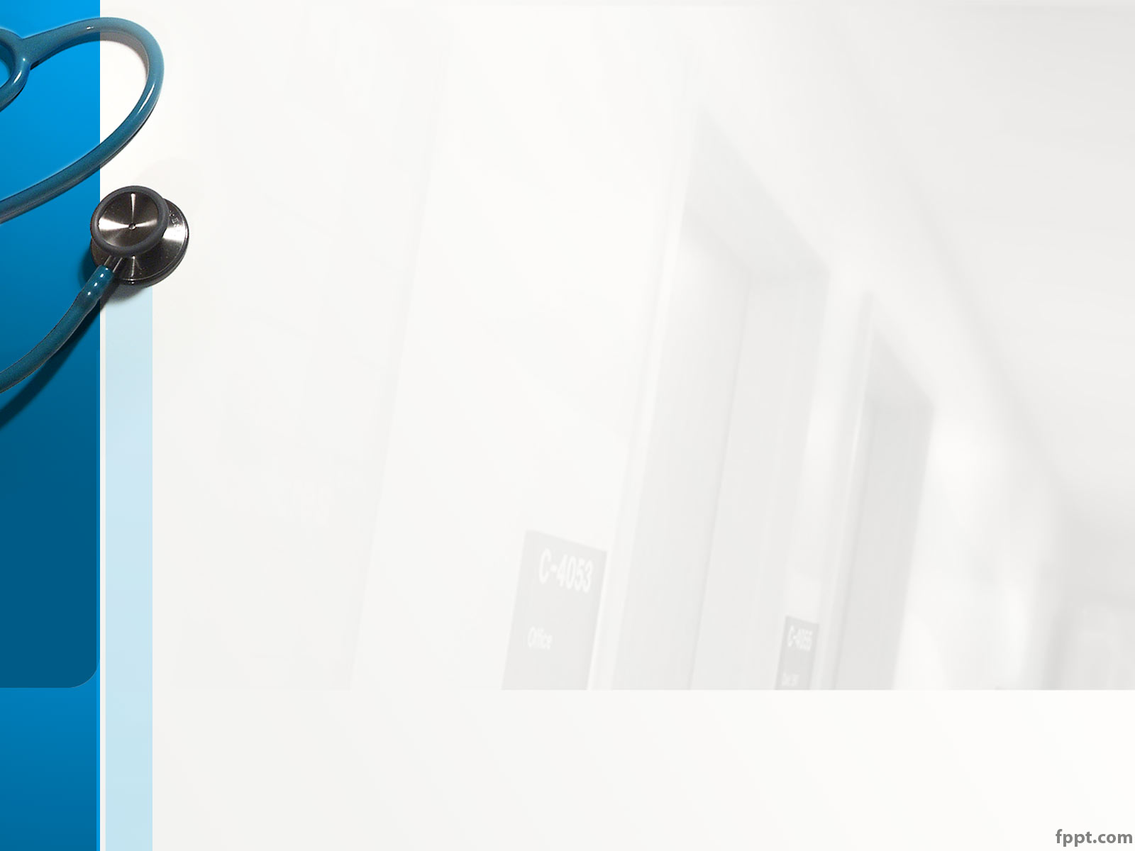
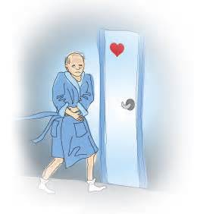
OK ! So ,
what is Urinary Incontinence ??

Slide 10
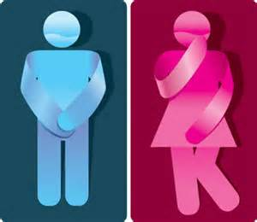
Overview - Introduction
Urinary incontinence is :
the uncontrolled loss of urine

Slide 11
Overview – A neglected Problem
People are too embarrassed to get help ,
But :
Urinary incontinence is a very common problem :
-> Statistics shows that 26000000 adults
have been affected along in America
It indeed can be easily treated and cured
Even more , it sometimes indicates more serious medical conditions
Therefore , they should not be ignored !!

Slide 12
Overview – the Symptom
It’s a symptom rather than a disease
Relate to Urologic & Neurological system
Causes for temporary incontinence :
urinary tract infection , vaginal
infection , constipation , etc .
Causes for persistent incontinence :
weakness of the urethral sphincter ,
overactive bladder , hormone
imbalance in women , etc .
Again , most of them can be easily treated !!

Slide 13
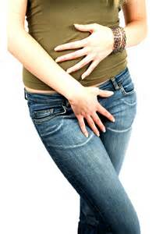
More deeper :
How many kinds of incontinences
are there around our lives ?

Slide 14
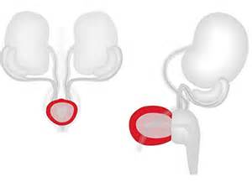
More deeper – Urge incontinence
It usually makes people involuntary loss of urine especially when people want to go to the bathroom
Caused by detrusor muscle contractions
(迫尿肌收縮)

Slide 15
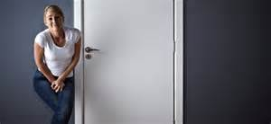
More deeper – Urge incontinence
Those who get it will leak urine when :
1. can’t arrive bathroom in time
2. drink a small amount of liquid
3. hear or touch running water

Slide 16
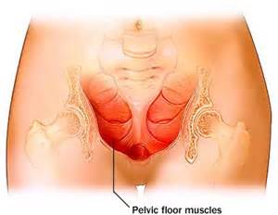
More deeper – Stress incontinence
It usually makes people loss small amount of urine when intra – abdominal pressure (腹部內的壓力) increases
Caused when pelvic floor muscle (骨盆底肌) is weak

Slide 17

More deeper – Stress incontinence
Those who get it will leak urine when :
1. sneeze , cough , or laugh
2. get up from chair or get out of bed
3. walks or does other kinds of activity

Slide 18
More deeper – Overflow incontinence
It usually makes people feel that they never completely empty their bladder (膀胱)
People may experience constant dribbling(流口水) when passing urine
Decreased detection of overfilling and weakened detrusor muscle:
-> caused by automonic neuropathy or spinal cord injury
Increase outlet resistance and blocked urethra
-> caused by tumors , kidney stones , and benign prostatic hyperplasia (良性前列腺增生)

Slide 19
More deeper – Overflow incontinence
Those who get it will :
1. lose small amount of urine often
2. get up often to go to bathroom
3. feel the need to empty the bladder often
4. have difficulty emptying the bladder
5. spend a long time on the toilet
6. produce a weak , dribbling stream of urine

Slide 20
Conclusion
Urinary Incontinence shouldn’t be ignored by people !

Slide 21
Discussion – the questions
Urinary incontinence is really an important problem we shouldn’t ignore . Think about if you are a patient , what actions you should take to cure the symptom ?

Slide 22
Discussion – the questions
Think about when you become the doctor , what will you tell your patients to remember , after seeing the doctor , to supervise and cure the symptom?

Slide 23
Discussion - reference answers
For problem 1 , we could :
For problem 2 , we could:
Clean the skin routinely
Do pelvic muscle exercises
Avoid heavy lifting , etc
Remind them to take the medicines regularly
Always report any side-effects from the medicines
Always report any changes to their healthcare providers , etc

