Slide 1
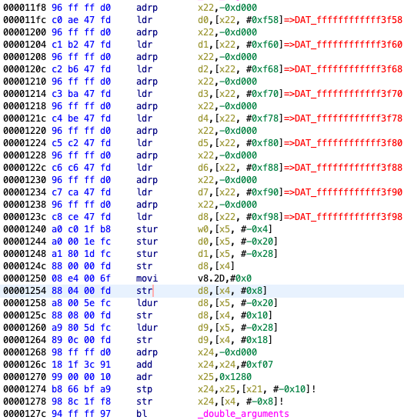
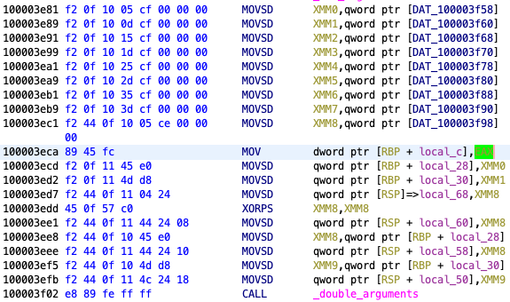
Parameters are passed through registers
Parameters are passed through stack region
Disassembly listing of the AOT file
Disassembly listing of the original binary

Slide 2
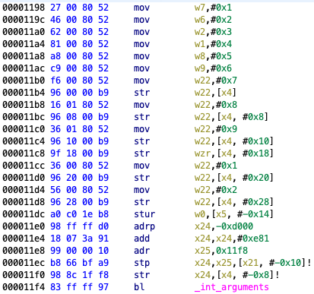
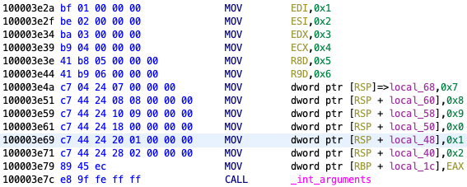
Parameters are passed through registers
Parameters are passed through stack region
Disassembly listing of the AOT file
Disassembly listing of the original binary

Slide 3
Disassembly listing of the AOT file
Disassembly listing of the original binary

Slide 4
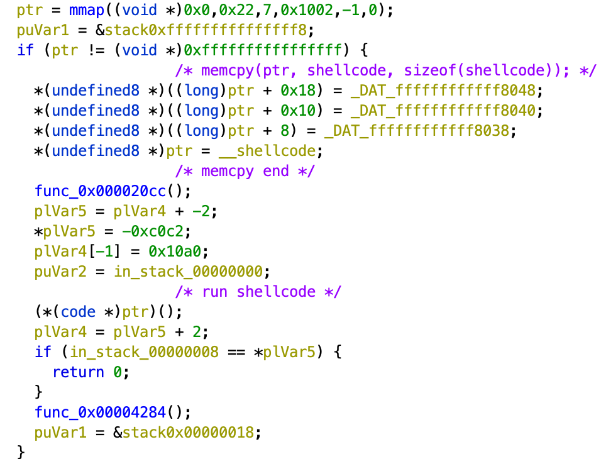
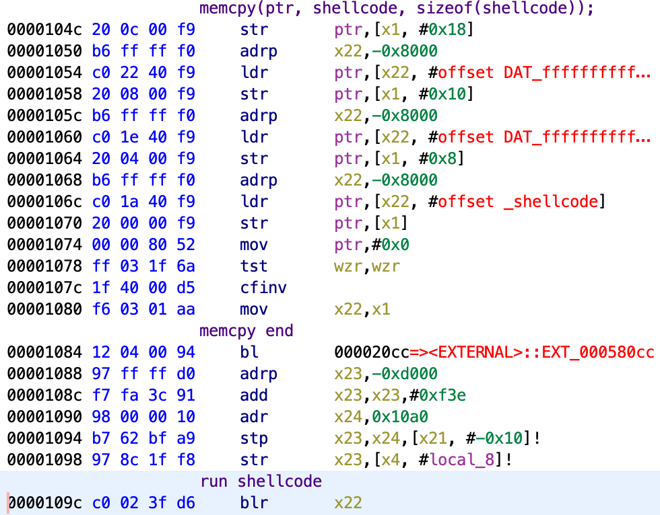
Function call of Rosetta 2 runtime

Slide 5
/var/db/oah/16c678…
00d232…/chmod.aot
023f62…/git.aot
03a2cd…/Python.aot
045e5e…/Xcode.aot
mmap
094be9…/a.out.aot
0c01df…/libmacho.dylib.aot
oahd
Mach IPC
a.out
runtime
a.out.aot

Slide 6
AOT shared cache header
CodeFragmentMetaData
BranchData
MetaData section
InstructionMapData
…
runtime or AOT file
Code section
runtime or AOT file
…

