Slide 1
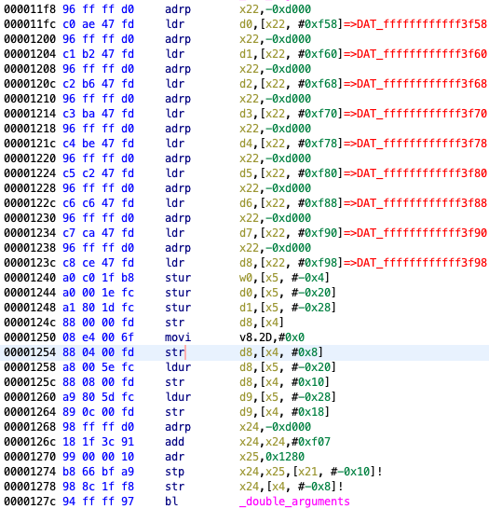
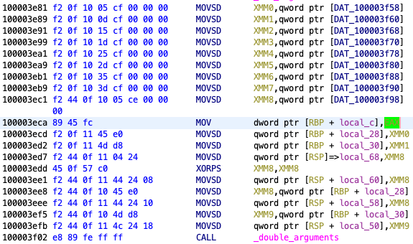
Parameters are passed through registers
Parameters are passed through stack region
Disassembly listing of the AOT file
Disassembly listing of the original binary

Slide 2
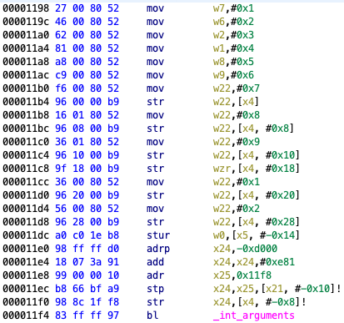
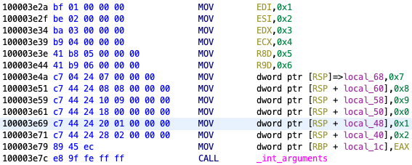
Parameters are passed through registers
Parameters are passed through stack region
Disassembly listing of the AOT file
Disassembly listing of the original binary

Slide 3
Disassembly listing of the AOT file
Disassembly listing of the original binary

Slide 4
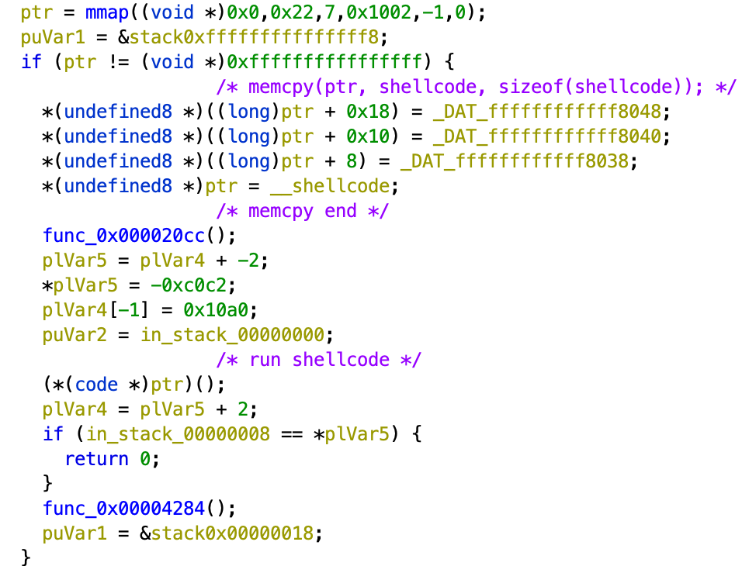
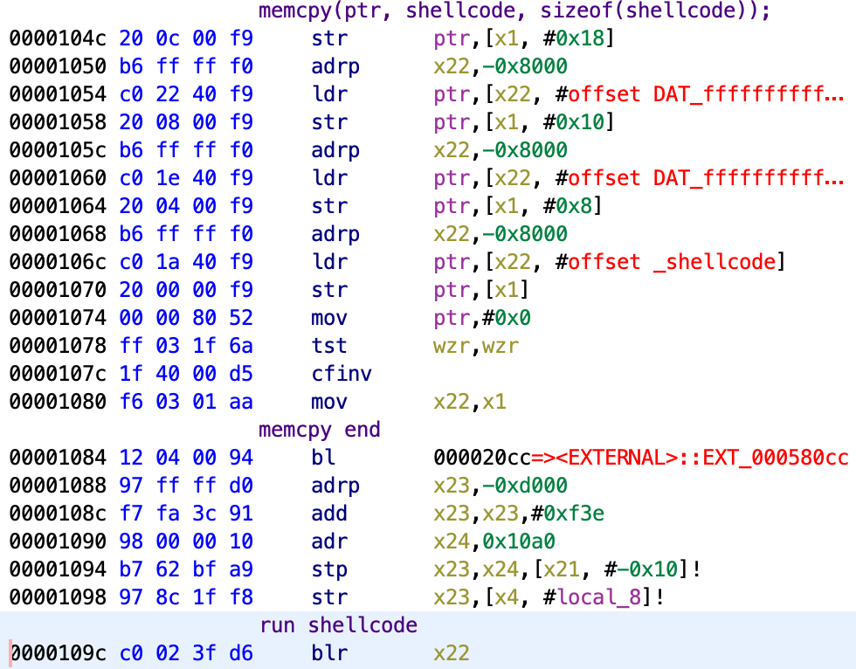
Function call of Rosetta 2 runtime

Slide 5
/var/db/oah/16c678…
00d232…/chmod.aot
03a2cd…/Python.aot
045e5e…/Xcode.aot
(3) memory-mapped for each segment
094be9…/a.out.aot
0c01df…/libmacho.dylib.aot
…
oahd
(2) fd of a.out.aot
(1) fd of a.out
a.out
runtime
a.out.aot

Slide 6
AOT shared cache header
Code fragment meta data
Branch data
Metadata segment
Instruction map
…
runtime
libsystem_blocks.dylib (translated)
AOT segment
libxpc.dylib (translated)
…
Code signature

Slide 7
Mapped
File
AOT shared cache header
AOT shared cache header
Meatdata segment
Meatdata segment
?
AOT Segment
(containing runtime and translated arm64 code)
AOT Segment
(containing runtime and translated arm64 code)
Code signature (not mapped)
Text Segment
(containing x86_64 code and image path names)
Segment mapped
Segment not mapped
Segment not in AOT shared cache file

