Slide 1


Feeds: Personalized Social Platform
Our social media platform is designed for kids, students, premium, and normal users, offering features like profile management, content sharing, notifications, and privacy controls. It ensures safety, engagement, and a user-friendly experience for all age groups.
Contributors
Arnav Ranjan
Atin Chowdhury
Ayush
Gourav Khakse
Vakadani Kavyamrutha

Slide 2
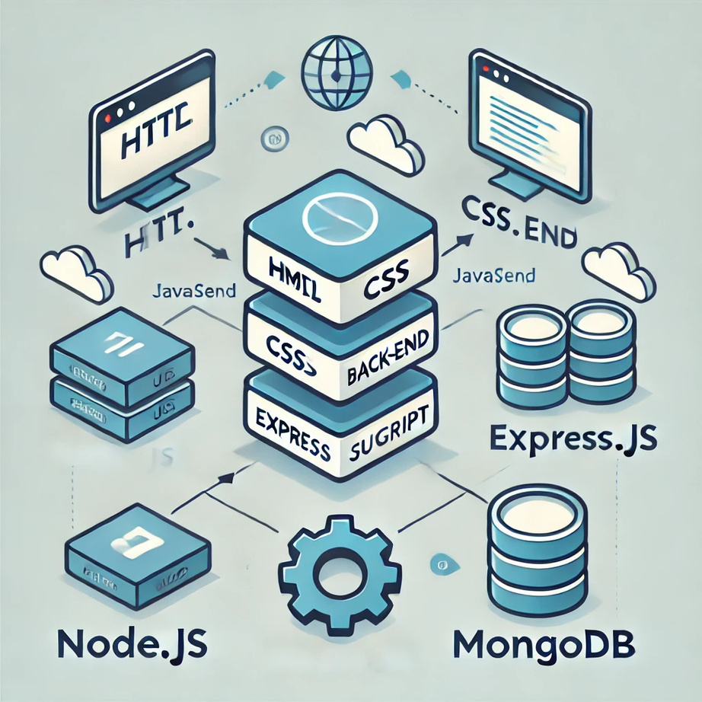
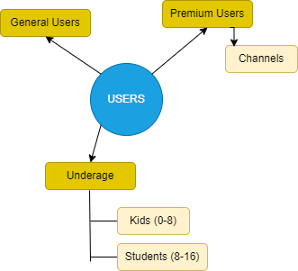


n
TECH STACK
Diverse User Base
Node
-

Slide 3
KEY FEATURES
Pages
Home | Profile | Posts/Reels | Stories
Chats | Games | Connect | Notifications
Direct Message | Help | Terms | Archive
Saved | Daily Usage | Activity | Blocked
User Registration and Profile Management
Content Sharing: Posts, Reels, Stories, and Daily Streaks
Privacy Controls: Incognito Mode, Block/Report Options
Notifications and Activity Tracking
Age-Appropriate Features: Limited screen time and parental controls for kids
Secure Communication: Chats and Direct Messages
Gaming Section: Fun and engaging for all users
Ad-Free Experience for Premium Users
Search and Follow Functionality: Connect with accounts and channels
Revenue Model: Premium subscriptions and targeted ads
Forms
LOGIN | REGISTRATION | EDIT PROFILE
DELETE ACCOUNT | PAYMENT

Slide 4
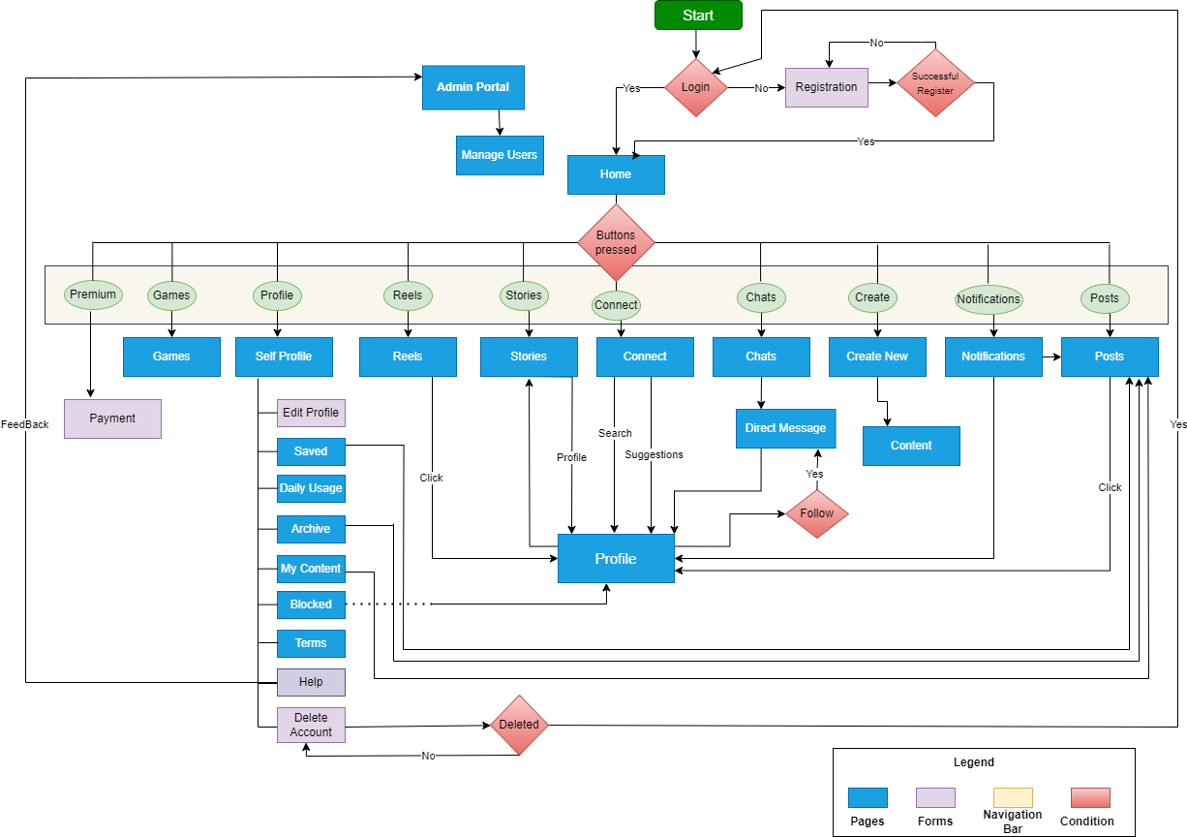
F
L
O
W
C
H
A
R
T

Slide 5
REVENUE MODEL
Premium Subscriptions: Exclusive features like ad-free browsing, incognito mode, and additional customization options.
Targeted Advertisements: Age-appropriate ads for non-premium users.
Partnerships: Collaborations with educational, entertainment, and gaming platforms.
CONCLUSION
The social media platform aims to provide a safe, engaging, and inclusive experience for users of all ages. With its innovative features, user-centric design, and scalable approach, it balances interaction, privacy, and monetization effectively. The project sets the foundation for a future-ready platform fostering meaningful connections.
Thank You

