Slide 1
Lecture 5
STEREOPSIS
Emanuele Trucco
Joint Research Institute on Signal and Image Processing
School of Engineering and Physical Sciences
Heriot-Watt University
e.trucco@hw.ac.uk

Slide 2
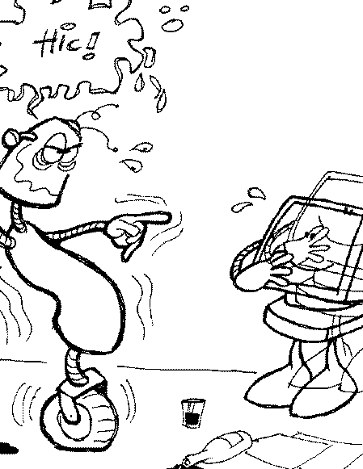
CONTENTS
5.1. About this lecture
5.2. Subproblems, definitions
5.3. Correspondence
5.4. Epipolar geometry
5.5. Reconstruction
5.6. Beyond binocular stereo
5.7. Lecture summary, further readings

Slide 3
5.1. ABOUT THIS LECTURE
Objectives:
To introduce the basic principles of 2-view stereo:
  correspondence
  epipolar geometry
  rectification
  reconstruction
To point to recent developments and approaches
➔ Extension topics in handouts (not in book) marked “ *”

Slide 4
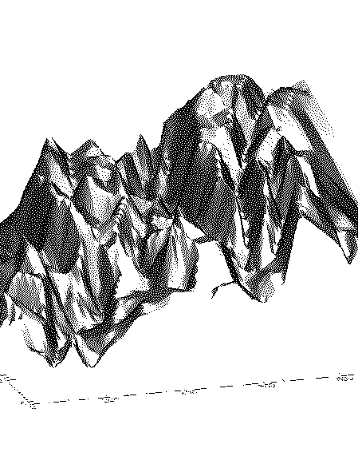
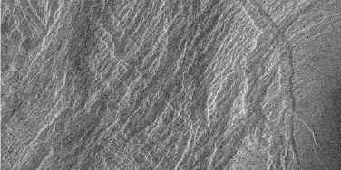
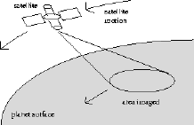
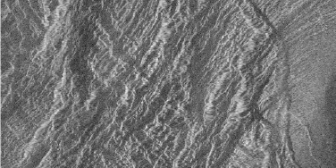
5.2. SUBPROBLEMS AND DEFINITIONS
Textbook: Chapter 7
PROBLEM STATEMENT: infer 3-D information from 2 or more images taken from different viewpoints.

Slide 5
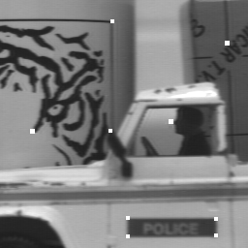
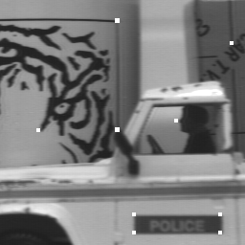
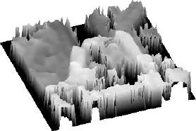
TWO SUBPROBLEMS
PB 1: CORRESPONDENCE. Which parts of the left and right images are projection of the same scene element?
PB 2: RECONSTRUCTION. Given a number of corresponding parts in the left and right images, what is the 3-D location and structure of the observed objects?

Slide 6
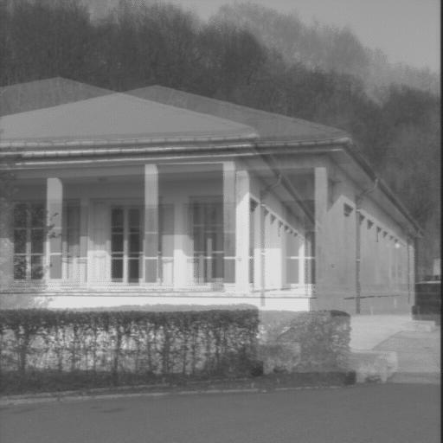
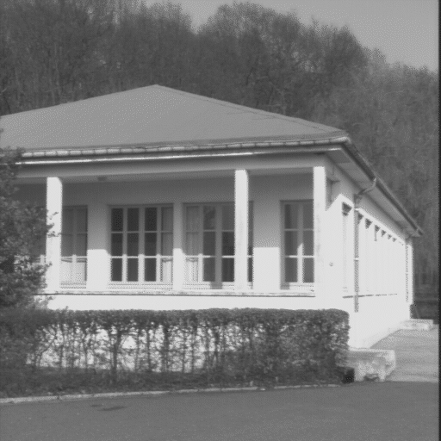
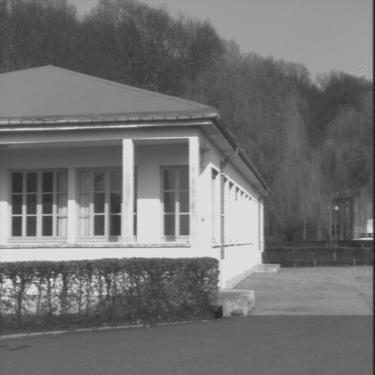
KEY CONCEPT: DISPARITY
DISPARITY OF A PIXEL: the difference vector of the image co-ords of two corresponding points. For example:
CORRESPONDING POINTS
DISPARITY VECTOR
SUPERIMPOSED IMAGE REFERENCE FRAMES
NOTICE
the disparity of a pixel, d , is a 2-D vector in image co-ords
therefore, a stereo pair defines a field of disparity vectors
can compute left-to-right (d_{LR}=p_{L}-p_{R}) or right-to-left (d_{RL}=p_{R}-p_{L})
d_{LR} = d_{RL} not always true !

Slide 7
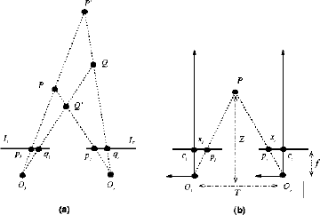
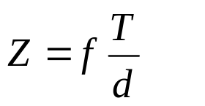

A SIMPLE STEREO SYSTEM (textbook pp. 143-144)
Special and important configuration! Fixation point, F, (=intersection of optical axes) at infinity
Reconstruction by triangulation (given correspondences)
In this simplified config: Depth inversely proportional to disparity. General: disparity increases with distance from special surface (horopter)

Slide 8
5.3. CORRESPONDENCE
PROBLEM STATEMENT: Which parts of the left and right images are projection of the same scene element?
Correspondence is clearly a search problem.
ASSUMPTIONS:
1. Most scene points visible from both cameras
2. Corresponding image regions appear “similar”
We must decide:
a. which image elements to match
b. which similarity measure to adopt.

Slide 9
CORRESPONDENCE ALGORITHMS
(textbook Section 7.2, pp. 145 ff.)
TWO BROAD CLASSES OF CLASSIC ALGORITHMS:
C1. Correlation-based methods
(a) Match image windows
(b) compare them by correlation-like metrics
C2. Feature-based methods
(a) Match image features (textbook Ch. 4, 5)
(b) compare them using distance between
feature descriptors

Slide 10
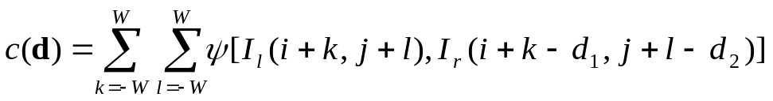

C1. CORRELATION-BASED METHODS
Algorithm CORR_MATCHING (textbook p. 146)
Input: a stereo pair of images, I_{l} (left) and I_{r} (right).
Let p_{l} and p_{r} the pixels in the left and right images; 2W+1 the width (in pixel) of the correlation window, R(p_{l} ) the search region in the right image associated with p_{l} , and ψ_{u,v} a function of the pixel values, u, v .
For each pixel p_{l} =[i,j]^{T} of the left image:
1. For each displacement d=[I_{l} , I_{l} ]T ∈ R(p_{l} ) compute
2. Th disparity of p_{l} is the vector
Ouput: array of disparity (the disparity map), one per each pixel of I_{l} .

Slide 11
CORRELATION-BASED VISUALLY
SEARCH REGION
BEST MATCH
LEFT-IMAGE WINDOW (SAME POSITION AS IN LEFT IMG)
LEFT-TO-RIGHT DISPARITY ESTIMATION

Slide 12



COMPARING WINDOWS: COMMON METRICS
Cross-correlation:
SSD (sum of squared differences):
Absolute value:
NOTICE: often SSD preferable to cross-correlation (why?) (textbook p. 147) . See also normalised SSD and cross-corr. (textbook, exercise 7.3)

Slide 13
COMPARING WINDOWS: COMMENTS
Correlation-like methods yield dense disparity maps: a disparity value at each pixel.
BUT! Not all disparity values make sense (e.g., occlusions, specularities); consistency checks needed,
e.g., d_{LR} ≈ d_{RL} , the left-right consistency constraint
(textbook p. 148)
The size of the correlation window (or support window) depends on the spatial scale of the problem
The size of the search region depends on the maximum expected disparity, often predictable geometrically
Anticipation: the 2-D search region can always be reduced to a 1-D search segment.

Slide 14
C2. FEATURE-BASED METHODS
Algorithm FEATURE_MATCHING (textbook p. 149)
Input: a stereo pair of images, I_{l} (left) and I_{r} (right), and two sets of descriptors of corresponding features.
Let R(f_{l} ) the search region in the right image associated with a feature descriptor f_{l} , and
d(f_{l} , f_{r} ) the disparity between two corresponding features f_{l} , f_{r} .
For each f_{l} in the left image set :
1. Compute the similarity measure between f_{l} and each image feature in R(f_{l} ).
2. Select the right-image feature, f_{r} , that maximizes the similarity measure.
3. Save the correspondence and the disparity of f_{l} (the displacement between the points defining the feature’s position).
Ouput: a list of feature correspondences and associated disparities (disparity map).

Slide 15
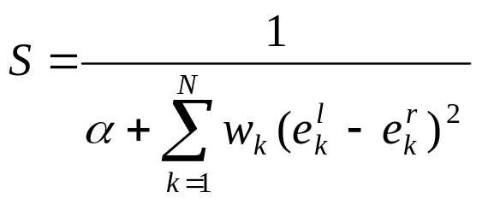
COMPARING FEATURES: COMMENTS
What do feature descriptors and metrics look like?
For instance, for line segments: f = [l , o , x , y , c ]^{T}
    l = length ; o = orientation ;
    x, y = midpoint co-ords; c = average contrast
A simple metric:
e_{k} = k-th element of feature descriptor, f
α = constant to avoid division by 0
w_{k} = weights quantifying relative importance of elements

Slide 16
WHEN SPARSE, WHEN DENSE? *
Depends on the problem ! For instance:
RIGID EGOMOTION: determine constant rotation and translation of a moving camera observing a static scene, given 2 or more consecutive frames.
Constant rigid motion → 6 params to estimate → 6 or more constraints (in practice a few tens) sufficient.
Sparse correspondences sufficient!
VIEW SYNTHESIS: given a stereo pair, synthesize an image of the same scene taken from a third viewpoint.
Every single pixel of the new image must be filled.
Dense correspondences necessary!
Remember: each correspondence generates equations (constraints) linking left and right image co-ordinates; more under “Epipolar geometry”.

Slide 17
5.4. EPIPOLAR GEOMETRY
KEY IDEA: the geometry of a stereo system generates useful constraints linking corresponding points.
We shall use such constraints to reduce the 2-D search region to a 1-D line segment.
Geometric constraints can be expressed algebraically; the 2-camera epipolar geometry is captured by a single matrix (the fundamental matrix).
NOTATION
P_{l} = [X_{l} , Y_{l} , Z_{l} ]^{T}, P_{r} = [X_{r} , Y_{r} , Z_{r} ]^{T} the same 3-D points, P, as a vector in left and right camera co-ordinates
p_{l} = [x_{l} , y_{l} , z_{l} ]^{T}, p_{r} = [x_{r} , y_{r} , z_{r} ]^{T} the projection of P in left and right camera co-ordinates
(Notice! No image co-ords → calibrated!)

Slide 18
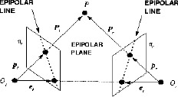
BASICS AND DEFINITIONS
Epipole = projection of an optic centre on the image plane of the other camera.
Epipolar plane = defined by a 3-D point and the two centers of projections.
Epipolar line = intersection of the epipolar plane of a 3-D point and an image plane.
Conjugated epipolar lines = the epip. lines generated by the same 3-D point on the left and right image planes

Slide 19
PROPERTIES
It is easy to realise that:
Only one epipolar lines goes through each image point (apart from the epipole)
All epipolar lines go through the epipole
Corresponding points must line on conjugated epipolar lines
The last property suggests 1-D correspondence search :
given p_{r} , the point corresponding to p_{r} must lie on l !
p_{r}
l

Slide 20



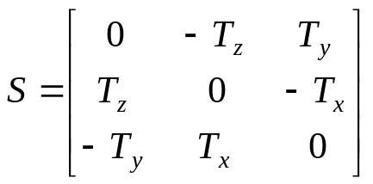



ALGEBRAIC EPIPOLAR GEOMETRY (CALIBRATED)
Write epipolar plane equation:
Use , achieving (7.10)
Write vector product through antisymmetric matrix:
then (7.10) becomes
where E is the ESSENTIAL MATRIX, and E=RS
(7.12) can be re-written as
This is the algebraic constraint yielded by corresponding points, and a mapping btw left and right camera co-ords
(7.12)
(7.14)

Slide 21







ALGEBRAIC EPIP. GEOMETRY (UNCALIBRATED)
All the previous treatment uses camera co-ordinates [mm] !
Now assume corresponding points in image co-ords, ; i.e., no calibration information is available.
Write the transformation image-camera co-ords (textbook Ch 2):
substituting in (7.14):
where F is the FUNDAMENTAL MATRIX.
The implicit coefficients u=[a,b,c]^{T} of the right-camera epipolar line associated to the left-camera point are

Slide 22
E AND F: A SUMMARY OF PROPERTIES
THE ESSENTIAL MATRIX, E
E encodes the epipolar geometry in CAMERA co-ords
If E is known, epipoles and epipolar lines are too (algorithms later)
E satisfies for any corresponding pair of points in camera co-ordinates
E has rank 2, since E=SR, rank(S)=2, rank(R)=3
E has 2 nonzero, equal singular values
THE FUNDAMENTAL MATRIX, F
F encodes the epipolar geometry in IMAGE co-ords
If F is known, epipoles and epipolar lines are too (algorithms later)
F satisfies for any corresponding pair of points in image co-ordinates
E has rank 2, since rank(T_{l})=rank(T_{r})=3, rank(E)=2

Slide 23
COMPUTING F: A CLASSIC ALGORITHM
Algorithm EIGHT_POINT (textbook p. 156)
Input: n point correspondences, n ≥ 8 , in camera co-ordinates.
1. Write (7.18) as a linear system with the unknown vector is formed by the entries of F . Let A be the n×9 system matrix; let A=UDV^{T} be the SVD of A .
2. The solution (up to a scale factor) is the column of V corresponding to the least singular value of A .
3. To enforce singularity numerically, compute the SVD of F, F= UDV^{T} ;
4. Set the smallest singular v alue in D to zero, and let D’ the corrected matrix.
5. The final estimate of the fundamental matrix is
F’ = UD’V^{T}
Ouput: the estimate F’ of the fundamental matrix .
See textbook p.156 for practical advice on numerical stability.
See Luong&Faugeras 1996, Zisserman&Hartley 2001 for alternative algorithms.

Slide 24





COMPUTING THE EPIPOLES
Since the epipole, say , lies on all epipolar lines, we have
for every . Since F≠0, it must be
the epipole is the null space of F; is the null space of F^{T}.
Algorithm EPIPOLES_LOCATION (textbook p. 157)
Input: the fundamental matrix, F .
1. Compute the SVD of F, F= UDV^{T} .
2. Compute e_{l} as the column of Vcorresponding to the null singular value.
3. Compute e_{r} as the column of U corresponding to the null singular value.
Ouput: the epipoles, e_{l} and e_{r} .

Slide 25
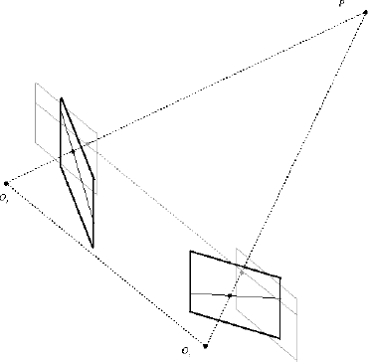
RECTIFICATION
Correspondence search is now a 1-D problem along epipolar lines.
We now want to map epipolar lines to image rows: i.e., in rectified co-ordinates, the corresponding point of p_{l} =[i, j]^{T} must be p_{r} =[i, k]^{T}.
This can be achieved by mapping the original image planes onto new, co-planar image planes.

Slide 26
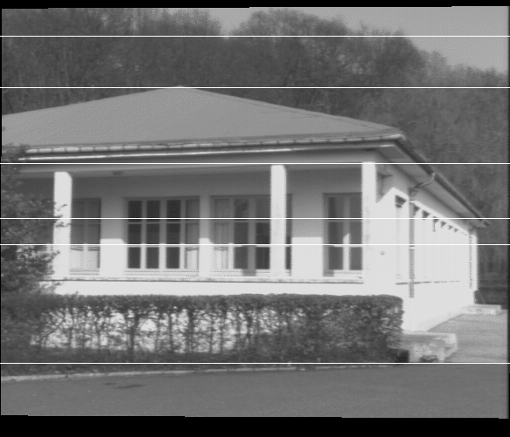
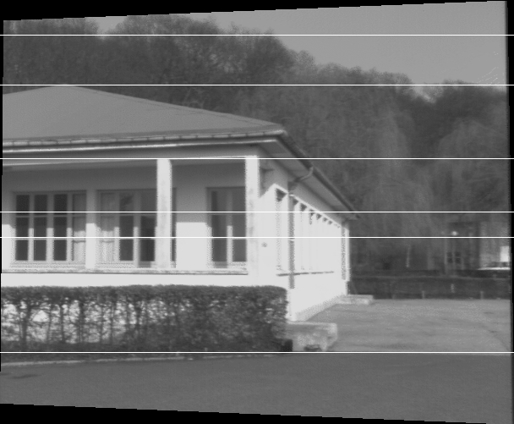
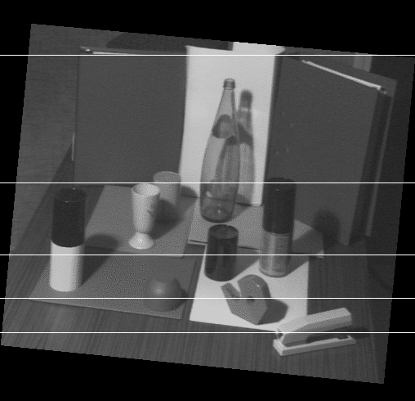
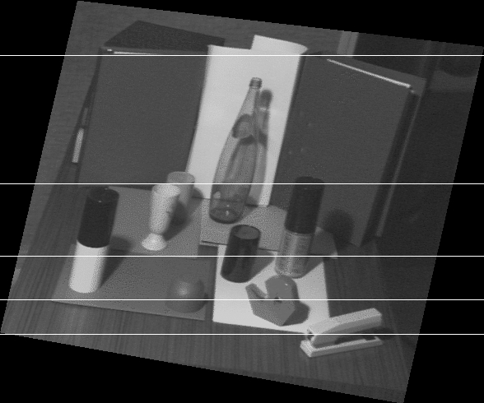
RECTIFICATION VISUALLY
NOTICE distortion of frames (not rectangular)

Slide 27
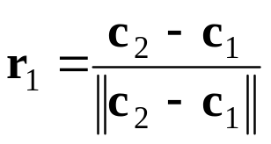


RECTIFICATION ALGORITHM*
KEY IDEA: rotate both cameras around optic centers to get:
1. the new X axis (unit vector r₁) parallel to the baseline:
2. the new Y axis (unit vector r₂) orthogonal to X and to the original Z axis of the left camera:
3. obviously, the new Z axis (unit vector r₃) orthogonal to X and Y:
(Pathological case: Z axis of left camera parallel to baseline )

Slide 28


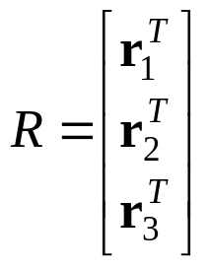



RECTIFICATION ALGORITHM (cont’d) *
We can derive a simple and practical algorithm using projective geometry.
The transformation mapping the original image plane into the new image plane is a collineation, or linear transformation of the projective plane.
It can therefore be expressed by a matrix multiplication.
The rectified (target) PPMs can be written as (exercise!)
in which is built as per previous slide.
Then the rectifying transformations are simply ,
with the original PPMs.

Slide 29
5.5. RECONSTRUCTION
PROBLEM STATEMENT: reconstruct the geometry of the 3-D scene from stereo disparities.
What can be reconstructed given what information?
a. Intr + extr params : absolute co-ords
(complete reconstruction)
b. Intr params only : same but up to scale factor
c. No params at all: same but up to an unknown
projective transformation
NOTICE: we’ll come back to this later (Sect 1.6, p 136, these slides)
We analyse 1, 2, 3 in turn.

Slide 30
a. RECONSTRUCTION BY TRIANGULATION
PROBLEM STATEMENT: given intrinsic and extrinsic parameters, computer the location of 3-D points from their projections, p_{l} and p_{r} .
Key idea: in our assumptions, the projection rays can be computed and so can their intersection in 3-D space.
Caveat: the estimated rays will not usually intersect, as params and image locations are known approximately.
We shall use the point of minimum distance btw the rays to approximate their intersection.

Slide 31
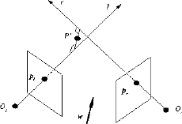

THE SOLUTION (textbook pp.162 ff )
Algorithm TRIANG (summary; see textbook p. 162)
Input: a set of correposnding points; let p_{l} and p_{r} be a generic pair.
All vectors and co-ords are referred to the left camera reference frame.
With reference to the figure above, solve the following system for a, b, c, and determine the mid-point, P’, of the segments joining the two lines and parallel to w (“×” = vector product)
Ouput: the set of estimated 3-D points, one for each pair of corresponding image points.

Slide 32
b. RECONSTRUCTION UP TO SCALE FACTOR
PROBLEM STATEMENT: given intrinsic parameters only, computer the location of 3-D points from n>8 corresponding pairs, p_{l} and p_{r} .
Key idea: unknown baseline implies irrecoverable absolute scale of viewed scene, unless at least one distance in the scene is known.

Slide 33


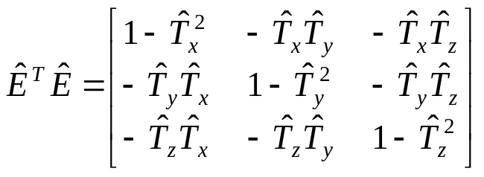



A CLASSIC SOLUTION (textbook pp.162 ff )
TRANSLATION. From the definition of the essential matrix:
so, dividing the entries of E by means normalizing the baseline to unit.
T can be computed from an estimate of E and any row of
where and T is estimated up to a sign.
ROTATION. It can be proven that
where , (i,j,k) span all permutations of 1,2,3, and , with p =1,2,3

Slide 34

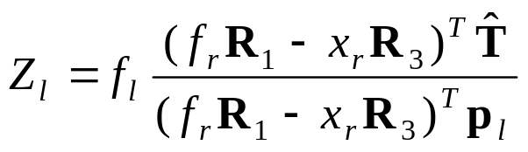
SOLUTION (cont’d)
The above yields 4 estimates for the pair , but
only one has consistent Z co-ordinates.
Z is given by (see textbook p. 165)
where R_{k} is the k-th row of the rotation matrix.
Summary: algorithm EUCLID_REC (textbook p.166).
Notice the numerical warning on p.166 !

Slide 35
c. PROJECTIVE RECONTRUCTION, AND MORE*
PROBLEM STATEMENT: compute the geometry of the scene from only point correspondences.
It is reasonably straightforward to reconstruct point co-ordinates up to an unknown projective transformation (by triangulation)
But this reconstruction is not much use in practice.
As 5 points fix a spatial projective transformation, knowing 5 points in the scene allows one to recover Euclidean co-ordinates.
But there is more!

Slide 36

5.6. BEYOND BINOCULAR STEREO* (pointers)
AUTOCALIBRATION: determining the intrinsic params (and the scene structure) from correspondences only, i.e., from fundamental matrices.
Modern solutions cast in a projective framework.
RESULT: Constant intrinsic params -> 3 views enough
Idea: exploit the so-called rigidity constraint, i.e., given F, there is a pair of intr params matrices (A, A’) , and a rigid motion (t, R) such that
the RC generates equations (constraints) identifying the intrinsic parameters.

Slide 37
BEYOND BINOCULAR STEREO 2* (pointers)
STRATIFICATION: an alternative approach.
Image correspondences only
PROJECTIVE RECONSTRUCTION
Plane at infinity
(vanishing points of 3 orthogonal bundles)
AFFINE RECONSTRUCTION
Absolute conic
(intrinsic params)
EUCLIDEAN RECONSTRUCTION
TRUE STRUCTURE
TRUE STRUCTURE UP TO A SIMILARITY TRANSFORMATION

Slide 38
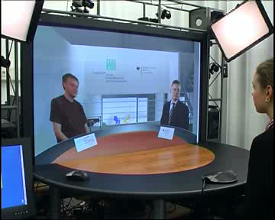
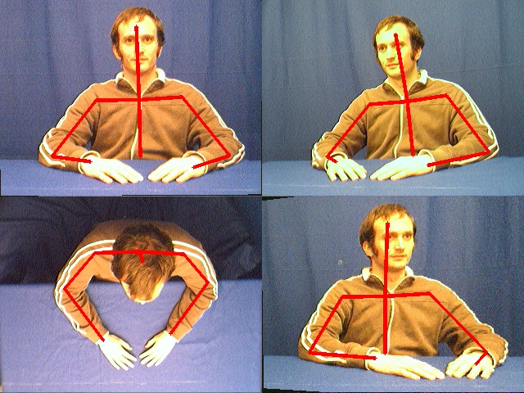
A GLIMPSE ON MULTI-VIEW STEREO*
FITTING BODY MODEL TO MULTI-VIEW SEQUENCES
(Ivekovic et al, IEEE CEC 2006; Robertson and Trucco BMVC 2006)
IMMERSIVE VIDEOCONFERENCING
(Trucco et al, IEEE Xsact CSVT, 2004)
Video courtesy of Fraunhofer HHI

Slide 39
CORRESPONDENCE: RECENT DEVELOPMENTS
Dense correspondence algorithms: ranked list and evaluation at www.middlebury.edu/stereo
Current best performers: composite techniques = combining multiple methods and cues, e.g., colour segmentation, plane fitting, and belief propagation (see further readings)
Popular recent paradigm: graph cuts (see further readings)

Slide 40
5.7. LECTURE 4: TAKE-HOME MESSAGES
The main subproblems of stereo are correspondence and reconstruction.
Correspondence (image points projection of same scene points) is a search problem.
The epipolar geometry (epipoles, epipolar lines) reduces this search to a 1-D problem.
The EG is specified by the fundamental matrix, F.
F can be estimated from image correspondences only.
Reconstruction (estimating co-ords of scene points): how complete depends on how much is known.
Fully calibrated (intr+extr known)-> absolute 3-D co-ords
Uncalibrated (corr.s only) -> up to similarity transform.
Self-calibration and stratification: modern, unified paradigms.

Slide 41
SOME REFERENCES*
Geometry of stereo and multi-view
Hartley and Zisserman: Multiple-view geometry in computer vision, CUP, 2002.
The definitive book on multi-view vision from a geometric viewpoint.
Correspondence
Scharstein and Szeliski, A taxonomy and evaluation of dense two-frame stereo correspondence algorithms, Int Journ of Comp Vision, 47(1-3), 2002.
A recent, extensive, experimental comparison of tens of correspondence algorithms.
Accompanying website with continuously updated ranking of stereo algorithms.
Pollard, Mayhew, Frisby, A stereo correspondence algorithm using a disparity gradient limit, Perception vol 14, 1985.
Early treatment of stereo constraints (still valid!).
Tomasi and Manduchi, Stereo matchgin as nearest neighbor problem, IEEE PAMI 20(3), 1998.
An example of feature-based correspondence with nontrivial features
Marchand et al: Robust real-time visual tracking using ...., Proc IEEE ICCV 1999.
Example of finding correspondences indirectly, as a by-product of a pose algorithm.
Autocalibration, stratification, multi-view
Hartley and Zisserman (see above)
Mendonça and Cipolla, A simple technique for self-calibration, IEEE CVPR, 1999.
Hyden and Astrom, Euclidean reconstruction from constant intrinsic parameters, Int Conf on Pattern Recogn, Vienna, 1996.
Trivedi, Can multiple view make up for lack of camera registration?, Image and Vision Computing 6(1), 1988.

Slide 42
SOME REFERENCES (cont’d)*
Top performers in Middlebury stereo page (Nov 2006)
1) A. Klaus, M. Sormann and K. Karner, Segment-based stereo matching using belief propagation and a self-adapting dissimilarity measure. Proc Int Conf on Pattern Recognition, ICPR 2006.
2) Yáng, L. Wang, R. Yang, H. Stewénius, and D. Nistér, Stereo matching with color-weighted correlation, hierarchical belief propagation and occlusion handling. Proc IEEE Conf on Comp Vision and Pattern Recognition CVPR 2006.
3) J. Sun, Y. Li, S.B. Kang, and H.-Y. Shum, Symmetric stereo matching for occlusion handling. Proc IEEE CVPR 2005.
Graph cuts
V. Kolmogorov and R. Zabih, Computing visual correspondence with occlusions using graph cuts. Proc IEEE Int Conf on Comp Vision ICCV 2001.
V. Kolmogorov and R. Zabih, Multi-camera scene reconstruction via graph cuts. Proc European Conf on Comp Vision ECCV 2002.

