Slide 1
Getting started with (modern) Python packaging
Filipe Laíns (@FFY00)
@MissingClara / @MissingClara@gensoukyou.jp.net

Slide 2
About Me
Involved in Python packaging for 3 years
Involved Linux distribution packaging for 5 years
Upstream maintainer for:
  pypa/build (as in pip install build)
  Python (sysconfig, import system, etc)
  Arch Linux (Python, hardware dev tooling, etc)

Slide 3
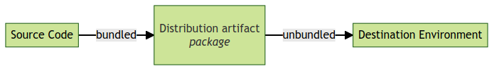
What is packaging?
What? A solution for sharing code between people.
How? By bundling into something you can easily share with others.

Slide 4
What is required?
A distribution format
  Usually it consist of a single file (often a ZIP)
  Contains your code
  Generally includes some metadata (project name, version, etc.)
Extras
  A package repository (peferably standardized)
  Etc.

Slide 5
What does it look like in Python?
Distribution format
  Source: sdist (.tar.gz — uh... usually)
  Binary: Wheel (.whl)
Package repository: PyPI (Python Packaging Index)

Slide 6
How, but I don’t know how these things work...
You don’t need to!
We have something called build backend
Build backends implement this for you

Slide 7
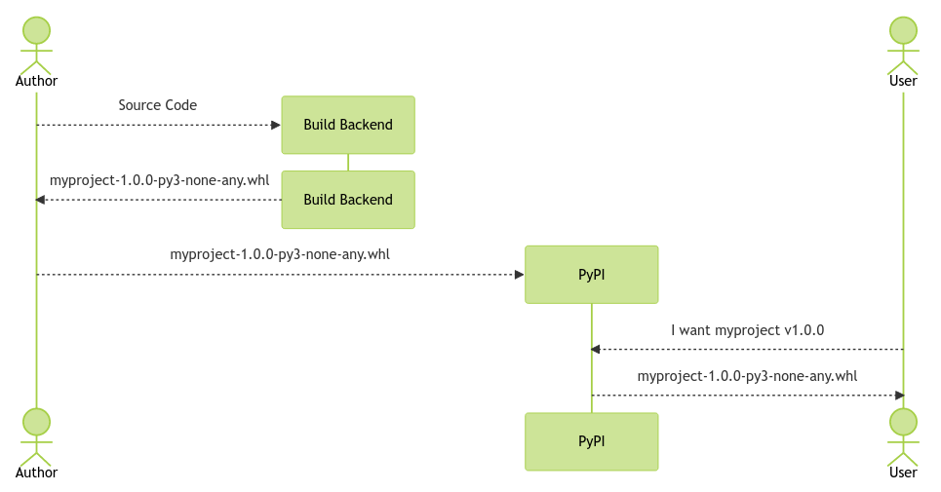
Releasing a package

Slide 8
The old way
You have probably seen a setup.py file
  This used to be how you packaged Python projects
Some (very simplified) history
  distutils was added to the Python standard library
    Slow to update because it’s tied to the Python installation
    Could not support all possible use-cases
  People started write alternatives outside the stdlib
  After a while setuptools emerged as the de-facto choice
  pip was created and effectively solidified setuptools as the only choice

Slide 9
Modern Python Packaging
Standardized an interface for build backends
  Now anyone can write their build backend
  We are no longer limited to setuptools
  It made it easier to write new package managers and other kinds of packaging tooling

Slide 10
Getting started
Choose a build backend
  setuptools (good for general purpose)
  flit (pure-Python only)
  hatch (more integrated dev experience)
  poetry (more integrated dev experience)
  pdm (more integrated dev experience)
  maturin (for Rust)
  meson-python (for using Meson as the build system)
  Scikit-build (for using Cmake as the build system)
  Etc.

Slide 11
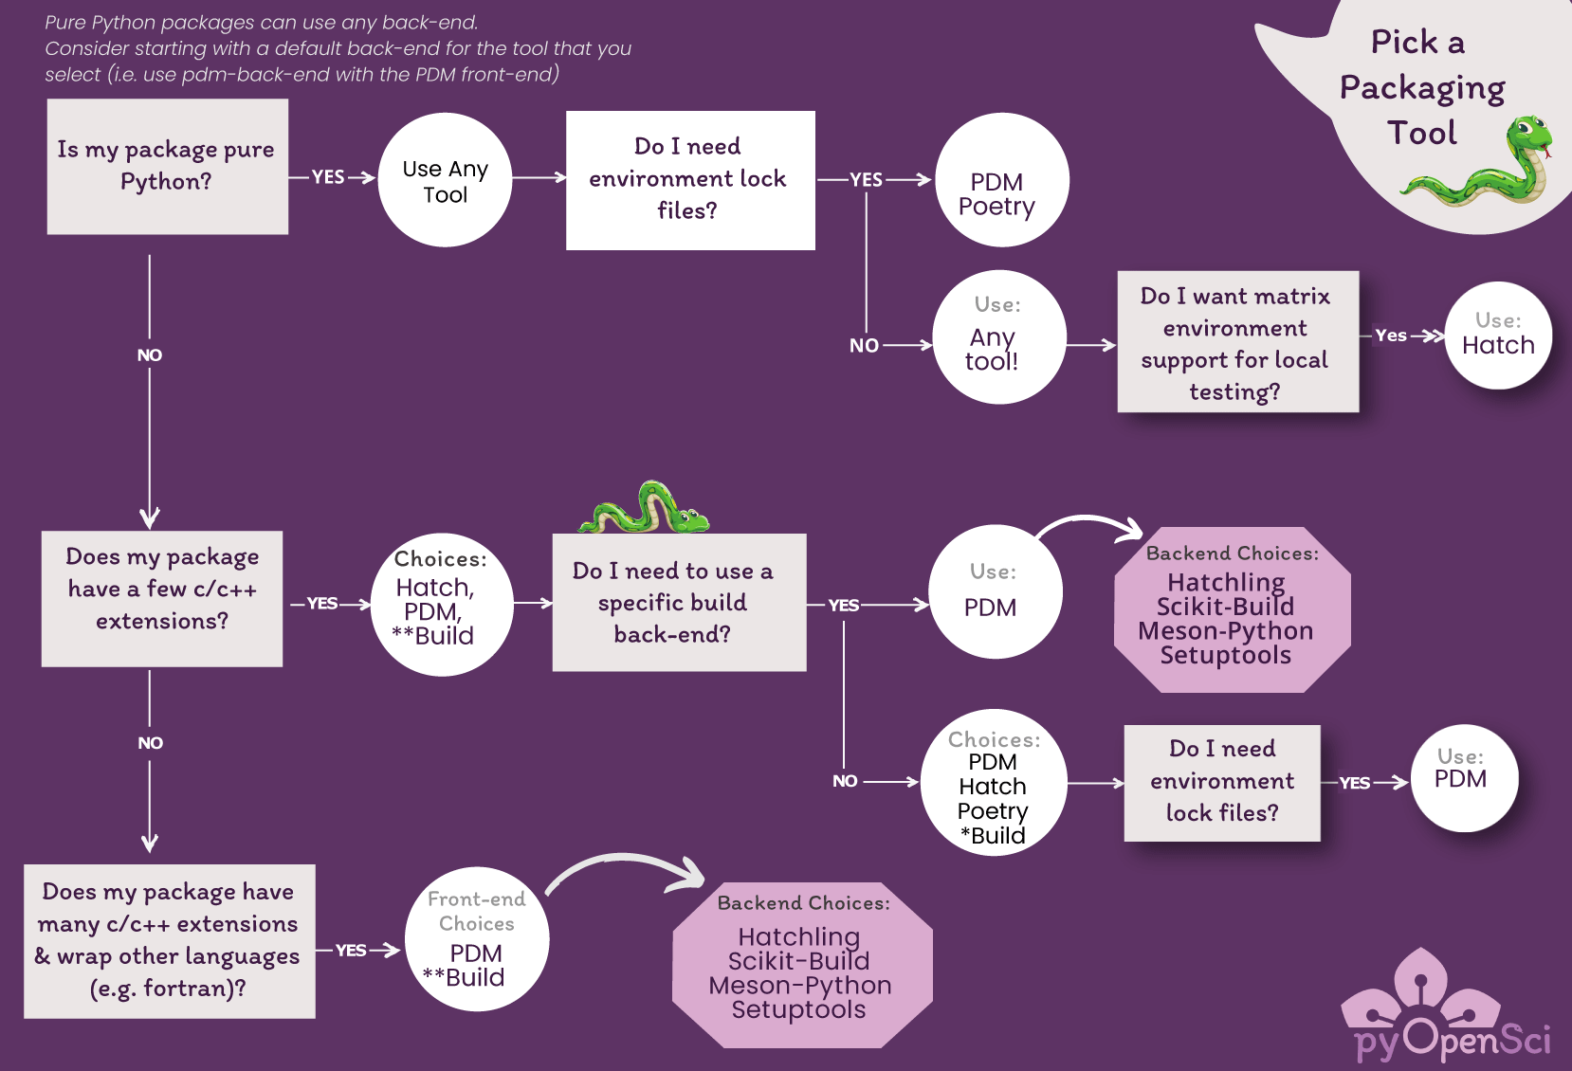
Guidance (for choosing a build backend, etc.)
I recommend looking at the pyOpenSci packaging guide

Slide 12
Creating a project
Look at the documentation for the build backend you are using
Create a pyproject.toml file (at the root of your project)
Specify the build backend and build dependencies
[build-system]
requires = ['hatchling']
build-backend = 'hatchling.build'

Slide 13
Creating a project (cont.)
Add the project metadata
  There’s a standardized way to specify project metadata in pyproject.toml
    See Declaring project metadata (PyPA specifications)
    Not all build systems support it!

Slide 14
Creating a project (cont.)
...
[project]
name = 'myproject'
version = '1.0.0'
description = 'Our example Python project'
requires-python = '>=3.8'
license = {file = 'LICENSE'}
authors = [
{name = 'Filipe Lains', email = 'lains@riseup.net'},
]

Slide 15
Sharing the project
Building
  (install pypa/build) pip install build
  python -m build
Uploading it to PyPI
  (install twine) pip install twine
  twine upload dist/*
    To upload to TestPyPI you can pass the -r testpypi option
Note: Some build backends (eg. flit, hatch, poetry) have their own CLI, which may support these fatures (and even more).

Slide 16
Thank you
Questions?
Slides available at https://github.com/FFY00/talks
Feel free to find me afterwards if you want to talk about packaging 😅

