Slide 1
SLIM: Sliced Distributed Container Migration

Slide 2






“Simple” Migration: Backup and Restore
The entire container image is transferred from the source to the destination
Steps
Migration request issued to both nodes
Backup of the container at the source (backup)
Backup sent to the destination
Backout extraction and new container started at the destination (restore)
The source gets notified when the new instance is up and running
User-service handover from source to destination
(Original container stopped at the source)
Migration request status updated to completed
m
5
Migr. req
1
Migr. req
n₁
3
n₂
2
4
5

Slide 3
Open Issues
Overhead Issues
Higher MEC node load for the migration steps (pre-copy, etc.)
Higher bandwidth utilization between the source and the destination
Application/Service Specific Issues
The increased total migration time affects the service continuity
The application Quality of Service (QoS) suffers due to the downtime
The migration overhead reduces the network capacity for the data plane operations

Slide 4
Proposed Solution
SLIM: Sliced Distributed Container Migration
The target node, instead of requiring the source to send the entire containerized service (base image + storage + runtime state), may obtain some parts of it from neighboring nodes that have a copy of the same information
Coordination among edge nodes
Allows efficient migration for “popular” services (caching and shared layers among containers)
Reduces total migration time to cope with high-mobility and highly dynamic environments
Reduces the overhead (source node load and network bandwidth) by re-distributing it to the other nodes
Enables further improvements by exploiting pre-distribution based on predictions

Slide 5
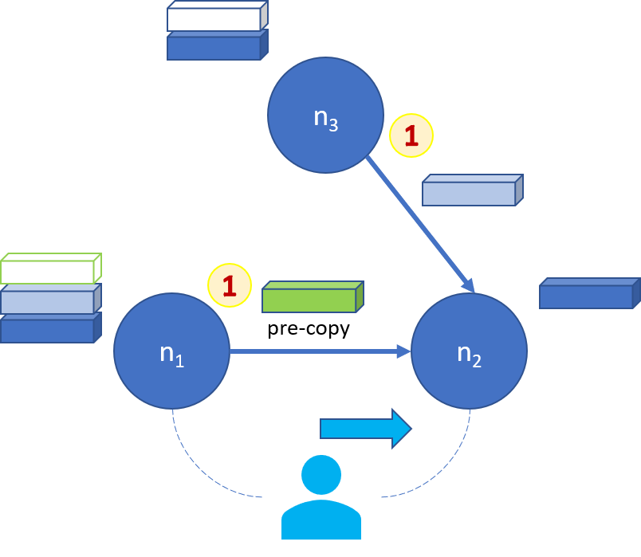
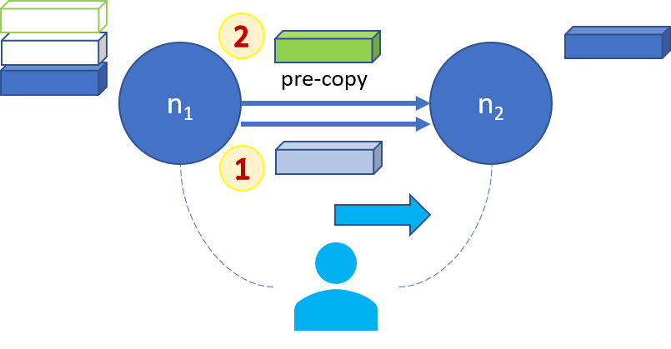
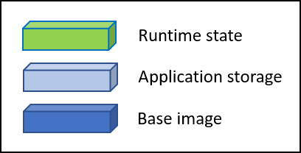
Approaches
Traditional migration
Cooperative migration

Slide 6
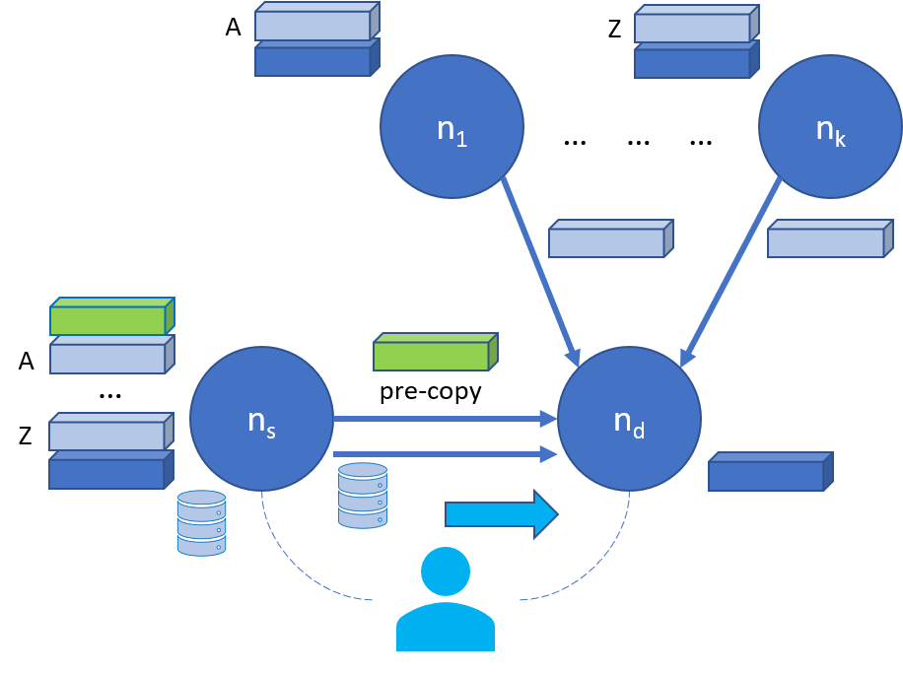
Reference Architecture: Shared Layers
Base image (blue)
Common to all services, it can be pre-distributed on all nodes
Application storage (light blue)
Application “idle” files and dependencies → Read-only layers
Infrequently updated user-specific data → Storage volumes
Runtime state (green)
Application and user state in memory (RAM)
User-specific persisted state (frequent write) → Writable layer

Slide 7
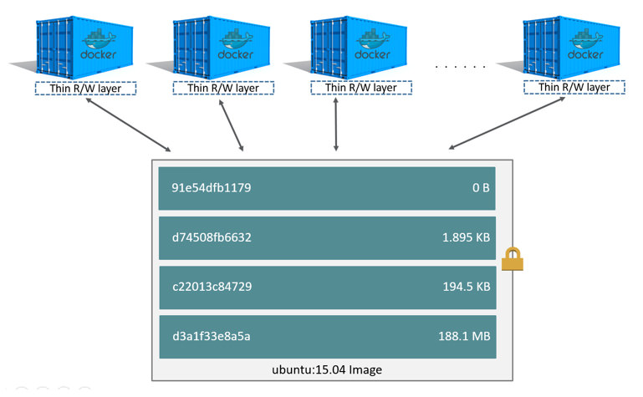
Technology: Docker
Utilizes a union file system through a storage driver
It implements a union mount for a stack of layers
Each container has its own writable layer (container layer)
As changes are written to the container layer, the underlying layers can be shared
The storage driver hides the details about how these layers interact with each other
It handles volumes to store data
They survive containers deletion
They can be safely shared among containers
They provide better performance compared to Docker’s UnionFS

Slide 8
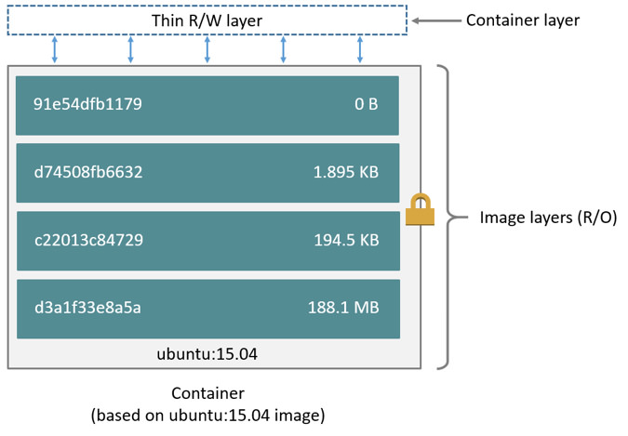
Docker Image (with layers)
A Docker image is built up from a series of layers
Each layer represents an instruction in the image’s Dockerfile
Each layer except the last one (the container layer) is read-only
Read-only layers can be shared among multiple containers
Sample Docker File
FROM node:6.14.2
EXPOSE 8080
COPY server.js .
CMD node server.js

Slide 9
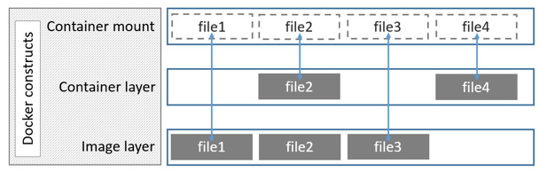
Layered File System
It uses Copy-on-Write
It reads from the top-most file with the same name
The implementation depends on the storage driver in use (e.g., overlay2)

Slide 10

Decentralized Layered Migration
Image layers not already present are transferred from the source to the destination
Layers are stored and distributed through the destination’s Registry
Steps
Migration request issued to both nodes
The source uploads the container image layers (push)
The destination gets notifies when this is done
Those already present locally are not uploaded
The destination downloads the layers it needs (local pull)
New container started at the destination
The source gets notified when the new instance is up and running
User-service handover from source to destination
(Original container stopped at the source)
Migration request status updated to completed
m
1
5
Registry
3
n₁
2
n₂
4
5
*Registry can be at multiple places

Slide 11

Use-cases and Topology
Intra-cluster migration: single cluster with decentralized registry
Stateless migration: stateless service (no session/per-user state) and no request state migration
Stateful migration: stateful service with writable volumes
Client application: Real-time image processing
N1
Registry
SRC
DST
N2

Slide 12
Case | Delay (ms) | Layer Size | Load
1 | 0 | 100 KB | S > D
2 | 0 | 100 KB | D > S
3 | 0 | 100 KB | S = D
4 | 0 | 1 MB | S > D
5 | 0 | 1 MB | D > S
6 | 0 | 1 MB | S = D
7 | 0 | 10 MB | S > D
8 | 0 | 10 MB | D > S
9 | 0 | 10 MB | S = D
10 | 0 | 100 MB | S > D
11 | 0 | 100 MB | D > S
12 | 0 | 100 MB | S = D
13 | 1 | 100 KB | S > D
14 | 1 | 100 KB | D > S
15 | 1 | 100 KB | S = D
16 | 1 | 1 MB | S > D
17 | 1 | 1 MB | D > S
18 | 1 | 1 MB | S = D
Case | Delay | Layer Size | Load
19 | 1 | 10 MB | S > D
20 | 1 | 10 MB | D > S
21 | 1 | 10 MB | S = D
22 | 1 | 100 MB | S > D
23 | 1 | 100 MB | D > S
24 | 1 | 100 MB | S = D
25 | 5 | 100 KB | S > D
26 | 5 | 100 KB | D > S
27 | 5 | 100 KB | S = D
28 | 5 | 1 MB | S > D
29 | 5 | 1 MB | D > S
30 | 5 | 1 MB | S = D
31 | 5 | 10 MB | S > D
32 | 5 | 10 MB | D > S
33 | 5 | 10 MB | S = D
34 | 5 | 100 MB | S > D
35 | 5 | 100 MB | D > S
36 | 5 | 100 MB | S = D
Emulation Parameters
Stateless Application

Slide 13
Case | Delay (ms) | Vol. Size | Load
1 | 0 | 100 KB | S > D
2 | 0 | 100 KB | D > S
3 | 0 | 100 KB | S = D
4 | 0 | 1 MB | S > D
5 | 0 | 1 MB | D > S
6 | 0 | 1 MB | S = D
7 | 0 | 10 MB | S > D
8 | 0 | 10 MB | D > S
9 | 0 | 10 MB | S = D
10 | 0 | 100 MB | S > D
11 | 0 | 100 MB | D > S
12 | 0 | 100 MB | S = D
13 | 1 | 100 KB | S > D
14 | 1 | 100 KB | D > S
15 | 1 | 100 KB | S = D
16 | 1 | 1 MB | S > D
17 | 1 | 1 MB | D > S
18 | 1 | 1 MB | S = D
Case | Delay | Vol. Size | Load
19 | 1 | 10 MB | S > D
20 | 1 | 10 MB | D > S
21 | 1 | 10 MB | S = D
22 | 1 | 100 MB | S > D
23 | 1 | 100 MB | D > S
24 | 1 | 100 MB | S = D
25 | 5 | 100 KB | S > D
26 | 5 | 100 KB | D > S
27 | 5 | 100 KB | S = D
28 | 5 | 1 MB | S > D
29 | 5 | 1 MB | D > S
30 | 5 | 1 MB | S = D
31 | 5 | 10 MB | S > D
32 | 5 | 10 MB | D > S
33 | 5 | 10 MB | S = D
34 | 5 | 100 MB | S > D
35 | 5 | 100 MB | D > S
36 | 5 | 100 MB | S = D
Emulation Parameters
Stateful Application
Layer size=10 MB
Change Volume=10%

Slide 14
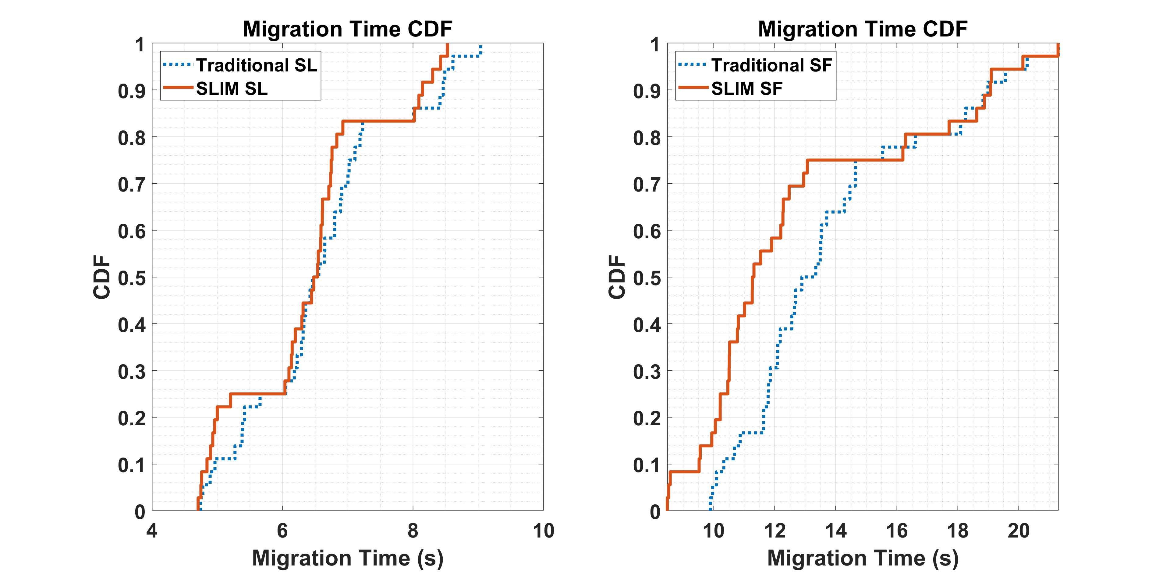
Migration Time CDF
*Ongoing work

Slide 15
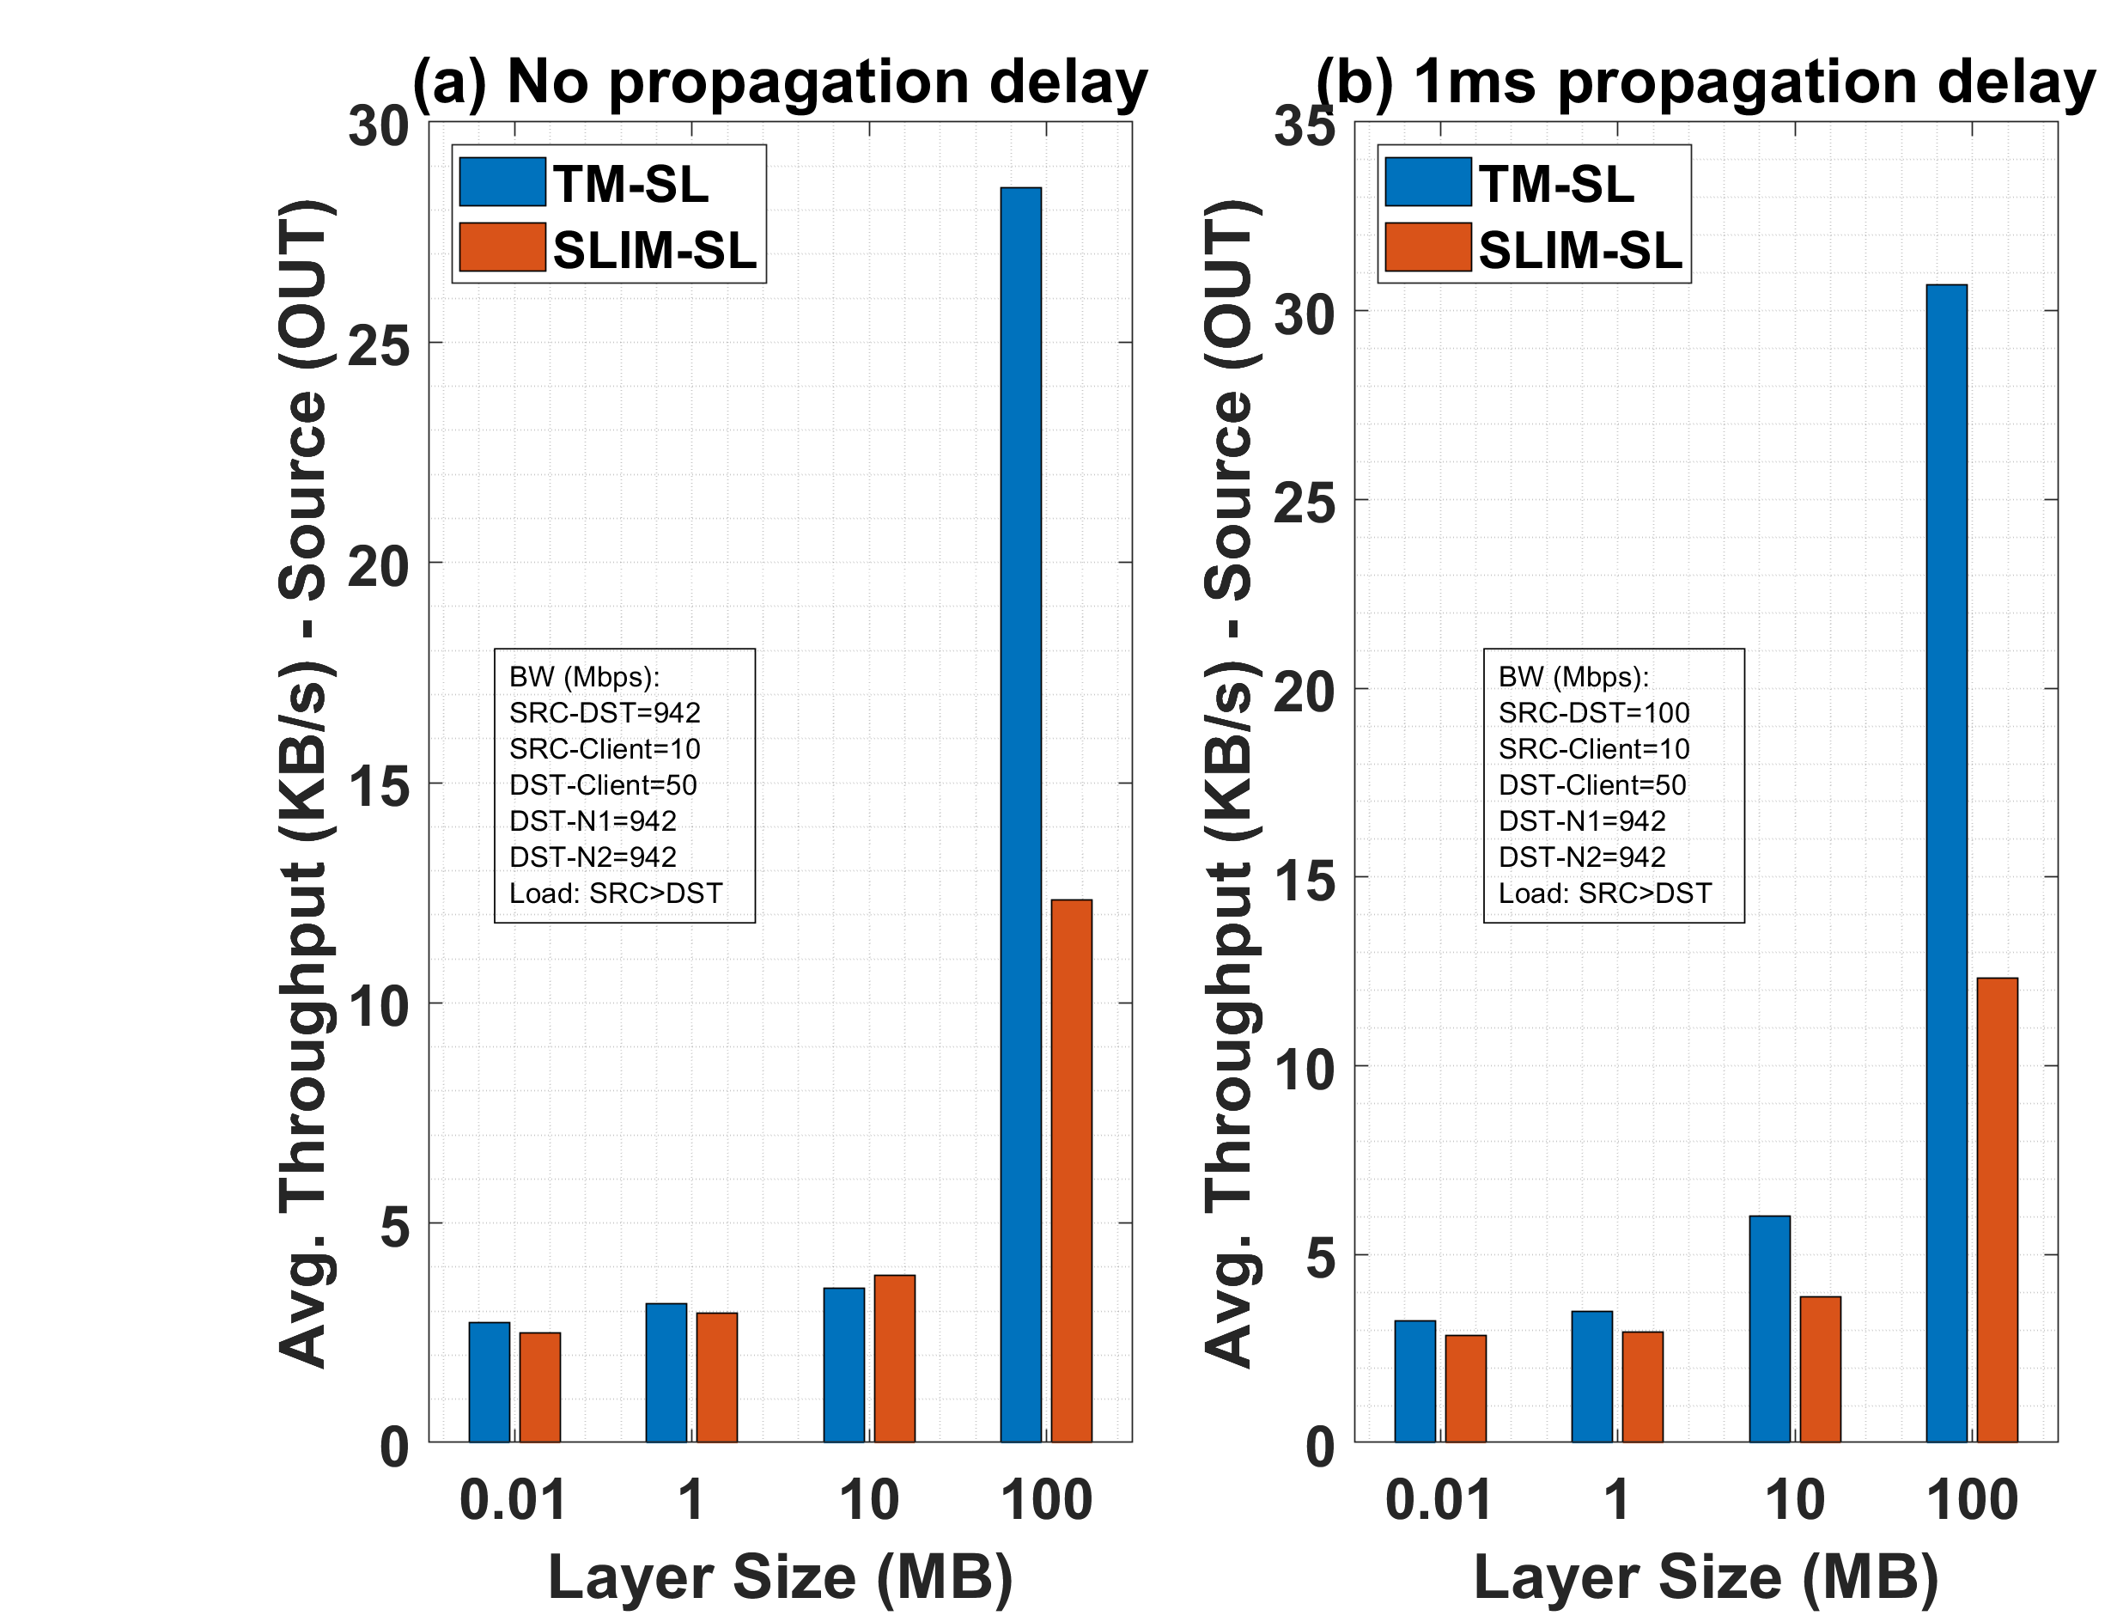
Impact of Inter-edge BW on Avg. Throughput - Stateless
*Ongoing work

Slide 16
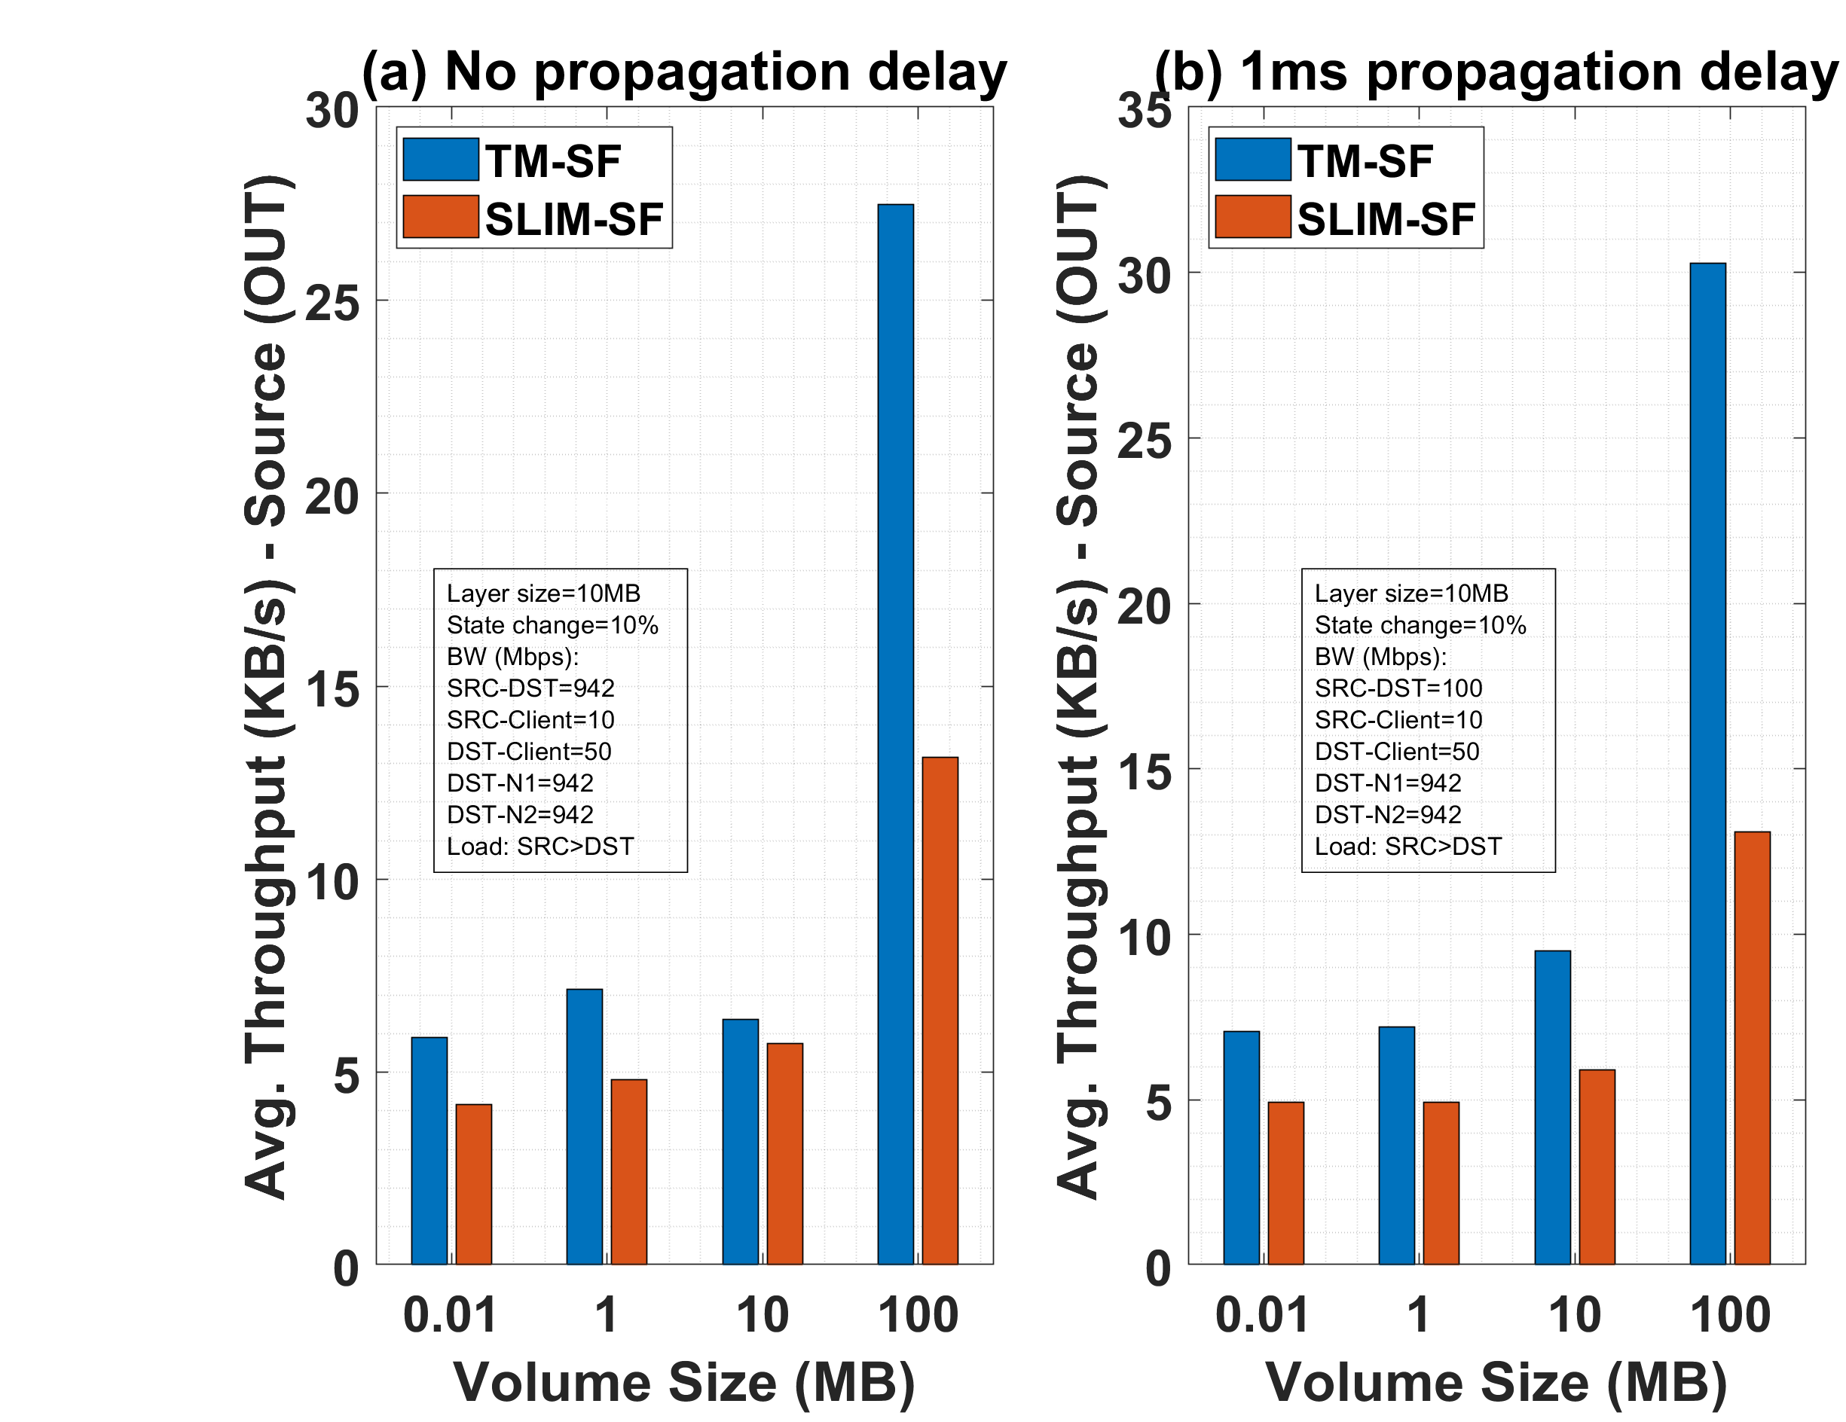
Impact of Inter-edge BW on Avg. Throughput - Stateful
*Ongoing work

Slide 17
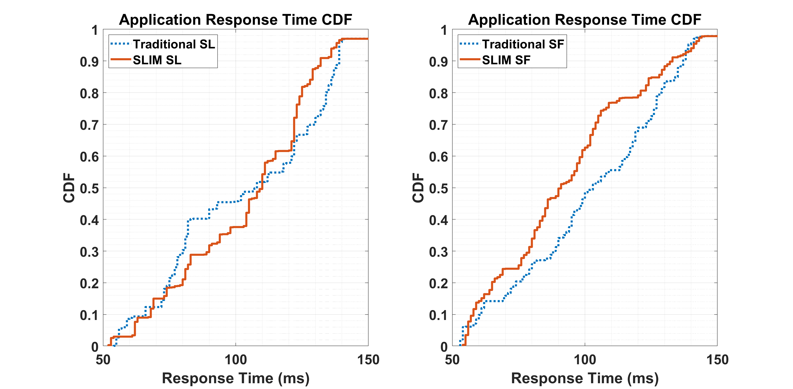
Application Response Time CDF
*Ongoing work

Slide 18
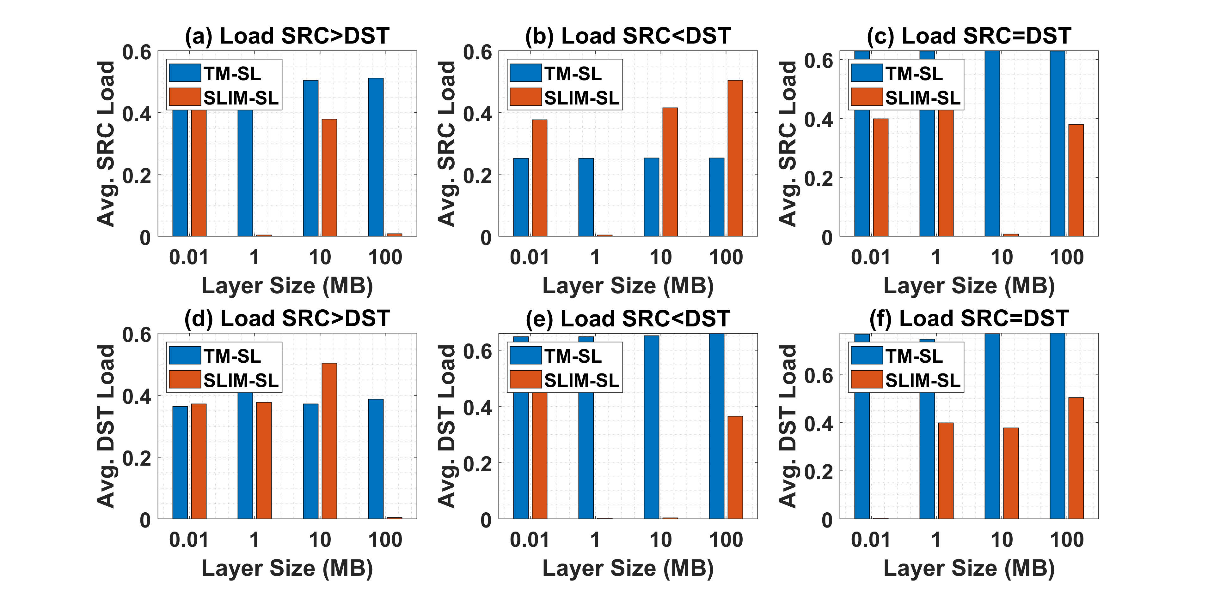
Average SRC and DST Load - Stateless
*Ongoing work

Slide 19
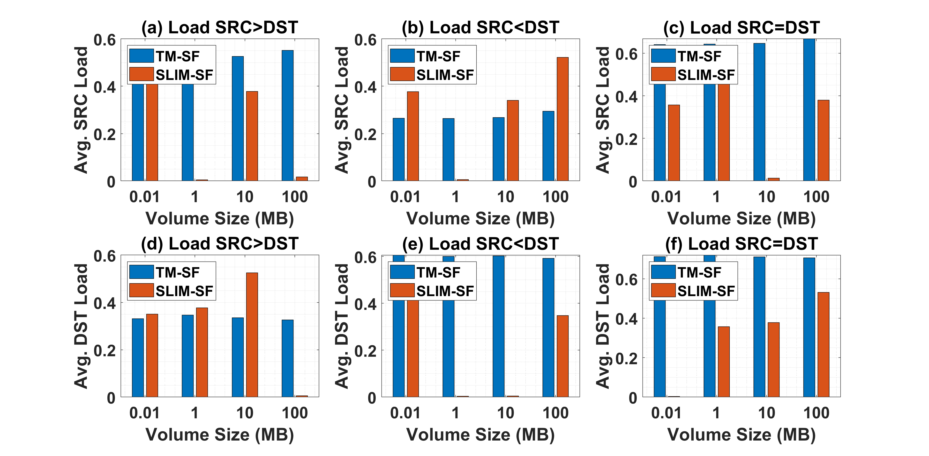
Average SRC and DST Load - Stateful
*Ongoing work

Slide 20
Use-cases and Topology
Multi-cluster migration: source and destination are in different clusters
Stateless migration: stateless service (no session/per-user state) and no request state migration
Stateful migration: stateful service with writable volumes
Client application: Real-time image processing
N1
P1
P2
Registry
SRC
DST
Registry
N2

