Slide 1
Environment
Sensors
Application logic
Sonar1
TemperatureSensor
Clock
Sonar2
VirtualDDR
RealDDR
Led
Hue Lamp
HumanOperator
Actuators

Slide 2
Resource Model
Environment
Application logic
Sensors
Sonar1
TemperatureSensor
Software Agent
Sonar2
Clock
Controller
VirtualDDR
RealDDR
Led
Hue Lamp
HumanOperator
Actuators

Slide 3

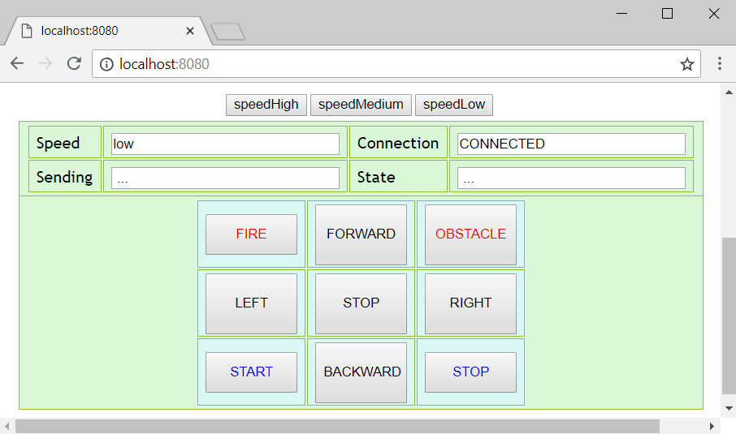
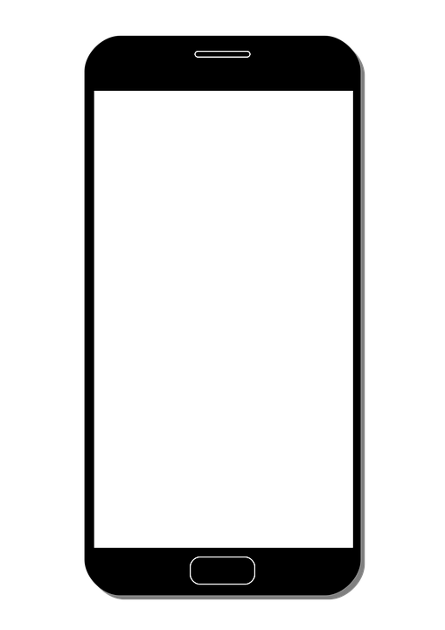
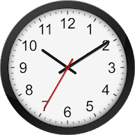


ExternalDevices
PC
Robot
HumanOperator
RealRobot
Led
Application Logic
Environment
VirtualRobot
Sonar1
Sonar2
ClockAgent
HueLampAgent
TemperatureAgent
HueLamp
RemoteThermometer

Slide 4

ExternalDevices
PC
Robot
HumanOperator
RealRobot
Led
Application Logic
Environment
ResourceModel
Controller
VirtualRobot
SoftwareAgent
Sonar1
Sonar2
ClockAgent
HueLampAgent
TemperatureAgent
HueLamp
RemoteThermometer

Slide 5
repeat
timeout(800)
init
timeout(800)
receivedCmd
externalcmd : usercmd(start)
swagmsg : cmd(halt)
[ ?? startCmd], sonarSensor
detectedByFinal
externalcmd: usercmd(halt)
detectedBySonar
sonarSensor
swagmsg : cmd(clean)
timeout(800)
cleaning
handleFront
frontSonar

Slide 6
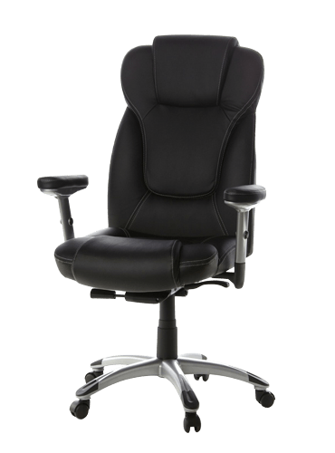

*
*
handleFront
frontSonar
avoidFix
swagmsg : cmd(initialP)
*
frontSonar
checkDoor
frontSonar
timeout(800)
timeout(800)
swagmsg : cmd(giveUpRight/
giveUpLeft)
avoidMobile
timeout(800)
giveUp
failure
frontSonar
switch
swagmsg : cmd(giveUpRight /
giveUpLeft)
doorFound
cleaning
swagmsg : cmd(resumeLastPos)
timeout(800)
switch
*
swagmsg : cmd(initialP)
*
*
externalcmd
goToPrevLevel
end
resumeLastPosition
receivedCmd
timeout(200)
timeout(800)

Slide 7
handleFront
checkDoorRight
frontSonar
timeout(200)
avoidFixRight
timeout(800)
timeout(800)
frontSonar
goToPrevLevelRight
avoidMobile
frontSonar
switch
swagmsg : cmd(giveUpRight)
doorFoundRight
timeout(200)
switch
frontSonar
switchDirection
failure
cleaning
switch
switch
externalcmd
resumeLastPosition
swagmsg : cmd(initialP)
swagmsg : cmd(initialP)
timeout(800)
avoidFixLeft
swagmsg : cmd(initialP)
externalcmd
swagmsg : cmd(giveUpLeft)
externalcmd
externalcmd
frontSonar
externalcmd
timeout(200)
receivedCmd
givingUp
externalcmd
goToPrevLevelLeft
externalcmd
init
frontSonar
doorFoundLeft
switch
switch
timeout(800)
checkDoorLeft
timeout(800)

Slide 8
startCleaning
frontSonar
leftTurn
timeout(800)
timeout(800)
detectedByFinal
end
backCleaning
swagmsg : usercmd(halt)
frontSonar
sonarSensor
timeout(800)
forwardCleaning
righTurn

Slide 9
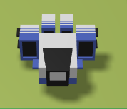
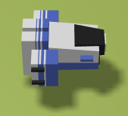
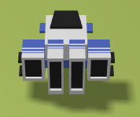
end
start
forward
leftTurn
rightTurn
backward

