Slide 1
Environment
Sensors
Application logic
Sonar1
TemperatureSensor
Clock
Sonar2
VirtualDDR
RealDDR
Led
Hue Lamp
HumanOperator
Actuators

Slide 2
Resource Model
Environment
Application logic
Sensors
Sonar1
TemperatureSensor
Software Agent
Sonar2
Clock
Controller
VirtualDDR
RealDDR
Led
Hue Lamp
HumanOperator
Actuators

Slide 3

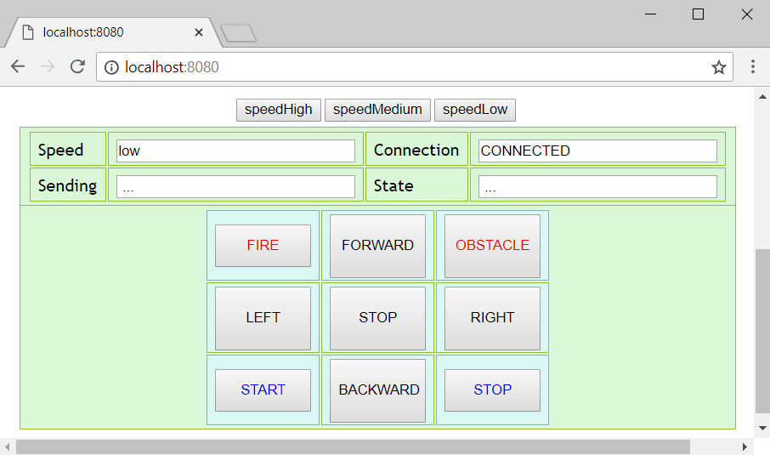
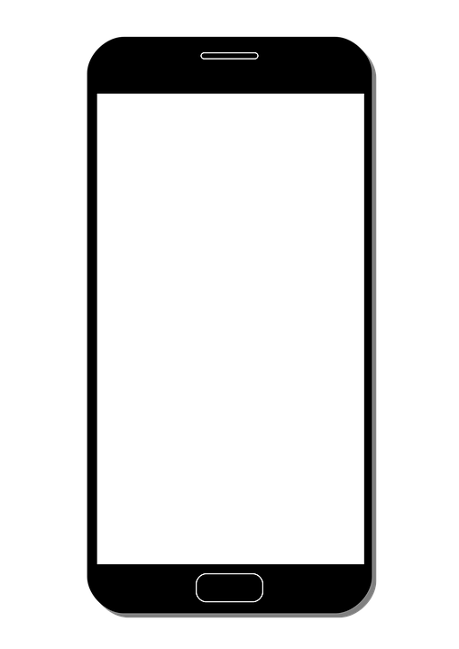
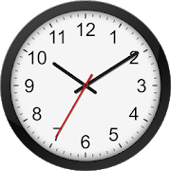


ExternalDevices
PC
Robot
HumanOperator
RealRobot
Led
Application Logic
Environment
VirtualRobot
Sonar1
Sonar2
ClockAgent
HueLampAgent
TemperatureAgent
HueLamp
RemoteThermometer

Slide 4

ExternalDevices
PC
Robot
HumanOperator
RealRobot
Led
Application Logic
Environment
ResourceModel
Controller
VirtualRobot
SoftwareAgent
Sonar1
Sonar2
ClockAgent
HueLampAgent
TemperatureAgent
HueLamp
RemoteThermometer

Slide 5
repeat
timeout(800)
init
timeout(800)
receivedCmd
externalcmd : usercmd(start)
swagmsg : cmd(halt)
[ ?? startCmd], sonarSensor
detectedByFinal
externalcmd: usercmd(halt)
detectedBySonar
sonarSensor
swagmsg : cmd(clean)
timeout(800)
cleaning
handleFront
frontSonar

Slide 6
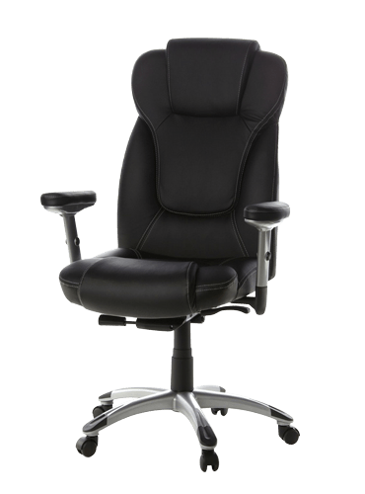

*
*
handleFront
frontSonar
avoidFix
swagmsg : cmd(initialP)
*
frontSonar
timeout(800)
checkDoor
frontSonar
timeout(800)
swagmsg : cmd(giveUpRight/
giveUpLeft)
avoidMobile
timeout(800)
giveUp
failure
switch
swagmsg : cmd(giveUpRight /
giveUpLeft)
frontSonar
doorFound
cleaning
swagmsg : cmd(resumeLastPos)
timeout(800)
switch
*
swagmsg : cmd(initialP)
*
*
externalcmd
goToPrevLevel
end
resumeLastPosition
receivedCmd
timeout(200)
timeout(800)

Slide 7
handleFront
checkDoorRight
frontSonar
timeout(200)
avoidFixRight
timeout(800)
timeout(800)
frontSonar
goToPrevLevelRight
avoidMobile
frontSonar
switch
swagmsg : cmd(giveUpRight)
doorFoundRight
timeout(200)
switch
frontSonar
switchDirection
failure
cleaning
switch
switch
externalcmd
resumeLastPosition
swagmsg : cmd(initialP)
swagmsg : cmd(initialP)
timeout(800)
avoidFixLeft
swagmsg : cmd(initialP)
externalcmd
swagmsg : cmd(giveUpLeft)
externalcmd
externalcmd
frontSonar
externalcmd
timeout(200)
receivedCmd
givingUp
externalcmd
goToPrevLevelLeft
externalcmd
init
frontSonar
doorFoundLeft
switch
switch
timeout(800)
checkDoorLeft
timeout(800)

Slide 8
startCleaning
frontSonar
leftTurn
timeout(800)
timeout(800)
detectedByFinal
end
backCleaning
swagmsg : usercmd(halt)
frontSonar
sonarSensor
timeout(800)
forwardCleaning
righTurn

Slide 9
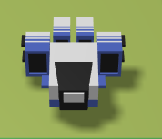
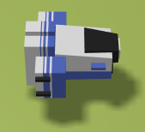
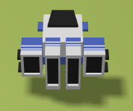
end
start
forward
rightTurn
leftTurn
backward

Slide 11




Arduino
Raspberry
PC
Loop()
Python
System
Serial
events
Robot Server
Temp Server
Java TCP Client
6666
6667
events
request
accept
.pl
Java TCP Client
Mock TempGUI
Real Robot

Slide 12
Real Robot
System
temperature
sonar
movement commands
Sensors
blink led
Serial
temperature
Actuators
front sonar
led
motors

Slide 13


Browser
Actuators
Controller
Frontend Server
Sensors
users
Robots
Database

Slide 14






Frontend Server
a)
System
Robot model
alarm | usercmd : usercmd(CMD)
alarm | usercmd : usercmd(CMD)
robot state
users
b)
Browser
MQTT
MongoDB

Slide 15
ctrlEvent : ctrlEvent(robot,r1,CMD)
System
Frontend Activator QA
a)
alarm | usercmd : usercmd(CMD)
PUT
Frontend Server JS
Robot model
alarm | usercmd : usercmd(CMD)
robot state
b)
Browser
MQTT
users
MongoDB

Slide 16
