Slide 1

W

Slide 2
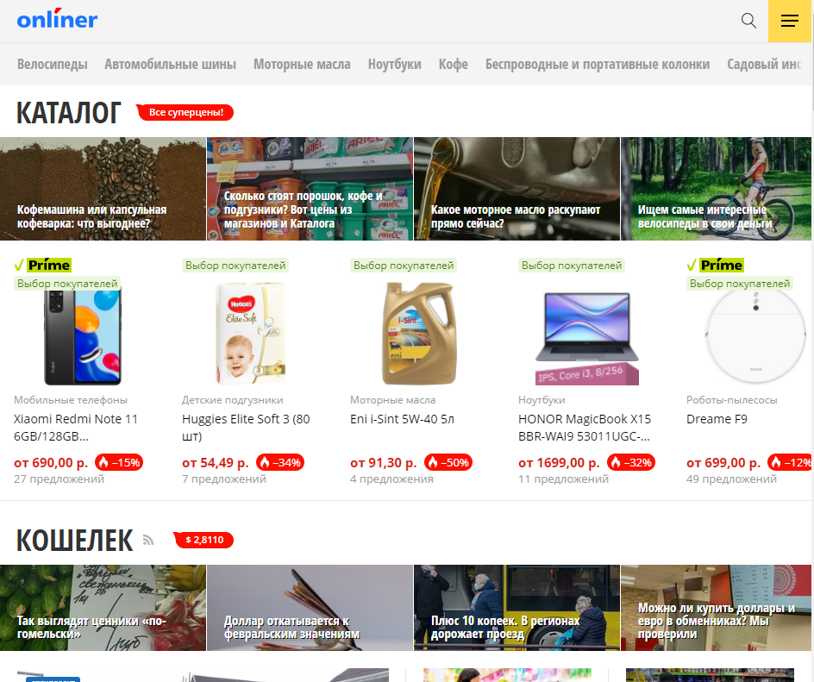

Introduction
It is impossible to imagine a modern society without online stores. THeir usE is strongLy embedded in our Lives.

Slide 3
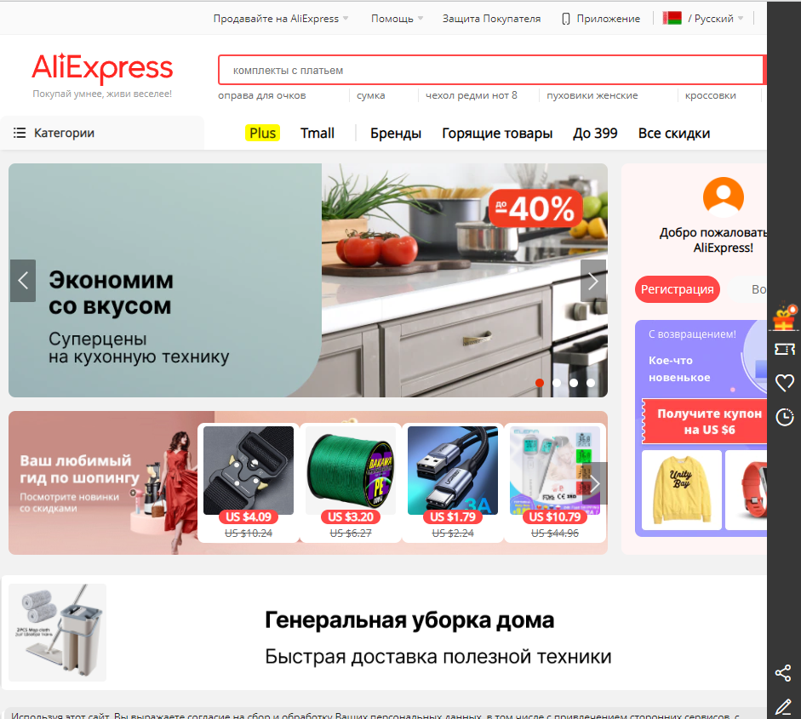
Some troubles
When we need to buy something, we write in Google: "Buy blablabla". Few people in the modern world will go looking for things in a store without knowing where it is sold.

Slide 4
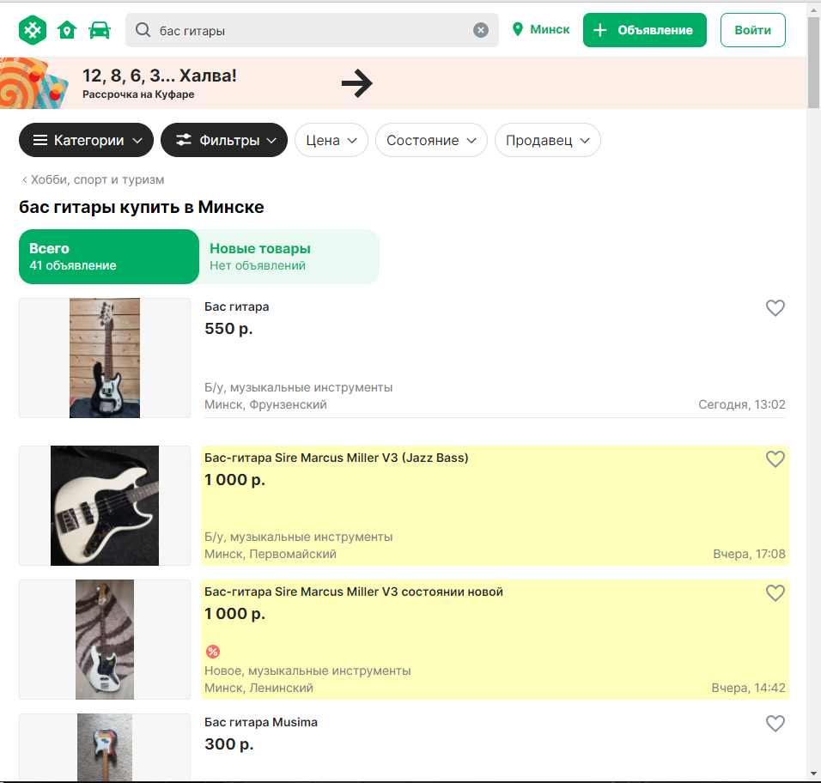

Unexpected twists
Modern stores, if they do not have a full-fledged online store, they use online stores like "Aliexpress" or "Onliner".

Slide 5
A little history
The first online store, as we are used to seeing them now, appeared in 1992, when Charles Stack used all the possibilities of B2B and created an online bookstore.

Slide 6

Thanks for attention!

