Slide 1
Fábio Geiss Fucks
Hibernate Anti-Patterns and Patterns

Slide 2
N +1 Anti-Pattern
- It is a performance problem when the hibernate executes 1 query for the main entity and N additional queries to load poorly managed relations.
- You think it is doing ONE SELECT, but under the hood the hibernate does N + 1 hidden SELECTS.

Slide 3
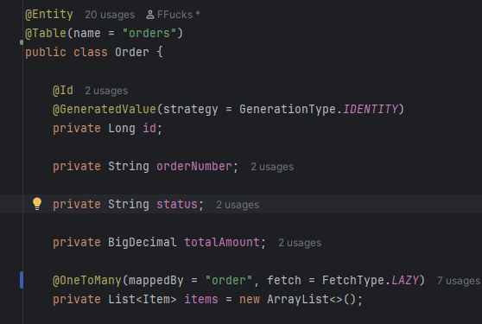
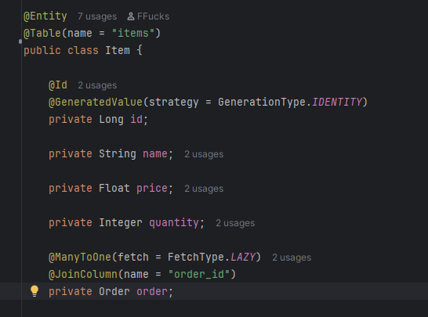
Entity Order
Entity Item

Slide 4
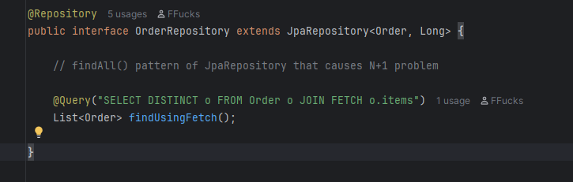
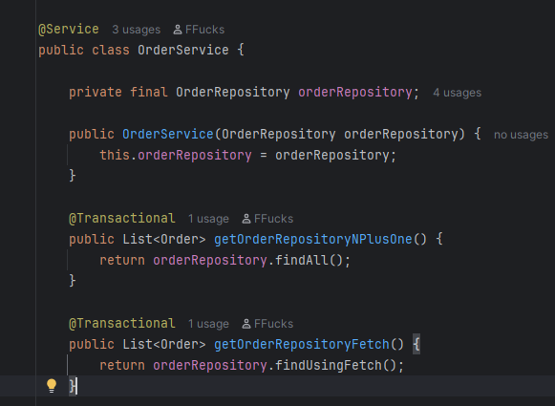

Slide 5
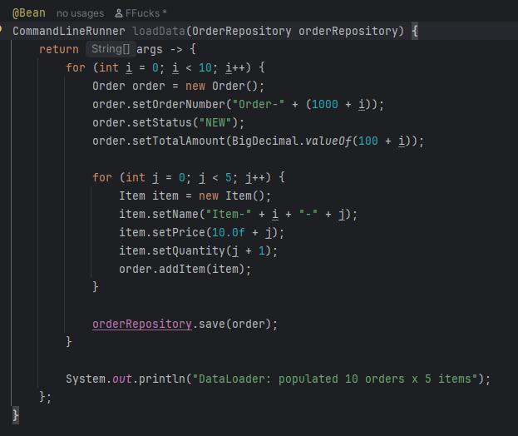
Bean to populate 10 orders and 5 Items for each order

Slide 6
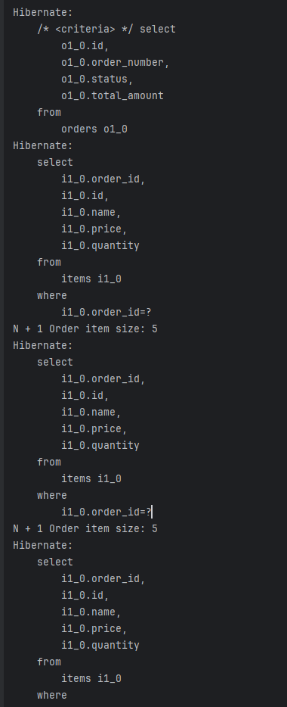
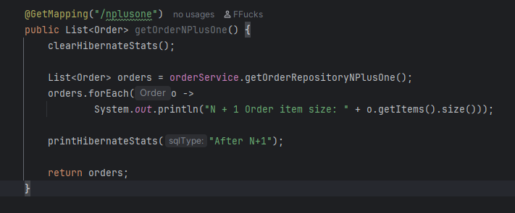

Controller for normal query
SQL Executions

Slide 7
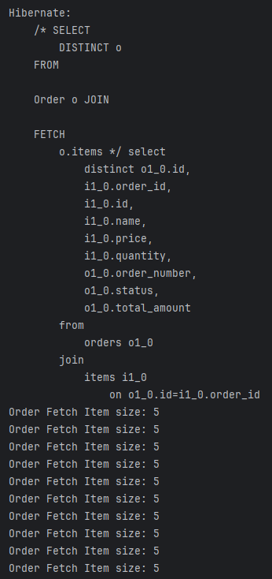
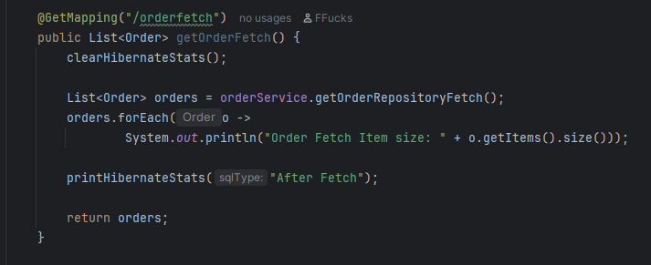

Controller for Query with Fetch
SQL executions
SQL generated by hibernate

Slide 8
Indiscriminated Cascade.ALL Anti-Pattern
Cascade.ALL is used to disseminate persistence operations from one entity to another.
Any operation performed on a Child entity defined as CascadeType.ALL, it will also reflect in the Parent entity.
This can lead to the accidental removal of the parent or the unintentional persistence of transient objects.

Slide 9
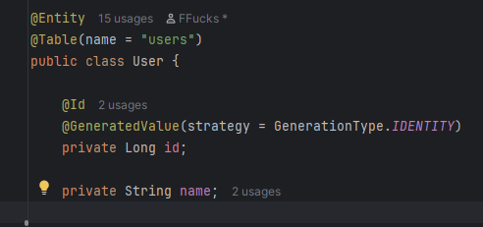
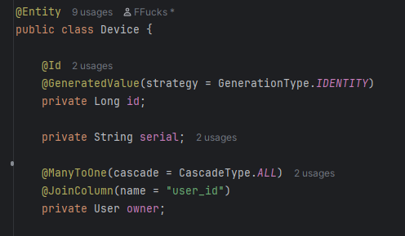
Entity User
Entity Device

Slide 10
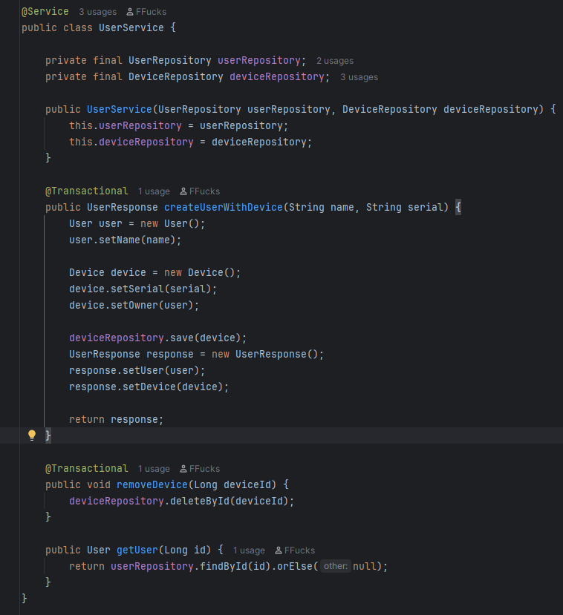
UserService showing that only deviceRepository.save is called

Slide 11
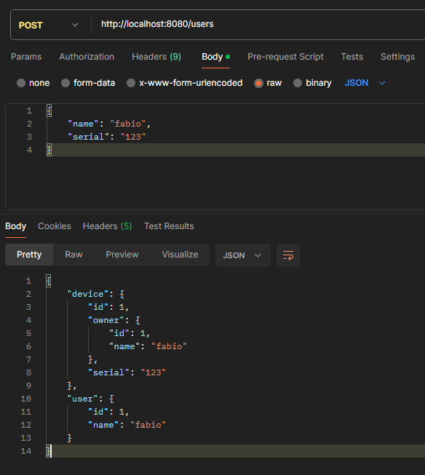
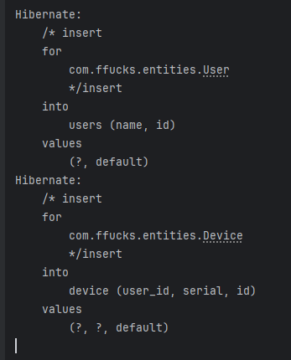
Endpoint to Insert User and Device
Query executed by hibernate

Slide 12
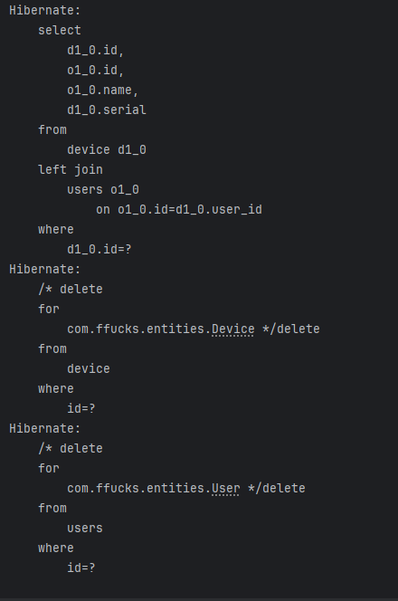
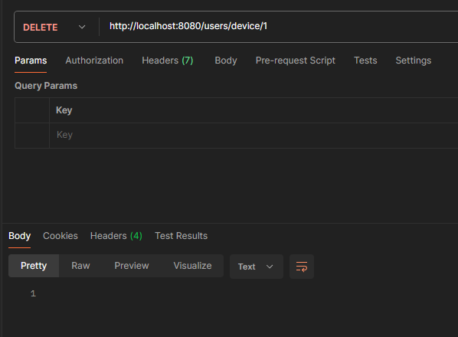
Endpoint call to remove the Device
It also remove the User

Slide 13
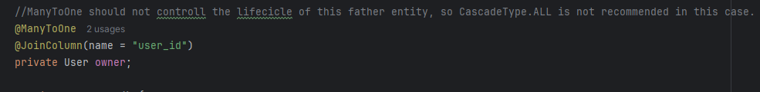
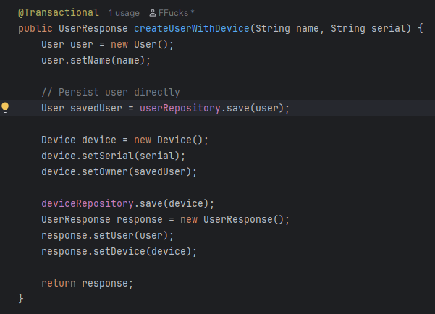
Remove CascadeType.ALL
Persist User and Device

Slide 14
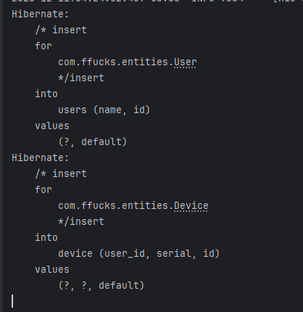
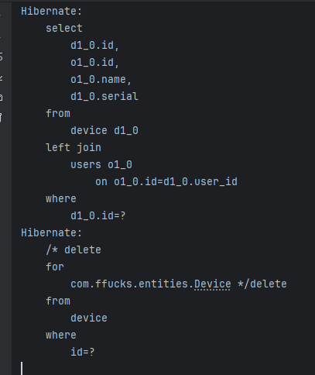
Insert on User and Device
It will only remove Device entity when call the service

Slide 15
Indiscriminated Cascade.ALL Anti-Pattern
"Don't let the children control the parents, this can lead to unwanted problems."
Fucks, Fábio

Slide 16

https://github.com/FFucks/hibernate

