Slide 1

Max Heap Scala

Slide 2
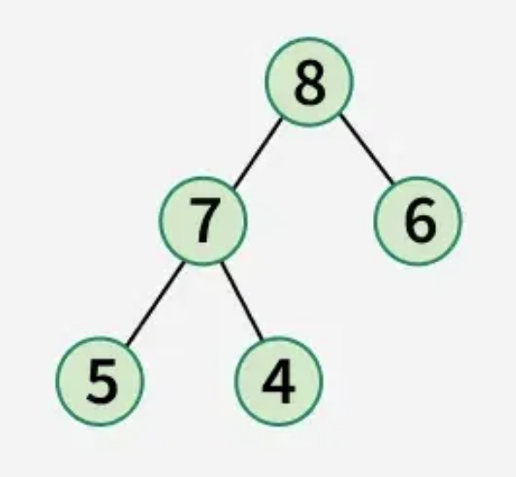
Max Heap Scala
What it is a Max Heap ?
Parent/child values.

Slide 3
Max Heap Scala
A heap can be efficiently represented using an array.
If a node is stored at index i:
Its left child is at index 2 * i + 1.
Its right child is at index 2 * i + 2.
The parent of a node at index i can be found with[(i-1)/2].

Slide 4
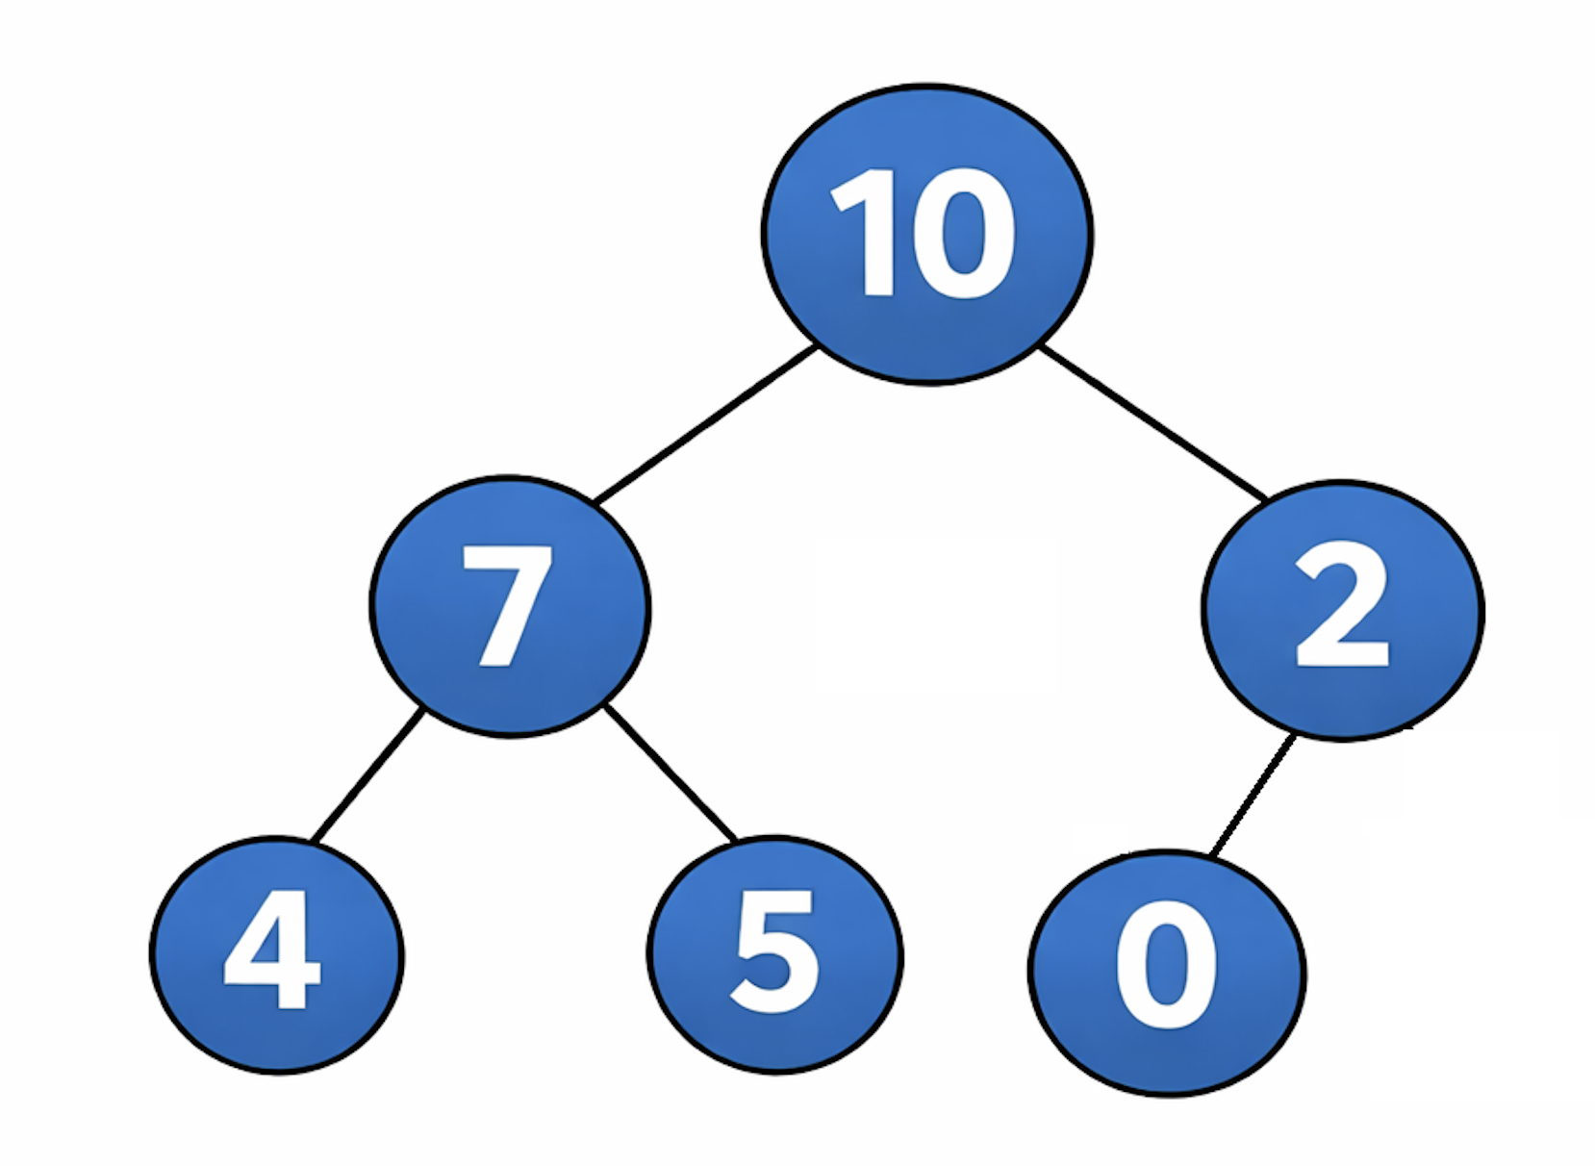
[10, 7, 2, 4, 5, 0]
Node position 1 (value 7):
Left child: 2 * 1 + 1 = 3 (value 4)
Right child: 2 * 1 + 2 = 4 (value 5)

Slide 5
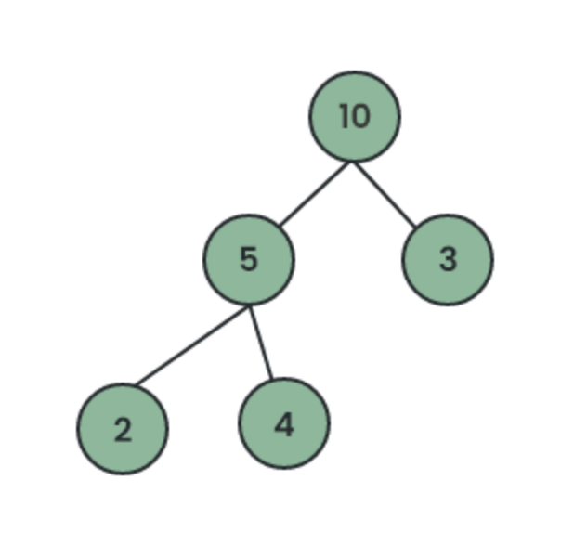
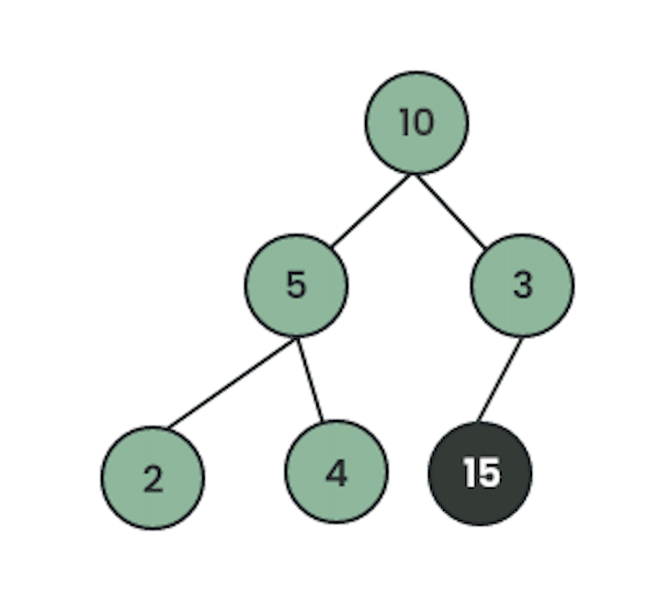
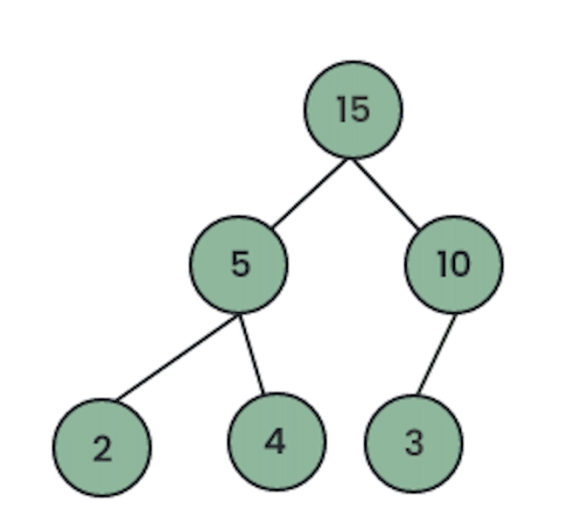
Insertion

Slide 6
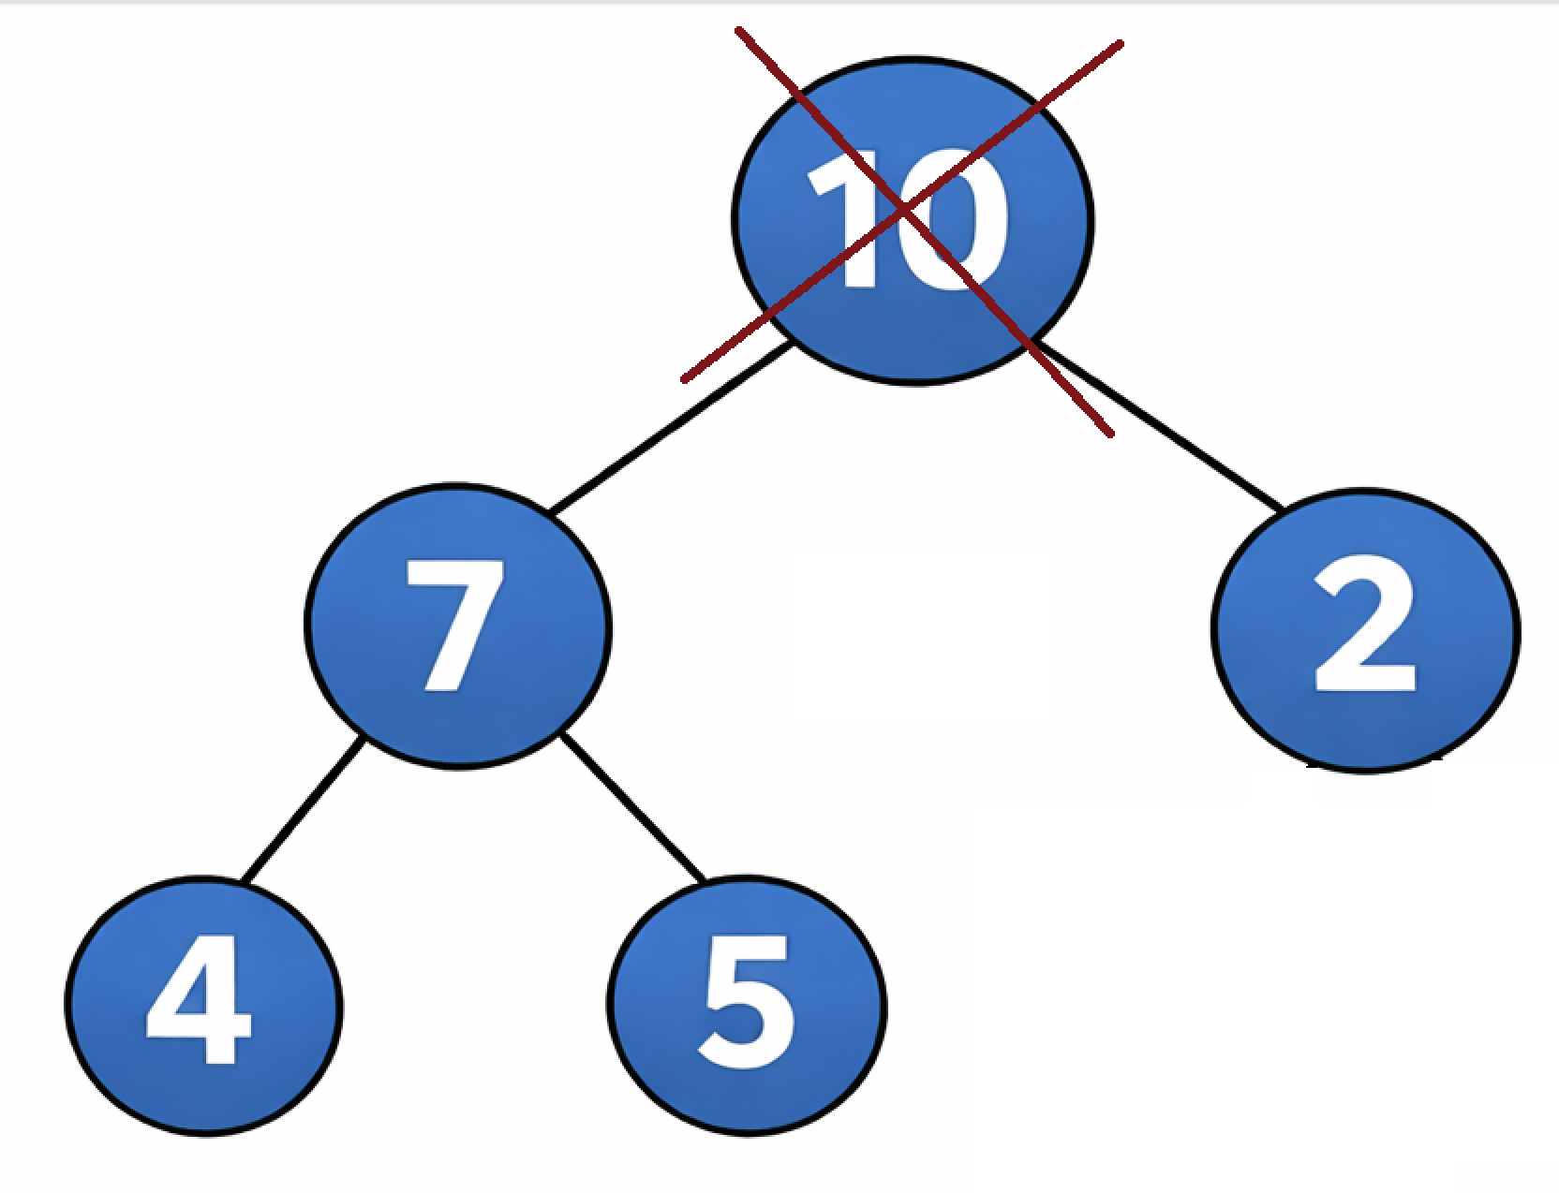
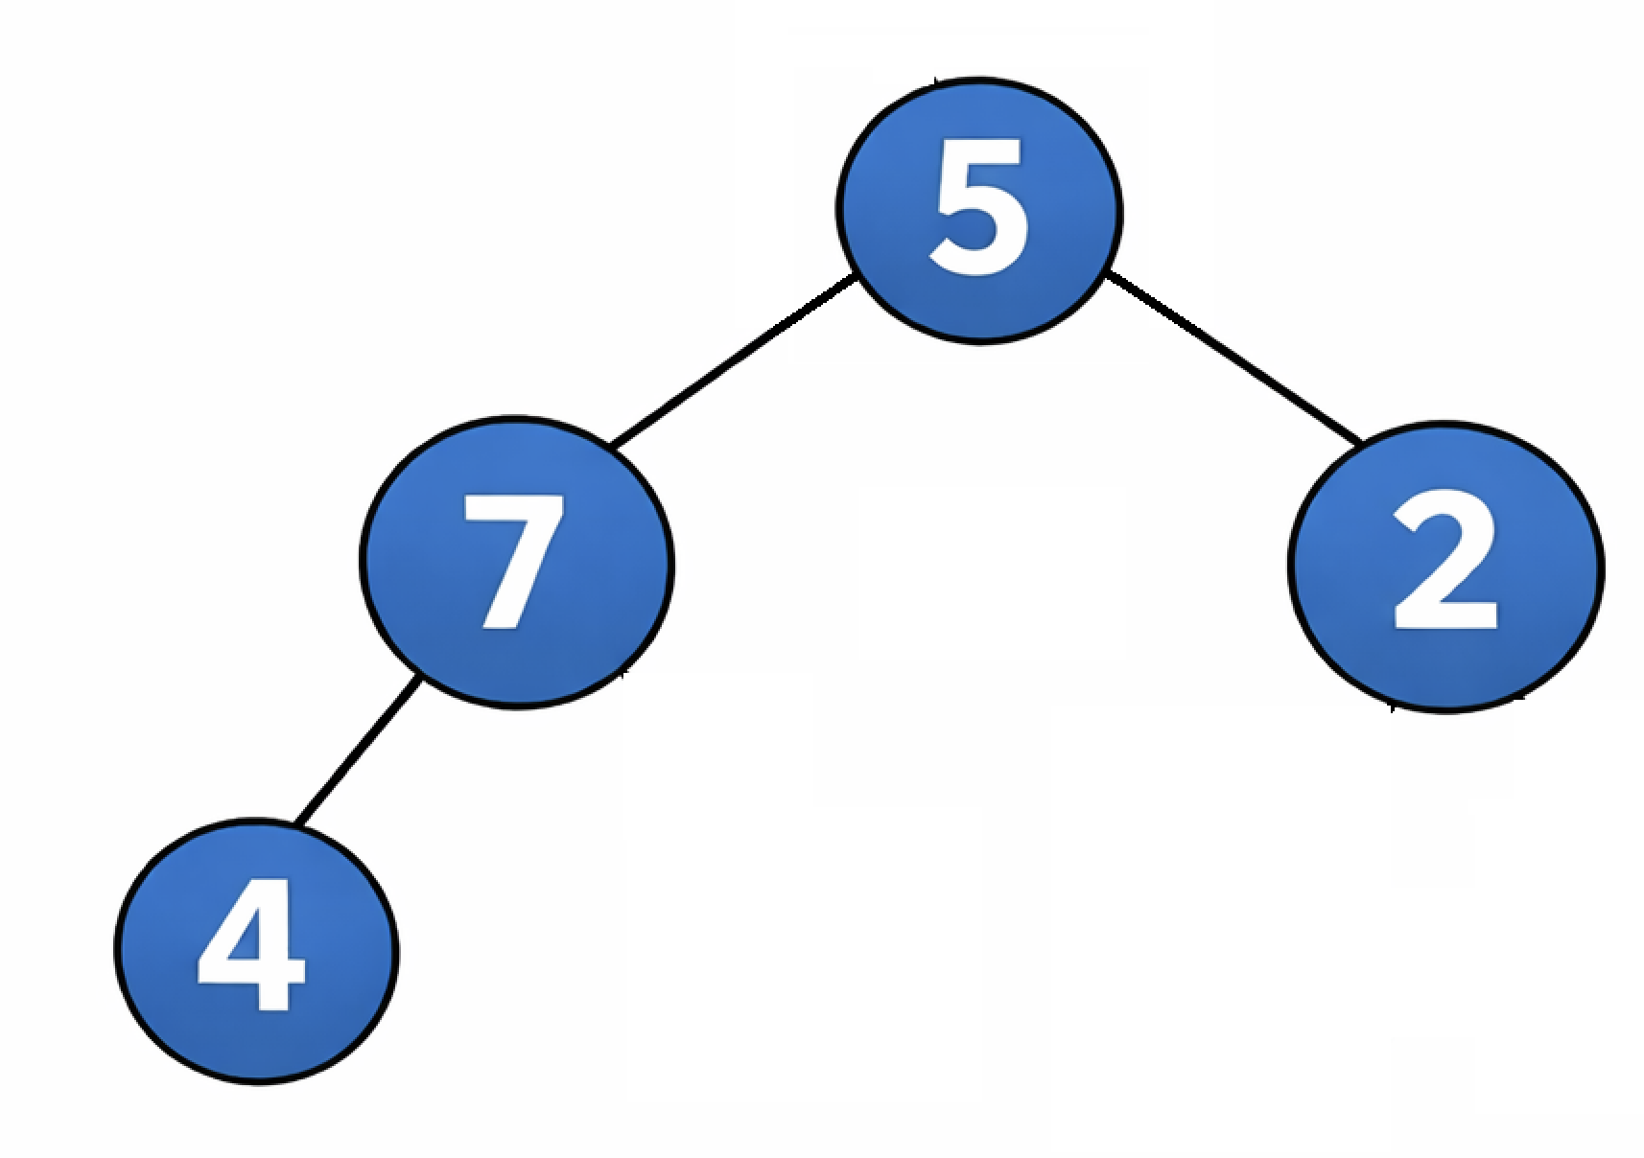
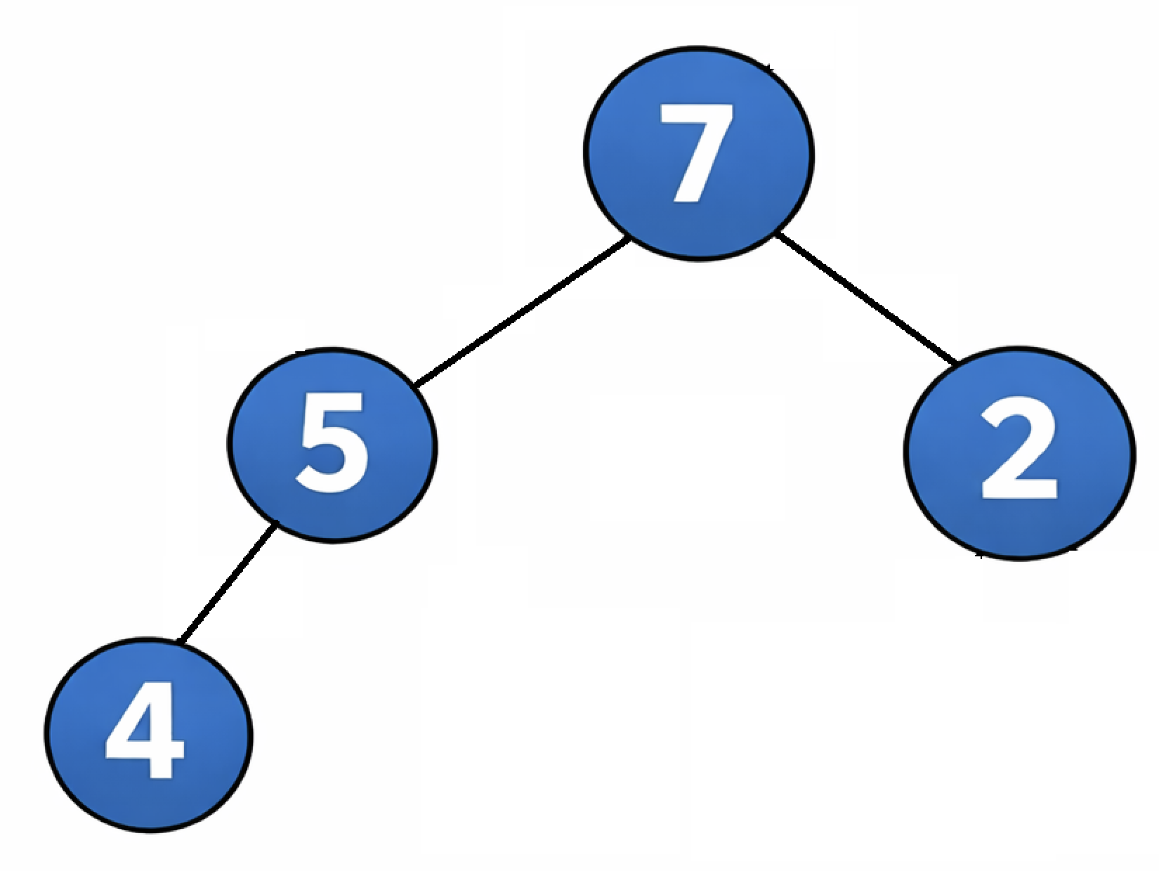
Extract Max

Slide 7
Conclusion
Quick access to maximum
Efficient insert/delete
Priority Queues

