Slide 1

Fábio Geiss Fucks
Spring AMQP

Slide 2
Spring AMQP
- AMQP: Advanced Message Queuing Protocol
  It is a messaging protocol.
  Asynchronous message exchanges.
  Uses Exchanges, Queues and Messages.

Slide 3
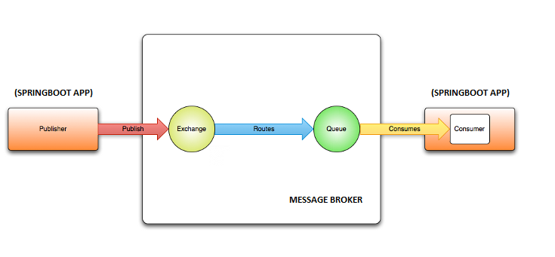
Spring AMQP
- Spring AMQP is a Spring framework that abstracts AMQP protocol.
  It is not a Broker.
  It is a Java/Spring layer for producing and consuming AMQP messages.
  RabbitMQ is the most used broker.

Slide 4
Spring AMQP
- JMS (Java Message Service)
  API in Java.
  Java ecosystem only.
  Defines interfaces and contracts.
- AMQP
  Messaging protocol.
  Language Independent.
  Defines message routing and delivery.
- Kafka
  Messaging and streaming platform.
  Stores message over time.
  Suports message replay.

Slide 5
Spring AMQP
Positive:
- Simple integration with Spring.
- Mature and reliable consumption model.
- Decoupling between services.
Negative:
- Abstraction can hide perfomance problems.
- Broker dependency.
- Error handling could be complex.

Slide 6

https://github.com/FFucks/spring-amqp

