Slide 1
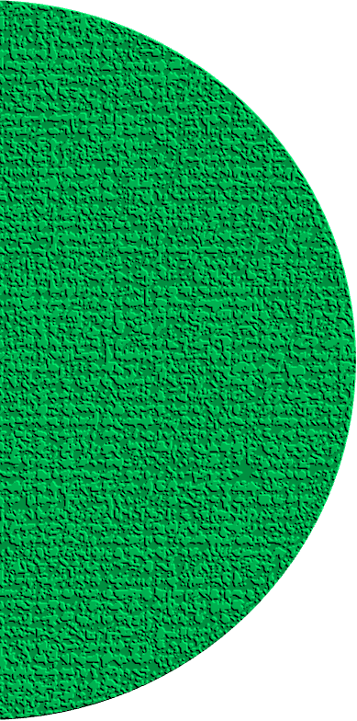





Global Initiative on AI for Health
Ideathon
Introduction
Marc Lecoultre

Slide 2
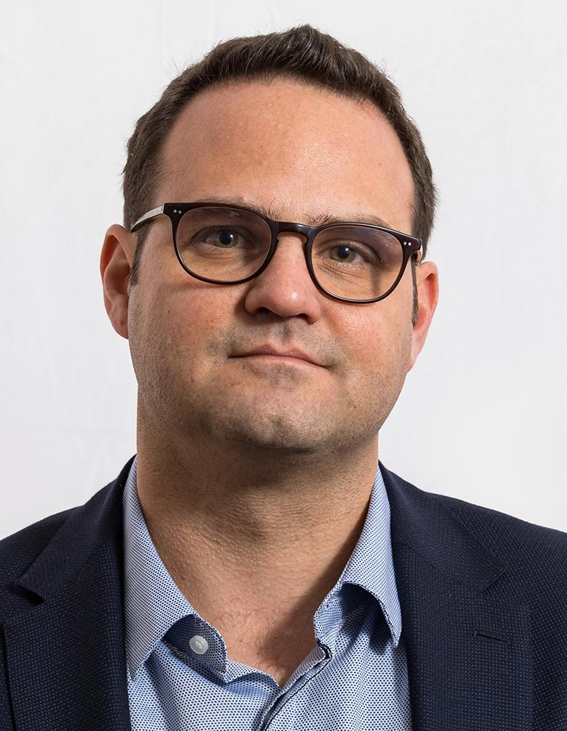
Your Ideathon Host
FG-AI4H
Part of the management team
Leading the Open Code Initiative
Chairman of WG-DASH
Topic Group driver for AI solutions related to neurology
Master of Science in Communication from the Swiss Federal Institute of Technology, a Graduate Certificate from Stanford and multiple certifications in Lean Management and AI domains.

Slide 3
Ideathon Goals
Examples
We expect the Ideathon to yield impressive outcomes, such as innovative AI models, ground-breaking digital concepts, insightful white papers, and other meaningful presentations.
These deliverables will be showcased to both the conference attendees and the Ideathon jury.
Develop an AI-driven algorithm that not only enhances diagnostic accuracy but also integrates ethical considerations, ensuring patient autonomy and privacy are respected throughout the decision-making process
Design a patient-centric digital ecosystem that empowers individuals to manage and track their health data seamlessly, promoting proactive health management and personalized healthcare solutions
Imagine an intelligent AI system that optimizes clinical trial procedures, enhancing the efficiency of participant recruitment, data analysis, and trial outcome predictions, ultimately expediting the process of bringing innovative treatments to market.

Slide 4




Areas
Collaborate on solutions in the following areas
Ethical AI for Health
In the era of AI, we're committed to ensuring that technology is harnessed ethically in healthcare. Explore AI's potential to improve diagnostics, streamline patient care, and support healthcare professionals while maintaining the highest ethical standards.
Digital Health Innovation
Dive into the world of digital health, where transformative technologies are revolutionizing patient care, data management, and telemedicine. Bring your innovative ideas to the table, and let's explore the future of healthcare together.
AI-Driven Research
Revolutionize the world of medical research through artificial intelligence. Collaborate on ground-breaking projects that use AI to accelerate the pace of discovery and improve research methodologies.

Slide 5
Topics (1/2)
Topics for Ideathon projects
Mental Health
Help bridge the gap in mental healthcare. Develop solutions to provide better access, support, and destigmatize mental health issues.
Cardiovascular Diseases
Dive into the realm of cardiovascular health. Find innovative ways to prevent, diagnose, and manage heart-related conditions.
Diabetes
Join the fight against diabetes. Develop tools and strategies for better prevention, treatment, and patient management.
Cancer
Make a difference in the battle against cancer. Contribute ideas and innovations to improve early detection, treatment, and support for patients and their families.

Slide 6
Topics (2/2)
Topics for Ideathon projects
Elderly Care
Address the unique challenges of an aging population. Create solutions to enhance the quality of life, healthcare, and social support for the elderly.
Antimicrobial Resistance
Combat the rising threat of antimicrobial resistance. Propose solutions to preserve the effectiveness of antibiotics and antifungal medications.
Healthcare Policies Impact
Examine the impact of healthcare policies. Develop insights and strategies for ensuring that healthcare policies align with the best interests of patients and providers.
Health Equity
Tackle disparities in healthcare. Brainstorm ways to ensure equitable access to quality healthcare services and eliminate health inequalities.

Slide 7
Key Moments
2023
Monday | Tuesday | Tuesday | Wednesday
30.10 | 31.11 | 01.11 | 02.11
09:30 –12:30
Team Work
09:30 –12:30
Team Work
09:30 –13:00
Team Work
14:00 – 14:20
Ideathon Opening
13:30 –17:00
Team Work
13:30 –17:00
Team Work
14:00 – 15:00
Ideathon Presentations
14:20-15:00
Ideathon Overview
15:00 – 16:00
Judges reconvening session
15:00-15:30
Teams and Mentors Mapping
15:30-16:30
Coffee and Brainstorming
16:00 – 16:30 Award Session
16:30 –17:30 Team Work
17:00 – 17:30 Daily Wrap-Up
17:00 – 17:30 Daily Wrap-Up
Mentorship sessions

Slide 8
Submission
Deadline: November 2nd 14:00
To ensure a seamless and organized submission process for your work, please follow the instructions below for using and submitting your projects via GitHub:
GitHub Account: If you don't already have one, please create a GitHub account at https://github.com.
Folder Setup: Use folder team (team-#) for your idea on GitHub in the following repository: https://github.com/FG-AI4H/ideathon-riyadh.
Commit Regularly: Make sure to commit your changes regularly to track your progress effectively.
Documentation: Provide clear documentation within your repository, including a README.md file that explains your idea's purpose, features, and how it is organized.
Submission: Prior to the deadline, submit your final documents, code etc. by pushing all your deliverables to the GitHub repository.
For any technical assistance or troubleshooting related to GitHub, refer to GitHub's comprehensive documentation or reach out to our mentor team.

Slide 9
Supporting your Team
Stay connected with your team and mentors
Meet Your Mentors:
Our experienced mentors are here to guide and support you.
Find them on Slack channels for instant help.
Mentorship Goals:
Enhance your skills and knowledge.
Overcome challenges with expert assistance.
Be a Communication Pro:
Keep messages concise and clear.
Use the right channels for different topics.
Encourage teamwork and respect among your fellow participants.

Slide 10

Communication via Slack
We're using Slack for real-time communication
You got an invitation to join the Slack workspace https://gi-ai4h.slack.com/
If not, use this link: bit.ly/join-ideathon
Use the right channels
#ideathon-main for general questions and communication
#Ideathon-support to get technical and organisational support
Team-## for your team work

Slide 11
Mentorship
Role of Mentors and Effective Communication
Understanding the Role of Mentors:
Mentors offer guidance, expertise, and valuable insights throughout the Ideathon.
They are here to support you in achieving your goals and overcoming challenges.
How to Connect with Mentors:
Reach out to mentors via dedicated Slack channels or during scheduled mentorship sessions.
Seek their advice on technical, strategic, and conceptual aspects of your idea.
Key Communication Tips:
Clearly articulate your challenges and questions.
Be open to constructive feedback and suggestions.
Engage actively and respect their time and expertise.

Slide 12
Team Card (Team-#)
Team Members
Area & Topic
…
…
…
…
…
…
Area:
Topic:
Description:
Please fill one slide per team and send it to marc.lecoultre@itu.int

Slide 13
Thank you!
https://github.com/FG-AI4H/ideathon-riyadh
marc.lecoultre@itu.int

