Slide 1

FG-TIDA update
Status 20 October 2026
Update of SG17-TD315/PLEN

Slide 2

What FG-TIDA is
To define architectural models and interoperability frameworks that establish trust in agentic AI.
Mandate
ITU-T Focus Group on Trust and Identity for Humans and Agentic AI
Established under Recommendation ITU-T A.7
Parent group: ITU-T SG17 (Security)
Pre-standardization
Terminology · use cases · architectures · trust frameworks and lifecycle · machine-readable trust metadata · guidelines · a (pre-)standardization roadmap
Collaboration platform
With ITU-T Study Groups, other SDOs, industry, open-source communities and academia
Open to all
Free of charge
No ITU membership required
CO-CHAIRS
Debora Comparin (Thales)
Amir Banifatemi (Cognizant)
VICE-CHAIRS
Sounil Yu (Knostic)
Claire (Liangliang) Zhang (Huawei)
TSB
Thomas Basikolo (Counsellor)
N'Goran Franck Konan
2

Slide 3
How FG-TIDA was created
Four SG17 workshops in 2026
30–31 March
Trustable and Interoperable Digital Identities (Geneva)
12 May
5th X.509 Day
2 June
Global interoperability for trust management
9 July
Designing Trust Management for Agentic AI (AI for Good)
10 June 2026 FG-TIDA agreed by consensus at the close of the SG17 meeting — ToR in SG17-TD295/PLEN
9 July 2026 Launch on the AI for Good Centre Stage with 37 initial supporters
Community behind the creation
400+ participants 54 countries 42 Member States 47 companies 11 universities
3

Slide 4
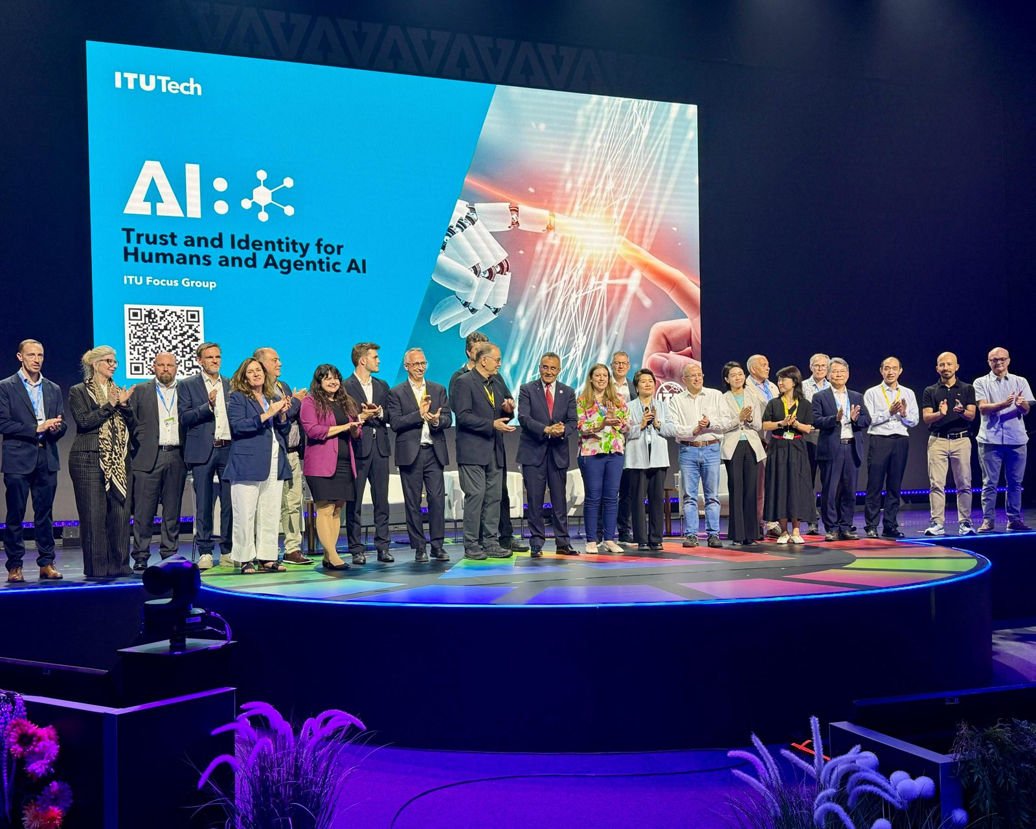
9 July 2026: launch and visibility
37
40+
initial supporters on stage
supporters listed on tida.community
15+
7
media outlets covered the launch
stages and interviews, Sept.–Nov.
Coverage includes: ITU press release · Reuters (syndicated by Yahoo Finance, AOL, US News, TradingView, The Star) · The Next Web · Developing Telecoms · Telecompaper · The Fast Mode · insideAI News · Nairametrics · IT-Online · Panodyssey (FR/EN)
Full list and events: tida.community/news
4

Slide 5
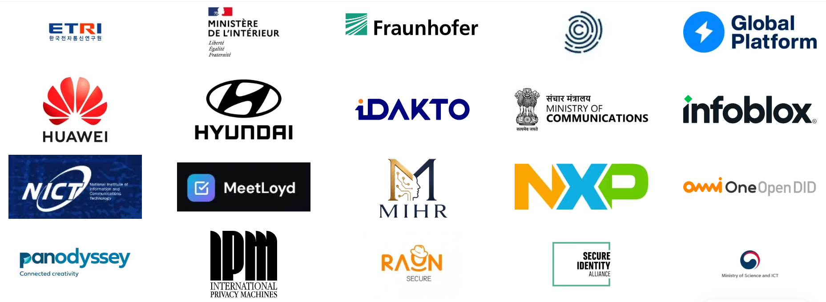
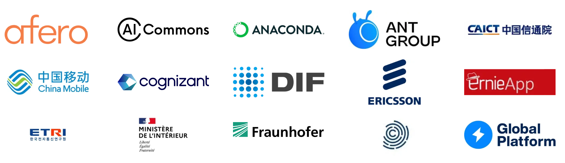


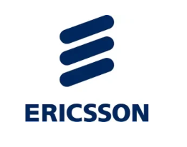
Supporters (see tida.community)
Supported by governments, industry, institutions and academia
40+ supporters
full list at tida.community
5

Slide 6
How to join
How to join
Create a free ITU user account, then register on the FG-TIDA registration page
Mailing list: registered participants are subscribed to fgtida@lists.itu.int (archive available with an ITU account)
Free of charge — no ITU membership required
No access to GitHub? The repositories are mirrored on the ITU GitLab; request access from tsbfgtida@itu.int
Participation so far
Preparation meetings: 60 → 100 → 144 → 125 participants (29 Jul – 14 Oct 2026)
Paris: register through the online form by 20 November 2026; seats are limited
218
registered participants (as of 20 October 2026)
6

Slide 7
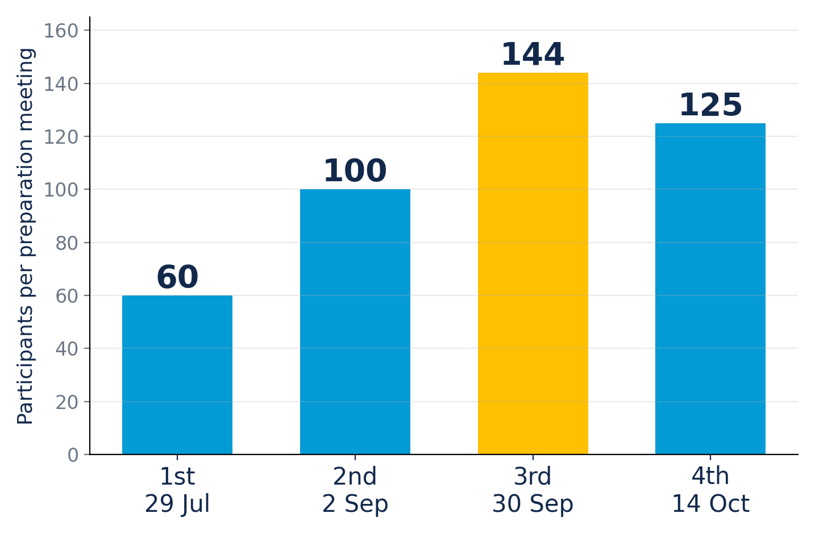
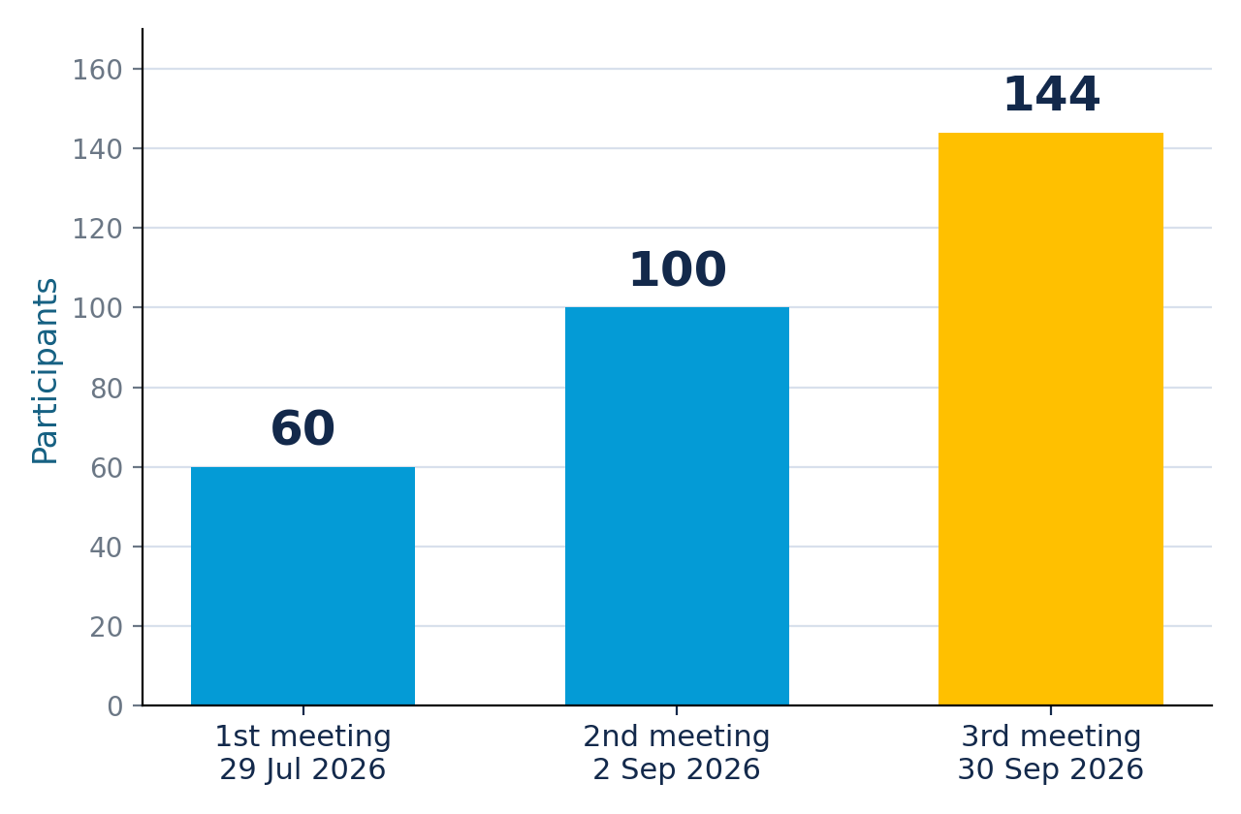
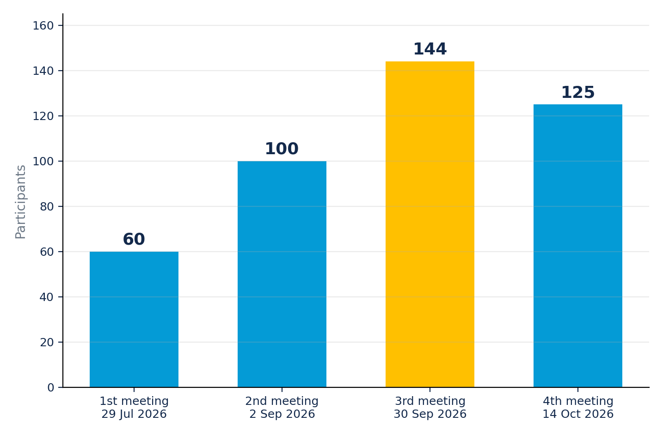
Interregnum meetings
Virtual meetings to prepare structure, leadership and deliverables for Paris
29 Jul — path so far; six candidate Working Group ideas
2 Sep — Paris programme; use-case template; themes #4, #6, remote attestation teaser
30 Sep — Use Cases WG and spec template live; themes #22, #25, #23 (up to 137 connected simultaneously)
14 Oct — 4th preparation meeting (additional, 125 participants): themes #18 and #2; SG17 Chair on the ITU process; GitLab mirror
4 Nov — 5th preparation meeting (virtual)
Minutes: github.com/FG-TIDA/meetings
7

Slide 8

Our GitHub space
TIDA · GitHub
themes
Theme proposals that will shape the Working Groups (43 submitted)
Cannot use GitHub?
use-cases
Use Cases WG: template, submissions and index (25 submitted)
An ITU GitLab mirror for participants who cannot access GitHub
Two-way automatic synchronisation: contributions made on either platform appear on the other
GitHub remains the master
Access: create a GitLab account, then write to tsbfgtida@itu.int
spec-template
Common FG-TIDA specification template (reStructuredText, built to HTML and PDF)
wg1-ra-aai
First WG repository (dry run): Remote Attestation for Agentic AI, published online
meetings
Agendas and minutes of the preparation meetings
8

Slide 9
Themes: 43 proposals, 38 open
Proposals are discussed as GitHub issues; a few are presented at each preparation meeting, and they will inform the Working Groups (max ~5) fixed in Paris
Presented so far
New since 8 October
#45 Subject-anchored identity, delegation and discovery
#44 Security of agentic AI: from benchmarks and community controls to evidence of trust
#42 Evidence grading for verifier decisions
#41 Governance and regulatory frameworks
#37 Moderators of AI trustworthiness
#36 Identity–behaviour–enforcement mismatch for AI agents
2 Sep
#4 Access control and policy enforcement with metamorphic AI agents · #6 Intent-based security policies
30 Sep
#22 Remote Attestation for Agentic AI · #25 Age-aware identity and delegated authority · #23 Authorization and privilege lifecycle of AI agents
14 Oct
#18 Trustworthiness of multi-objective agentic AI · #2 Sovereign discovery ++ modularity
Earlier examples: provenance of authority · global trust and accountability · trust management for digital ID · human oversight · agentic AI and embodied systems · telco-grade identity and delegation · supply chain · terminology
9

Slide 10
Use cases: 25 submitted
Use Cases Working Group live since September (FG-TIDA/use-cases): common template, submissions as GitHub issues, queryable index
Use cases ground the work in concrete situations, from all sectors and perspectives
Examples (including 11 new since 8 October)
PUBLIC SERVICES
Citizen's AI assistant applies for a public service, with an operator in the loop
ENTERPRISE
Enterprise procurement with multi-level delegation and cumulative limits
PAYMENTS
A seller checks the paying agent's attested software before accepting payment
PAYMENTS
Upstream model update invalidates derived payment authority mid-chain
ACCOUNTABILITY
One prompt, 168 hours: reconstructing what an unattended agent did
CHILD PROTECTION
Child-aware AI agent acting across services
Next: qualify and classify the submissions; a dedicated use-case session in Paris
10

Slide 11


Preparing Paris (30 Nov.–1 Dec.)
Announce the structure: Working Groups (max ~5) formed from the interregnum themes
Confirm the leadership of the Working Groups
Publish an initial definition of deliverables on GitHub
Advance the technical work in person, including a dedicated use-case session
UNESCO Headquarters, hosted by the French Ministry of the Interior · limited seats · sponsorship package prepared by ITU
11

Slide 12
Next meetings
Date | Meeting
4 Nov. 2026 | 5th preparation meeting (virtual)
4 Nov. 2026 | FG-TIDA presented at the World Internet Conference Wuzhen Summit — Forum on Mutual Trust, Interconnectivity and Interoperability of AI Agents
30 Nov.–1 Dec. 2026 | 1st FG-TIDA meeting, Paris (UNESCO HQ), hosted by the French Ministry of the Interior
25 Jan. 2027 | SG17 workshop on Child Online Protection in the age of AI, Geneva
26–27 Jan. 2027 | 2nd FG-TIDA meeting, Geneva, during the SG17 meeting (18–29 Jan. 2027)
The overall SG17 planning, including FG-TIDA milestones, is in SG17-TD316/PLEN.
12

Slide 13
Links and how to join
FG-TIDA AT ITU
itu.int/en/ITU-T/focusgroups/tida
REGISTER — FREE, NO ITU MEMBERSHIP NEEDED
Registration page
TERMS OF REFERENCE (SG17-TD295/PLEN)
ToR page
COMMUNITY SITE AND NEWS
tida.community
GITHUB (MASTER)
github.com/FG-TIDA
ITU GITLAB MIRROR
itu.int/itad/gitlab — access via tsbfgtida@itu.int
MAILING LIST · SECRETARIAT
fgtida@lists.itu.int · tsbfgtida@itu.int
CO-CHAIRS
Debora Comparin — debora.comparin@thalesgroup.com
Amir Banifatemi — amir@cognizant.com
13

Slide 14
THANK YOU FOR YOUR ATTENTION
14

