Slide 1
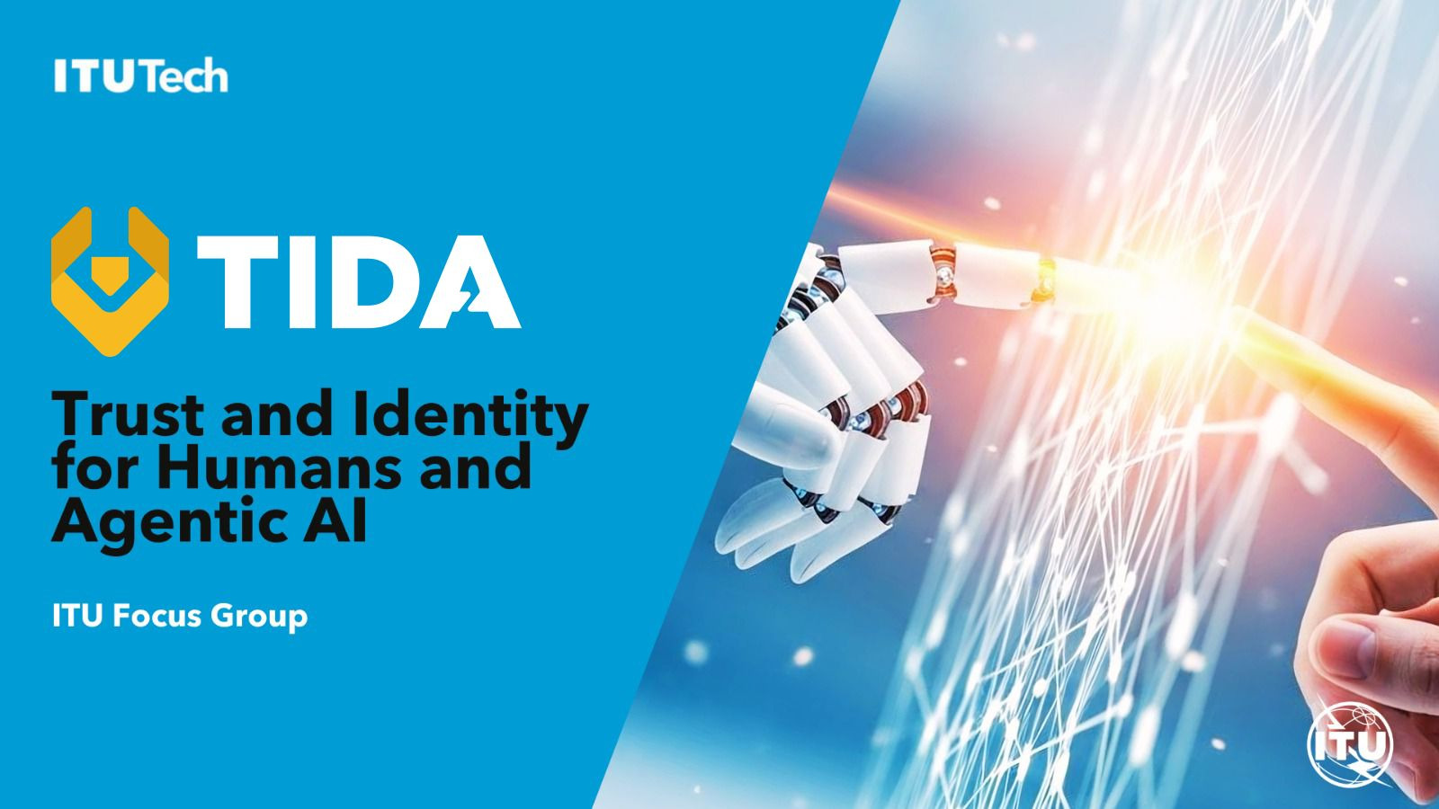
Auto-reporting tools

Slide 2

Why TIDA matters
Our mission: architectural models and interoperability frameworks that establish trust in agentic AI, built within the UN with Member States, industry and academia.
Speed. Standards bodies are still debating whether to form working groups. TIDA lets experts advance the work now.
Inclusion. Few organisations can attend every standards body. Without a shared baseline, only the largest platforms will set the rules.
No fragmentation. We fragmented digital identity for humans. TIDA provides common frameworks so we do not repeat that for AI agents.

Slide 3
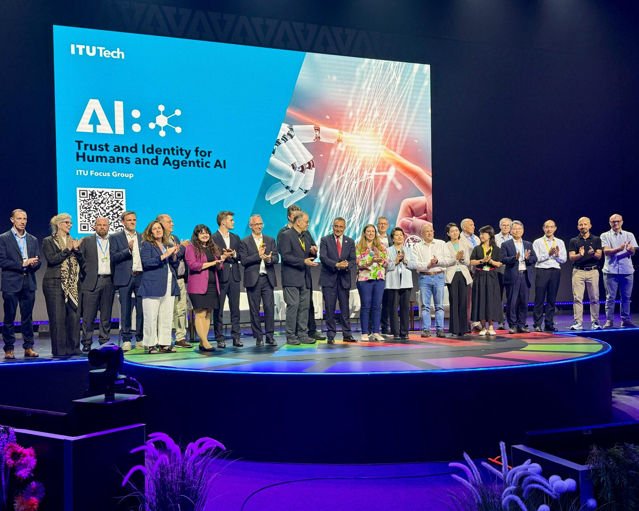
Launched 9 July 2026
54
48
governments
companies
11
37
universities
initial supporters on stage
Already 12 use-case and 28 working-group proposals submitted.
Open to all, free of charge, no ITU membership required · tida.community

Slide 4
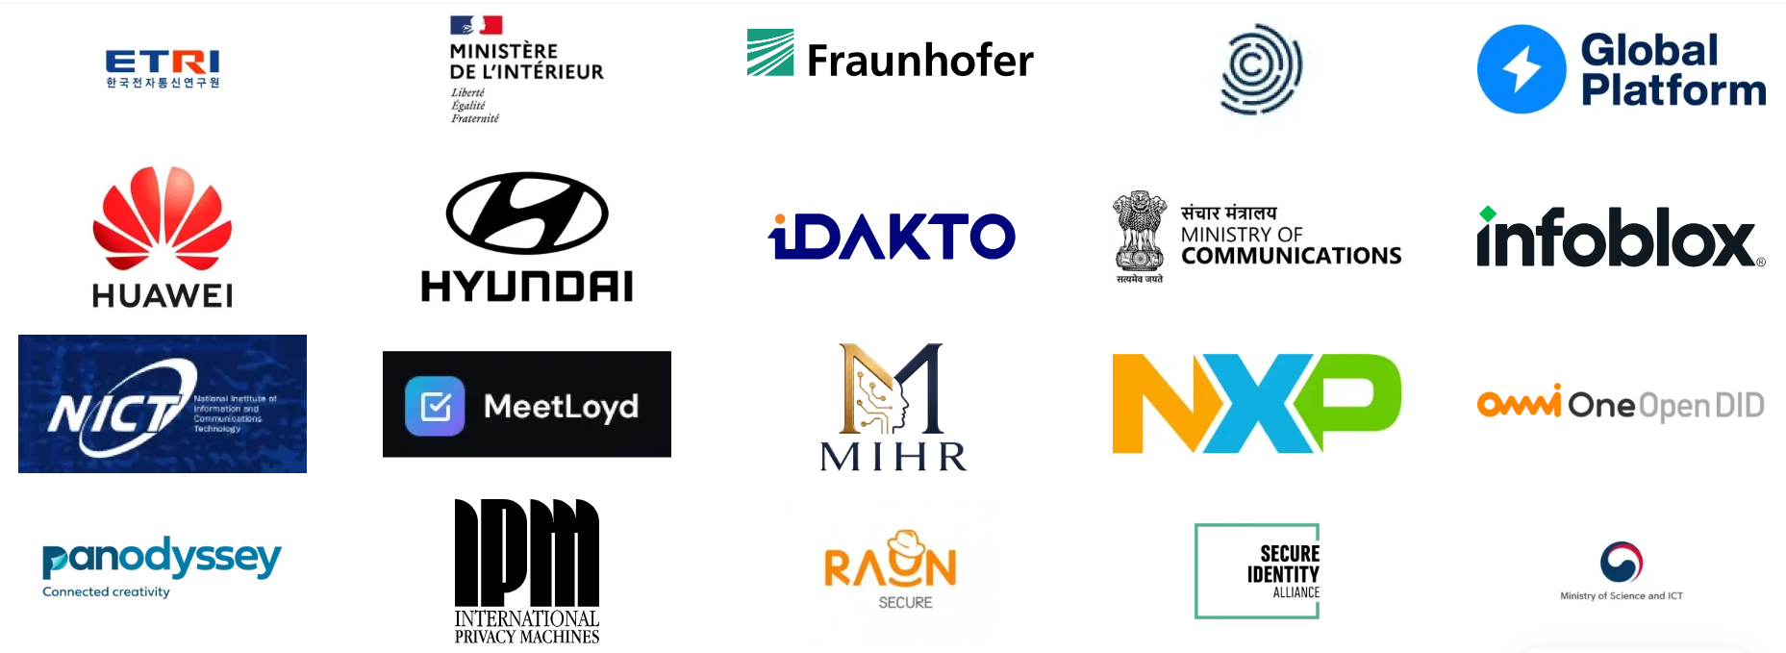
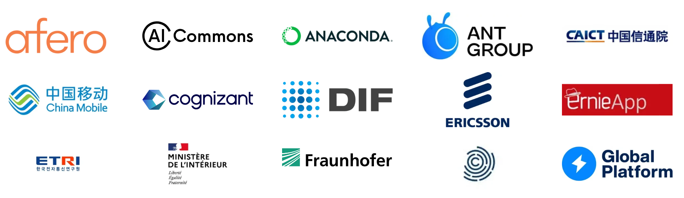
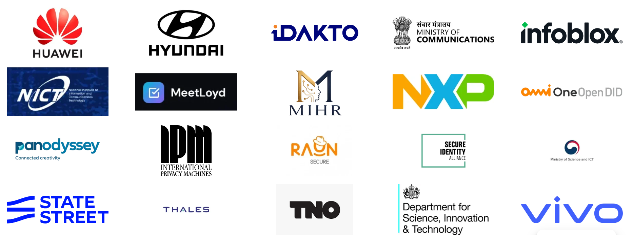
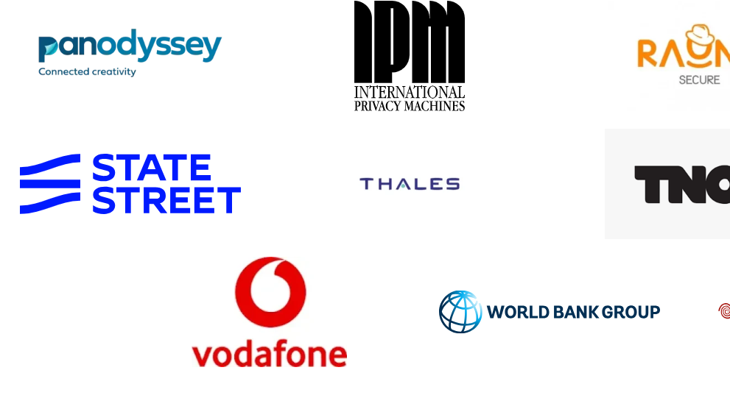
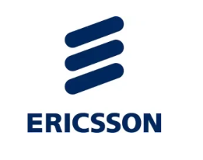
Who supports TIDA
Governments, industry and academia. Full list at tida.community

Slide 5


Next steps
Select the priority working groups from the 28 proposals
Publish initial deliverables openly on GitHub
First in-person meeting:
Paris, 30 Nov – 1 Dec 2026, hosted by the French MoI at UNESCO

