Slide 1
FINAL PROJECT Smart Home
Group 3 – Class SE1814
SE193983 – Trần Đình Thiện
SE194751- Trương Đoàn Anh Khoa
SE194533- Nguyễn Phú Cường
SE194001-Nguyễn Huỳnh Nhật Thịnh

Slide 2
PROJECT FEATURES
Scan Card ID to open the door
CO Sensor over 800 to active buzzer
Movement Sensor to light the LED
Obstacle Sensor to active buzzer
Using Web to turn on Light

Slide 3
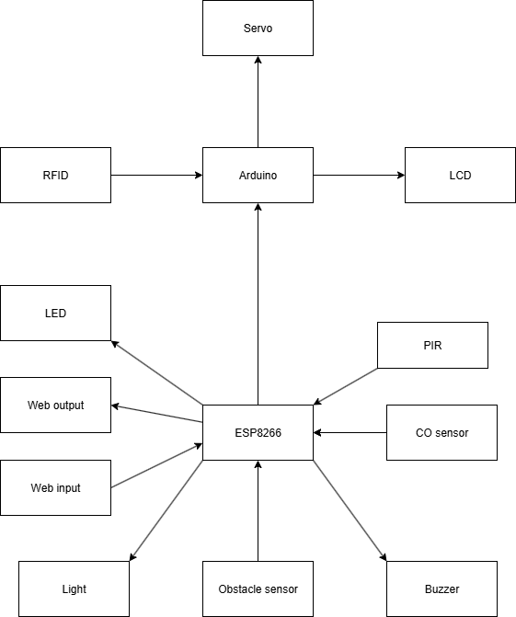
BLOCK DIAGRAM

Slide 4
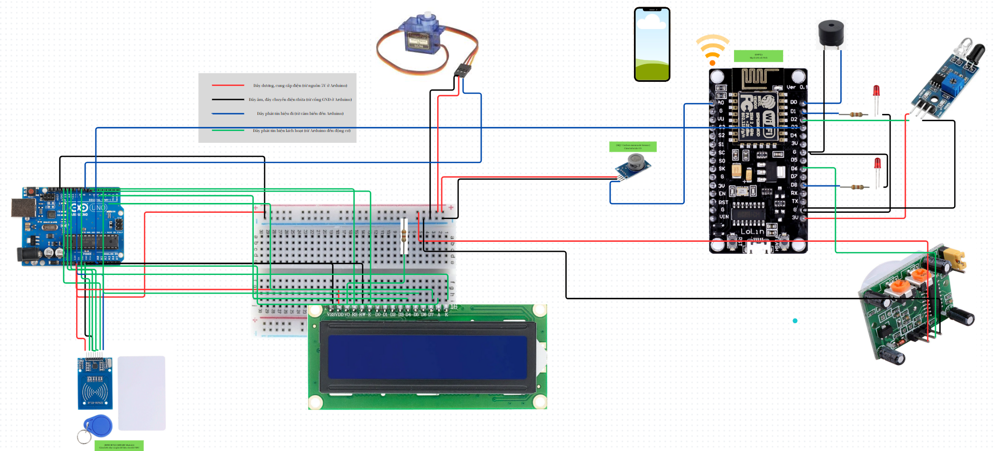
CIRCUIT SCHEMATIC

Slide 5
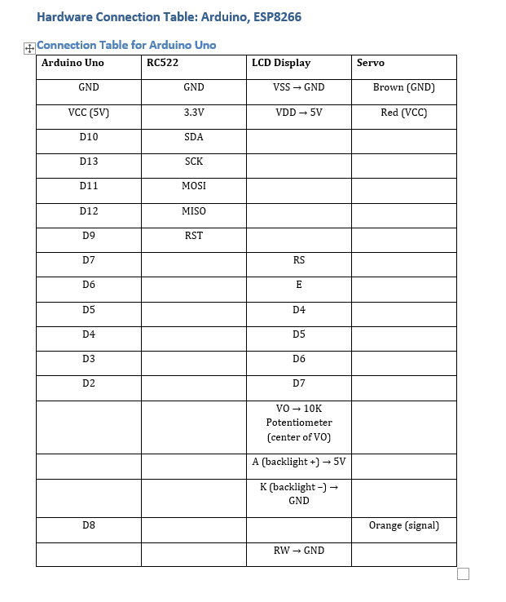
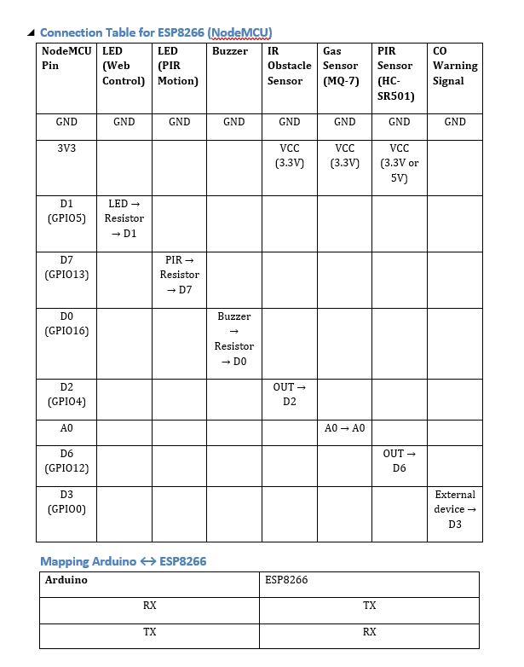
HARDWARE INTERFACING
.

Slide 6
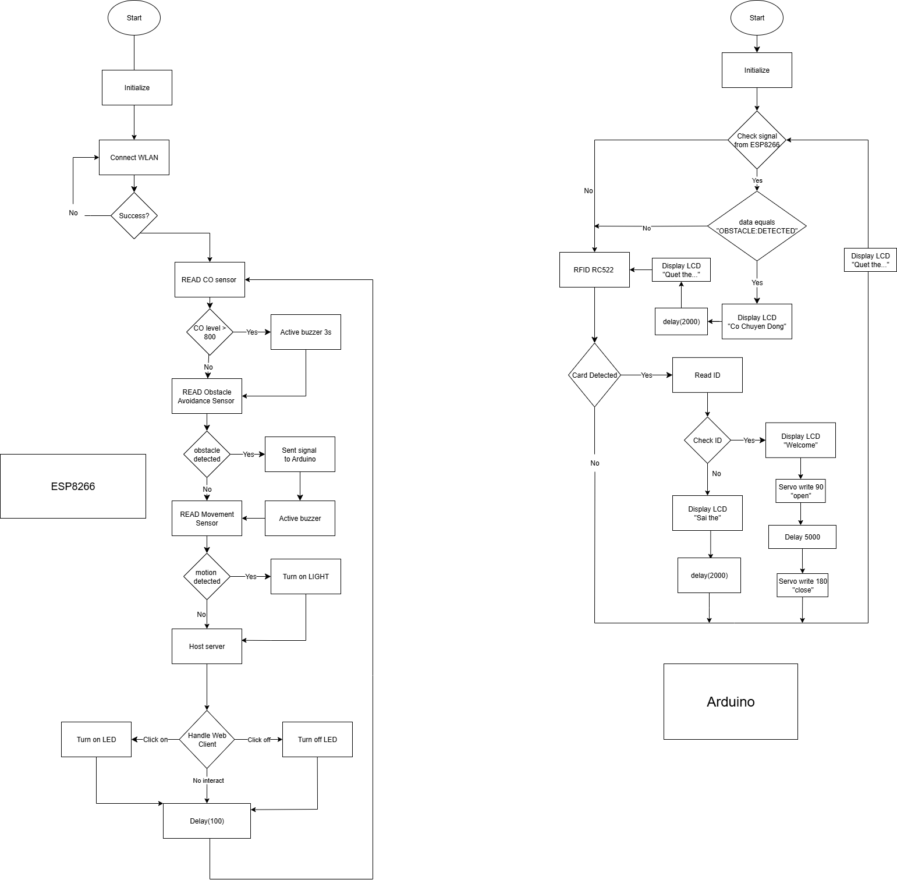
FLOWCHART

Slide 7
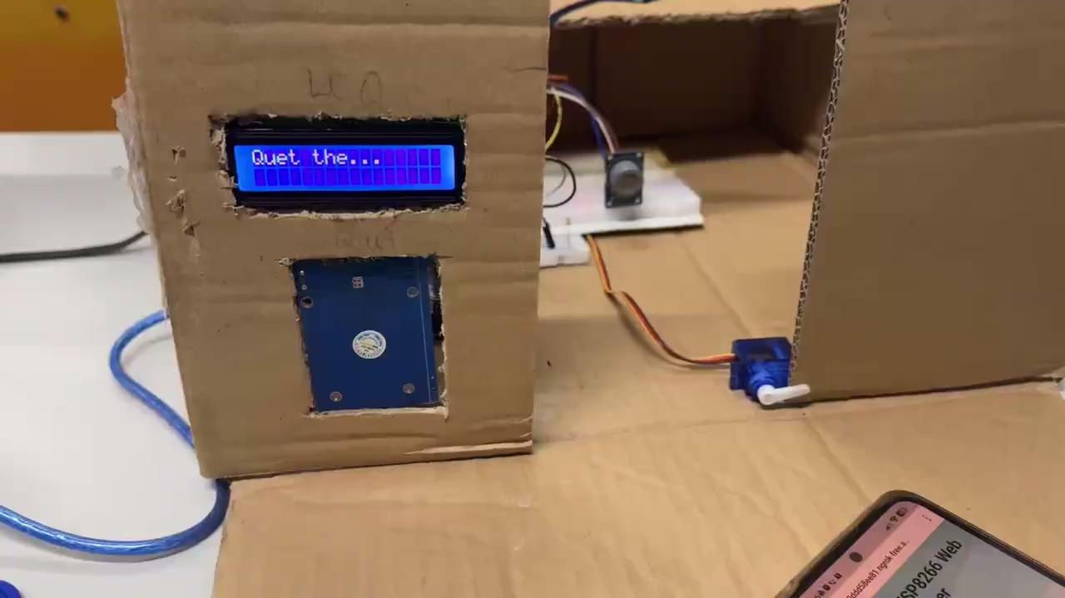
Demo Clip

Slide 8
Conclusions
1. RFID-Based Door Access: Uses RFID scanning to allow only authorized users to enter, improving security.
2.Contact Sensor (CO sensor) as Bell: Detects when CO is at the alarm level and triggers a doorbell to notify occupants.
3.Motion Sensor for Automation: Automatically turns on light or activates alert (LED/buzzer) when motion is detected.
4.Remote Control via Web Interface: Allows users to control the light through the internet.
5.Obstacle Sensors and Actuators: Combines multiple components for a functional and practical smart system.
6.Application and Purpose: -Enhances home or office security, convenience, and automation.
-Serves as a basic model for developing advanced smart systems.

Slide 9
Future Work
To enhance system functionality and reliability, we recommend the following future developments:
-Implement two-factor authentication for secure access.
-Transition to dashboard with user login.
-Fix the Logic and Bugs between ESP and Arduino

Slide 10
Q&A

