Slide 1

PHP Do jeito certo! Por Jonata Weber - jonataa@gmail.com
Apoio:
devfsa@googlegroups.com
http://horaextra.org/
http://br.phptherightway.com/

Slide 2
What is PHP?
PHP (PHP: Hypertext Preprocessor) is a widely-used open source general-purpose scripting language that is especially suited for web development and can be embedded into HTML (http://php.net/)

Slide 3
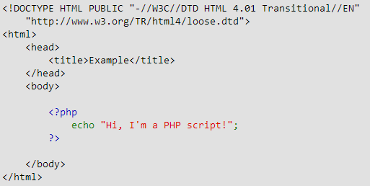
PHP & HTML

Slide 4
What is a PHP File?
PHP files can contain text, HTML, JavaScript code, and PHP code
PHP code are executed on the server, and the result is returned to the browser as plain HTML
PHP files have a default file extension of ".php"

Slide 5
What Can PHP Do?
PHP scripts are executed on the server
PHP can generate dynamic page content
PHP can create, open, read, write, and close files on the server
PHP can collect form data
PHP can send and receive cookies
PHP can add, delete, modify data in your database
PHP can restrict users to access some pages on your website
PHP can encrypt data

Slide 6
What Can PHP Do?
With PHP you are not limited to output HTML. You can output images, PDF files, and even Flash movies. You can also output any text, such as XHTML and XML.

Slide 7
Why PHP?
PHP runs on different platforms (Windows, Linux, Unix, Mac OS X, etc.)
PHP is compatible with almost all servers used today (Apache, IIS, etc.)
PHP has support for a wide range of databases
PHP is free. Download it from the official PHP resource: www.php.net
PHP is easy to learn and runs efficiently on the server side

Slide 8
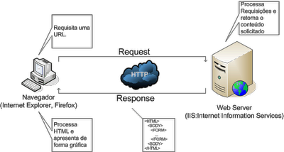
Arquitetura Web

Slide 9
Destaques da Linguagem
Paradigmas de programação
Linguagem dinâmica e flexível;
Suporte a diversas técnicas de programação;
Evoluiu drasticamente
Sólido modelo de orientação a objetos no PHP 5.0 2004);
Funções anônimas e namespaces no PHP 5.3 (2009) e;
Traits no PHP 5.4 (2012).

Slide 10
Destaques da Linguagem
Suporte completo ao POO
Incluindo suporte à classes, classes abstratas, interfaces, herança, construtores, clonagem, exceções e muito mais.

Slide 11
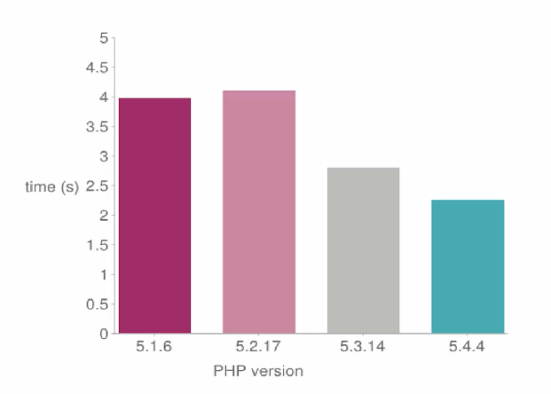
Performance entre versões do PHP

Slide 12
Getting Started!
Baixar o PHP 5.4;
Declarar no Path (variáveis de ambiente);
http://www.php.net/downloads.php
Tags especiais:
<?php echo ‘Hello World’; ?>
Executar script na linha de comando
Servidor Web Embutido
php –S localhost:8000

Slide 13

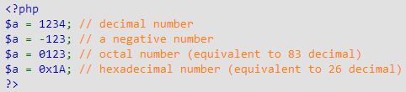
Tipos Primitivos
Boolean: TRUE or FALSE
Integer:

Slide 14

Tipos Primitivos
Floating point number
String
single quoted
double quoted
heredoc syntax
nowdoc syntax

Slide 15
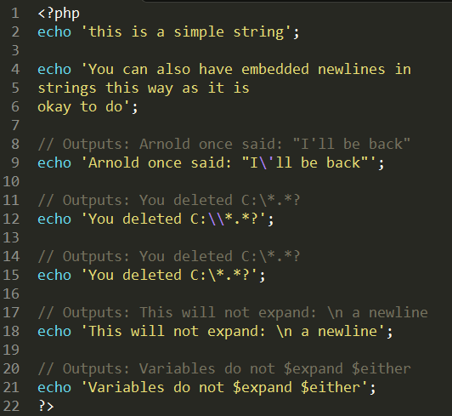
String
Single quoted

Slide 16
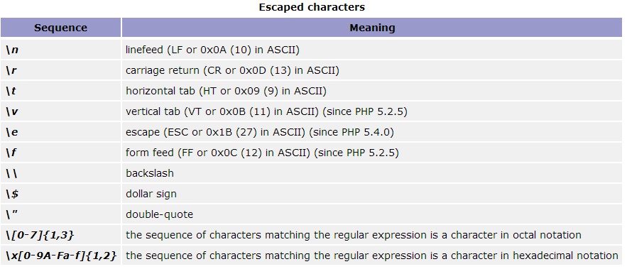
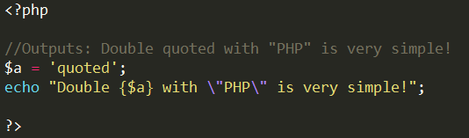
String
Double quoted

Slide 17
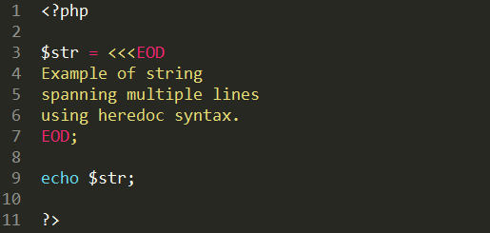
String
Heredoc

Slide 18
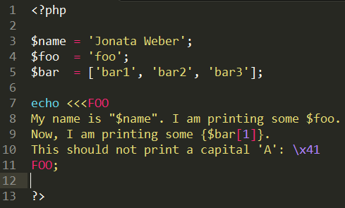
String
Nowdoc

Slide 19
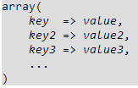
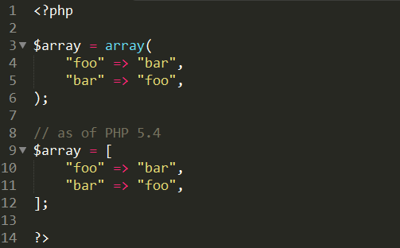
Arrays
Syntax

Slide 20
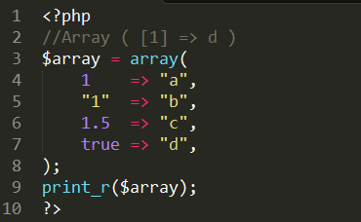
Arrays
Type Casting and Overwriting example

Slide 21
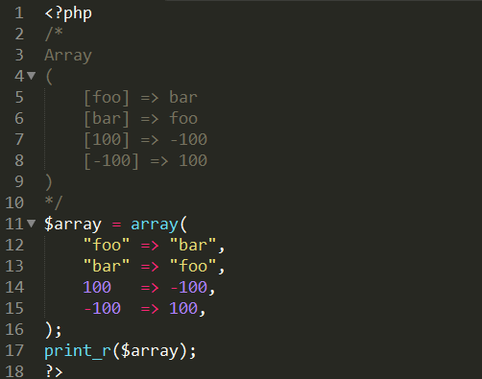
Arrays
Mixed integer and string keys

Slide 22
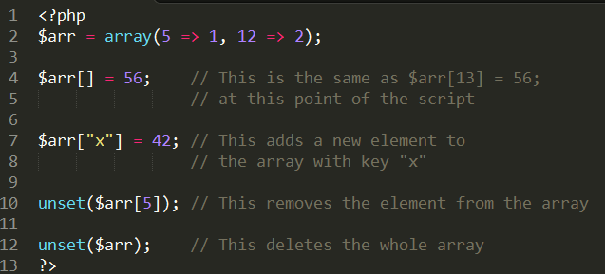
Arrays
Creating/modifying with square bracket syntax

Slide 23
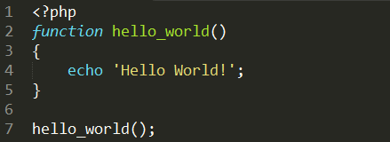
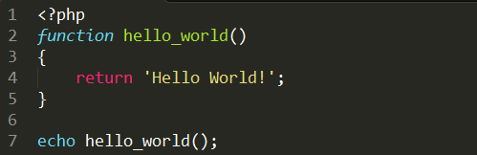
Funções

Slide 24
Referências
http://php.net/
http://phptherightway.com
http://www.w3schools.com/php/

