Slide 1
SNR
snr is a tool that:
Reads DICOM files from an input folder, ensuring they are 2D medical images with the Photometric Interpretation tag set to MONOCHROME1 or MONOCHROME2.
Constructs a 3D volume by ordering the slices based on the DICOM Instance Number tag.
Calculates snr in the 3D volume:
SNR = iavg/σi
where iavg is average value at the center of the volume(kernel size = 5x5) and σi is the standard deviation of the background (top left corner of size 5x5)
Save the SNR value to a text file in the output folder.
The guide describes how to run a container independently of XNAT and how to launch the container in XNAT.

Slide 2
Run a container without XNAT
Clone the GitHub Repository and go to the snr folder:
Repo: https://github.com/FGammaraccio/Docker-EOSC4Cancer-D2-2.git
Build the Docker Image:
docker build -t snr .
Run the Container:
docker run --rm
-v C:\Users\YourUser\Desktop\Docker-EOSC4Cancer-D2-2\data\input:/input
-v C:\Users\YourUser\Desktop\Docker-EOSC4Cancer-D2-2\data\output:/output
snr

Slide 3
Run a container in XNAT (1)
Clone the GitHub Repository and go to the snr folder:
Repo: https://github.com/FGammaraccio/Docker-EOSC4Cancer-D2-2.git
Build the Docker Image:
docker build -t snr .

Slide 4
Run a container in XNAT (2)
"This guide assumes that you have built your histogram Docker image on the same machine as is hosting XNAT. If your XNAT instance is hosted on a different machine, you will need to push your Docker image to a remote repository before proceeding."
Link: https://wiki.xnat.org/container-service/building-docker-images-for-container-service
Install:
XNAT + Plugin
Container Service Plugin
Batch Launch Plugin
Link: https://www.xnat.org/download/

Slide 5
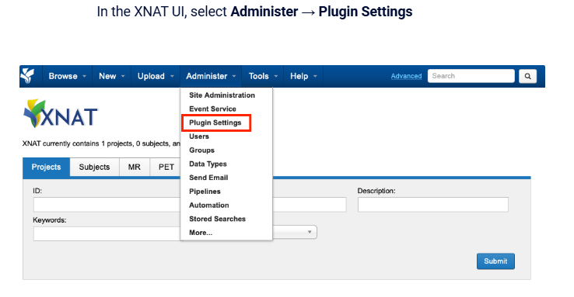
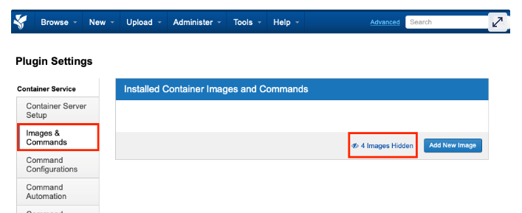
Run a container in XNAT (3)

Slide 6
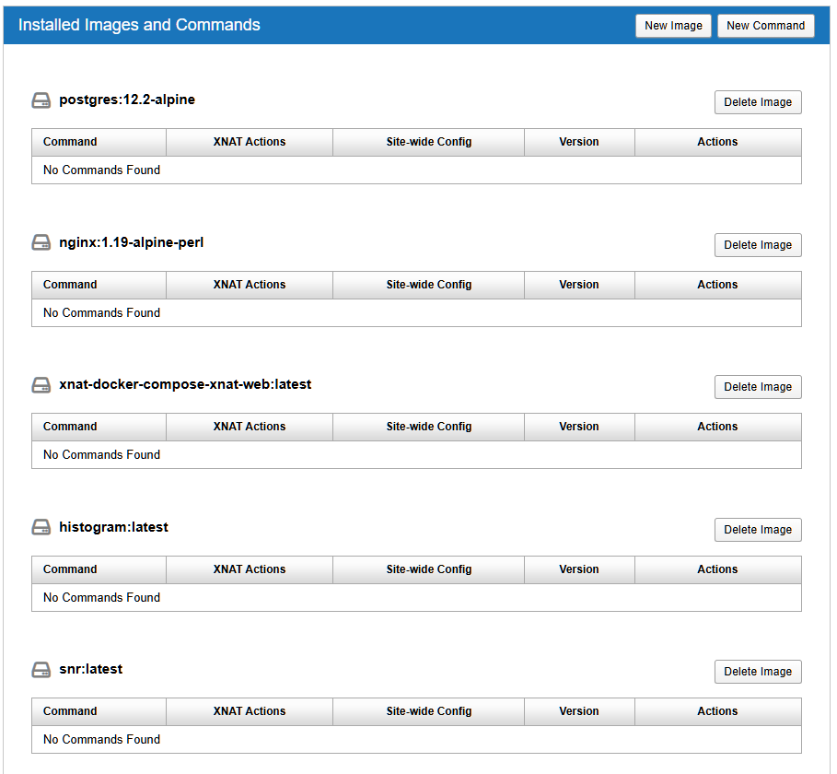
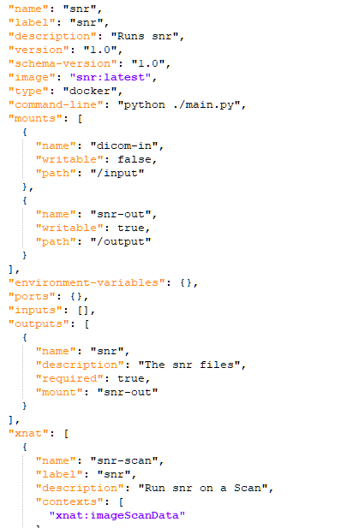
Run a container in XNAT (4)
Type the command JSON

Slide 7
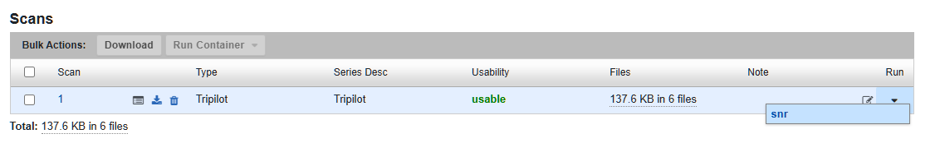
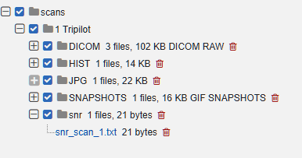
Run a container in XNAT (5)
Run container: select scan on which to launch the container
Result: The tool's output is saved inside an output folder. The SNR value is saved in a text file

Slide 8
Info
Docker version 4.24.1.0
XNAT version 1.8.10
Container Service Plugin version 3.3.0
Batch-Launch-Plugin version 0.5.0
Link Video Tutorial: https://drive.google.com/drive/folders/1-TaOmXurFRz_Z5HH44pAyF7tUXEltCDP?usp=drive_link

