Slide 1
Why/When to use?

Slide 2
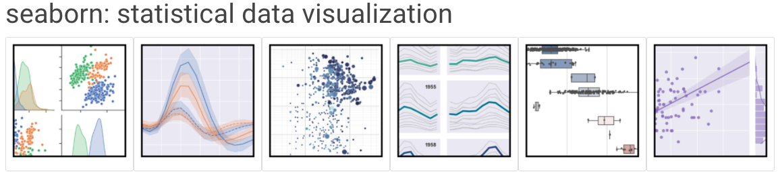
Seaborn
based on matplotlib
provides high level interface for drawing attractive statistical graphics
Similar (in style) to the popular ggplot2 library in R
Link: https://seaborn.pydata.org/

Slide 3
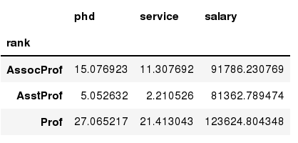
Data Frames groupby method
Using "group by" method we can:
Split the data into groups based on some criteria
Calculate statistics (or apply a function) to each group
In [ ]:
#Group data using rank
df_rank = df.groupby(['rank'])
In [ ]:
#Calculate mean value for each numeric column per each group
df_rank.mean()

Slide 4
Missing Values
There are a number of methods to deal with missing values in the data frame:
df.method() | description
dropna() | Drop missing observations
dropna(how='all') | Drop observations where all cells is NA
dropna(axis=1, how='all') | Drop column if all the values are missing
dropna(thresh = 5) | Drop rows that contain less than 5 non-missing values
fillna(0) | Replace missing values with zeros
isnull() | returns True if the value is missing
notnull() | Returns True for non-missing values

Slide 5
Missing Values
When summing the data, missing values will be treated as zero
If all values are missing, the sum will be equal to NaN
cumsum() and cumprod() methods ignore missing values but preserve them in the resulting arrays
Missing values in GroupBy method are excluded (just like in R)
Many descriptive statistics methods have skipna option to control if missing data should be excluded . This value is set to True by default (unlike R)

Slide 6
Aggregation Functions in Pandas
Aggregation - computing a summary statistic about each group, i.e.
compute group sums or means
compute group sizes/counts
Common aggregation functions:
min, max
count, sum, prod
mean, median, mode, mad
std, var

Slide 7
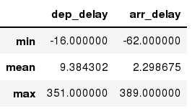
Aggregation Functions in Pandas
agg() method are useful when multiple statistics are computed per column:
In [ ]:
flights[['dep_delay','arr_delay']].agg(['min','mean','max'])
Out[ ]:

Slide 8
Basic Descriptive Statistics
df.method() | description
describe | Basic statistics (count, mean, std, min, quantiles, max)
min, max | Minimum and maximum values
mean, median, mode | Arithmetic average, median and mode
var, std | Variance and standard deviation
sem | Standard error of mean
skew | Sample skewness
kurt | kurtosis
NEXT WEEK

Slide 9
DATA 601 Lecture 7: Relational Data

Slide 10
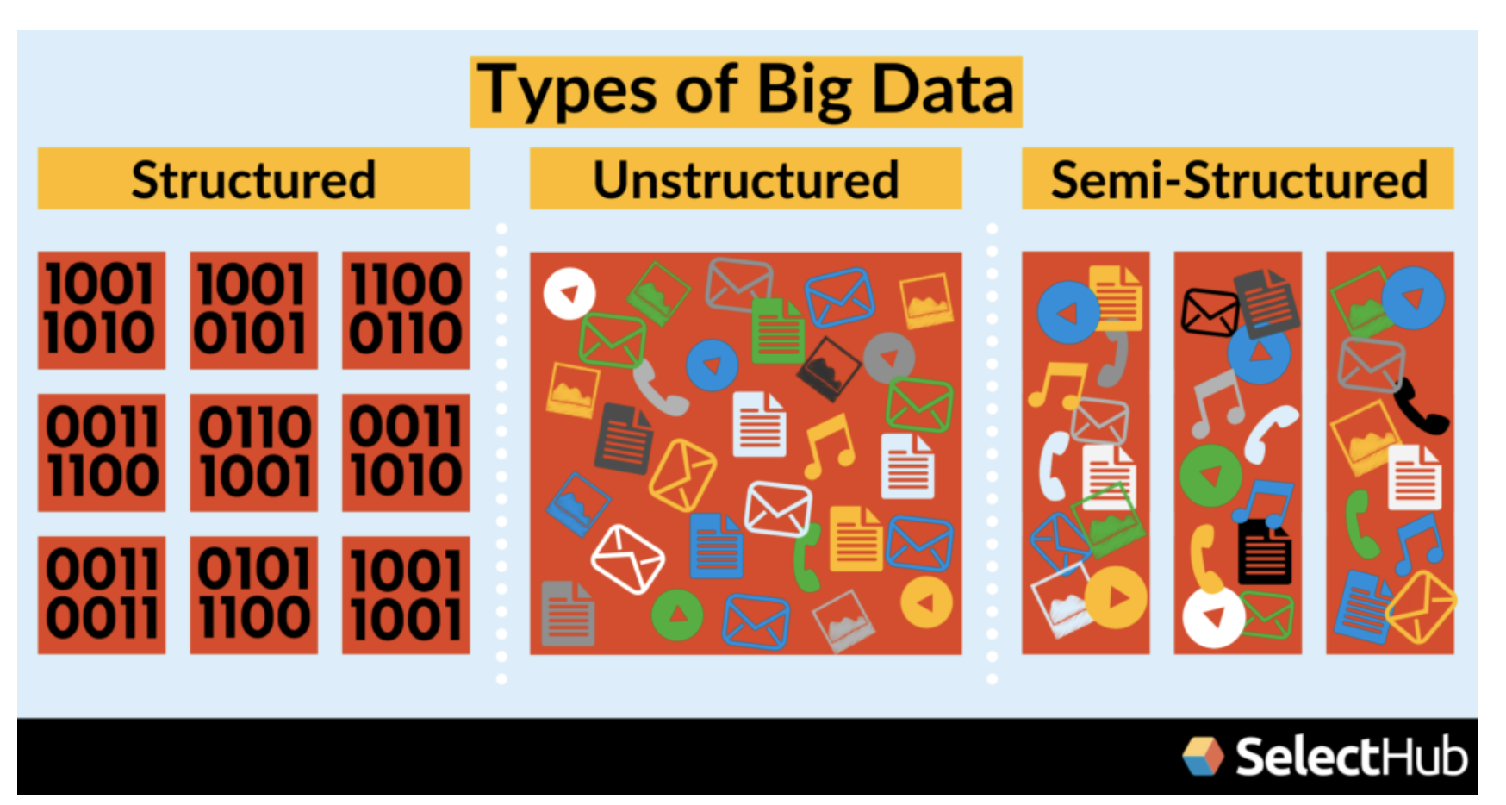
Types of Data
Image Source
Notes:
This week we will focus on more structured data and how to store it and query it.

Slide 11
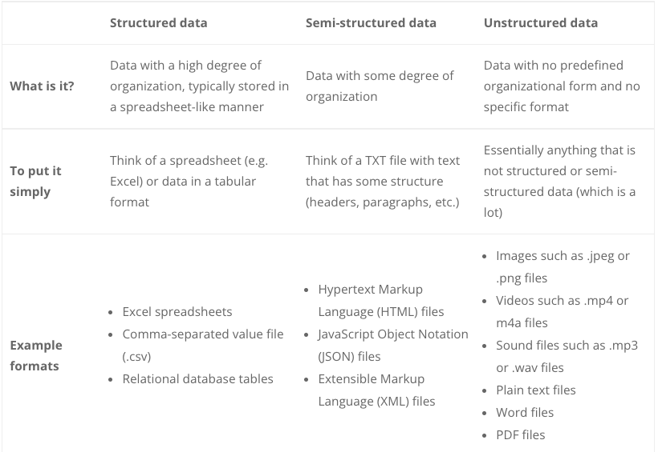
https://www.michael-gramlich.com/what-is-structured-semi-structured-and-unstructured-data/

Slide 12
What is a Relational Database?
A collection of data items with pre-defined relationships between them
where these items are organized as a set of tables with columns and rows.
Tables --- An entity
Columns -- attributes
Rows -- collection of data about one entity
Notes:
resources

Slide 13
PK: Primary Key
FK: Foreign Key (an attribute migrating from another table)
Note: A foreign key can only point one way
AK: Alternate Key
(1:1) each tuple in each table maps to exactly one tuple in the other
(1:0) when a PK of one table becomes PK & FK in another table
Notes:
resources

Slide 14
What is SQL?
Structured Query Language
A programming language that allows us to access relational databases
Its purpose is to: query, add/delete data, data definition (schemas)
One of the first commercial programming languages
DO I NEED TO LEARN SQL?
SQL becoming a standard tool in data science
SQL integrates with scripting languages
It is declarative (can be used to solve problems without requiring the programmer to specify an exact procedure to be followed)
Gives a solid foundation to understand/appreciate the challenges/needs for other types of databases.

Slide 15
User Roles
Data Engineer
Data Scientist
Developers
Create and manage databases
Give access and create other roles
Checks and fine-tunes
Access data
Read only
Can use some tools (as abstraction)
Can use SQL query tools to directly get access to the data
Create applications can write and read from databases
They use programming languages like Python, C++, Java, etc and use API, interfaces to get access to the databases.
Notes:
Different Data Roles in Netflix
Note that here we discussed the user roles who might want to access to the databases.

Slide 16
Database Management Systems
Check: https://db-engines.com/en/ranking
Note that open source systems and cloud based systems are becoming increasingly popular
https://www.capacitymedia.com/articles/3823826/cloud-future-for-75-of-databases-by-2022-says-gartner

