Slide 1
On the Concrete Security of Approximate FHE Schemes with Noise-Flooding Countermeasures
Flavio Bergamaschi, Anamaria Costache, Dana Dachman-Soled,
Hunter Kippen, Lucas LaBuff, and Rui Tang
50th FHE.org Meetup—May 2nd 2024

Slide 2
Motivation
Realizing large-scale deployments of FHE remains difficult
Efficiency
Usability
Risk
Concrete Security-efficiency tradeoffs are unclear
Hardware
Tooling

Slide 3
CKKS
Ring-LWE based FHE scheme introduced in 2017 [CKKS17]
Relaxes correctness requirements, allowing for lower noise growth
Arithmetic operations become approximate (i.e. floating point)
Parameters can be smaller
Approximate arithmetic is sufficient for desirable FHE functionality!
Privacy preserving ML

Slide 4
The Li-Miccancio Attack on CKKS [LiMic21]
Approximate correctness leads to an efficient attack
Consider the decryption equation for CKKS, $ct=\left(c_{0},c_{1}\right)$:
Attack is largely indifferent to CKKS’ message encoding
$$⌊c_{0}+s⋅c_{1}⌉=m \left(mod q\right) \\ s⋅c_{1}=m+E−c_{0} \\ s=c_{1}^{−1}⋅\left(m+E −c_{0}\right)$$
$$c_{0}+s⋅c_{1}=m+E \left(mod q\right) \\ s⋅c_{1}=m+E−c_{0} \\ s=c_{1}^{−1}⋅\left(m+E −c_{0}\right)$$

Slide 5
Noise-Flooding
Add noise to decryption
In a follow-up work, Li et al. analyzed noise flooding as a countermeasure [LMSS22]
Using Differential Privacy, can prove security
Difficult to achieve high message precision with secure noise flooding
$s≈32$ for single precision, $s≈\{64, 80\}$ for 16 and 8-bits of precision
$$c_{0}+s⋅c_{1}+𝓝\left(0, σ^{2}\right)=m+E+𝓝\left(0, σ^{2}\right) \left(mod q\right)$$

Slide 6
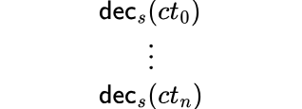
Objectives
Gap between provably secure noise flooding and poly-time attacks
Analyze concrete security loss for
Find a balance between message precision and added noise
Noise Levels
Number of decryptions
Circuits

Slide 7
LWE With Side Information
Model CKKS decryptions using framework of [DDGR20], [DGHK23]
Framework introduces an intermediate step: DBDD
Lattice
Reduction
$DBDD^{\left(0\right)}$
$$DBDD$$
$$LWE$$
$$SVP$$
Hint
$DBDD^{\left(1\right)}$
$$⋯$$
$DBDD^{\left(k\right)}$

Slide 8
LWE With Side Information
Allows iterative integration of side information (hints)
Run/Estimate lattice reduction on reduced instance
Types of Hints [DDGR20]
Perfect Hints | $$\left\langle v, \overline{s}\right\rangle =ℓ$$
Modular Hints | $$\left\langle v, \overline{s}\right\rangle =ℓ \left(mod k\right)$$
Approximate Hints | $$\left\langle v, \overline{s}\right\rangle ≈ℓ$$
Short Vector Hints | $v∈Λ$ s.t. $v$ is short
Types of Hints [DDGR20]
Perfect Hints | $$\left\langle v, \overline{s}\right\rangle =ℓ$$
Modular Hints | $$\left\langle v, \overline{s}\right\rangle =ℓ \left(mod k\right)$$
Approximate Hints | $$\left\langle v, \overline{s}\right\rangle ≈ℓ$$
Short Vector Hints | $v∈Λ$ s.t. $v$ is short
Guessing Attacks

Slide 9
Analyzing Concrete Security Loss via Hints
Consider the decryption equation again
Can be thought of as an approximate-modular hint
Not optimal
What about a stronger attacker model?
$$c_{0}+s⋅c_{1}+𝓝\left(0, σ^{2}\right)=m+E+𝓝\left(0, σ^{2}\right) \left(mod q\right) \\ s⋅c_{1}=E^{′}−𝓝\left(0, σ^{2}\right) (mod q)$$

Slide 10
Attack Model
Key store
sk
$$ct^{′}$$
$$Dec_{sk}\left(ct^{′}\right)+𝓝\left(0, σ^{2}\right)$$
Evaluator
User
$$\left(ct, 𝒞\right)$$
$$ct^{′}$$
pk
ek
$$ct←Enc_{pk}\left(m\right)$$

Slide 11
Analyzing Fresh Decryptions
Consider the decryption equation again (again)
$$c_{0}+s⋅c_{1}+𝓝\left(0, σ^{2}\right)=m+E+𝓝\left(0, σ^{2}\right)$$

Slide 12
Analyzing Fresh Decryptions
Consider the decryption equation again (again)
$$c_{0}+s⋅c_{1}+𝓝\left(0, σ^{2}\right)=m+E+𝓝\left(0, σ^{2}\right) \\ c=m+v⋅e+e_{0}+e_{1}⋅s+𝓝\left(0, σ^{2}\right)$$

Slide 13
Analyzing Fresh Decryptions
Consider the decryption equation again (again)
No wrap-around $mod q$
Approximate hint on $\left(e\left\|s\right.\right)$
$$c_{0}+s⋅c_{1}+𝓝\left(0, σ^{2}\right)=m+E+𝓝\left(0, σ^{2}\right) \\ c=m+v⋅e+e_{0}+e_{1}⋅s+𝓝\left(0, σ^{2}\right)$$
Attacker Controlled

Slide 14
Challenges Integrating Hints
Solution 1: Use full-dim approximate hints
Tracking DBDD ellipsoid requires $2n×2n$ matrix inversion
Tracking DBDD ellipsoid requires 2𝑛×2𝑛 matrix inversion
Can calculate hardness with Ellipsoid volume
Depends on hint matrix determinant
Solution 2: Only calculate volume
Explicit calculation still a bit too slow…
For $n=256$ and $16$ hints, roughly a week on a supercomputer
For 𝑛=256 and 16 hints, roughly a week on a supercomputer
We instead compute the expectation of the determinant
CKKS dimensions are quite large!
$n$ up to $2^{17}$
Estimating 100s of hints already computationally infeasible

Slide 15
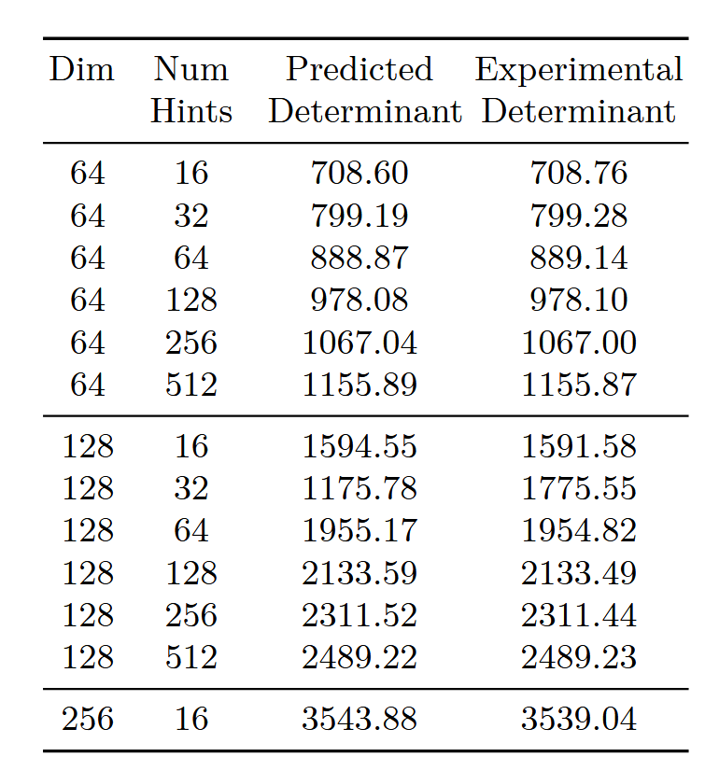
Expectation of Determinant
Lemma 5.1 in the paper
Provides a closed-form expression
Experimentally validated

Slide 16
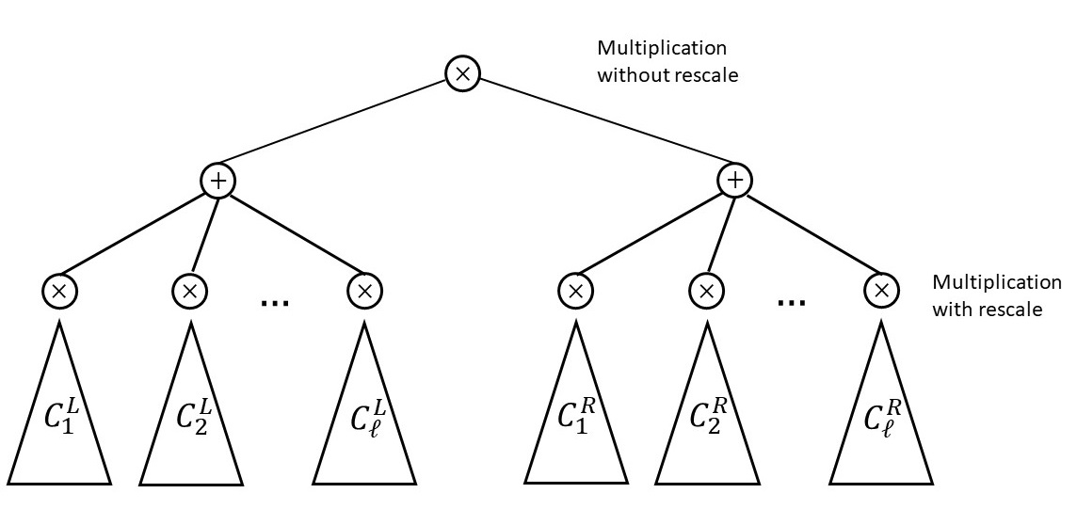
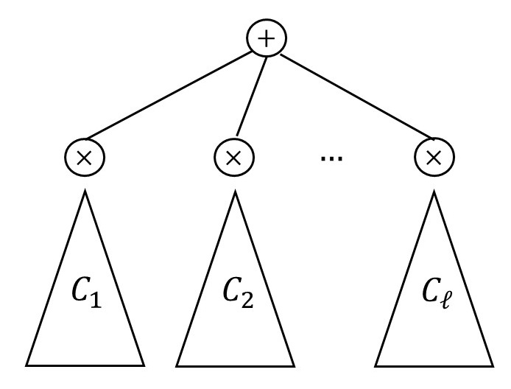
Beyond Identity Circuits
We consider two additional classes of circuits
Class 1
Class 2

Slide 17
Effects of Multiplications
Multiplication with rescaling results in rounding error dominating
We get: $B_{final}=Δ^{−1}\left(B_{mult}+B_{ks}\right)+B_{round}$
Rounding error in each $C_{i}$
$δ_{1}^{i}⋅s+δ_{0}^{i}$
Class 1

Slide 18
Experimental Set up
Noise-flood by $ρ^{2},100·ρ^{2},t·ρ^{2}$
$ρ^{2}$ is an average-case estimate of the variance of the underlying noise, as estimated by [CC+22]
Validate by running estimates for statistical noise flooding
Then run all those attacks for the parameters suggested by homomorphicencryption.org

Slide 19
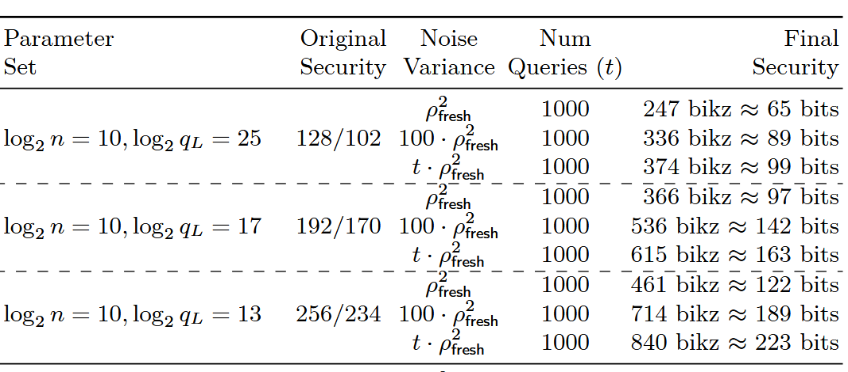
Lattice Attacks on Fresh Ciphertexts

Slide 20
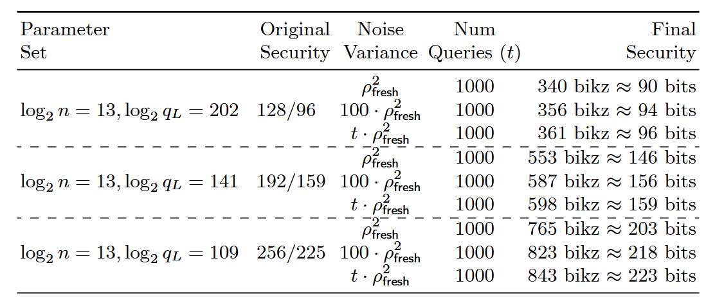
Lattice Attacks on Fresh Ciphertexts

Slide 21
Lattice Attack Trends

Slide 22
Guessing Attacks
Attacker keeps track of LWE secret/error covariance after $t$ hints
When variance small enough, round the mean of the distribution
For $t$ large enough, can guess $n$ out of $2n$ coordinates
Notes:
Keeping track of the covariance matrix requires a $2n×2n$matrix inversion
Knowing the distribution of the matrix allows to derive w.h.p. bounds on the trace and eigenvalues
These can in turn be used to bound the success probability of the guessing attack

Slide 23
Guessing Attack Trends

Slide 24
Hybrid Attacks
Combines the two strategies
Guess $g<n$ coordinates
Integrate guesses as perfect hints
Notes:
Keeping track of the covariance matrix requires a $2n×2n$matrix inversion
Knowing the distribution of the matrix allows to derive w.h.p. bounds on the trace and eigenvalues
These can in turn be used to bound the success probability of the guessing attack

Slide 25
Hybrid Attack Trends

Slide 26
General Observations
Greater reduction in bit-security for lattice attacks for identity circuits vs C1/2
Hints in identity circuits involve all $2n$ coordinates in the LWE secret/error
Greater security reduction for higher target security level vs. lower target security level
When fixing the dimension, a higher security level has a smaller modulus
Notes:
So variance of all 2n coordinates is reduced after each hint
Hints in Class 1 and Class 2 circuits involve only the n coordinates from the LWE secret
So only the variance of these n coordinates is reduced after each hint
As the modulus becomes smaller, hints obtained from decryption have more of an impact on the bit-security for lattice reduction attacks

Slide 27
General Observations
Guessing attacks perform significantly better for Class 1 and 2 circuits
For C1/2 circuits, hints correspond to linear combinations of only the $s$ variables
Validated absence of security drop when using the statistically-secure noise-flooding
Biggest drop in bit security is observed when noise-flooding by $ρ^{2}$
Noise-flooding by $t⋅ρ^{2}$ leads to a very low reduction in bit-security
Notes:
For identity circuits, there are a total of 2n eigenvalues that are
reduced by obtaining hints
• But n of those have relatively larger expectation, while the other n
have smaller expectation

Slide 28
Summary
Noise-flooding by $t·ρ^{2}$seems to be enough
Perhaps a less cautious approach is to noise-flood by $α·t·ρ^{2}$, for some $α∈(0, 1)$
Think of $α$ as a fine-tuning parameter
Perhaps for some higher dimensions, a security loss of a few bits is acceptable?
Start to use these results to establish key refreshing policies

Slide 29
Thank you!
Paper: https://ia.cr/2024/424
Email: hkippen@umd.edu
hunterkipt@gmail.com

Slide 30
References
[CKKS17] Cheon, J.H., Kim, A., Kim, M., Song, Y. (2017). Homomorphic Encryption for Arithmetic of Approximate Numbers. In: Takagi, T., Peyrin, T. (eds) Advances in Cryptology – ASIACRYPT 2017. ASIACRYPT 2017. Lecture Notes in Computer Science(), vol 10624. Springer, Cham. https://doi.org/10.1007/978-3-319-70694-8_15
[LiMic21] Baiyu Li and Daniele Micciancio. On the security of homomorphic encryption on approximate numbers. In Advances in Cryptology–EUROCRYPT 2021: 40th Annual International Conference on the Theory and Applications of Cryptographic Techniques, Zagreb, Croatia, October 17–21, 2021, Proceedings, Part I 40, pages 648–677. Springer, 2021.
[LMSS22] Baiyu Li, Daniele Micciancio, Mark Schultz, and Jessica Sorrell. Securing approximate homomorphic encryption using differential privacy. In Annual International Cryptology Conference, pages 560–589. Springer, 2022.
[CC+22] Anamaria Costache, Benjamin R. Curtis, Erin Hales, Sean Murphy, Tabitha Ogilvie, and Rachel Player. On the precision loss in approximate homomorphic encryption. Cryptology ePrint Archive, Paper 2022/162, 2022. https://eprint.iacr.org/2022/162.

Slide 31
References
[DDGR20] Dachman-Soled, D., Ducas, L., Gong, H., & Rossi, M. (2020, August). “LWE with side information: attacks and concrete security estimation.” In Advances in Cryptology–CRYPTO 2020: 40th Annual International Cryptology Conference, CRYPTO 2020, Santa Barbara, CA, USA, August 17–21, 2020, Proceedings, Part II (pp. 329-358). Cham: Springer International Publishing.
[DGHK23] Dachman-Soled, D., Gong, H., Hanson, T., Kippen, H. (2023). Revisiting Security Estimation for LWE with Hints from a Geometric Perspective. In: Handschuh, H., Lysyanskaya, A. (eds) Advances in Cryptology – CRYPTO 2023. CRYPTO 2023. Lecture Notes in Computer Science, vol 14085. Springer, Cham. https://doi.org/10.1007/978-3-031-38554-4_24

