Slide 1

Exploratory Data Analysis
G2M Case Study
19-Mar-2023

Slide 2
Agenda
Executive Summary
Problem Statement
Approach
EDA
EDA Summary
Recommendations

Slide 3
Executive Summary
Profit Analysis
The Exploratory Data Analysis was conducted to compare the performance of two taxi companies, Yellow Cab and Pink Cab, across various criteria such as customer reach, pricing strategy, market share, customer loyalty, age range target, and profit margin. The The Exploratory Data Analysis showed that Yellow Cab appears to be a better company to invest in, based on all the characteristics above. However, investment decisions should not solely be based on the results of The Exploratory Data Analysis , and other factors such as financial stability and market trends should be taken into account.

Slide 4
Problem Statement
Profit Analysis
What is the distribution of the data, and are there any outliers or anomalies?
2. How can we visualize and summarize the data to gain insights and make decisions?
3. Who has better pricing strategy?
4. Who has greater profit and profit margin?
5. Who is performing better in each city?
6. Who is performing better over time?

Slide 5
Approach
16 Features( including 4 derived features)
Timeframe of the data: 2016-01-31 to 2018-12-31
Total data points: 440,098
Total Nulls: 80,706
Assumptions:
Outliers are present in Price_Charged feature but due to
unavailability of trip duration details ,we are not treating this as outlier.
Profit of rides are calculated keeping other factors constant and only
Price_Charged and Cost_of_Trip features used to calculate profit.
Users feature of city dataset is treated as number of cab users in the city.
we have assumed that this can be other cab users as well(including Yellow and
Pink cab)
Cab_Data.csv
Customer_ID.csv
Transaction_ID.csv
City.csv
Final cab data

Slide 6
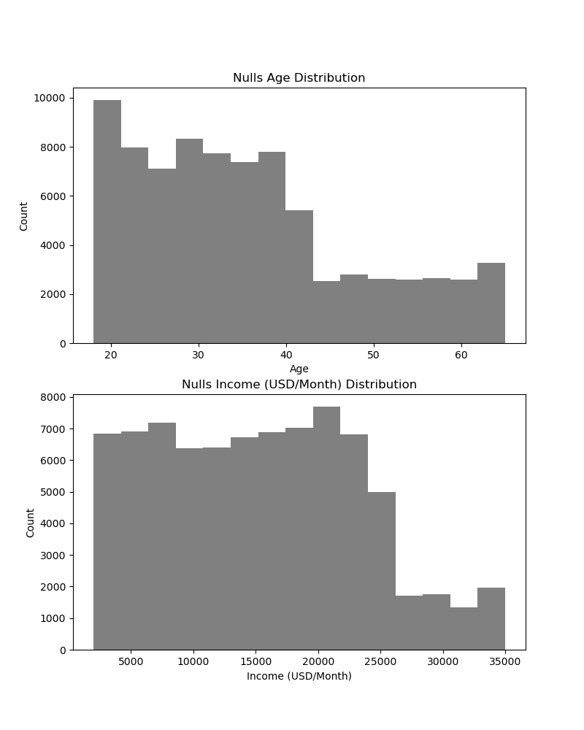
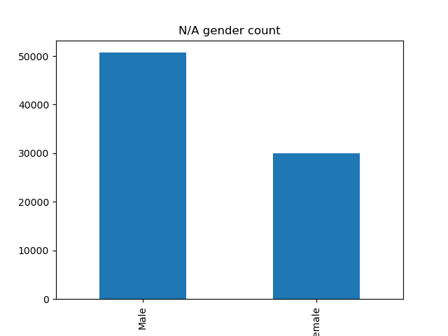
EDA – NULLs Analysis
Profit Analysis

Slide 7
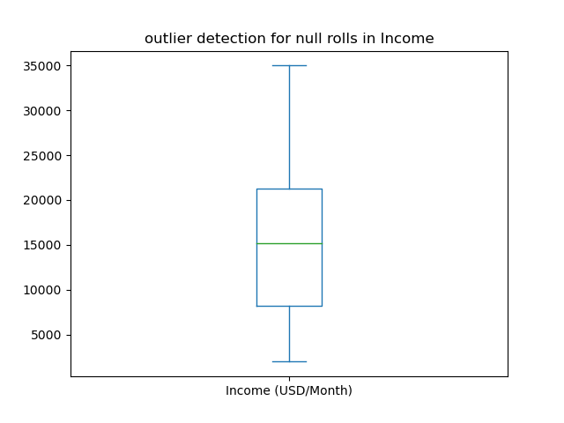
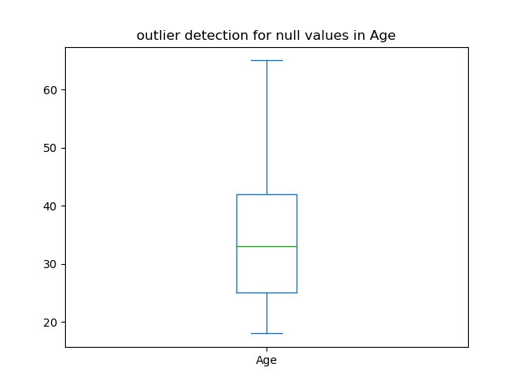
EDA – NULLs Analysis
Profit Analysis

Slide 8
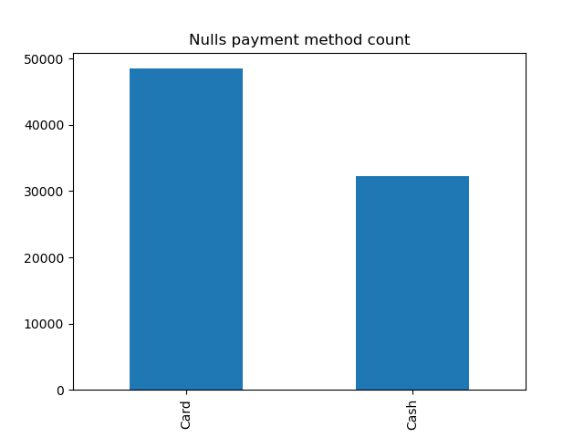
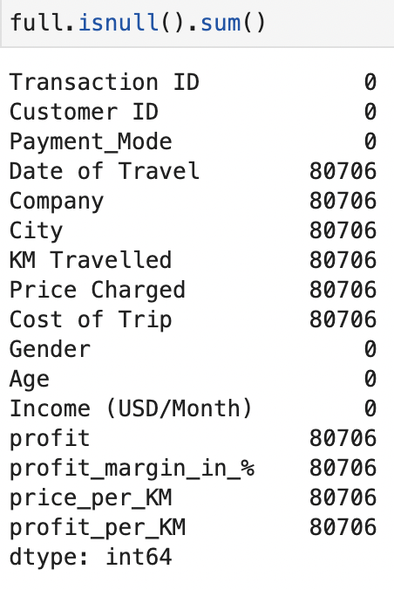
EDA – NULLs Analysis
Profit Analysis

Slide 9
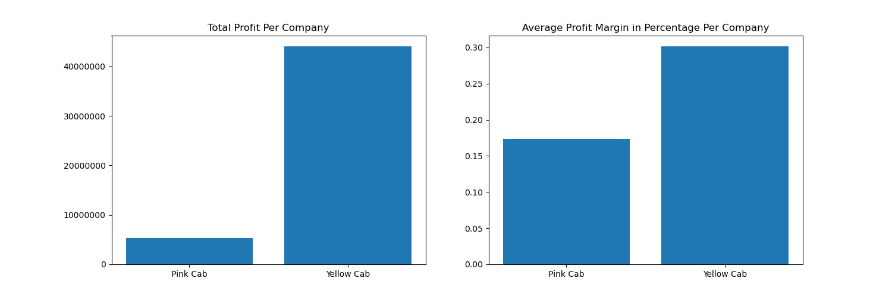
EDA - Profit Analysis
Profit Analysis

Slide 10
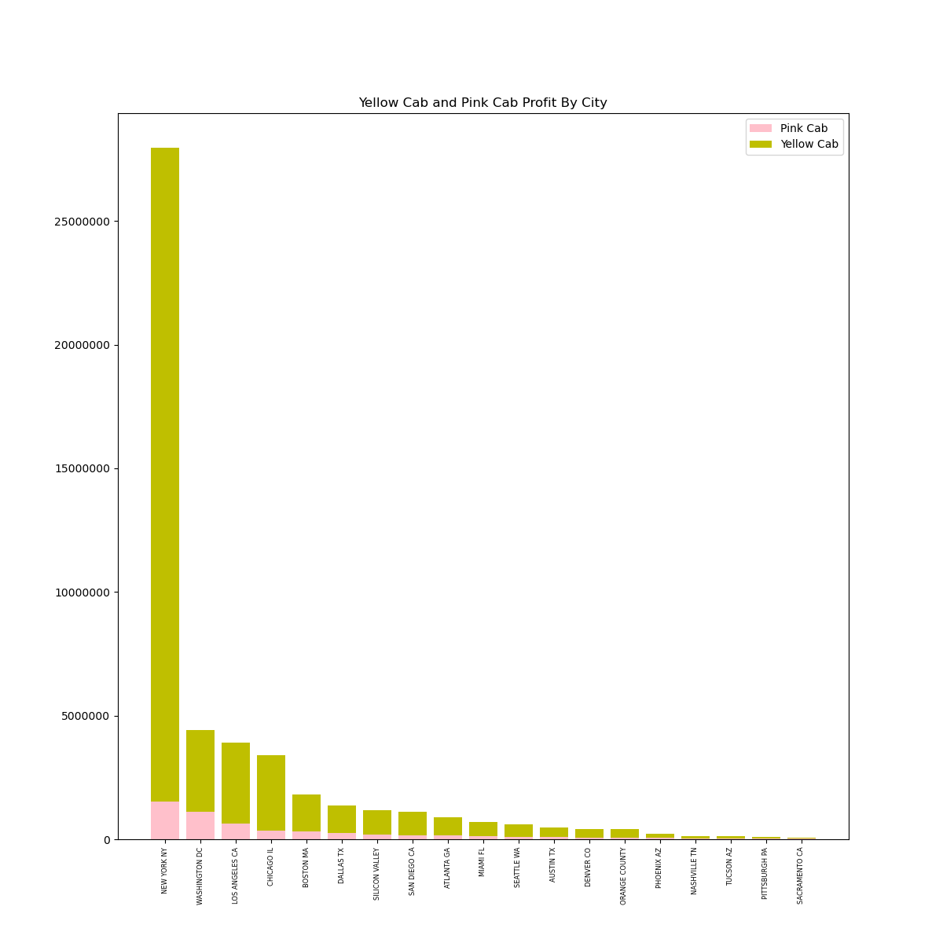
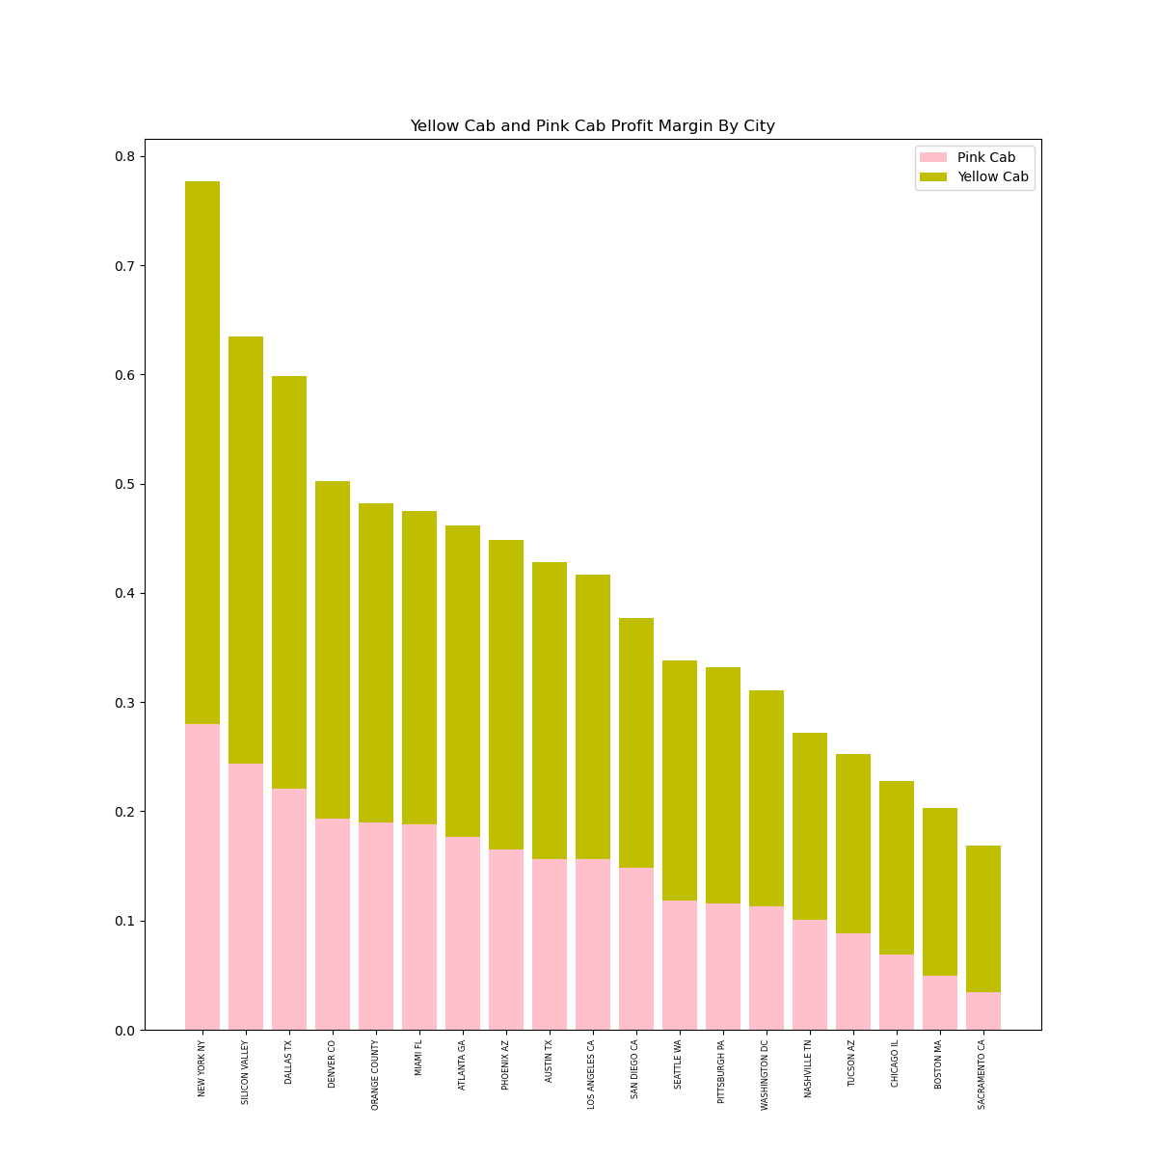
EDA - Profit Analysis

Slide 11
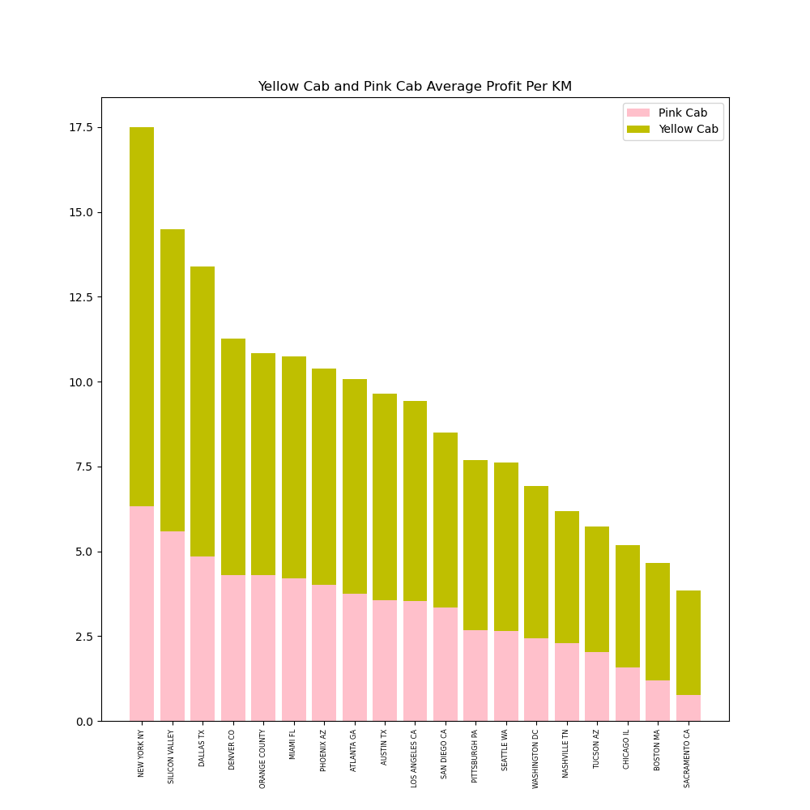
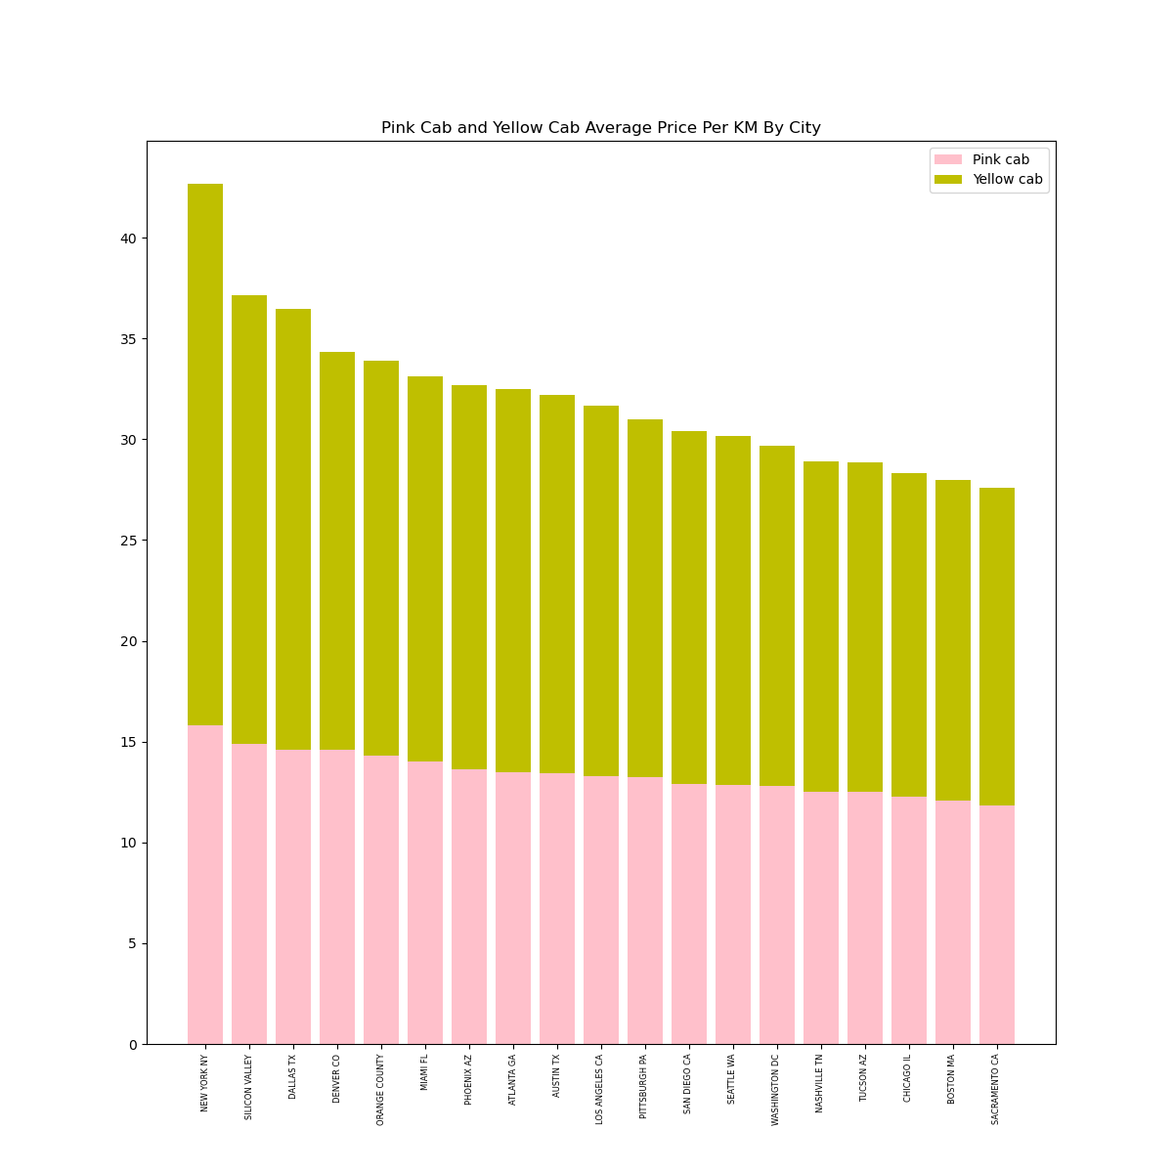
EDA - Profit Analysis

Slide 12
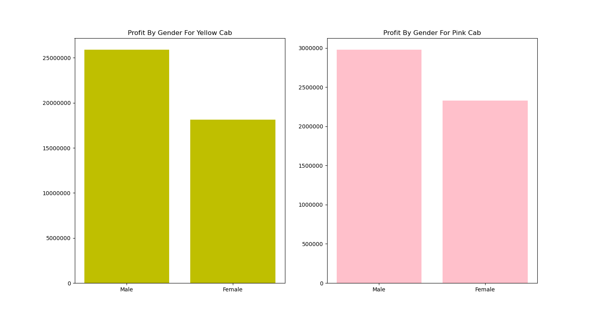
EDA - Profit Analysis

Slide 13
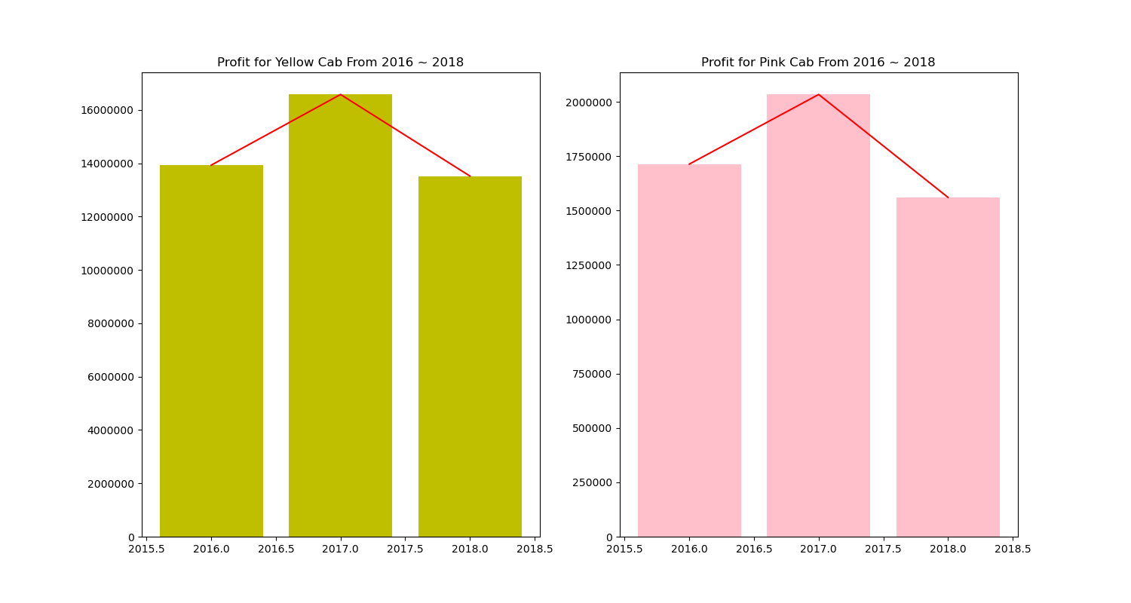
EDA - Profit - Time Series

Slide 14
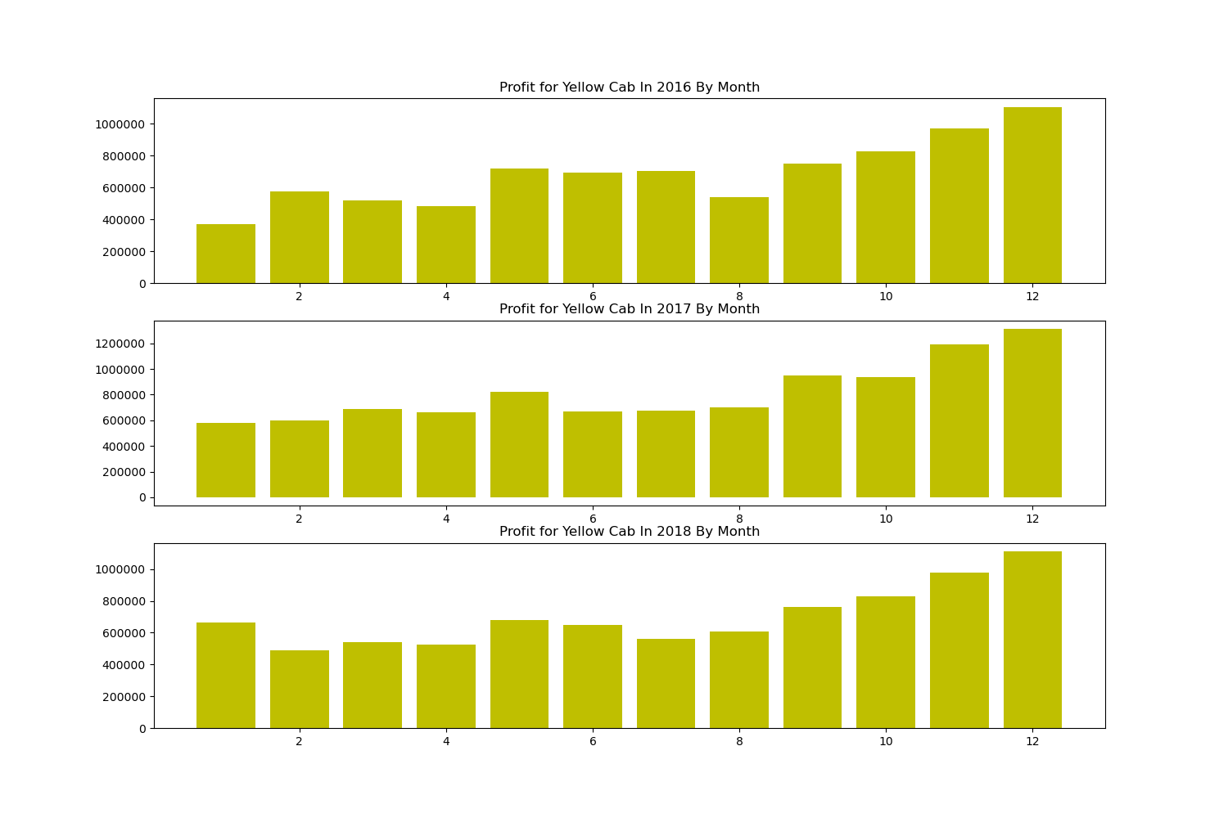
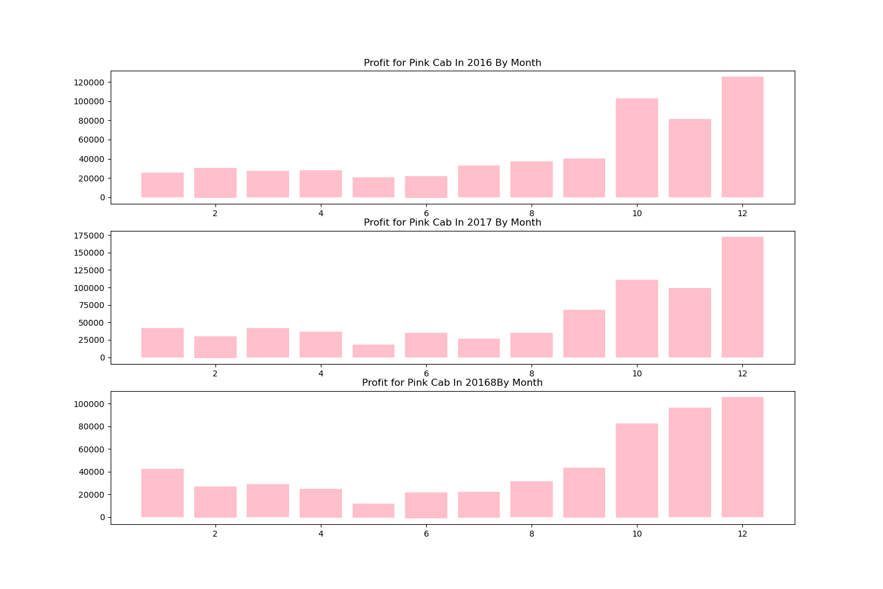
EDA - Profit - Time Series

Slide 15
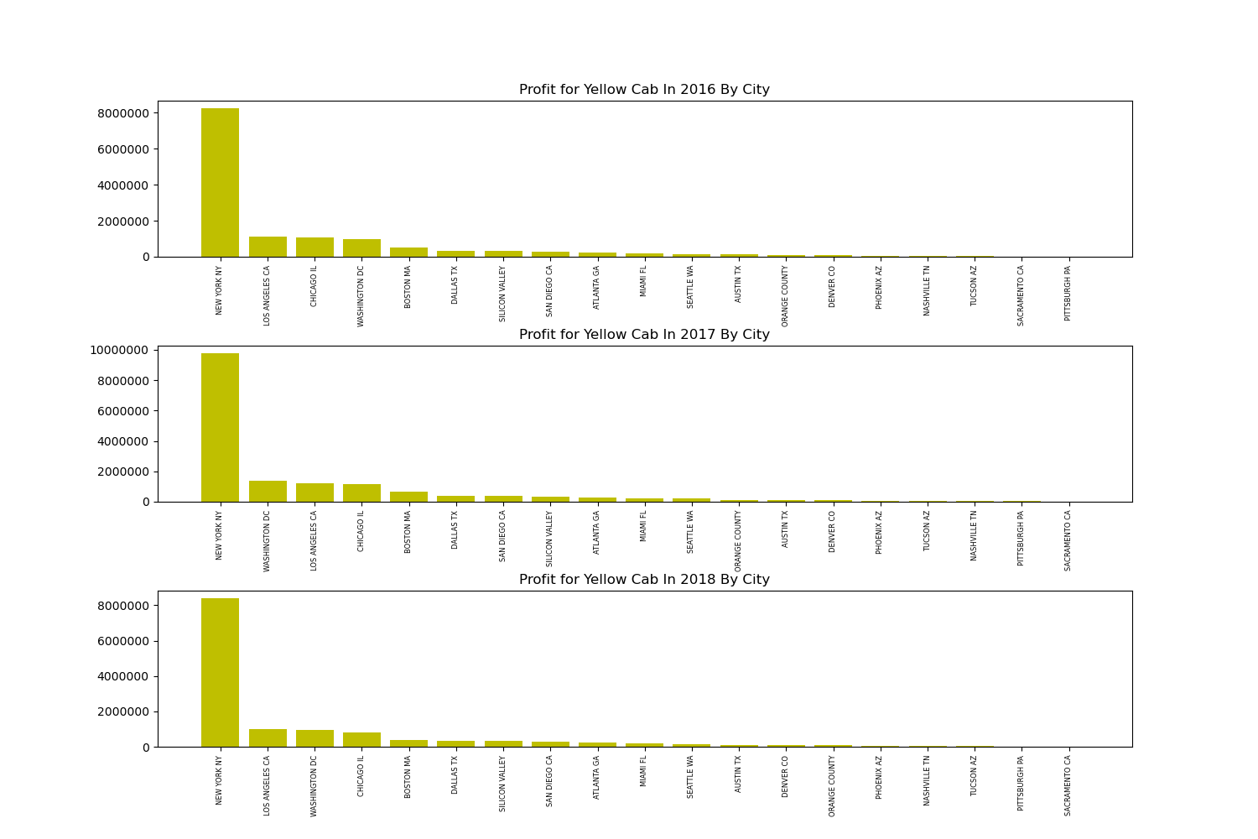
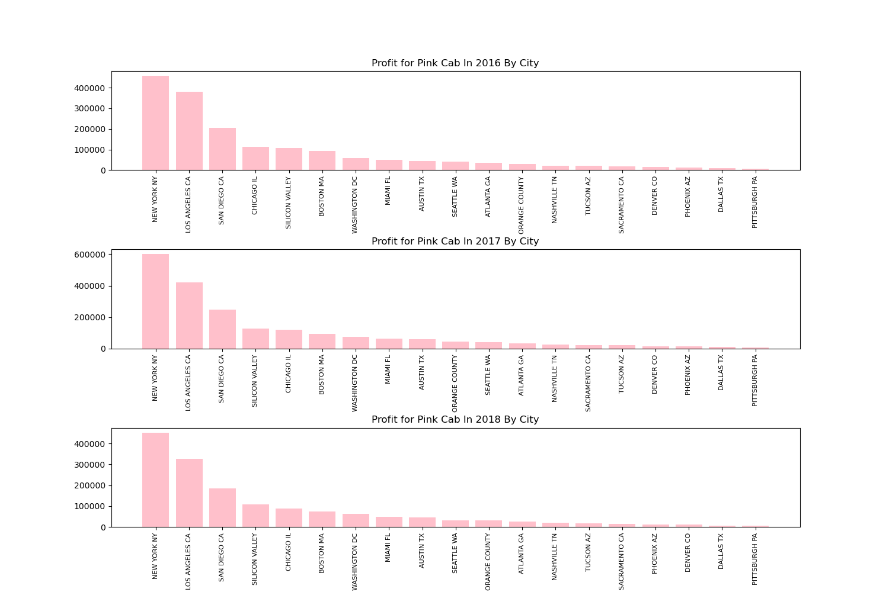
EDA - Profit - Time Series

Slide 16
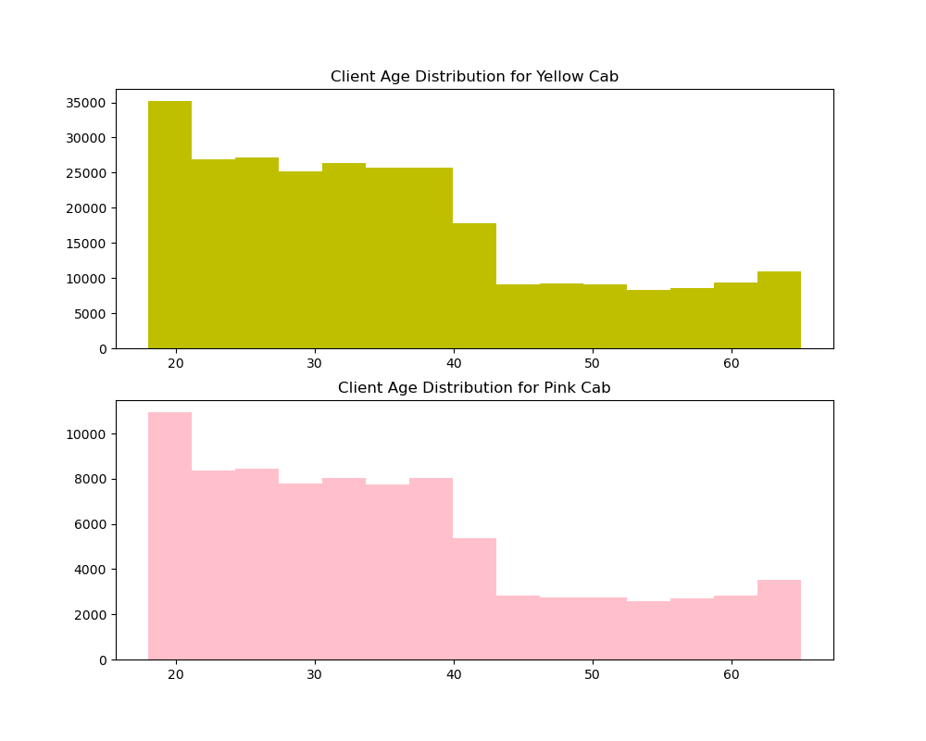
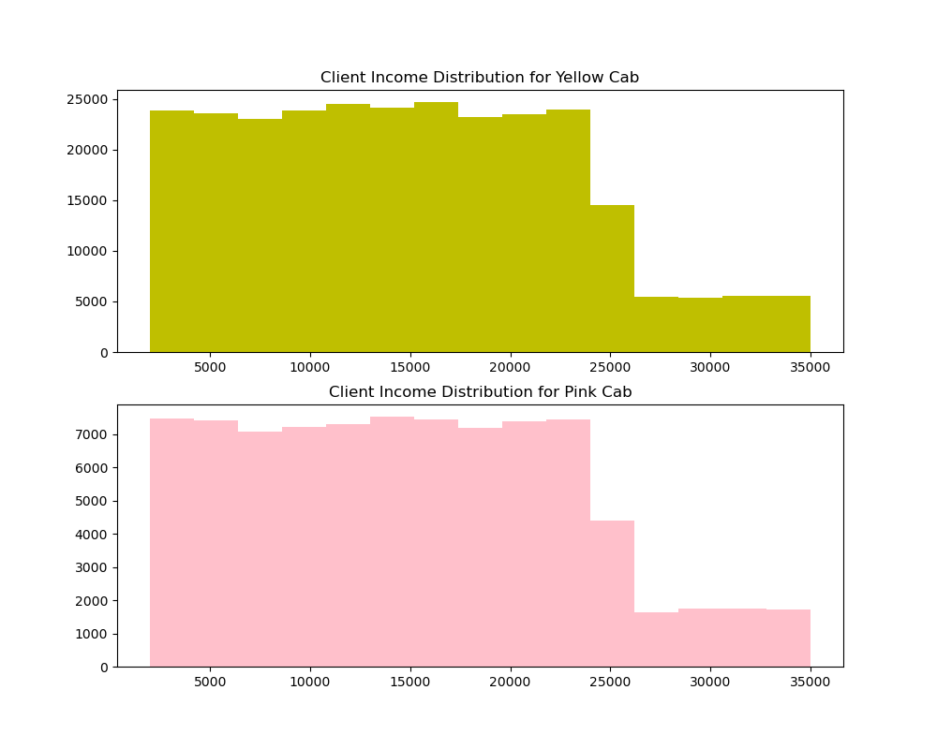
EDA – Customer Analysis

Slide 17
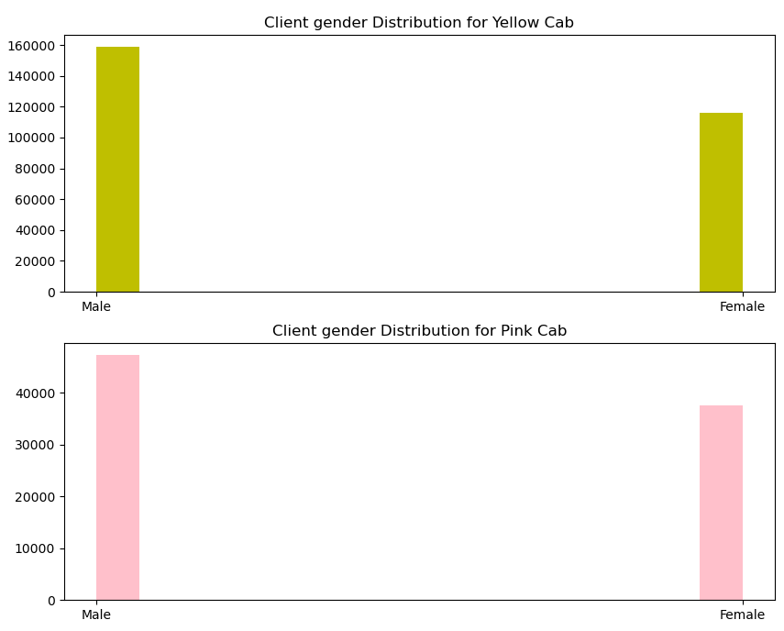
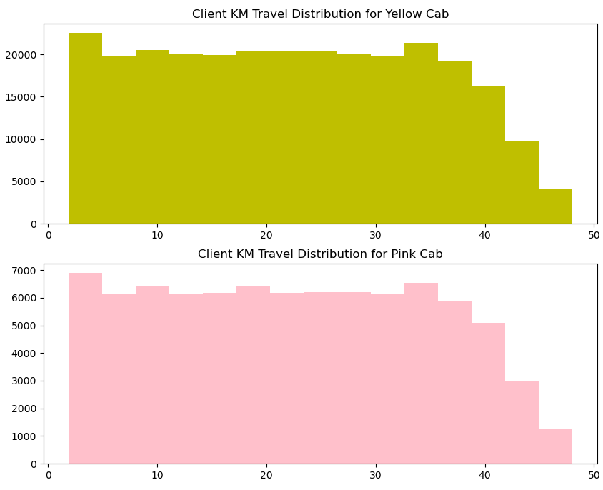
EDA – Customer Analysis

Slide 18
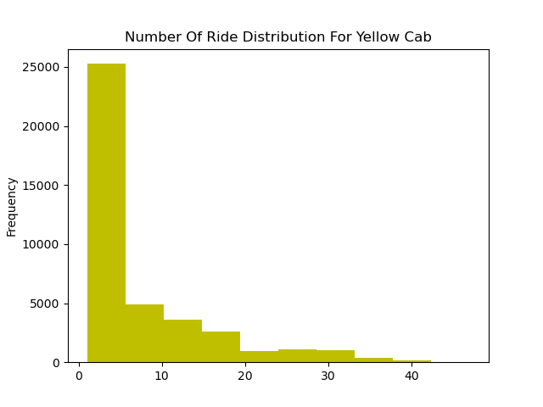
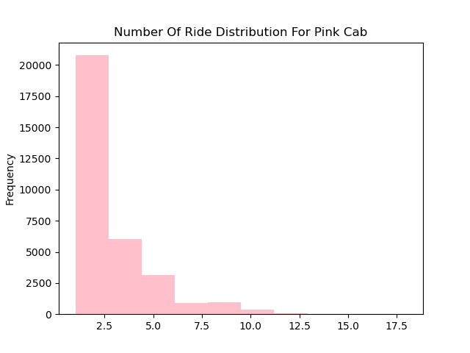
EDA – Customer Retention

Slide 19
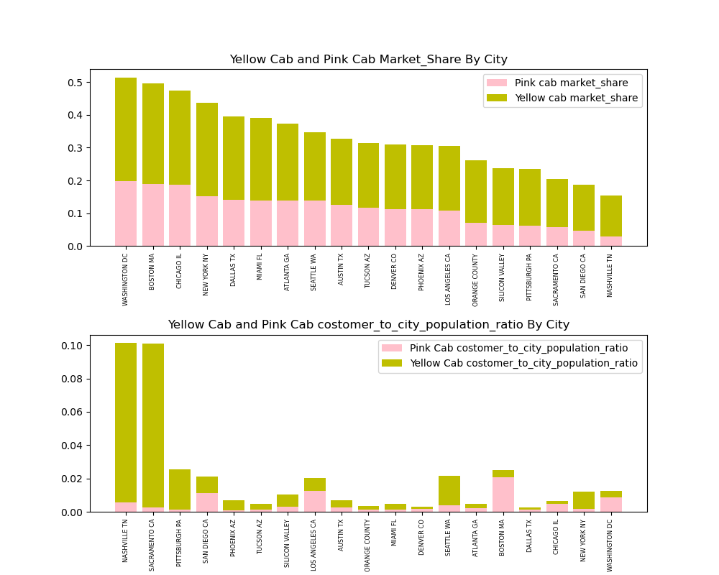
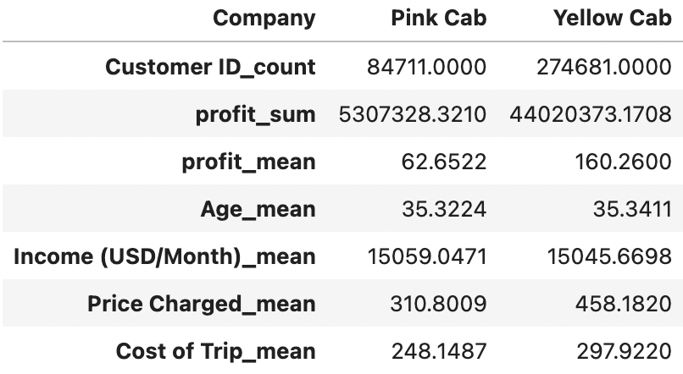
EDA – Market Share

Slide 20
EDA Summary
We have evaluated both the cab companies on following points and found Yellow cab better than Pink cab:
Customer Reach: Yellow cab has higher customer reach all 19 cities. We have also observed that Yellow cab is doing good in covering other cab users as compared to Pink cab.
Pricing: Yellow Cab has a better pricing strategy, we observed price distribution for Yellow Cab in different city and leads to better profit
Market Share: Yellow cab has a higher market share in all 19 cities.
Customer Retention: we found that Yellow cab is doing far better than Pink cab in terms of customer retention.
Age wise Reach : Yellow cab has customer in all age group, and it’s been observed that it’s even popular in 60+ age group as equally as its in 18-25 age group.
Average Profit per KM: Yellow cab’s average profit per KM is almost three times the average profit per KM of the Pink cab.
Income wise Reach :Both the cabs are very popular in high and medium income class but here also Yellow cab is performing better than Pink cab in offering their services to all the three income class group (low, medium and high)

Slide 21
Recommendations
Based on the EDA summary previously, we will recommend Yellow cab for investment.
Better Customer Reach
More Effective Pricing Strategy
Greater Market Share
Stable Customer Loyalty
Wider Age Range Target
Greater Profit Margin

Slide 22
Thank You

