Slide 1
G2M Case Study
Virtual Internship
19-Mar-2023

Slide 2
Background –G2M(cab industry) case study
G2M is a private equity firm in US. Due to remarkable growth in the Cab Industry in last few years and multiple key players in the market, it is planning for an investment in Cab industry.
Objective : Provide actionable insights to help G2M Investment firm in identifying the right company for making investment.
The analysis has been divided into four parts:
Data Understanding
EDA to the most profitable Cab company
Recommendations for investment

Slide 3
Data Exploration
24 Features( including 9 derived features)
Timeframe of the data: 2016-01-31 to 2018-12-31
Total data points: 440,098
Total Nulls: 80,706
Assumptions:
Outliers are present in Price_Charged feature but due to
unavailability of trip duration details ,we are not treating this as outlier.
Profit of rides are calculated keeping other factors constant and only
Price_Charged and Cost_of_Trip features used to calculate profit.
Users feature of city dataset is treated as number of cab users in the city.
we have assumed that this can be other cab users as well(including Yellow and
Pink cab)
Cab_Data.csv
Customer_ID.csv
Transaction_ID.csv
City.csv
Final cab data

Slide 4
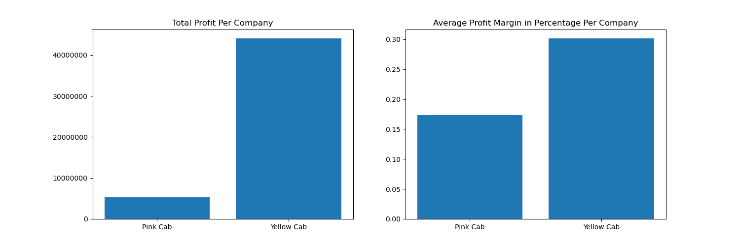
Profit Analysis
Profit Analysis

Slide 5
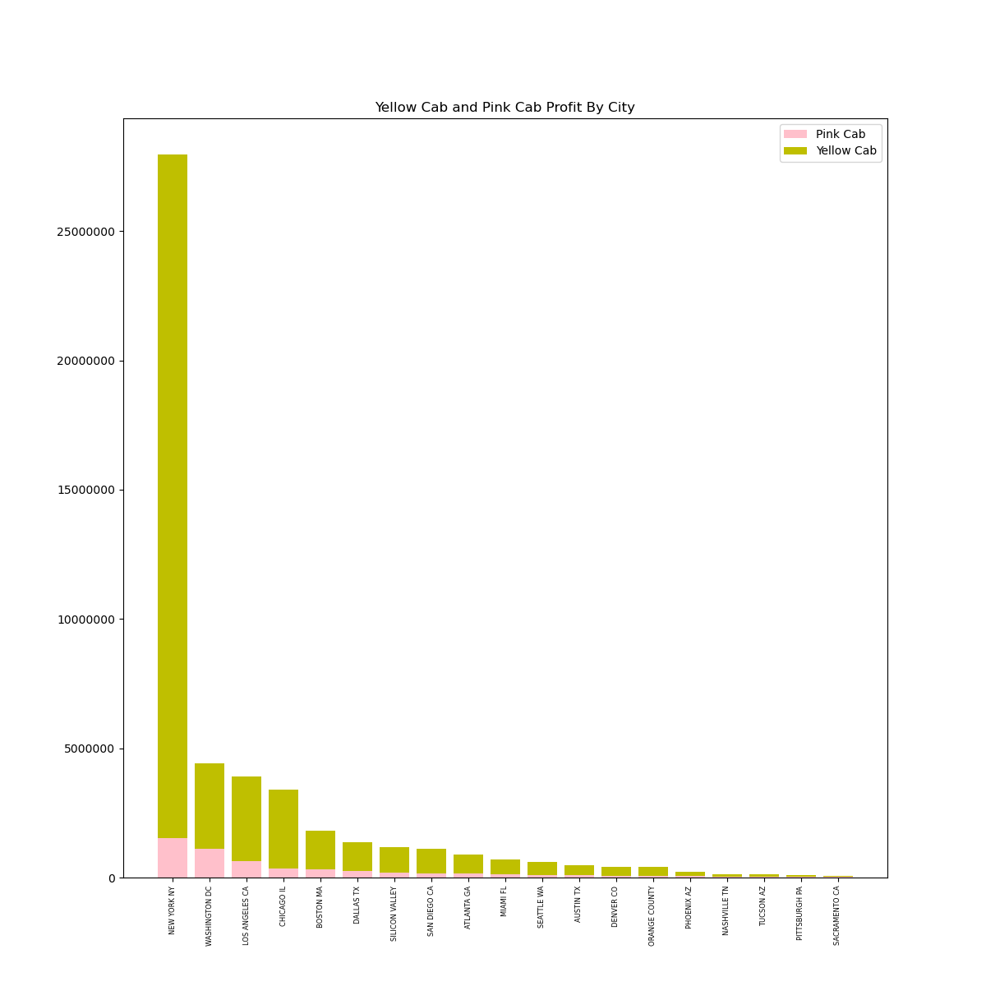
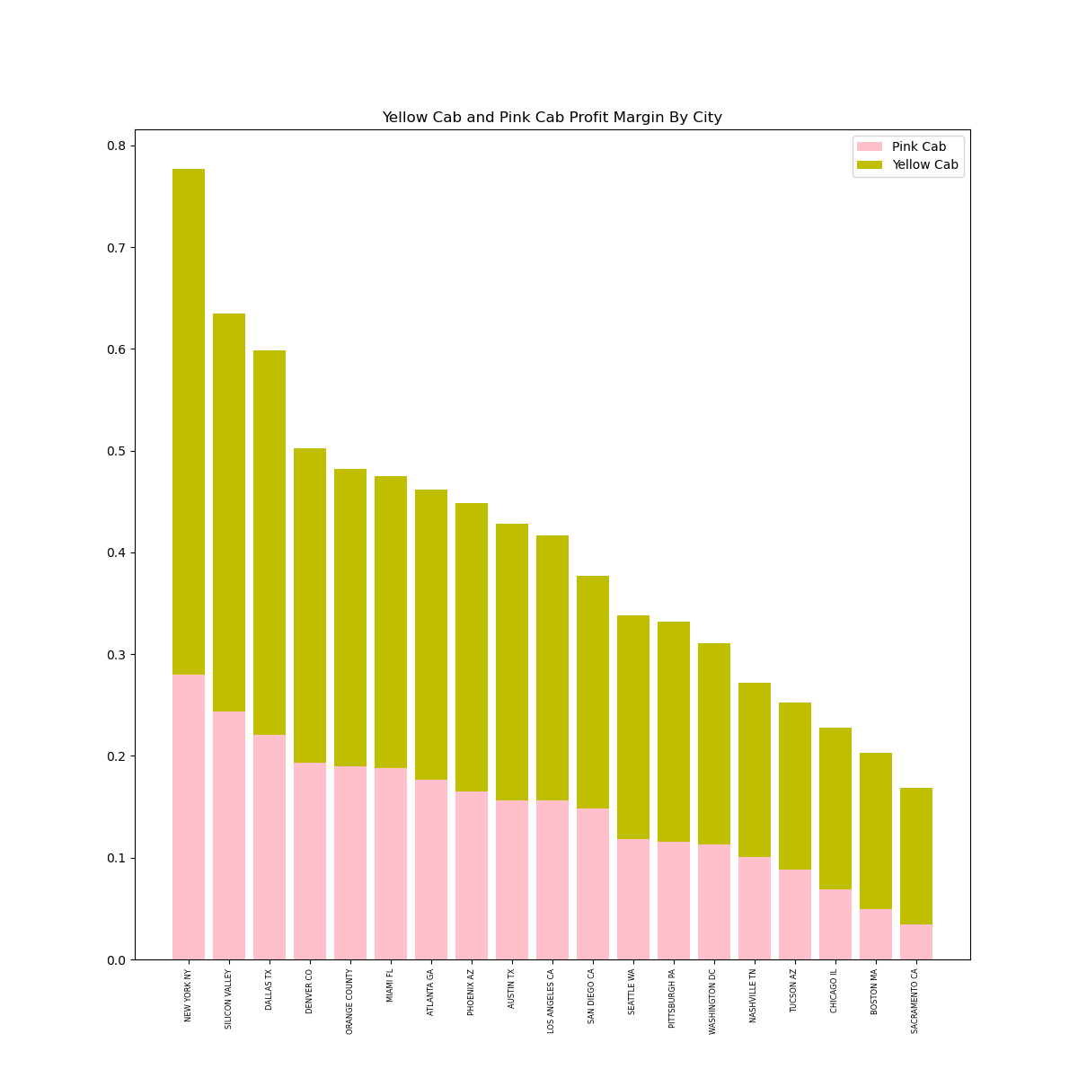
Profit Analysis

Slide 6
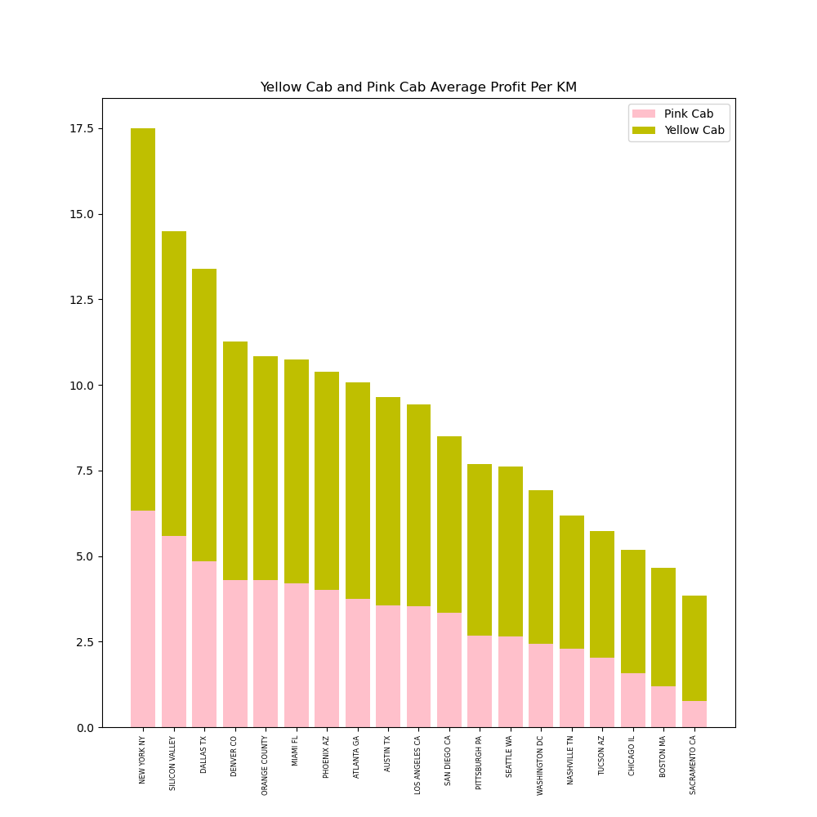
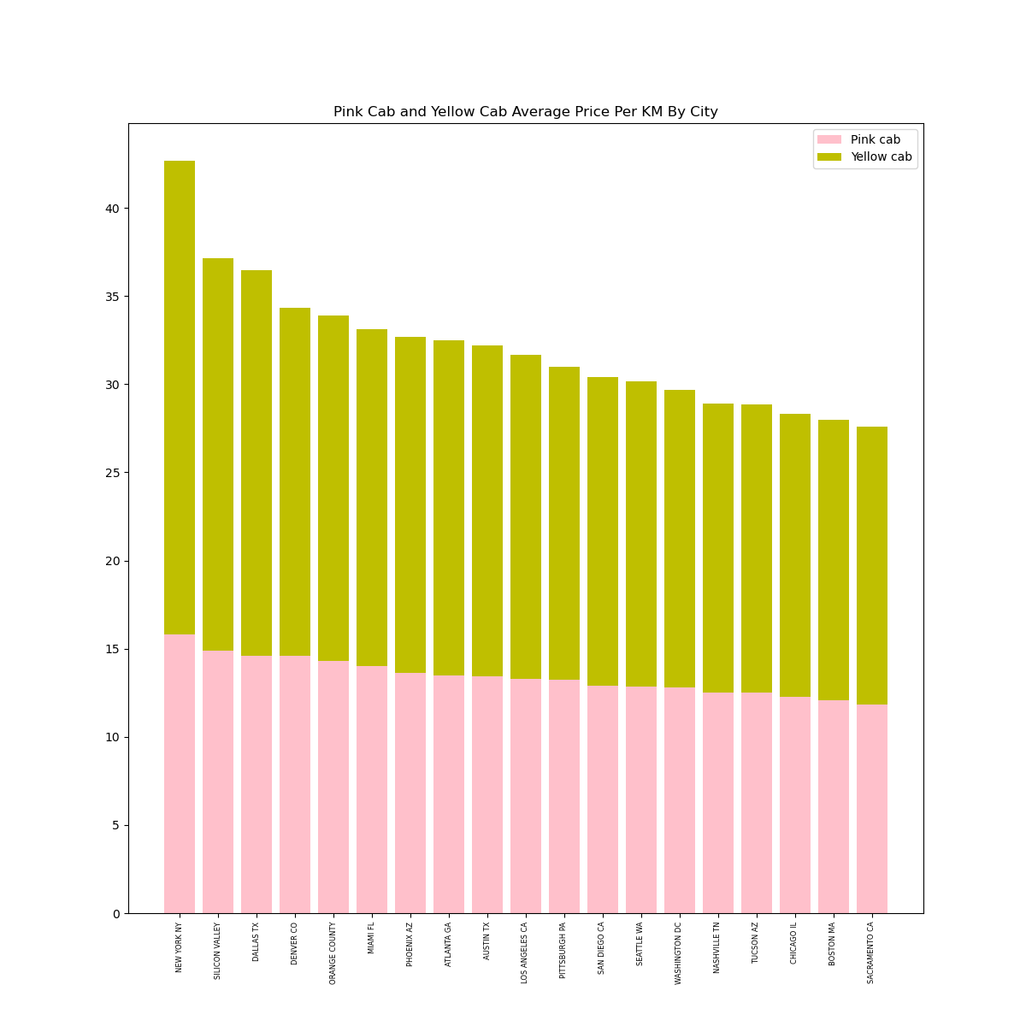
Profit Analysis
Profit Analysis

Slide 7
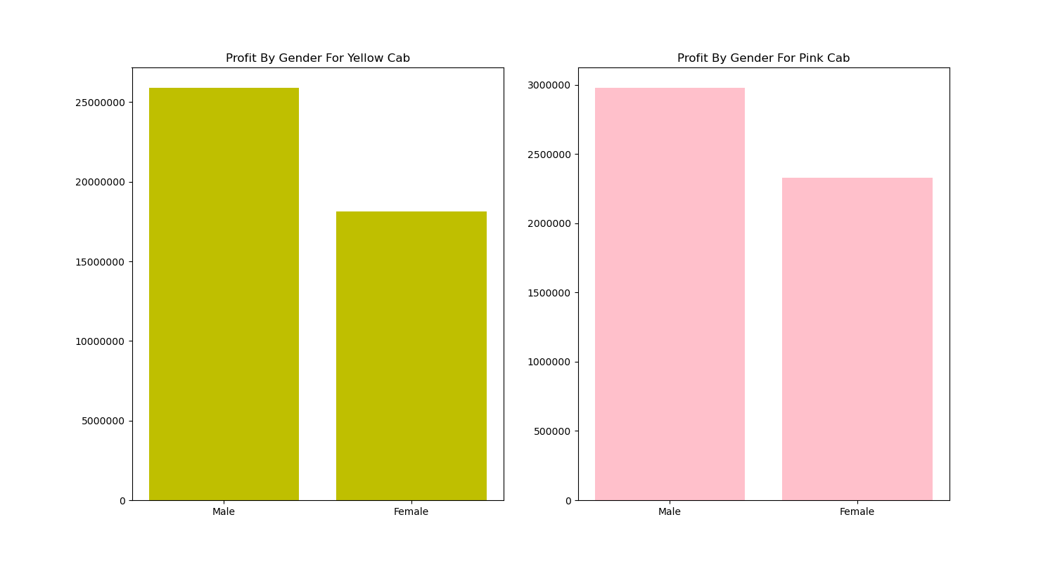
Profit Analysis
Profit Analysis

Slide 8
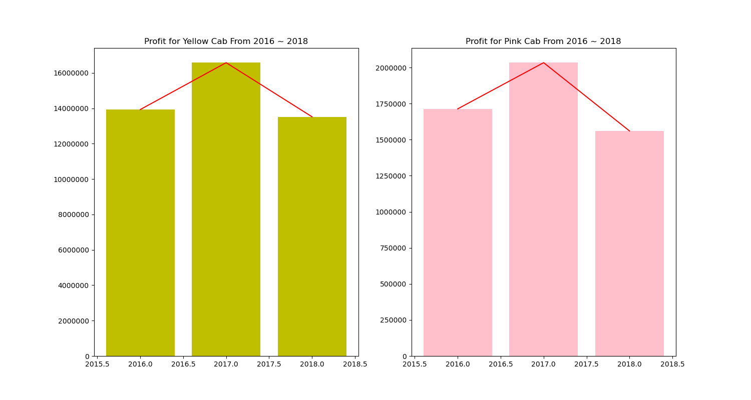
Profit Analysis
Profit - Time Series

Slide 9
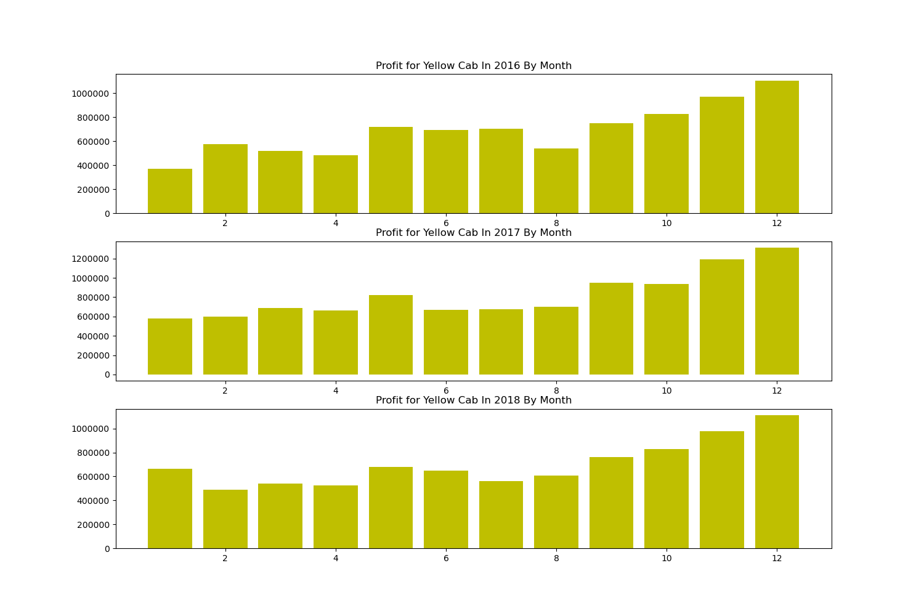
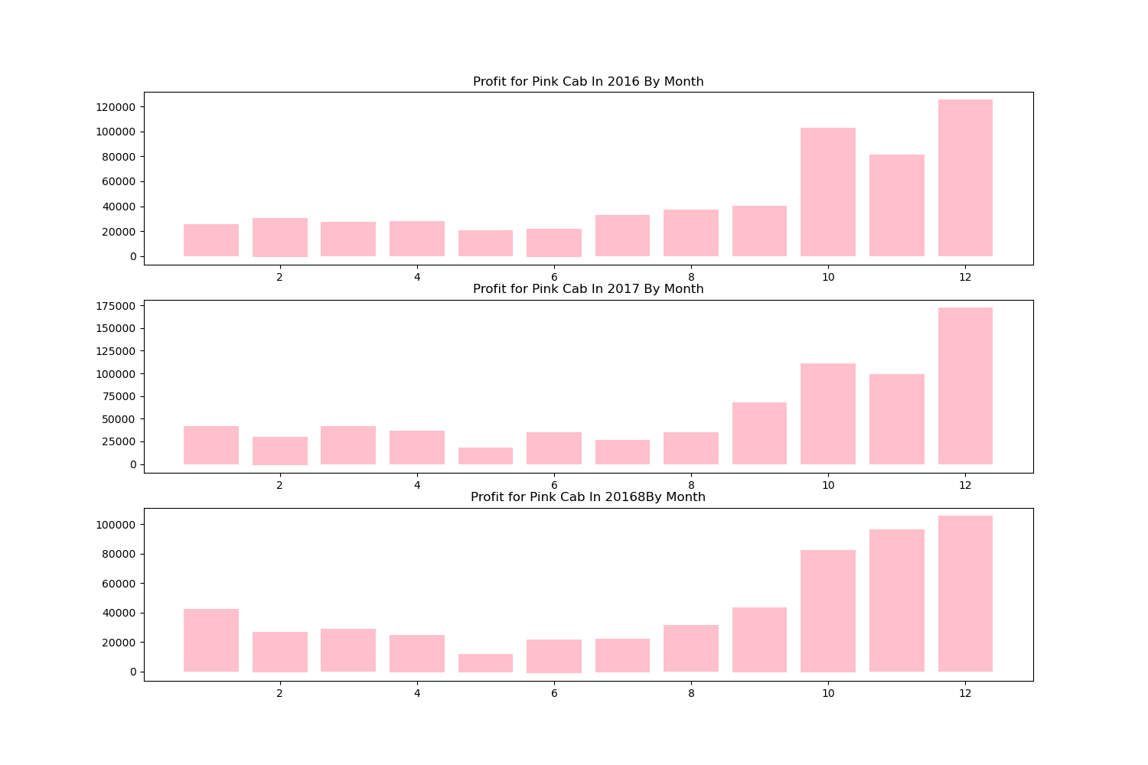
Profit Analysis
Profit - Time Series

Slide 10
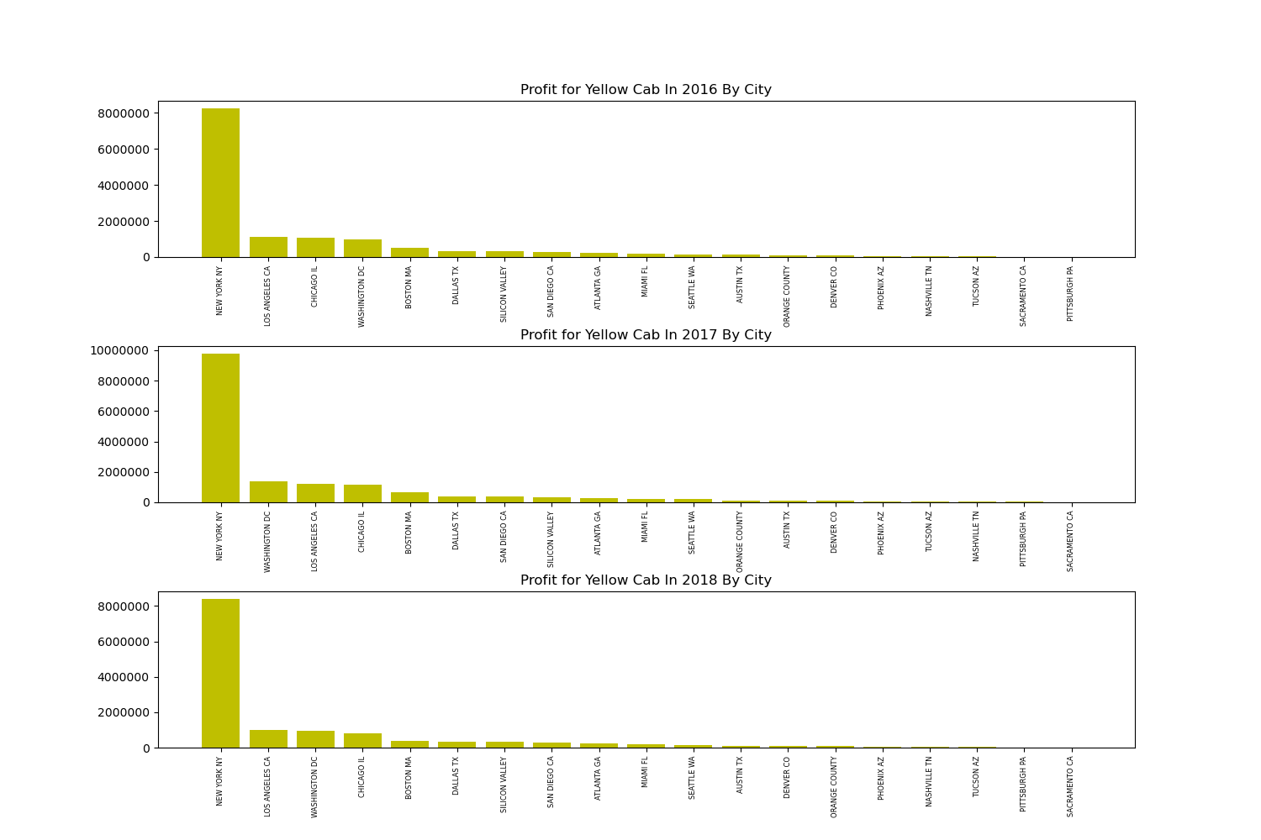
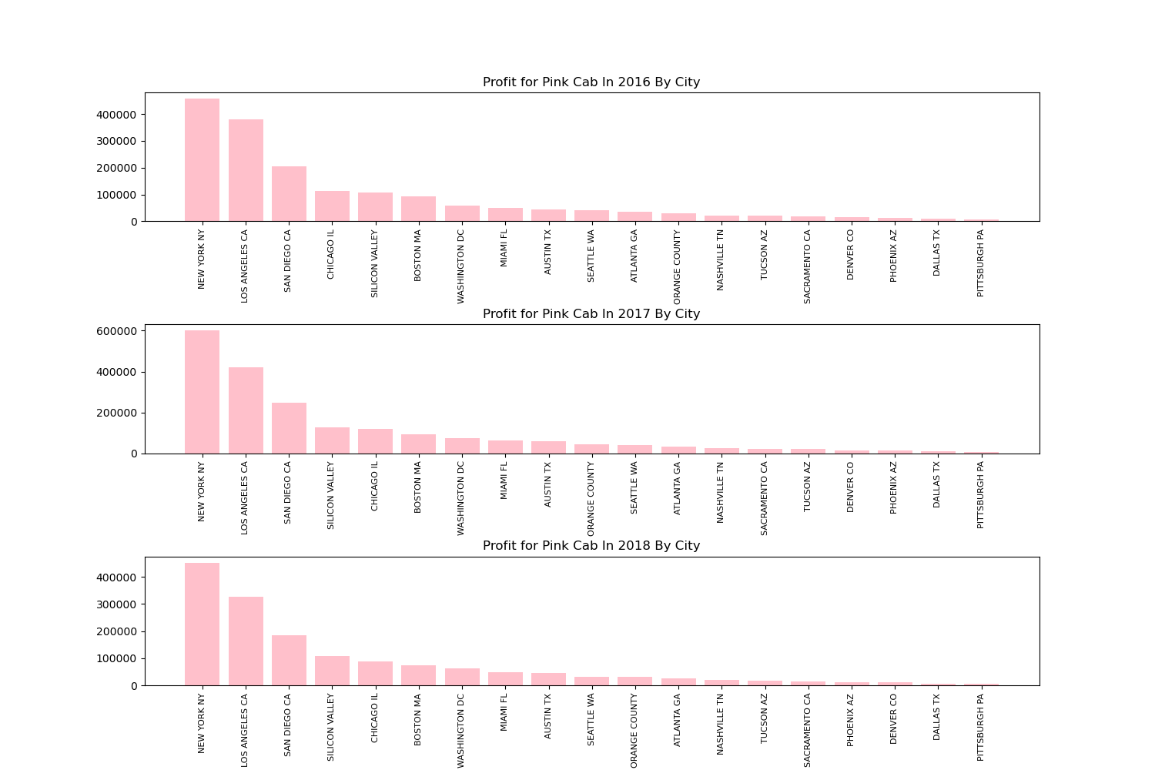
Profit Analysis
Profit - Time Series

Slide 11
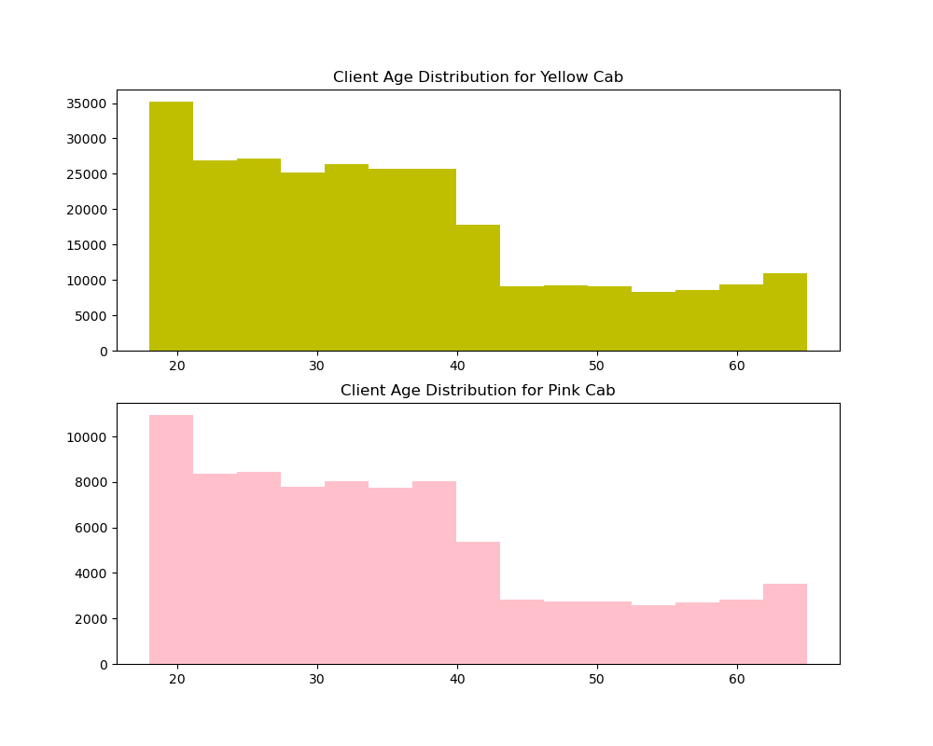
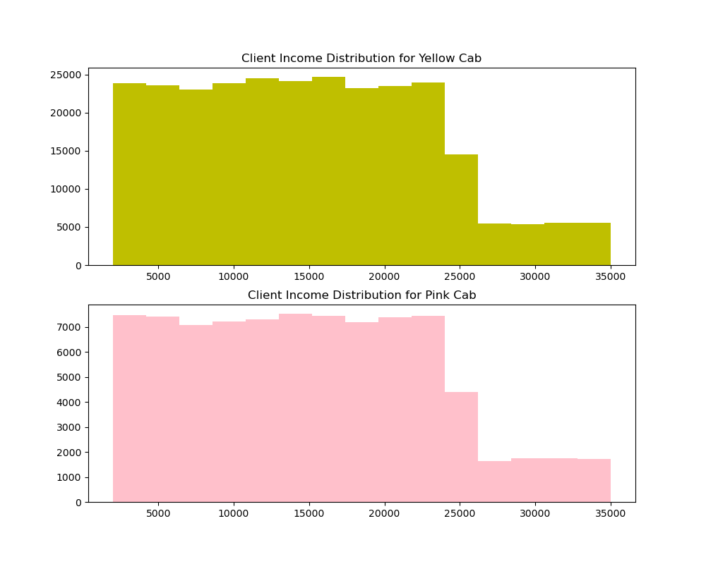
Customer Analysis

Slide 12
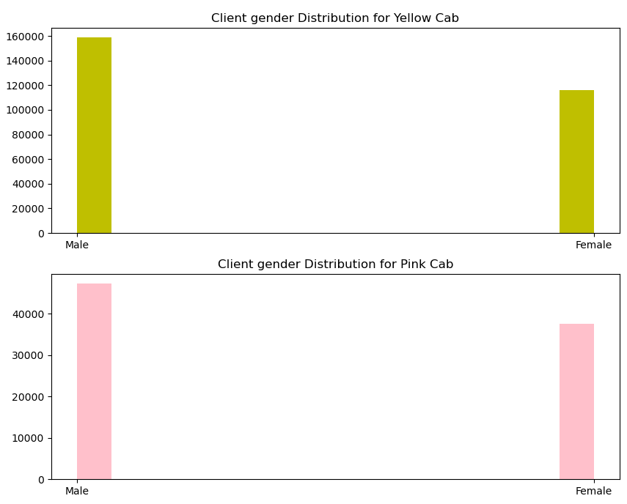
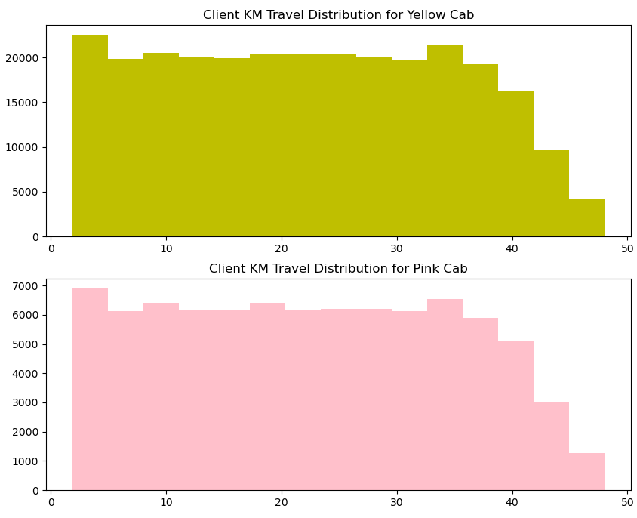
Customer Analysis

Slide 13
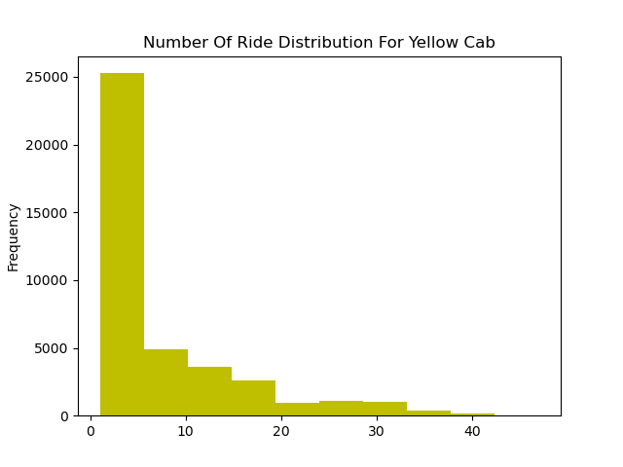
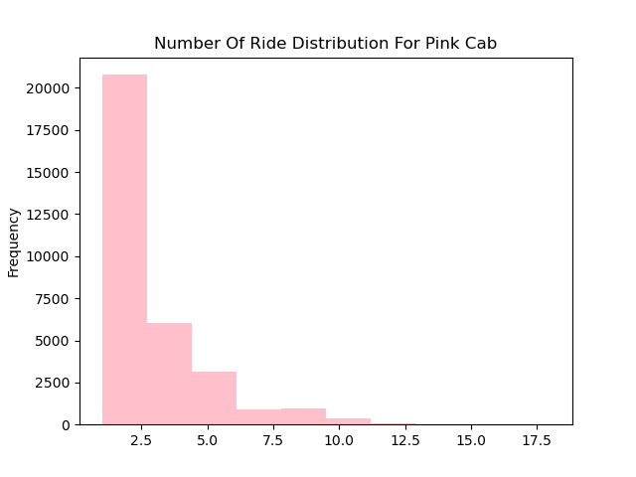
Customer Retention
Customers who have taken at least 5
rides of the same cab
company is considered
for the viz1
In Viz 2,only those customers considered who have taken at least 10 rides of the same cab company
Clearly in both the segments Yellow cab is far better than Pink cab.
Which shows Yellow cab is
able to retain their
customers well as
compared to Pink cab.

Slide 14
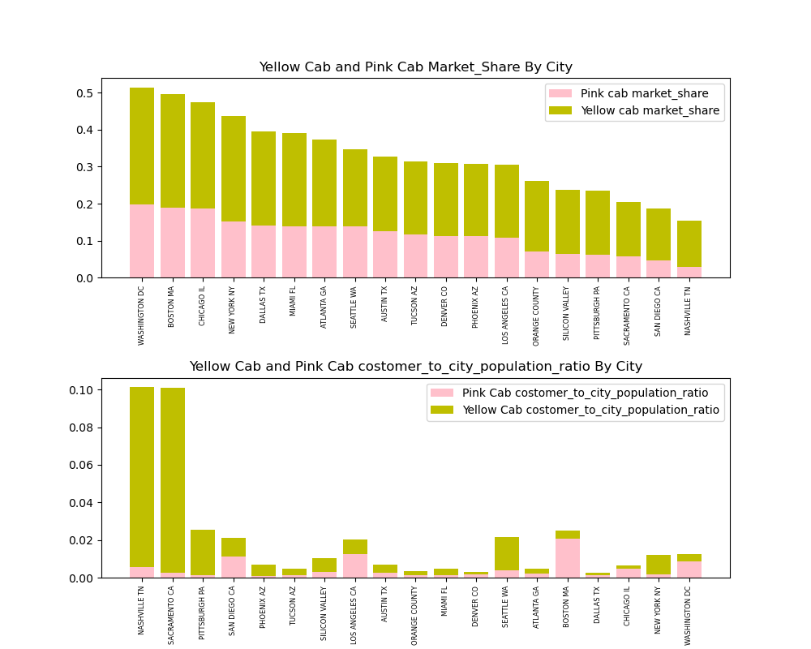
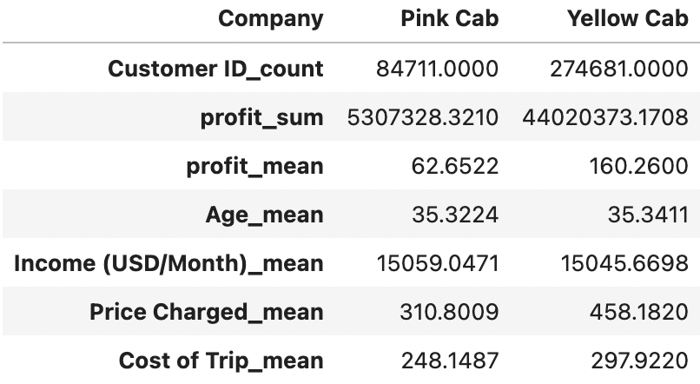
Market Share
Customers who have taken at least 5
rides of the same cab
company is considered
for the viz1
In Viz 2,only those customers considered who have taken at least 10 rides of the same cab company
Clearly in both the segments Yellow cab is far better than Pink cab.
Which shows Yellow cab is
able to retain their
customers well as
compared to Pink cab.

Slide 15
Recommendations
We have evaluated both the cab companies on following points and found Yellow cab better than Pink cab:
Customer Reach: Yellow cab has higher customer reach all 19 cities. We have also observed that Yellow cab is doing good in covering other cab users as compared to Pink cab.
Pricing: Yellow Cab has a better pricing strategy, we observed price distribution for Yellow Cab in different city and leads to better profit
Market Share: Yellow cab has a higher market share in all 19 cities.
Customer Retention: we found that Yellow cab is doing far better than Pink cab in terms of customer retention.
Age wise Reach : Yellow cab has customer in all age group, and it’s been observed that it’s even popular in 60+ age group as equally as its in 18-25 age group.
Average Profit per KM: Yellow cab’s average profit per KM is almost three times the average profit per KM of the Pink cab.
Income wise Reach :Both the cabs are very popular in high and medium income class but here also Yellow cab is performing better than Pink cab in offering their services to all the three income class group (low, medium and high)
On the basis of above point , we will recommend Yellow cab for investment.

Slide 16
Thank You
Felix Huang

