Slide 1

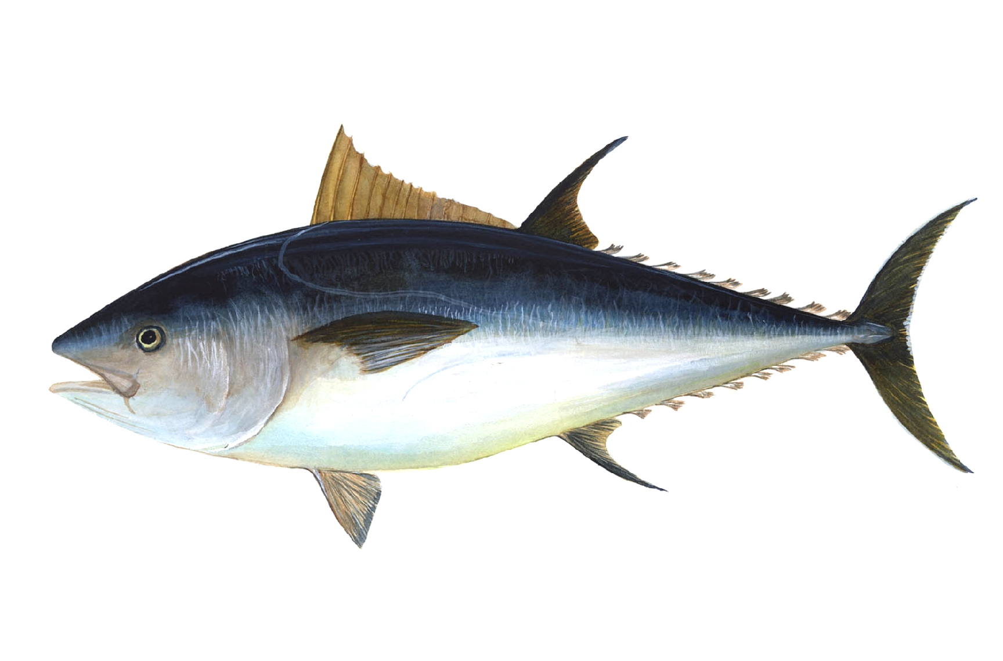
Advanced FHIR Shorthand
Mark Kramer
Chief Engineer, Health Innovation Center
MITRE Corporation
Chris Moesel
Principal Software Systems Engineer
MITRE Corporation
September, 2020

Slide 2
Tuna Topics
SUSHI
+
FSH Features:
ValueSets
Extensions
Caret Paths
Slicing
Instances
Rule Sets, Mixins
Invariants
Mapping
Exact Equality

Slide 3
Using SUSHI to Produce FHIR from FSH

Slide 4
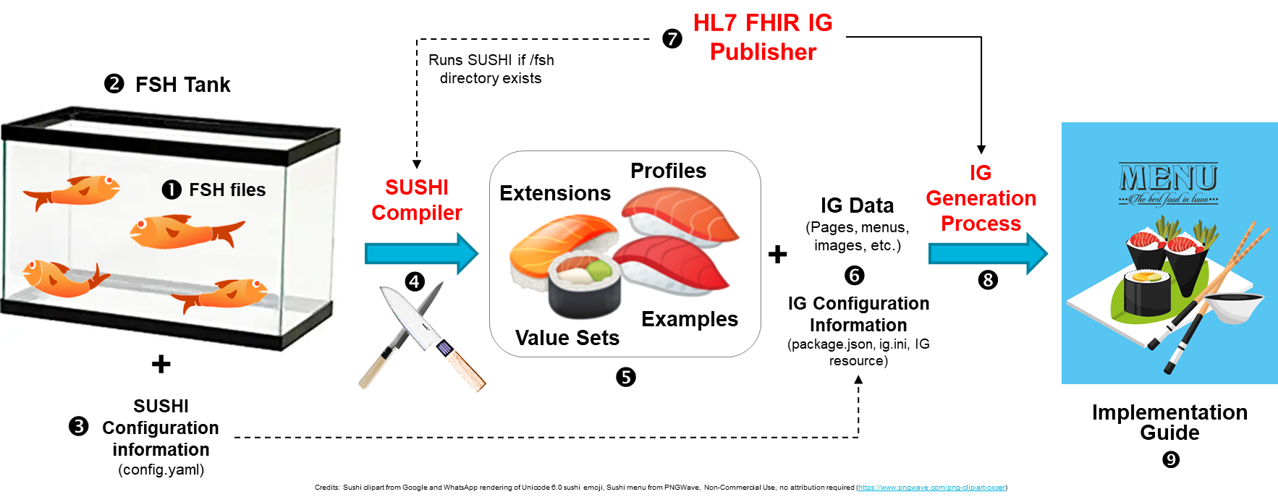
Workflow with FSH, SUSHI, and IG Publisher

Slide 5
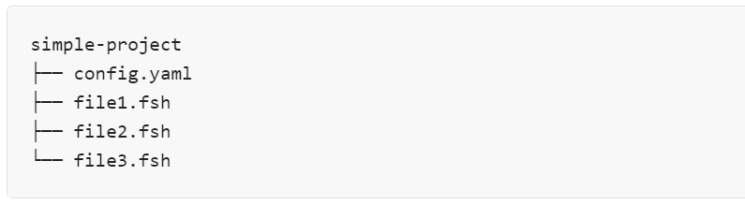
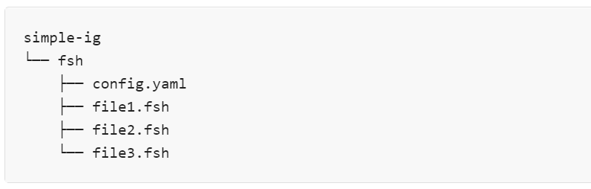
Project (FSH Tank) Structure
Each FSH file can contain multiple FSH definitions of varying types. FSH file names are not significant, but must end with the .fsh extension.
The config.yaml file provides project configuration data to SUSHI.
If the HL7 FHIR IG Publisher detects a fsh subdirectory, it will automatically run SUSHI on that directory and output the SUSHI results to the parent of the fsh subdirectory (e.g., the simple-ig directory in the example above). It will then continue with the normal IG Publisher process.

Slide 6
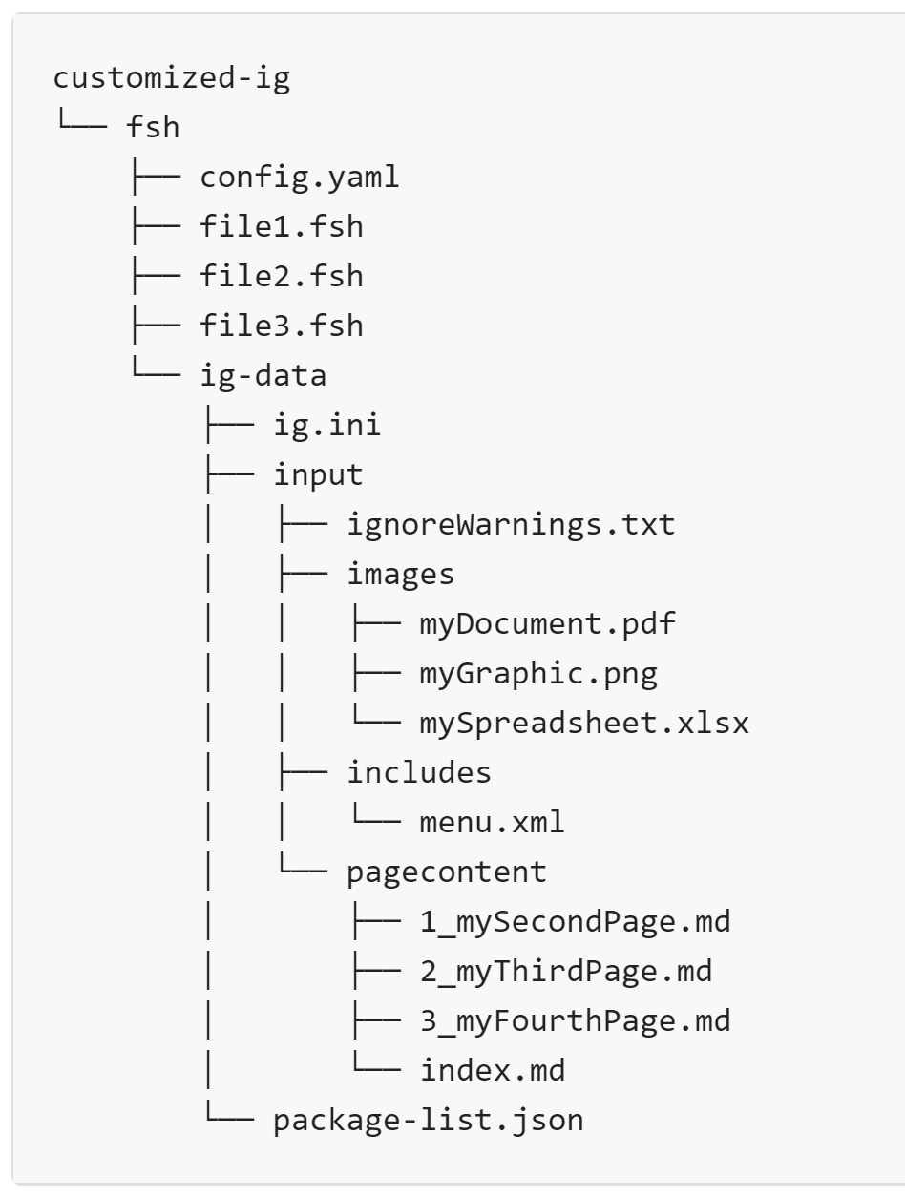
Project Structure for IGs
config.yaml: This required file provides project configuration data to SUSHI.
ig-data/ig.ini: If present and no template property is specified in config.yaml, the user-provided file will be used instead of a generated one.
ig-data/input/ignoreWarnings.txt: To suppress specific QA warnings and information messages during the FHIR IG publication process.
ig-data/input/images/: Contains non-page content (images, spreadsheets, etc.) to include in the IG.
ig-data/includes/menu.xml: If present and no menu property is specified in config.yaml, it will be used for the IG’s menu layout.
ig-data/input/pagecontent/: Contains markup (.xml) or markdown (.md) files with the narrative content of your IG.
ig-data/package-list.json: If present and no history property is specified in config.yaml, it will be used instead of a generated package-list.json.

Slide 7
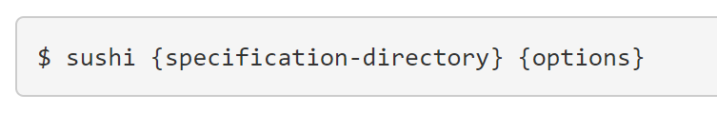
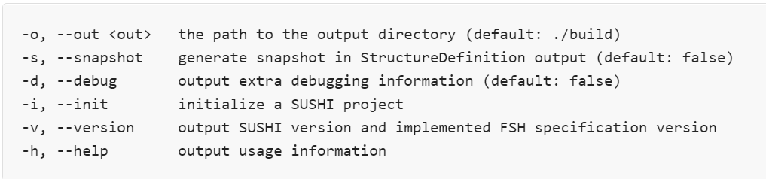
Executing SUSHI
Sushi translates FSH files into FHIR artifacts (profiles, extensions, value sets, instances, code systems)
SUSHI runs from a command prompt ($)
For installation, see https://fshschool.org/docs/sushi/installation/
https://fshschool.org/docs/sushi/running/#running-sushi

Slide 8
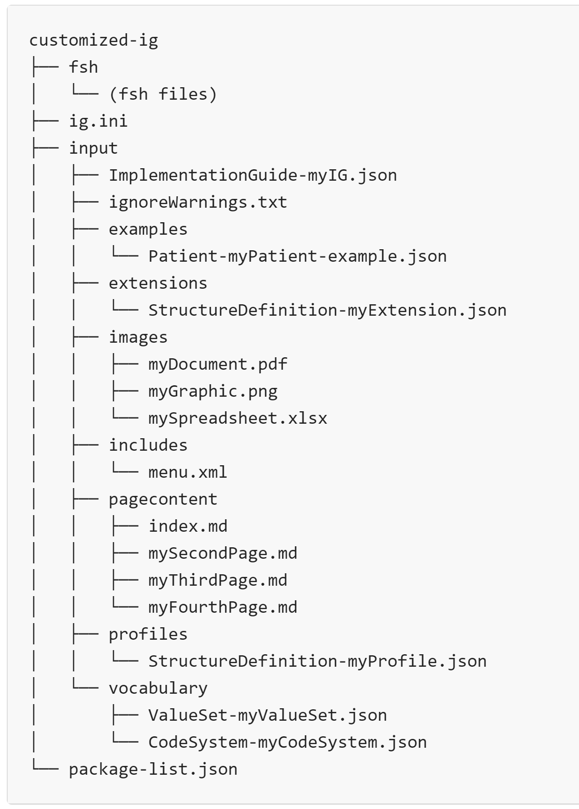
SUSHI Outputs
Default output is /build
Everything is where the IG Publisher expects to find them
The /build/input directory is actually an output of SUSHI, but so named because it is an input to the IG Publisher.

Slide 9
Value Sets

Slide 10
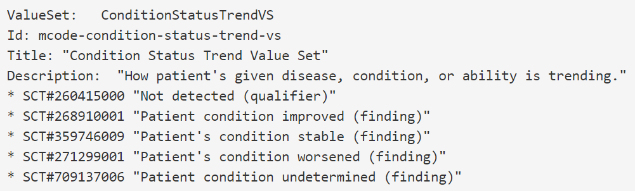
Defining Value Sets in FSH
An extensional value set contains an explicit list of codes
The extensional form is very simple: * {coding}

Slide 11
Value Set Rules
Rule to include or exclude a single code:
* SCT#54102005 "G1 grade (finding)"
* exclude SCT#54102005 "G1 grade (finding)"
Rule to include/exclude an entire value set:
* codes from valueset http://hl7.org/fhir/ValueSet/bodysite-laterality
* exclude codes from valueset http://hl7.org/fhir/ValueSet/bodysite-laterality
Rule to include/exclude an entire code system:
* codes from system http://hl7.org/fhir/ndfrt
* exclude codes from system http://hl7.org/fhir/ndfrt

Slide 12
Value Set Filtering Rules
Rules can contain filter expressions that modify the codes to be included/excluded
Syntax of filters depends on the particular vocabulary
e.g., ICD-10 filters are not the same as SNOMED-CT filters
Here are examples for SNOMED-CT (aliased to SCT):

Slide 13
Extensions, Caret Rules, and Slicing

Slide 14
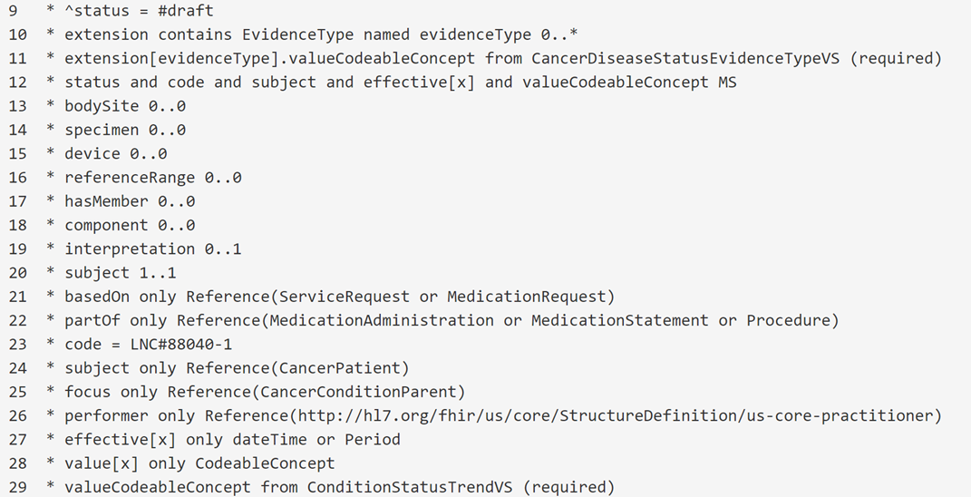
Walkthrough (Continued from Basic Tutorial)
Use "contains" rule both for extensions and slicing

Slide 15
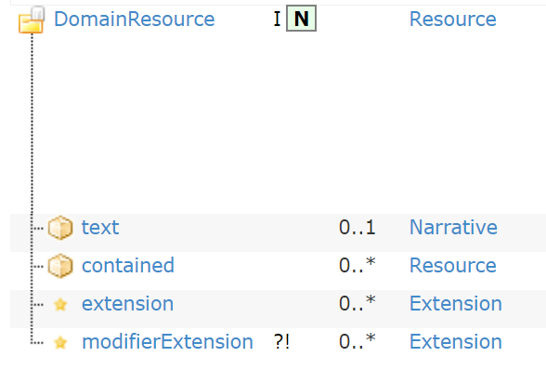
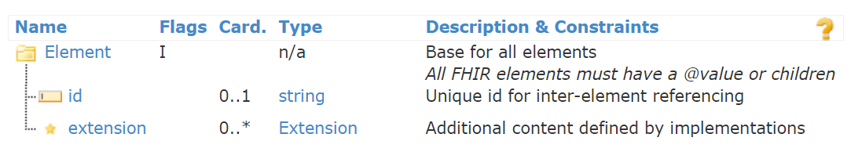
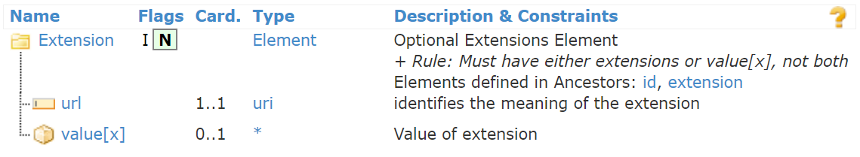
What is an Extension?
Every Resource has an extension array at the top level.
Every element has an extension array
Extension arrays contain Extension elements.
An Extension either has a value[x] or further extensions
"Adding an extension" really means constraining an extension array to contain a certain type of extension.

Slide 16
Extensions Rules (Two Types)
Inline Extensions:
* {extension-path} contains
{extension1} {card1}. {flags1} and
{extension2} {card2} {flags2} ...
Example:
* extension contains
treatmentIntent 0..1 MS and
terminationReason 0..* MS
Stand-Alone (Existing) Extensions:
* {extension-path} contains
{extension1} named {name1} {card1} {flags1} and
{extension2} named {name2} {card2} {flags2} ...
Example:
* extension contains
RadiationDosePerFraction named dosePerFraction 0..1 and
RadiationFractionsDelivered named fractionsDelivered 0..1 MS and
TotalRadiationDoseDelivered named totalDose 0..1
local name inside profile
choose names
existing extension names

Slide 17
Defining In-Line Extensions
Defining the extension in-line does not require an "Extension" structure.
The resulting extension will not have a separate StructureDefinition.
Inline extensions can only be defined inside of complex extensions (not profiles)
The "contains" statement is similar but does not name an extension.
* extension contains evidenceType 0..*
* extension[evidenceType].value[x] only CodeableConcept
* extension[evidenceType].valueCodeableConcept from CancerDiseaseStatusEvidenceTypeVS (required)

Slide 18
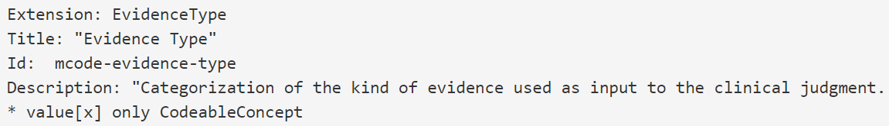
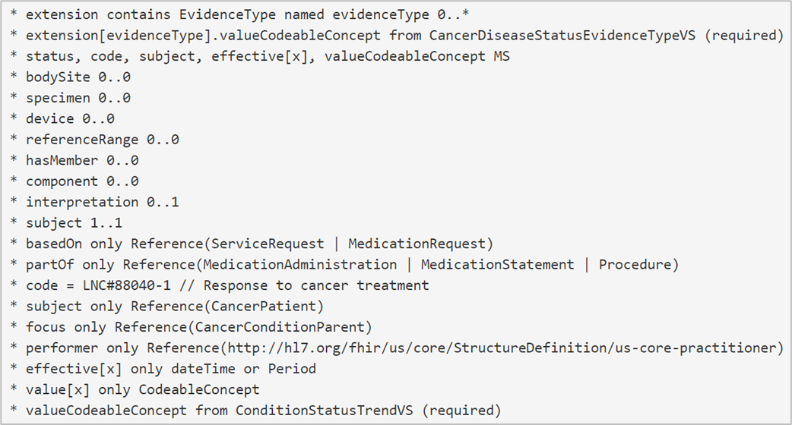
Defining Stand-Alone Extensions
Define the extension using the "Extension" keyword. No parent is needed because FSH knows it is an Extension.
Now, in the profile, add it to an extension array using "contains".
This grammar also applies to an extension defined in another IG (use its URL).
Once added, the extension can be further constrained by referring to the element in the extension array by name:

Slide 19
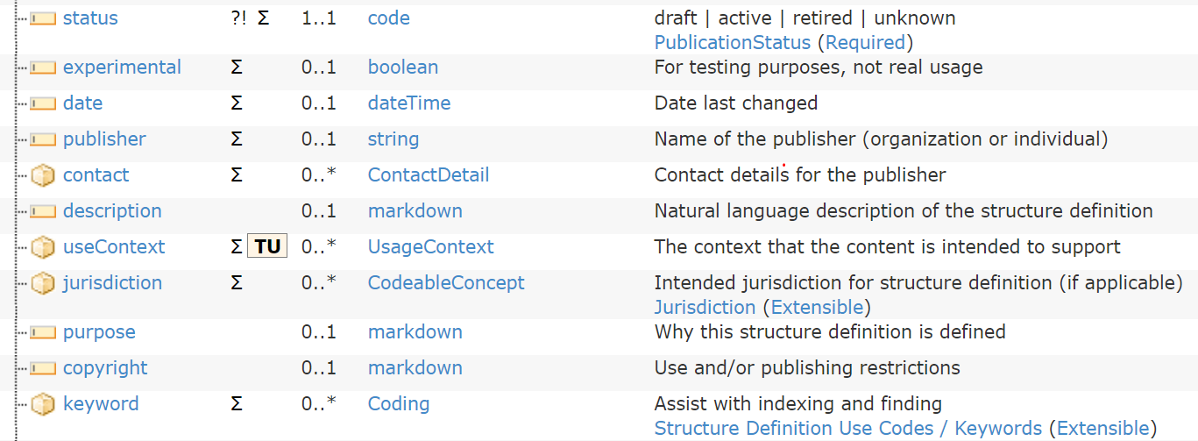
Caret Paths for StructureDefinitions
Caret (^) gives direct access to elements in StructureDefinition
Useful for setting or overriding metadata elements:

Slide 20
Caret Paths for ElementDefinitions
A StructureDefinition contains one ElementDefinition for every element and subelement
Use the element name followed by caret path into the ElementDefinition
Path examples:
valueInteger ^minValueQuantity
hasMember ^slicing.discriminator.path
hasMember[PrimaryTumorCategory] ^short
Example:
* communication.language ^binding.description = "This binding is dictated by US FDA regulations."
regular element path
path into ElementDefinition

Slide 21
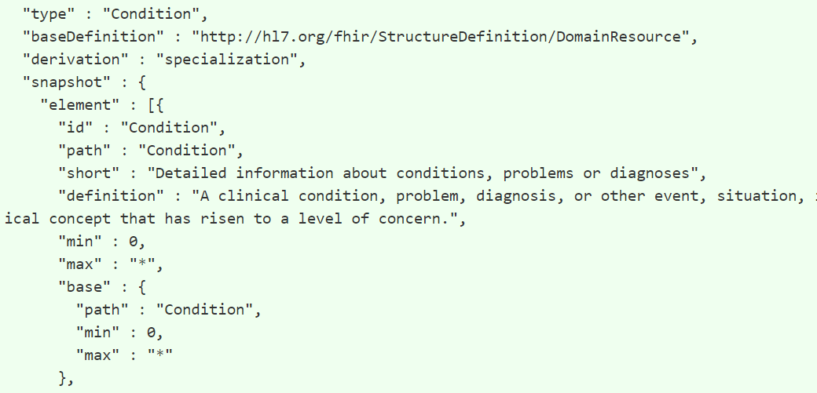
The Oddball Dot Caret Path
The first ElementDefinition in any StructureDefinition refers to entire item
To refer to properties of this particular "self" element, use dot (.) as the element path
Example: Provide a short description for an extension (defined in the “self” ElementDefinition):
* . ^short = "US Core Race Extension"

Slide 22
Slicing
Similar to extensions -- the objective is to say what can go into an array
The array elements will not be Extensions
Arrays we typically want to slice:
Backbone elements, such as Observation.component
Arrays of complex data types, such as Identifier or Address, such as Practitioner.identifier
Arrays of references to resources, such as Observation.hasMember
Divide slicing into three steps:
Specify the slicing logic
Identify the slices
Define each slice

Slide 23
Slicing Step 1: Define Slicing Logic
There has to be something that uniquely and reliably distinguishes the slices
Given an instance assigned to the array, how do we know what slice it belongs to?
The "discriminator" -- comprised of a type and path
Slicing logic is specified in the ElementDefinition part of the StructureDefinition
Use caret paths to specify the slicing logic
Example: Slice Observation.component on Observation.component.code
* component ^slicing.discriminator.type = #pattern // or #value, #profile, …
* component ^slicing.discriminator.path = "code" // any FHIRPath expression
* component ^slicing.rules = #open // additional elements are ok
* component ^slicing.ordered = false // by default, array elements in any order
* component ^slicing.description = “Slice pattern for component.code" // optional

Slide 24
Slicing Logic: Another Example
Example: Slice Observation.hasMember
* hasMember ^slicing.discriminator.type = #profile
* hasMember ^slicing.discriminator.path = "$this.resolve()"
* hasMember ^slicing.rules = #open

Slide 25
Slicing Step 2: Identify the slices ("contains")
* array-element-path contains
slice-name1 card1 flags1 and
slice-name2 card2 flag s2 ...
* component contains
systolicBP 1..1 and
diastolicBP 1..1
* hasMember contains
PrimaryTumorCategory 0..1 and
RegionalNodesCategory 0..1 and
DistantMetastasesCategory 0..1
Each element must match the datatype of the array
components
Profiled Observations

Slide 26
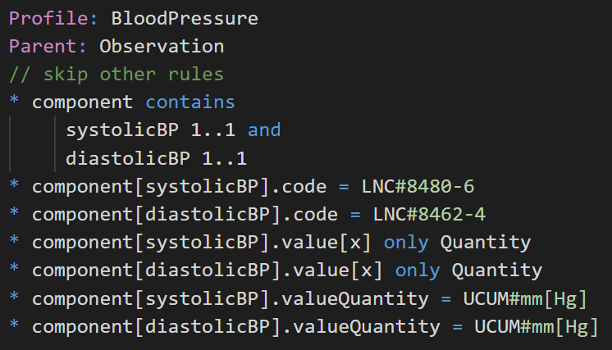
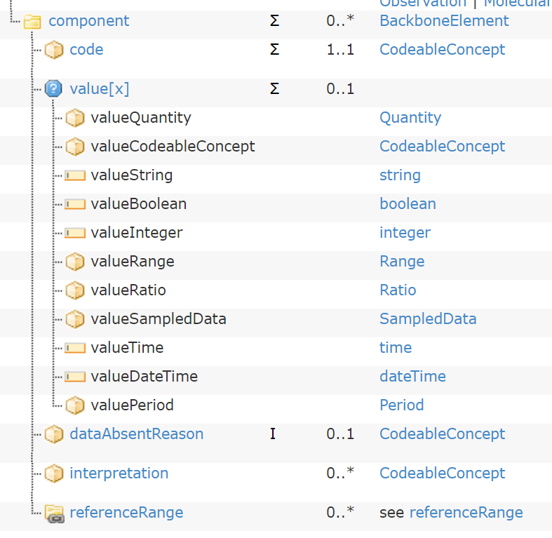
Slicing Step 3: Define Properties of Each Slice
If the array type is resource reference(s), then the slices are defined either in an existing resource profile, or any one you define in your project (similar to "stand-alone" extensions)
Slices are only defined in-line

Slide 27
Defining Instances in FSH

Slide 28
Instances in IGs
Examples
Instances that illustrate how to use a profile, presented on the Examples tab for the corresponding profile. You must have at least one example of each profile and extension in the IG.
Definitions
Conformance items that are instances of resources such as search parameter, operation definition, or questionnaire
Inline
Instances that should not be instantiated as an independent resource, but appears as part of another instance (for example, in a composition or bundle)

Slide 29
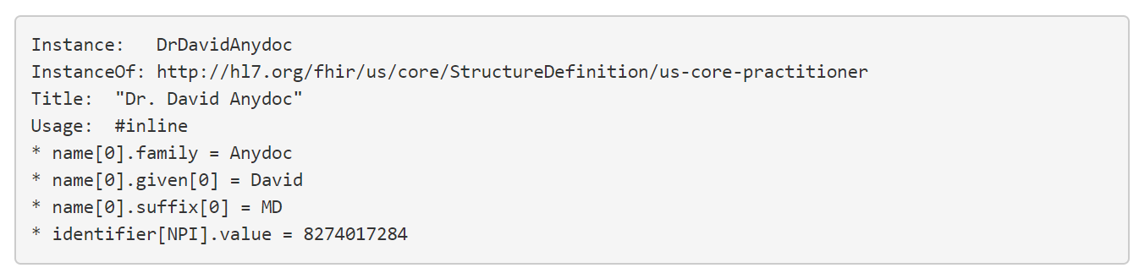
Defining Instances in FSH
Instances are defined in FSH using the "Instance" keyword
"InstanceOf" instead of "Parent"
All structures and values are inherited from the StructureDefinition (i.e. fixed codes, extension urls) -- don't have to be repeated
Instances only have fixed value rules, because instances have specific values

Slide 30
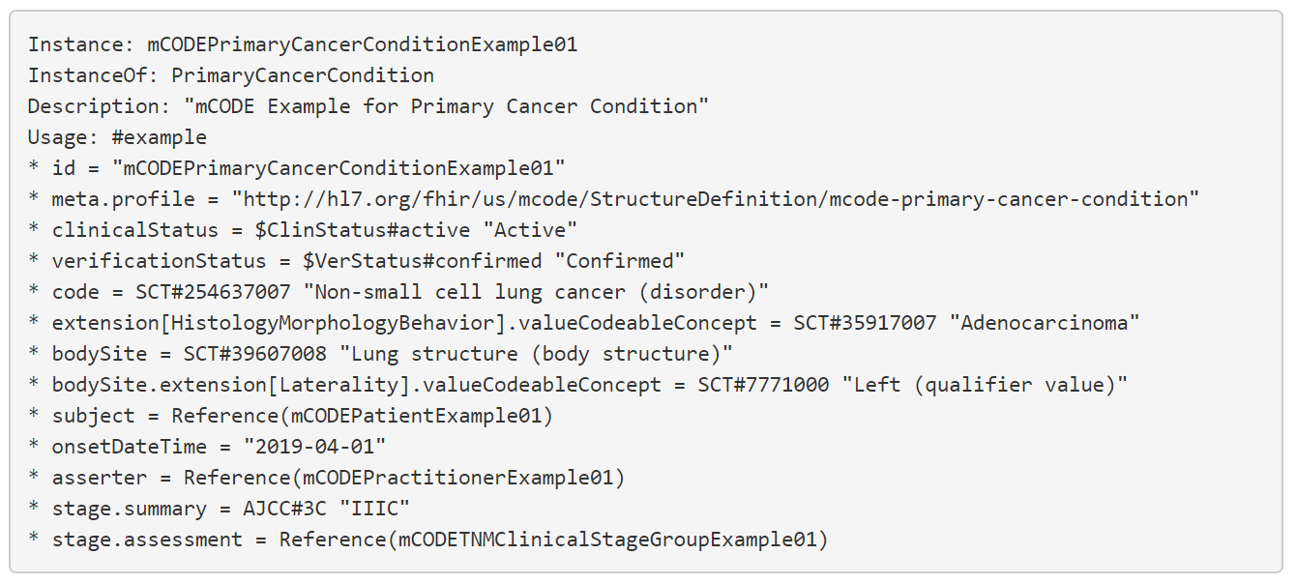
More Complex Instance Example

Slide 31
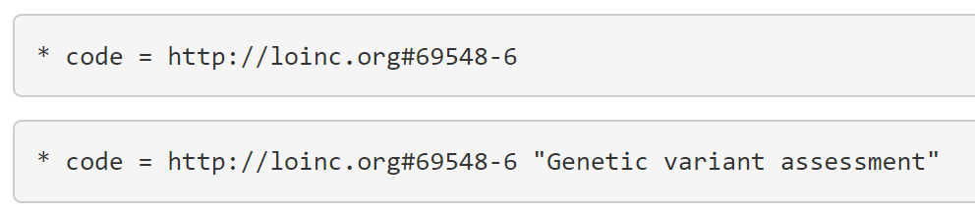
Assignment Statements in Profiles versus Instances
In profiles and extensions, values represent the minimum criteria for conformance
In the context of a profile, the first statement signifies an instance must have (1) the system http://loinc.org and (2) the code 69548-6 to pass validation.
The second statement says that an instance must have (1) the system http://loinc.org, (2) the code 69548-6, and (3) the display text “Genetic variant assessment” to pass validation.
Typically, only the system and code are important conformance criteria, so the first statement (without the display text) is preferred in a profiling context.
In an instance, however, the display text conveys additional information useful to the information receiver, so the second statement would be preferred.

Slide 32
Forcing an Exact Match (Profiles and Extensions)
* {path} = {value} (exactly)
"(exactly)" indicates conformance to the profile requires a precise match to the specification, no more or less
NO additional extensions, array elements, codings in CodeableConcept, etc.
Without "(exactly)" any instance that fulfills the pattern is valid -- i.e., no less but possibly more

Slide 33
Additional Rules

Slide 34
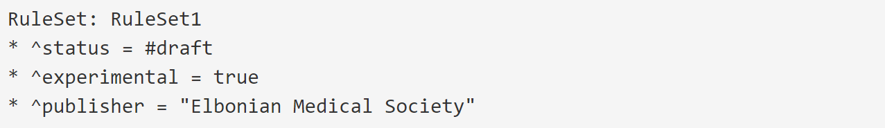
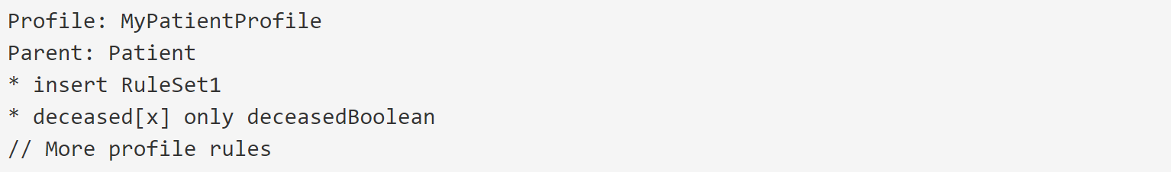
Rule Sets and Insert Rules
Provides ability to define free-floating rules and apply them to a compatible target
The same rule set can be used in multiple places
An example could be to set the same metadata on every StructureDefinition
A rule set can contain other rule sets
Defining a RuleSet
Inserting a RuleSet

Slide 35
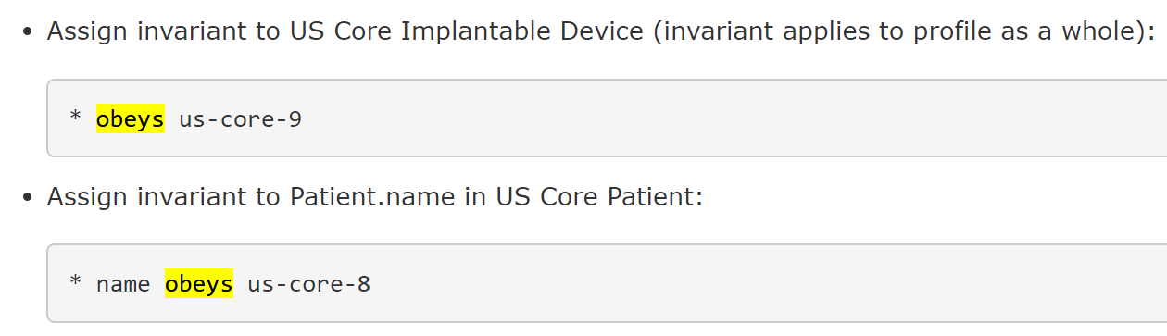
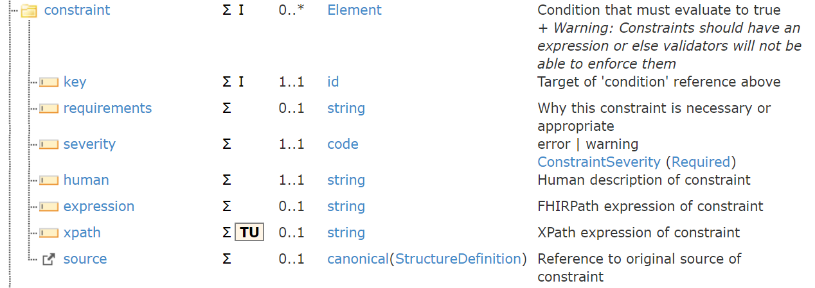
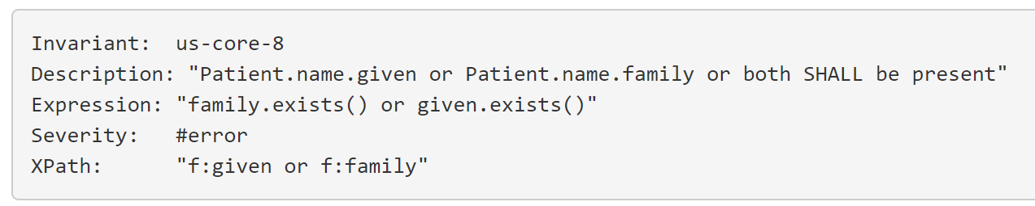
Invariants and "obeys"
Invariants represent logical constraints on values in a resource
"obeys" rule populates ElementDefinition.constraint
adds constraint to "self" ElementDefinition (remember dot caret?)
adds constraint to "name" ElementDefinition

Slide 36
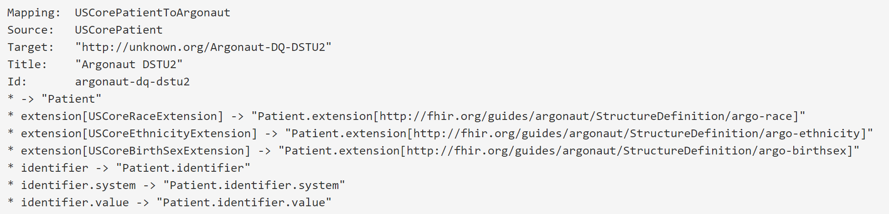
Mapping
Mappings are an optional part of SDs that can be provided to help implementers understand the content and use resources correctly
Mappings are informative and are not to be confused with computable mappings provided by FHIR Mapping Language or the StructureMap resource
In FSH, mapping rules are part of a separate Mapping definition

