Slide 1


Tutorial: FSHing Equipment
Julia Afeltra
Senior Software Engineer, MITRE Corporation
Nick Freiter
Software Engineer, MITRE Corporation
Mint Thompson
Senior Software Systems Engineer, MITRE Corporation
September, 2020

Slide 2
What is GoFSH?
A companion tool to SUSHI (SUSHI Unshortens ShortHand Inputs)
SUSHI unshortens FHIR Shorthand (FSH) into FHIR
GoFSH shortens FHIR into FSH
SUSHI
FSH files
FHIR IG artifacts
GoFSH

Slide 3
What is GoFSH good for?
When you start creating a new IG, you don't need GoFSH.
When you have an existing IG or StructureDefinitions, and you want to use FSH, you have an obstacle: accurately creating equivalent FSH
Manual conversion is tedious and error-prone
Automatic conversion using GoFSH removes this obstacle

Slide 4
Current State of GoFSH development
GoFSH is currently in alpha
Most features for converting StructureDefinitions to FSH Profiles and Extensions are working
Most FSH rules are correctly extracted
Some issues remain with complex value types, such as Quantity
Other FHIR resources are not yet supported
ValueSet, CodeSystem, and Instance

Slide 5
Future work for GoFSH
Support ValueSet, CodeSystem, and Instance
Stylistic improvements
Output should not only be correct, but when possible, should also reflect good FSH authoring styles
Round-trip using FSHing Trip
Helps verify correctness of FSH produced by GoFSH

Slide 6
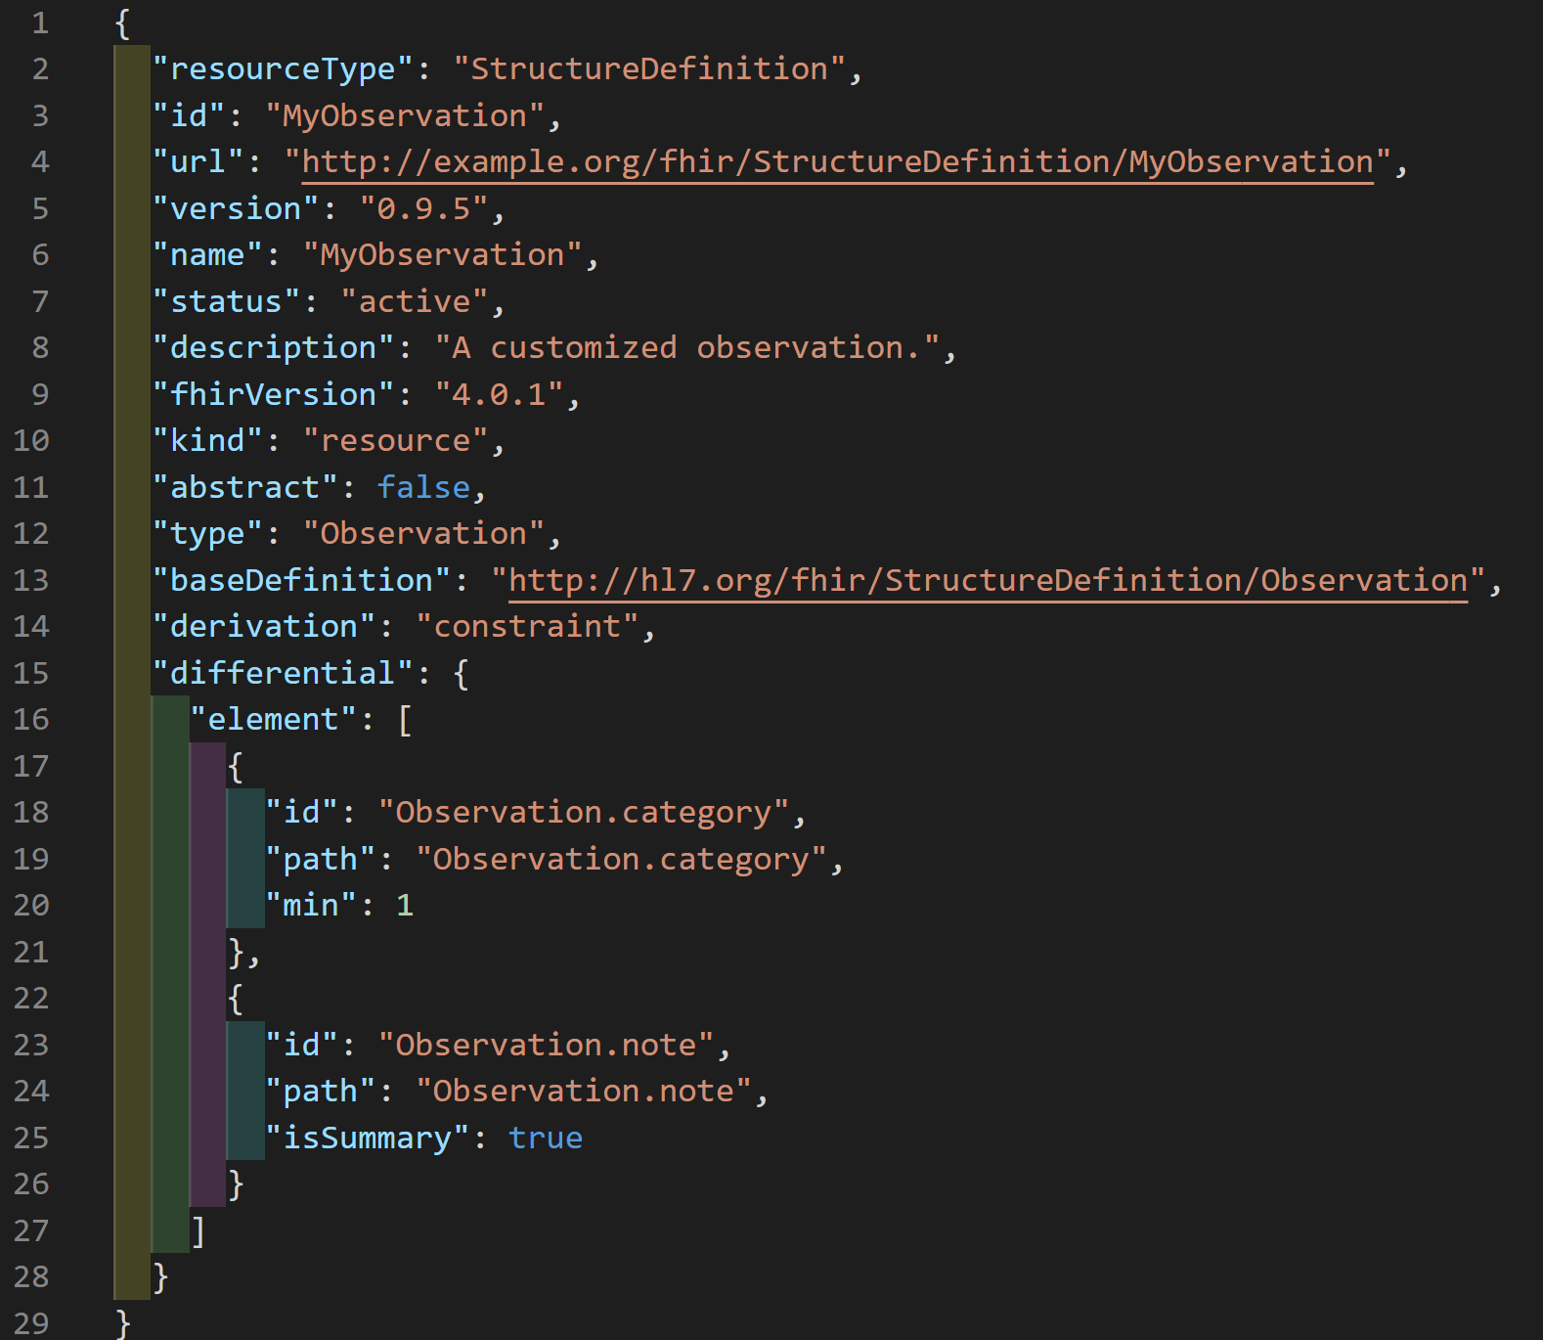
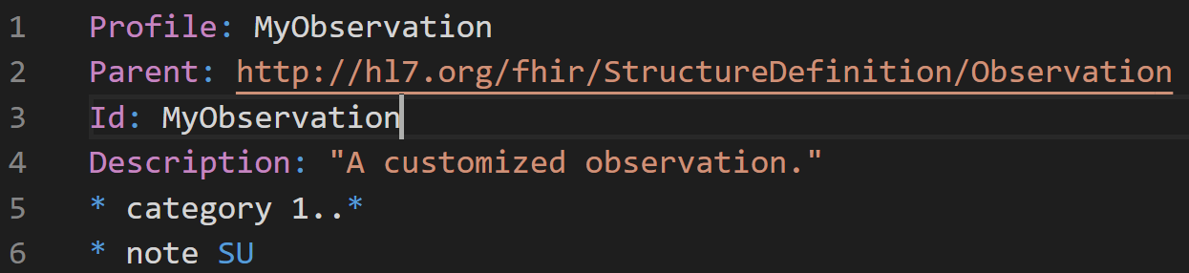
Example: StructureDefinition
Input: FHIR Resource JSON
Output: FSH definition
name – "Profile" keyword
baseDefinition – "Parent" keyword
id – "Id" keyword
description – "Description" keyword
differential.element[]
min – Cardinality rule
isSummary – Flag rule

Slide 7
Let's Try Using GoFSH!
Get your input files (StructureDefinition JSON) ready in one directory
Try using the profile at http://hl7.org/fhir/us/core/StructureDefinition-us-core-allergyintolerance.json.html
Install node (version 12.x or 10.x will work): https://nodejs.org/
Install GoFSH from the command line: npm install -g gofsh
Confirm installation from command line: gofsh --help
Run GoFSH from the command line: gofsh [path-to-fhir-resources]
Output is written to fsh/resources.fsh by default

Slide 8

FSH School
The place to go for learning and experimenting with FSH
Detailed documentation and tutorials showing you how to get started building IGs with FSH
New home of SUSHI documentation
Visit https://fshschool.org/

Slide 9
FSH and SUSHI Documentation on FSH School
https://fshschool.org/docs/

Slide 10
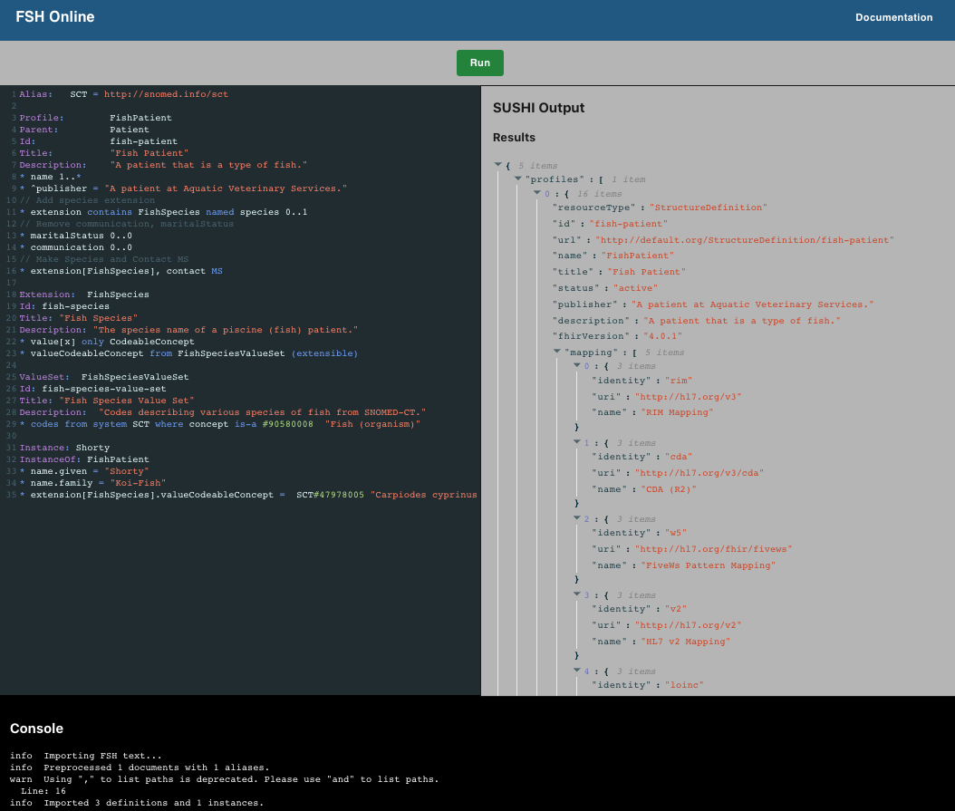
FSH Online
The place to go to quickly experiment with FSH
Author and edit FSH directly in the browser
Runs SUSHI on the authored FSH
Visit https://fshschool.org/FSHOnline/
Alpha version for early release and experimentation

