Slide 1
Chris Moesel and Mark Kramer, MITRE Corporation
Let's Build with FHIR Shorthand

Slide 2



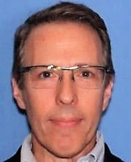
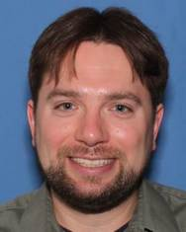



Mark Kramer
Chief Engineer for Health Innovation Center
Chris Moesel
Prinicipal Software Systems Engineer
Non-profit R&D funded by the US government
Clinical
Quality Language

Slide 3
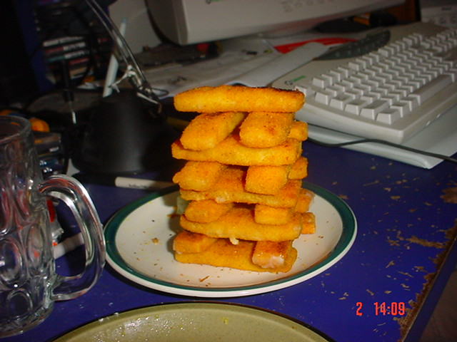
Let's Build with FSH
Image: https://www.flickr.com/photos/reilly/374345 (Creative Commons Atribution-ShareAlike 2.0)

Slide 4
Scenario: Adverse Events resulting from Vaccinations
Steps:
Create a FSH project
Create a value set for the type of AE
Create a value set for the seriousness of the AE
Create a value set for the grade of the AE
Create an extension representing the grade of the AE
Incorporate the above into a profile of AdverseEvent (AE)
Create an example of an ImmunizationAdverseEvent
Build an IG with all of the above using SUSHI and IG Publisher

Slide 5
What is an Adverse Event?
World Health Organization (WHO)
Medical occurrence temporally associated with the use of a medicinal product, but not necessarily causally related
FHIR Release 4
Actual or potential/avoided event causing unintended physical injury resulting from or contributed to by medical care, a research study or other healthcare setting factors that requires additional monitoring, treatment, or hospitalization, or that results in death.

Slide 6
Terminology
MedDRA (Medical Dictionary for Regulatory Activities)
Developed by the International Council for Harmonisation of Technical Requirements for Pharmaceuticals for Human Use (ICH)
Used worldwide to report clinical trial adverse events
Canonical URL: http://terminology.hl7.org/CodeSystem/MDRAE
CTCAE (Common Terminology Criteria for Adverse Events)
Defines grades (levels of severity or harm) for each type of event in MedDRA
Five levels from mild to fatal, represented by SNOMED-CT codes

Slide 7
Step 0: Install SUSHI
This tutorial assumes you are running SUSHI 1.0.1.
To install or update SUSHI:
Install Node.js LTS edition from https://nodejs.org/ (if applicable)
Open a terminal and run: npm install -g fsh-sushi
See https://fshschool.org/docs/sushi/installation/ for additional details.

Slide 8
Step 1: Create a FSH Project
Create a directory for development (e.g., devdays)
Open a terminal and:
Change to your development directory (e.g., cd C:\workspace\devdays)
Run the command: sushi --init
Recommended project properties:
Name: Covid19Vaccine
Id: devdays.letsbuildafhirspec.fsh
Canonical: https://fhir.devdays.com/R4/devdays-covid19-vaccine
Status: draft
Version: 0.1.0

Slide 9
Step 2: Create a value set for the type of AE
First, rename input/fsh/patient.fsh to input/fsh/adverse-event.fsh, then…
Define a new value set called “MedDRA_VS”
It should contain the set of all codes from the MedDRA code system
http://terminology.hl7.org/CodeSystem/MDRAE
Need help?
See FSH 3.6: Defining Items and FSH 3.6.9: Defining Value Sets
Consider defining an Alias for the MedDRA code system
See FSH 3.6.1: Defining Aliases

Slide 10
Step 3: Create a value set for the seriousness of the AE
Define a new value set called “AdverseEventSeriousness_VS”
In the MedDRA/CTCAE model of AEs, seriousness only has two values:
Code | Display
non-serious | Non-serious
serious | Serious
The “serious” indication means the event resulted in disability, death, hospitalization or birth defect.
AES Code System URI: http://terminology.hl7.org/CodeSystem/adverse-event-seriousness

Slide 11
Step 4: Create a value set for the grade of the AE
Define a new value set called “AdverseEventGrade_VS”
It should contain the following five codes from SNOMED-CT
Code | Display
255604002 | Mild (qualifier value)
6736007 | Moderate (severity modifier) (qualifier value)
24484000 | Severe (severity modifier) (qualifier value)
442452003 | Life threatening severity (qualifier value)
399166001 | Fatal (qualifier value)
SNOMED-CT URI: http://snomed.info/sct

Slide 12
Step 5: Create an extension for the grade of the AE
Define a new extension called “AdverseEventGrade”
Restrict value[x] to only allow CodeableConcept
Bind value[x] to the AdverseEventGrade_VS value set
Use binding strength: required
Need help?
See FSH 3.6: Defining Items and FSH 3.6.3: Defining Extensions
Also see FSH 3.5.9: Type Rules and FSH 3.5.2: Binding Rules

Slide 13
Step 6: Create a profile of Adverse Event
Define a new profile called “ImmunizationAdverseEvent”
Based on the AdverseEvent resource
Further constraints to follow on next slides…
Need help?
See FSH 3.6: Defining Items and FSH 3.6.7: Defining Profiles

Slide 14
Step 6a: Apply Type Constraints to AE Profile
Define the following Type rules to constrain types on AE elements:
Element/Path | Constrain Type to…
subject | Reference(Patient)
suspectEntity.instance | Reference(Immunization)
Need help?
See FSH 3.5.9: Type Rules

Slide 15
Step 6b: Apply Cardinality Constraints to AE Profile
Define the following Cardinality rules to constrain occurrences of AE elements:
Element/Path | Permitted | Required | Repeating | Notes
category | yes | yes | yes
event | yes | yes | no
event.text | yes | yes | no
severity | no | - | - | Severity is not a part of the MedDRA+CTCAE model We’ll use the AdverseEventGrade extension instead
Need help?
See FSH 3.5.3: Cardinality Rules

Slide 16
Step 6c: Apply Binding Constraints to AE Profile
Define the following Binding rules to constrain codes on AE elements:
Element/Path | From | Strength
event | MedDRA_VS | required
seriousness | AdverseEventSeriousness_VS | required
Need help?
See FSH 3.5.2: Binding Rules
NOTE: You can refer to locally defined value sets by their name

Slide 17
Step 6d: Apply Pattern Constraints to AE Profile
Define the following Assignment rules to constrain values of AE elements:
Element/Path | Value | Value Type | Exact?
actuality | actual | code | no
category | SNOMED-CT 264519003 | CodeableConcept | no
Need help?
See FSH 3.5.1: Assignment Rules and FSH 3.5.1.1: Assignments with Primitive Data Types and FSH 3.5.1.3: Assignments with the CodeableConcept Data Type
NOTE: Technically, we should “slice” category, but that is beyond the scope of this beginner’s exercise.

Slide 18
Step 6e: Add AdverseEventGrade extension to the AE Profile
Add the extension using a Contains rule with a local name
The local name should be “grade”
The extension should be optional and non-repeating
Need help?
See FSH 3.5.4: Contains Rules for Extensions
NOTE: You can reference locally defined extensions by their name

Slide 19
Sanity Check: Try Compiling with SUSHI
Open a terminal window
Change to your project root directory
Run the command: sushi
Do you get error messages? What do they tell you? Try fixing them and then run SUSHI again.
Review the generated files in ./fsh-generated/resources.
See https://fshschool.org/docs/sushi/running/ for additional details.

Slide 20
Step 7: Create an Example of an ImmunizationAdverseEvent
Your example should have the following values:
Element/Path | Value | Value Type
event | MedDRA 10002198 (display: Anaphylatcic reaction) | CodeableConcept
event.text | Anaphylaxis self-reported, self-treated by Epi pen. | string
extension[grade] .valueCodeableConcept | SNOMED-CT #6736007 (display: Moderate (severity modifier) (qualifier value)) | CodeableConcept
seriousness | AES non-serious (display: Non-serious) | CodeableConcept
outcome | AEO resolved (display: Resolved) | CodeableConcept
recorder | Mary Roe (id: mary-roe) | Reference
subject | Mary Roe (id: mary-roe) | Reference
suspectEntity.instance | Immunization Profile Example (id: immunizationprofile-example) | Reference
suspectEntity.causality .assessment | AEA probably-likely (display: Probably/Likely) | CodeableConcept
date | 2020-10-31 | dateTime
recordedDate | 2020-11-02 | dateTime
Help on next slide…

Slide 21
Step 7 Help
See FSH 3.6: Defining Items and FSH 3.6.4: Defining Instances
See FSH 3.4.6: Extension Paths and FSH 3.4.5: Data Type Choice [x] Paths
Code System URIs:
AES = http://terminology.hl7.org/CodeSystem/adverse-event-seriousness
AEO = http://terminology.hl7.org/CodeSystem/adverse-event-outcome
AEA = http://terminology.hl7.org/CodeSystem/adverse-event-causality-assess
The following will be inserted automatically based on the profile:
actuality = #actual
category = SCT#264519003 "Drug reaction (qualifier value)”
To avoid broken references in the IG Publisher, consider defining simple examples for mary-roe and immunizationprofile-example (but this is optional based on time available)

Slide 22
Step 8: Build an IG using SUSHI and the IG Publisher
Open a terminal window
Change to your project root directory
Run the command: sushi
Debug errors as necessary and run SUSHI again until you have 0 errors
Run the command: ./_updatePublisher (mac: .sh, win: .bat)
Run the command: ./_genonce (mac: .sh, win: .bat)
Open the generated ./output/index.html in your browser
See https://fshschool.org/docs/sushi/running/ for additional details.

Slide 23
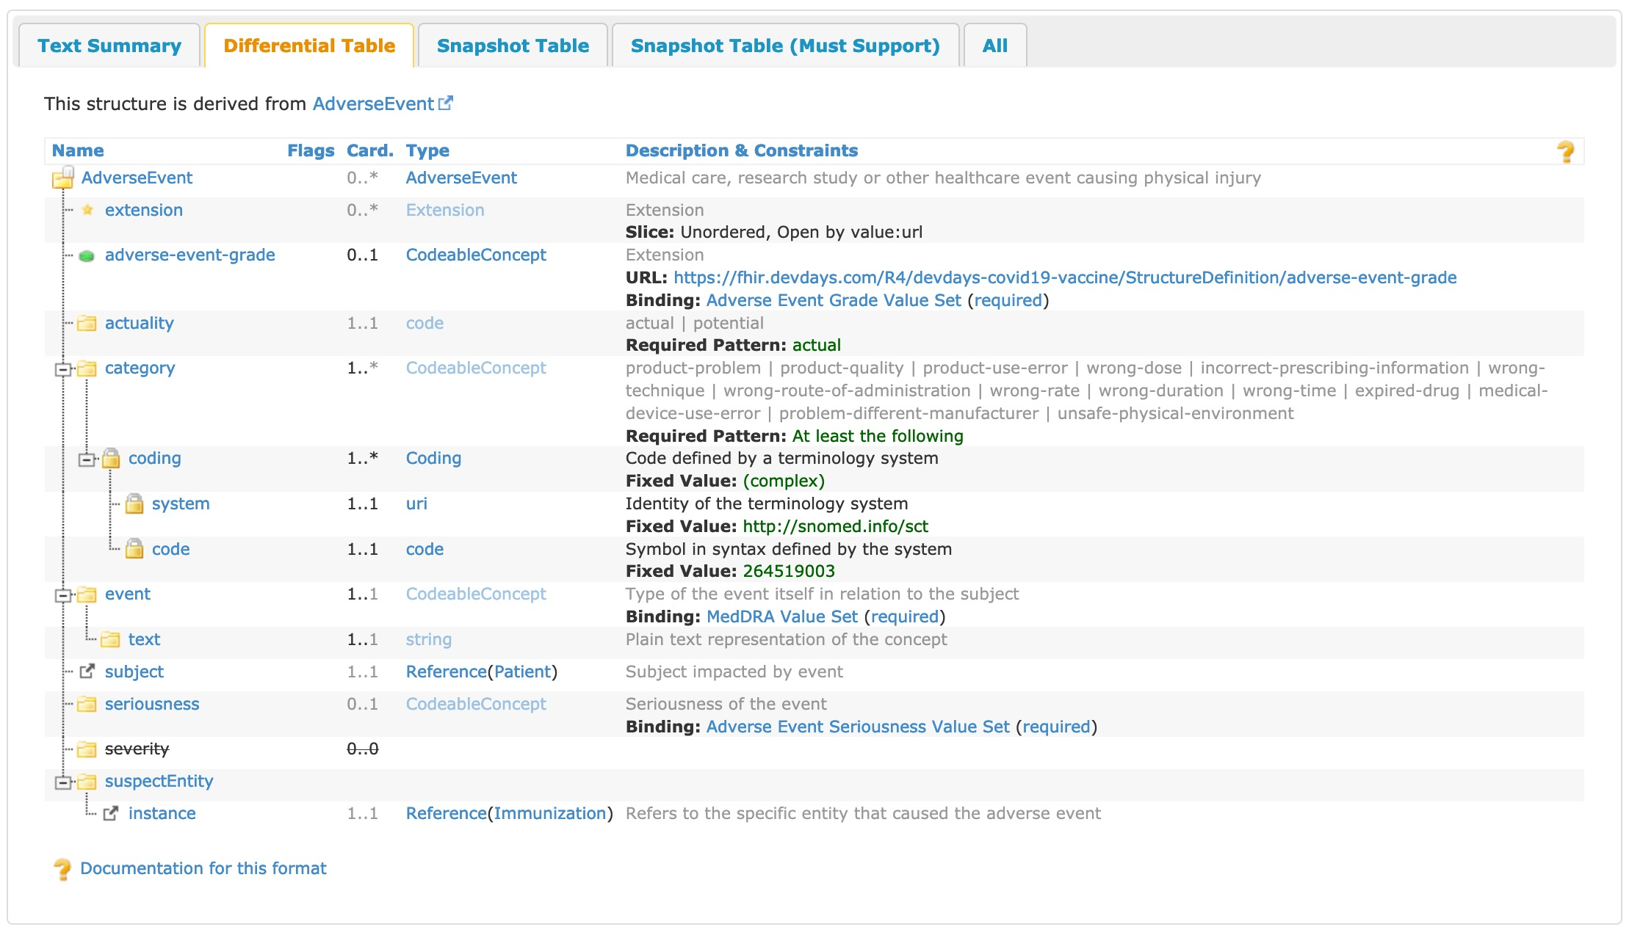
Rendered ImmunizationAdverseEvent Profile

Slide 24
Contact
During DevDays, you can find / reach us here:
Via Whova App – Speaker’s Gallery
# shorthand channel on chat.fhir.org
email: cmoesel@mitre.org
email: mkramer@mitre.org

