Slide 1
HL7® FHIR® Terminology
Rob Hausam MD
Part 2 – Searching and Services

Slide 2
This presentation
Can be downloaded here:
https://github.com/FHIR/documents/blob/master/presentations/2022-11%20Webinars/HL7%20FHIR%20Terminology/FHIR-Terminology-Part-2-2022-11-30.pptx
Is licensed for use under the Creative Commons, specifically:
Creative Commons Attribution 3.0 Unported License
(Do with it as you wish – just give credit)
Acknowledgements: Grahame Grieve, Lloyd McKenzie
2

Slide 3
This presentation
Based on the current official version of HL7 FHIR
FHIR Release #4B (v4.3.0) http://hl7.org/fhir/R4B/
Relevant and significant changes introduced in the R5 ballot will be highlighted
3

Slide 4
Tutorial Learning Objectives covered
Part 1 – Introduction and Fundamentals
Understand how coded data is represented in data types and model elements and is exchanged in FHIR resources
Understand how code systems and value sets in FHIR are defined, identified and used
Understand terminology binding and how to specify and use it correctly in FHIR models (resources and profiles)

Slide 5
Tutorial Learning Objectives
Part 2 – Searching and Services
Understand and use FHIR terminology-based search capabilities
Understand and use FHIR Terminology Service capabilities

Slide 6
Tutorial Learning Objectives
Part 3 – Advanced Topics (potential)
Further exploration of primary FHIR terminology service operations ($expand, $lookup, $validate-code, $subsumes, $translate)
Advanced terminology searching techniques
FHIR implicit value sets (SNOMED CT and other)
SNOMED CT Expression Constraint Language (ECL) in value set definitions
Code system supplements
Using terminology content in THO (terminology.hl7.org)
Submitting and managing a UTG proposal
Requesting new external (non-HL7) terminology content

Slide 7
Part 2 Topics Searching and Services
Terminology-Based Search
Terminology Service
Scenarios and Strategies for Using Terminology Services
References for Servers and Tools
Further (Advanced) Topics

Slide 8
Part 2 & 3 Topics Further (Advanced) Topics
Using SNOMED CT Expression Constraint Language (ECL) in value set definitions
Using FHIR implicit value sets
Features and uses of code system supplements and fragments
FHIR R5 ConceptMap updates – initial look
UTG and THO
Other topics?

Slide 9
Some Terminology-based searching techniques

Slide 10
Search parameters
Token
Exact match: system|code (SNOMED CT|Hypertensive disorder)
https://fhir.hausamconsulting.com/r4/Condition?code=http%3A%2F%2Fsnomed.info%2Fsct|38341003
Code, any system: code (LOINC Body weight Measured)
http://hapi.fhir.org/baseR4/Observation?code=3141-9

Slide 11
Search parameters
Token
System, any code: system| (SNOMED CT)
http://hapi.fhir.org/baseR4/AllergyIntolerance?code=http%3A%2F%2Fsnomed.info%2Fsct|
No system property exists, code: |code
https://fhir.hausamconsulting.com/r4/AllergyIntolerance?code=|allergy4387
This is expected to be quite rare
Why would you want to do this?

Slide 12
Search parameters
Modifiers
Search on CodeableConcept.text or Coding.display or Identifier.type.text: text
http://hapi.fhir.org/baseR4/Condition?code:text=angina
http://hapi.fhir.org/baseR4/Condition?code:text=angin
http://hapi.fhir.org/baseR4/AllergyIntolerance?code:text=ibuprofen
Exclude resources that match based on token: not
http://hapi.fhir.org/baseR4/Condition?severity:not=255604002
255604002 = “Mild”

Slide 13
Search parameters
Value Set-based Modifiers
ValueSet used in example
https://fhir.hausamconsulting.com/r4/ValueSet/upper-respiratory-infection
https://fhir.hausamconsulting.com/r4/ValueSet/upper-respiratory-infection/$expand
Code in value set: in
https://fhir.hausamconsulting.com/r4/Condition?code:in=http%3A%2F%2Fexample.org%2Fvs%2Fupper-respiratory-infection

Slide 14
Search parameters
Value Set-based Modifiers
Code not in value set: not-in
https://fhir.hausamconsulting.com/r4/Condition?code:not-in= http%3A%2F%2Fexample.org%2Fvs%2Fupper-respiratory-infection [unable to test with available server implementations]

Slide 15
Search parameters
Subsumption-based Modifiers
Code in a resource subsumes the specified search code (e.g. is-a* relationship): below “Diabetes mellitus” (73211009)
https://fhir.hausamconsulting.com/r4/Condition?code:below=http://snomed.info/sct|73211009
Code in a resource is subsumed by the specified search code (e.g. is-a* relationship): above “Diabetes mellitus type 2 without retinopathy” (1481000119100)
https://fhir.hausamconsulting.com/r4/Condition?code:above=http://snomed.info/sct|1481000119100
*’is-a’ relationship includes the code itself

Slide 16
Search Paging
Search results can be paged
http://hl7.org/fhir/search.html#count
Search paging example:
https://fhir.hausamconsulting.com/r4/Condition?code:below=http://snomed.info/sct|73211009&_count=5

Slide 17
Exploration of primary FHIR terminology service operations

Slide 18
Terminology Service Rationale
There’s a lot of complexity here:
Code Systems
Value Sets
Bindings
Many (or most) applications are much simpler
List of codes and displays in some table structure
This is a known problem

Slide 19
Terminology Service Rationale
Delegate the complexity to specialist software
Provide a set of services that do what applications need
It becomes easy to write applications that do terminology well

Slide 20
Terminology Service Operations - Overview
ValueSet
$expand
$validate-code
CodeSystem
$lookup
$subsumes
$find-matches
$validate-code
ConceptMap
$translate
$closure
Renamed in R4 (previously $compose)
Added in R4

Slide 21
FHIR Terminology Service Usage Scenarios
Usage scenario | FHIR Terminology Service solution
Obtain a list of codes to populate user interface widget - e.g., a dropdown list. | Invoke the $expand operation with the value set (which contains the codes) as the input parameter
Obtain a list of codes based on what the user has typed in a user interface text box | Invoke the $expand operation with the value set (which contains the codes) and the text the user has entered as the value set and filter input parameters
Determine if a received code is valid. | Invoke the $validate-code operation with the received code as the input parameter
How do I obtain the display names (descriptions) for a code so that I can display it ? | Invoke the $lookup operation with the received code as the input parameter
Obtain a translation of a concept in one code system to a concept in another code system. | Invoke the $translate operation with the source code and a concept map as input parameters

Slide 22
$expand
Takes a ValueSet reference or resource and returns another ValueSet resource containing the expansion (code set)
Default is the current expansion (as of “now”)
Uses include populating a drop-down list, “type ahead” search, etc.

Slide 23
$expand examples
Extensional value set definition (enumerated list)
https://fhir.hausamconsulting.com/r4/ValueSet/procedure-category
https://fhir.hausamconsulting.com/r4/ValueSet/procedure-category/$expand

Slide 24
$expand examples (cont.)
Intensional value set definition (code system query based)
“All codes”
https://fhir.hausamconsulting.com/r4/ValueSet/observation-category
https://fhir.hausamconsulting.com/r4/ValueSet/observation-category/$expand
“is-a” hierarchy
https://fhir.hausamconsulting.com/r4/ValueSet/route-codes
284009009 = “Route of administration value”
https://fhir.hausamconsulting.com/r4/ValueSet/route-codes/$expand

Slide 25
$expand examples (cont.)
Paging (count and offset parameters)
https://fhir.hausamconsulting.com/r4/ValueSet/route-codes/$expand?count=10&offset=0
https://fhir.hausamconsulting.com/r4/ValueSet/route-codes/$expand?count=10&offset=10

Slide 26
$expand examples (cont.)
$expand + filter For type-ahead search (with large value sets)
https://fhir.hausamconsulting.com/r4/ValueSet/route-codes/$expand?filter=intra
https://fhir.hausamconsulting.com/r4/ValueSet/route-codes/$expand?filter=intrales

Slide 27
$validate-code
Takes a code/Coding/CodeableConcept and checks if it’s valid against a value set or a code system
Specify value set (same as for $expand)
Code to validate – either code+system (with or without version, display), Coding or CodeableConcept
date – date to validate as of
Outputs: true/false
message if not valid, display names if valid
The primary method for validating coded data

Slide 28
$validate-code example (ValueSet)
FHIR condition-category “problem-list-item”
https://fhir.hausamconsulting.com/r4/ValueSet?url=http://hl7.org/fhir/ValueSet/condition-category
https://fhir.hausamconsulting.com/r4/ValueSet/$expand?url=http://hl7.org/fhir/ValueSet/condition-category
https://fhir.hausamconsulting.com/r4/ValueSet/$validate-code?url=http://hl7.org/fhir/ValueSet/condition-category&system=http://terminology.hl7.org/CodeSystem/condition-category&code=problem-list-item

Slide 29
$validate-code example (CodeSystem)
SNOMED CT “Pneumonia” (233604007)
https://terminz.azurewebsites.net/fhir/CodeSystem/$validate-code?system=http://snomed.info/sct&code=233604007&_format=json&_pretty=true

Slide 30
$lookup
Takes a code+system(version) or Coding and returns additional details about the concept
Name, version, preferred display string, properties (including subproperties) and designations (additional representations for the concept)
Can also be used to determine whether a code exists in the CodeSystem
But returns an OperationOutcome (error) if the code does not exist

Slide 31
$lookup example
SNOMED CT “Pneumonia” (233604007)
Note: Different servers will display different details
https://fhir.hausamconsulting.com/r4/CodeSystem/$lookup?system=http://snomed.info/sct&code=233604007
http://tx.fhir.org/r4/CodeSystem/$lookup?system=http://snomed.info/sct&code=233604007
https://terminz.azurewebsites.net/fhir/CodeSystem/$lookup?system=http://snomed.info/sct&code=233604007&_format=json&_pretty=true

Slide 32
$subsumes
Test whether codeA / codingA subsumes (or is subsumed by) codeB / codingB
Based on the semantics of subsumption in the underlying code system (e.g. SNOMED CT)
Returns one of four possible codes:
equivalent, subsumes, subsumed-by, and not-subsumed
If unable to determine the relationship between codes, returns an error

Slide 33
$subsumes example
SNOMED CT “Viral hepatitis” (3738000), “Disorder of liver” (235856003)
https://fhir.hausamconsulting.com/r4/CodeSystem/$subsumes?system=http://snomed.info/sct&codeA=3738000&codeB=235856003
https://fhir.hausamconsulting.com/r4/CodeSystem/$subsumes?system=http://snomed.info/sct&codeA=235856003&codeB=3738000
“Malarial hepatitis” (83072009), “Viral hepatitis” (3738000)
https://fhir.hausamconsulting.com/r4/CodeSystem/$subsumes?system=http://snomed.info/sct&codeA=83072009&codeB=3738000

Slide 34
$subsumes example (cont.)
SNOMED CT “Viral hepatitis” (3738000), “Viral hepatitis” (3738000)
https://fhir.hausamconsulting.com/r4/CodeSystem/$subsumes?system=http://snomed.info/sct&codeA=3738000&codeB=3738000&_format=json&_pretty=true
https://terminz.azurewebsites.net/fhir/CodeSystem/$subsumes?system=http://snomed.info/sct&codeA=3738000&codeB=3738000&_format=json&_pretty=true

Slide 35
$subsumes example (cont.)
SNOMED CT “Viral hepatitis” (3738000), “Viral hepatitis” (3738000)
http://tx.fhir.org/r4/CodeSystem/$subsumes?system=http://snomed.info/sct&codeA=3738000&codeB=3738000
https:///r4.ontoserver.csiro.au/fhir/CodeSystem/$subsumes?system=http://snomed.info/sct&codeA=3738000&codeB=3738000
https://snowstorm.ihtsdotools.org/fhir/CodeSystem/$subsumes?system=http://snomed.info/sct&codeA=3738000&codeB=3738000

Slide 36
$translate
Can you translate this code to another code system?
Uses ConceptMap to translate the code(s)
http://...ConceptMap/id$translate
code, Coding or CodeableConcept passed (as per $validate-code)
Output:
True if can be translated
Message if can’t be translated
Translated coding if it can be translated

Slide 37
$translate example
ConceptMap $translate tutorial example: FHIR address-use to V3 AddressUse value sets (Terminz)
ConceptMap resource used in the example: https://terminz.azurewebsites.net/fhir/ConceptMap?source=http://hl7.org/fhir/ValueSet/address-use&target=http://terminology.hl7.org/ValueSet/v3-AddressUse&_format=json&_pretty=true

Slide 38
$translate example (cont.)
ConceptMap $translate tutorial example: FHIR address-use to V3 AddressUse value sets (Terminz)
https://terminz.azurewebsites.net/fhir/ConceptMap/$translate?system=http://hl7.org/fhir/address-use&code=home&source=http://hl7.org/fhir/ValueSet/address-use&target=http://terminology.hl7.org/ValueSet/v3-AddressUse&_format=json&_pretty=true

Slide 39
$translate example (cont.)
ConceptMap $translate tutorial example: FHIR address-use to V3 AddressUse value sets (Terminz)
https://terminz.azurewebsites.net/fhir/ConceptMap/$translate?system=http://hl7.org/fhir/address-use&code=old&source=http://hl7.org/fhir/ValueSet/address-use&target=http://terminology.hl7.org/ValueSet/v3-AddressUse&_format=json&_pretty=true

Slide 40
Tutorial Learning Objectives covered
Part 1 – Introduction and Fundamentals
Understand how coded data is represented in data types and model elements and is exchanged in FHIR resources
Understand how code systems and value sets in FHIR are defined, identified and used
Understand terminology binding and how to specify and use it correctly in FHIR models (resources and profiles)

Slide 41
Tutorial Learning Objectives covered
Part 2 – Searching and Services
Understand and use FHIR terminology-based search capabilities
Understand and use FHIR Terminology Service capabilities

Slide 42
References for Servers and tools

Slide 43
Some Publicly Available Terminology Servers
Health Intersections (Grahame Grieve)
http://tx.fhir.org/ (FHIR build terminology server)
HAPI (University Health Network – James Agnew)
http://hapi.fhir.org/
OntoServer (CSIRO – Australia – Michael Lawley)
https://ontoserver.csiro.au/
https://stu3.ontoserver.csiro.au/fhir
https://r4.ontoserver.csiro.au/fhir

Slide 44
Some Publicly Available Terminology Servers
Value Set Authority Center (VSAC) – US National Library of Medicine (NLM)
https://cts.nlm.nih.gov/fhir/
Terminz (Patients First – New Zealand – Peter Jordan)
https://terminz.azurewebsites.net/fhir
Link to other publicly available FHIR servers (general and terminology)
https://confluence.hl7.org/display/FHIR/Public+Test+Servers

Slide 45
Some Useful Tools
clinFHIR (David Hay)
CodeSystem builder
http://clinfhir.com/codeSystem.html
ValueSet explorer
http://clinfhir.com/valuesetCreator.html
Query Tool
http://clinfhir.com/query.html
Postman
https://www.getpostman.com/

Slide 46
Some Useful Tools (cont.)
Shrimp SNOMED CT browser (CSIRO)
http://ontoserver.csiro.au/shrimp
CSIRO Value Set Comparison Tool
http://ontoserver.csiro.au/vstool
FHIR Tools release page
http://www.healthintersections.com.au/FhirServer/

Slide 47
further (Advanced) topics

Slide 48
Using SNOMED CT Expression Constraint Language (ECL) in value set definitions

Slide 49
SNOMED CT Expression Constraint Language (ECL)
A SNOMED CT Expression Constraint is a computable rule that can be used to define a bounded set of clinical meanings represented by either precoordinated or postcoordinated expressions.
SNOMED CT ECL documentation
Not all FHIR servers support ECL!
Ontoserver, Snowstorm and Terminz servers do support ECL

Slide 50
SNOMED CT Expression Constraint Language (ECL) (cont.)
Expressions
http://hl7.org/fhir/snomedct.html#4.3.1.0.5
ECL
See SNOMED CT Filters
See SNOMED CT Implicit Value Sets (fifth bullet)
SNOMED CT Browser
Expression Constraint Queries tab

Slide 51
SNOMED CT Expression Constraint Language (ECL) (cont.)
SNOMED ECL Builder (OntoServer)
https://ontoserver.csiro.au/shrimp/ecl/
CSIRO Value Set Comparison Tool
Includes several ECL queries and shows responses (or lack of response) from multiple FHIR servers
http://ontoserver.csiro.au/vstool

Slide 52

ECL Value Set Definition Example
https://build.fhir.org/ig/HL7/fhir-ips/ValueSet-procedures-snomed-ct-ips-free-set.html
POST the ValueSet resource to a server endpoint and invoke the $expand operation (show in VS Code and Postman)

Slide 53
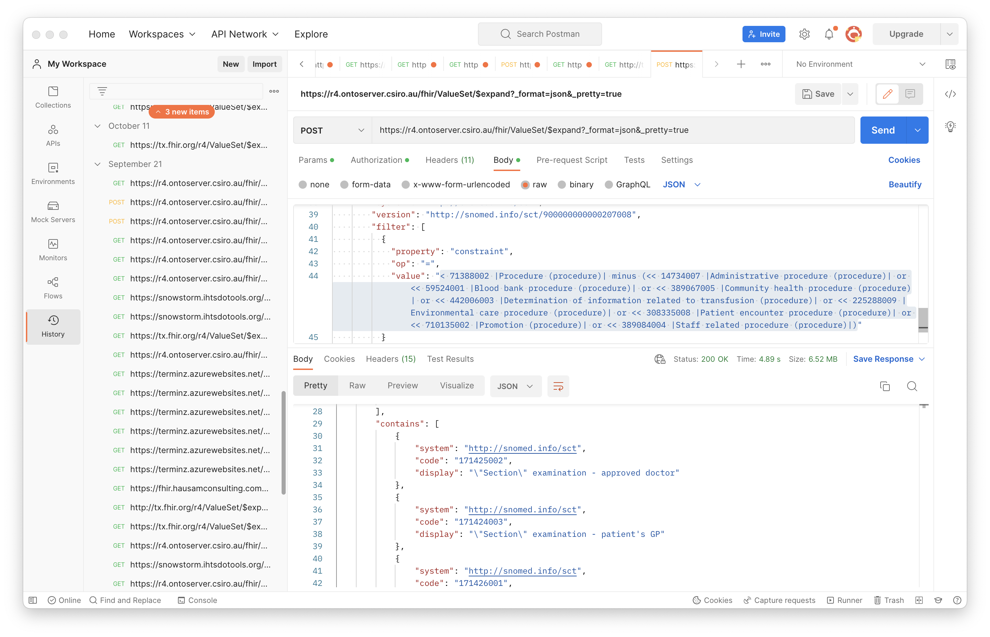

Slide 54
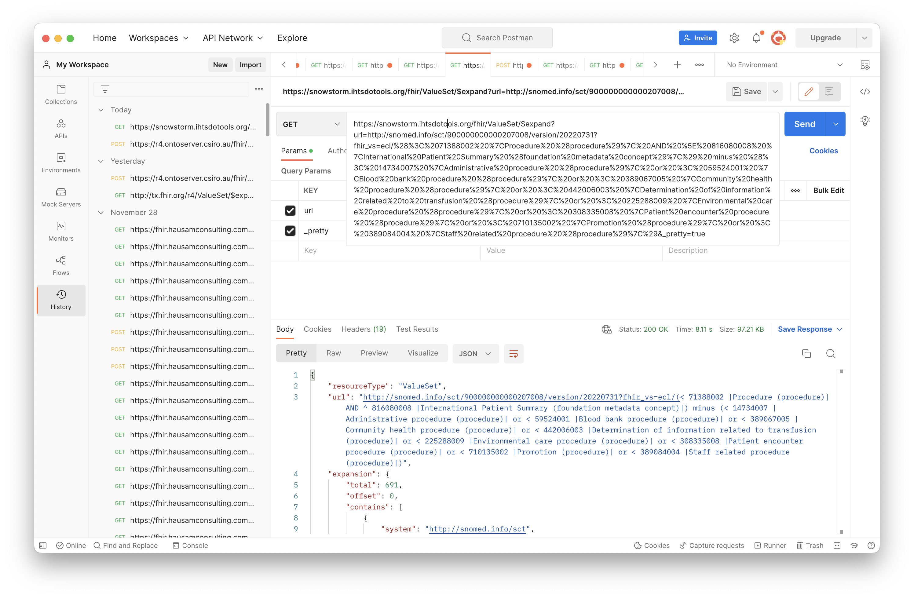

Slide 55
Using FHIR implicit value sets

Slide 56
Implicit Value Sets
Implicit value sets are those whose specification can be predicted based on the grammar of the underlying code system, and the known structure of the URL that identifies them
New documentation on this in ValueSet resource in R5 ballot
Note: This documentation will continue to be developed for R5 – feedback to Vocab WG is welcome!

Slide 57
Implicit Value Sets
Implicit value sets do not use complex queries
Allows a single URL to serve as a value set definition (without requiring an explicit ValueSet resource)
Can serve as the basis for the $expansion operation
Example - SNOMED CT has common sets of implicit value sets defined (more than any other code system at present):
By Subsumption, By Reference Set, etc.
See http://hl7.org/fhir/snomedct.html#implicit

Slide 58
Implicit Value Set $expand (isa)
SNOMED CT subtypes of “Pneumonia” (233604007)
https://r4.ontoserver.csiro.au/fhir/ValueSet/$expand?url=http%3A%2F%2Fsnomed.info%2Fsct%3Ffhir_vs=isa%2F233604007&_format=json&_pretty=true
http://tx.fhir.org/r4/ValueSet/$expand?url=http%3A%2F%2Fsnomed.info%2Fsct%3Ffhir_vs=isa%2F233604007
https://terminz.azurewebsites.net/fhir/ValueSet/$expand?url=http%3A%2F%2Fsnomed.info%2Fsct%3Ffhir_vs=isa%2F233604007&_format=json&_pretty=true

Slide 59
Implicit Value Set $expand (ECL expression)
SNOMED CT subtypes of “Pneumonia” (233604007) ECL expression: < 233604007 |Pneumonia (disorder)|
https://r4.ontoserver.csiro.au/fhir/ValueSet/$expand?url=http%3A%2F%2Fsnomed.info%2Fsct%2F900000000000207008%2Fversion%2F20220731%3Ffhir_vs%3Decl%2F%3C%20233604007%20%7CPneumonia%20%28disorder%29%7C&_format=json&_pretty=true

Slide 60
Features and uses of code system supplements and fragments

Slide 61
Code System Supplements and Fragments
Supplement
CodeSystem.content = ‘supplement’
http://hl7.org/fhir/codesystem.html#supplements
Fragment
CodeSystem.content = ‘fragment’
http://hl7.org/fhir/codesystem.html#fragments

Slide 62
Code System Supplement
CodeSystem.supplements SHALL have a value – the URL of the code system being supplemented
CodeSystem.url SHALL never appear in a Coding.system
CodeSystem.url must be under control of the authority creating or publishing the supplement (usually different from the original code system)

Slide 63
Code System Supplement
Cannot define any new CodeSystem.concept.code
All instances of CodeSystem.concept.code in the supplement must be a code from the "supplemented" code system
Note: If need to define new concepts/codes to use as property values, the supplement can be paired with a new (possibly contained) Code System and use the Coding type for the property values

Slide 64
Code System Supplement Example
CodeSystem
https://terminz.azurewebsites.net/fhir/CodeSystem/bundle-type?_format=json&_pretty=true
https://terminz.azurewebsites.net/fhir/CodeSystem/bundle-type-german?_format=json&_pretty=true
https://terminz.azurewebsites.net/fhir/CodeSystem?supplements=http://hl7.org/fhir/bundle-type&_format=json&_pretty=true

Slide 65
Code System Supplement Example
ValueSet
https://terminz.azurewebsites.net/fhir/ValueSet/Bundle-Type-supplemented?_format=json&_pretty=true
Value set expansion
https://terminz.azurewebsites.net/fhir/ValueSet/Bundle-Type-supplemented/$expand?_format=json&_pretty=true

Slide 66
Code System Supplement Discussions
FHIR Zulip chat
https://chat.fhir.org/#narrow/stream/179202-terminology/topic/Behaviour.20of.20CodeSystem.20operations.20with.20supplements
https://chat.fhir.org/#narrow/stream/179202-terminology/topic/Designations.20from.20code.20system.20supplements.20in.20Coding.2Edisplay.3F
https://chat.fhir.org/#narrow/stream/179202-terminology/topic/Designations.20vs.2E.20language-specific.20resources.20for.20VS.20and.20CS

Slide 67
Code System Fragment
Reasons for using a code system fragment
Different IP distribution rules for different parts of the code system
Special purpose modules for specific purposes
Distribution of proposed content for evaluation

Slide 68
Code System Fragment
Rules for code system fragments
SHALL have the same CodeSystem.url
Can only(?) be published by the code system authority, or according to a process defined by the authority, if they have defined one
Cannot contain codes, concepts or properties that are not found in a complete representation of the code system (if one exists)
Publishing a code system in multiple fragments can create confusion for terminology servers and terminology service consumers - need to be clear about the intent

Slide 69
Code System Fragment Examples and Discussion
Common UCUM units (?)
http://hl7.org/fhir/valueset-ucum-common.html (not CodeSystem)
But THO represents UCUM as ‘"content" : "not-present”’
SNOMED CT (?)
Each SNOMED CT edition could be considered as a fragment the entire SNOMED CT – but they aren’t represented that way
Recent and ongoing discussions on this topic
https://chat.fhir.org/#narrow/stream/179202-terminology/topic/Fragment.20.2F.20Example.20expansions

Slide 70
FHIR R5 ConceptMap updates – initial look

Slide 71
Summary of R5 ConceptMap changes
Element “equivalence” replaced by “relationship”
Was (10): relatedto | equivalent | equal | wider | subsumes | narrower | specializes | inexact | unmatched | disjoint
Now (5): related-to | equivalent | source-is-narrower-than-target | source-is-broader-than-target | not-related-to
The directional relationships have the direction made explicit in the code – should help avoid confusion!
group.element.target.equivalence = ‘unmatched’ replaced by group.element.noMap (boolean)
No longer necessary to create a ‘target’ when there is none!

Slide 72
Summary of R5 ConceptMap changes (2)
Now can do mappings from or to a valueSet, rather than only a single code per mapping (also in unmapped)
group.element.code OR group.element.valueSet
dependsOn and product now allow a choice of value types (not only string)
‘source’ and ‘target’ elements (references to uri or valueSet) are now renamed to ‘sourceScope’ and ‘targetScope’ to clarify their meaning and use
Other elements and descriptive text have been updated and (hopefully) clarified

Slide 73
Summary of R5 $translate changes
$translate operation parameters have also been renamed to be clearer and to match the corresponding resource elements
$translate ‘source’ and ‘target’ input parameters now can specify ‘code’, ‘Coding’ or ‘CodeableConcept’ (new parameters added)

Slide 74
Summary of R5 $translate changes (2)
‘dependency’ and ‘match.product’ values can now have a choice of value types (corresponding to the resource)
‘reverse’ input parameter removed
This was confusing
If both directions are needed, can make that explicit

Slide 75
R5 ConceptMap server support
CSIRO R5 endpoint
https://ontoserver-r5.australiaeast.cloudapp.azure.com/fhir
Example
https://ontoserver-r5.australiaeast.cloudapp.azure.com/fhir/ConceptMap/$translate?code=ADT_A04.MSH&system=http://hl7.org/fhir/ADT_A04
Zulip R5 terminology server discussion

Slide 76
UTG and THO

Slide 77
Unified Terminology Governance (UTG)
UTG is a process
How to add and maintain (modify, and in rare cases remove) content in THO (terminology.hl7.org)
Submit and vote (by registered UTG voters) on UTG proposals
UTG documentation
Additional slide deck available – time and interest permitting

Slide 78
terminology.hl7.org (THO)
https://terminology.hl7.org/
”Source of truth” for (most) HL7 terminology
Contains code systems (HL7 and external), identifier systems (normally external), value sets (some), concept maps (actually there are none at present)
THO is not a terminology service
But THO content is provided for the FHIR core and IG build ecosystem in tx.fhir.org

Slide 79
Questions?
Connect with the FHIR community: FHIR Zulip chat terminology stream
https://chat.fhir.org/#narrow/stream/terminology
Or ask me: Rob Hausam
rob@hausamconsulting.com rrhausam@gmail.com Or you can send a PM on the FHIR Zulip chat

