Slide 1


Structured Data Capture (SDC)
Workflow
Lloyd McKenzie | February 2025

Slide 2

Who am I?
Name: Lloyd McKenzie
Company: Dogwood Health
Background:
One of FHIR’s 3 initial editors
Co-chair FHIR-Infrastructure, past chair FHIR Management Group
HL7 Fellow
Lead for both the ONC and international FHIR SDC projects
lloyd@dogwoodhealthconsulting.com

Slide 3
This presentation
Can be downloaded from the Ontario Health e-Learning site:
https://elearning.ontariohealth.ca/login/index.php
Is licensed for use under the Creative Commons, specifically:
Creative Commons Attribution 3.0 Unported License
Do with it as you wish, so long as you give credit

Slide 4

Credit
These slides include content from Brian Postlethwaite and Bryn Rhodes
With updates by Lloyd McKenzie

Slide 5

The SDC Collection
SDC Overview
SDC Workflow (you are here)
SDC Expressions
SDC Rendering & Behavior
SDC Population
SDC Extraction
SDC Adaptive Forms
SDC Modular & Derived Forms

Slide 6

Objectives
You should be able to:
Describe the purposes and capabilities of the standard SDC roles
Identify which FHIR workflow pattern the Questionnaire and QuestionnaireResponse resources adhere to
List some of the terminology functions relevant for SDC
Explain the different mechanisms for asking for a form to be filled out
Differentiate between the different ways of identifying a Questionnaire
List some of the key search parameters used in retrieving a Questionnaire

Slide 7
SDC Workflow Outline
SDC System Roles
Form Creation Workflow
Form Fulfillment Workflow
Form Rendering Workflow
Workflow Exercises

Slide 8
SDC Workflow Outline
SDC System Roles
Form Creation Workflow
Form Fulfillment Workflow
Form Rendering Workflow
Workflow Exercises

Slide 9
SDC Roles and key functions
Form Filler
Search, Populate Questionnaire
Form Manager
Form Designer
Form Manager
Query, Create, Update, Delete Questionnaire
Read ValueSet
Query, Create, Update, Delete ValueSet
Form Response Manager
Query, Create, Update,
Extract from QuestionnaireResponse
Extract from QuestionnaireResponse
Query, Create, Update, Delete CodeSystem
Process QuestionnaireResponse
Form Receiver
Create QuestionnaireResponse
Form Archiver

Slide 10
Purpose of Roles (CapabilityStatements)
Standard set of expectations for systems
Increase consistency
Basis for asserting conformance
Common naming convention
Details are here:
SDC Capability Statements

Slide 11
Form Filler
Form Filler
Search, Populate Questionnaire
Form Manager
FHIR Client
Allows users to find, load, complete, edit, and store forms
Needs to:
Render questions and answers with proper controls
Determine allowed options
Enforce validation rules
Enforce flow control
Read ValueSet
Form Response Manager
Query, Create, Update,
Extract from QuestionnaireResponse
Extract from QuestionnaireResponse
Process QuestionnaireResponse
Form Receiver
Create QuestionnaireResponse
Form Archiver

Slide 12
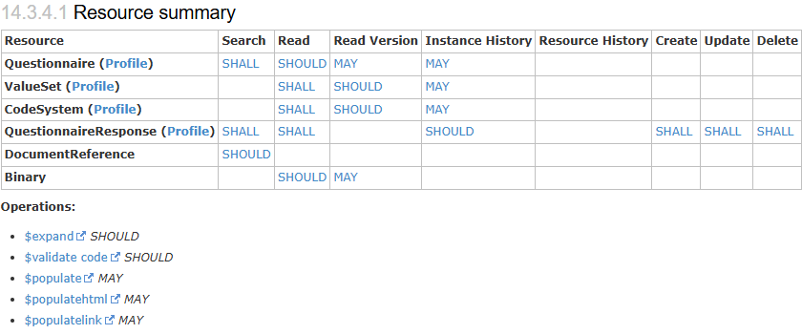
Form Filler functionality

Slide 13
Form Manager
Form Filler
Search, Populate Questionnaire
Form Manager
FHIR Server
Allows systems to search for, store, retrieve, and update Questionnaires
May also support associated ValueSets and CodeSystems
Handles multiple versions of the above
May support Questionnaire assembly
Read ValueSet

Slide 14
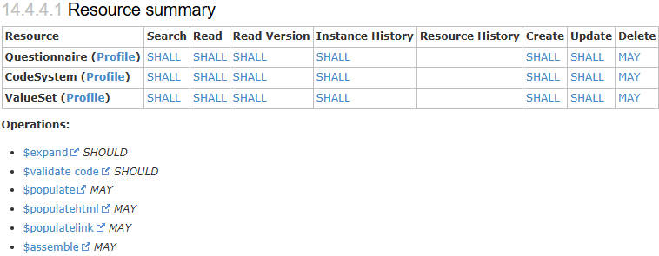
Form Manager Functionality

Slide 15
Form Response Manager
Form Filler
Form Response Manager
Query, Create, Update,
Extract from QuestionnaireResponse
FHIR Server
Allows creation, revision, and retrieval of QuestionnaireResponses
Extract from QuestionnaireResponse
Form Receiver

Slide 16

Form Receiver
Form Filler
Process QuestionnaireResponse
Form Receiver
FHIR Server
Consumes completed QuestionnaireResponses

Slide 17
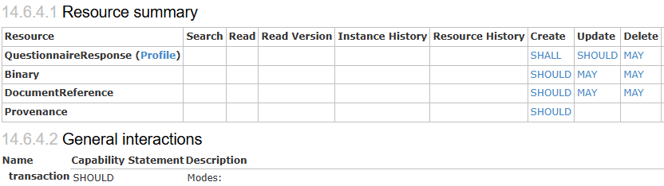
Form Archiver
Form Filler
Create QuestionnaireResponse
Form Archiver
FHIR Server
One-way storage for completed forms

Slide 18
Form Designer
Form Designer
Form Manager
Query, Create, Update, Delete Questionnaire
FHIR Client
Allows users to retrieve, create, and maintain:
Questionnaires
Value Sets
Code Systems
Should allow rendering forms to allow the author to see what they’ll look like
Query, Create, Update, Delete ValueSet
Query, Create, Update, Delete CodeSystem

Slide 19
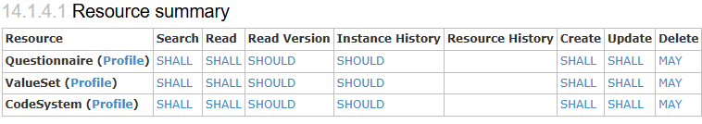
Form Designer

Slide 20
Additional considerations
One system can take on multiple roles
There can be multiple systems in an environment with the same role
This set of roles isn’t exhaustive, but it covers common functionalities
More complex roles can be composed of these
E.g. an EHR might take on the role of Form Filler, Form Manager, and Form Response Manager

Slide 21
SDC Workflow Outline
SDC System Roles
Form Creation Workflow
Form Fulfillment Workflow
Form Rendering Workflow
Workflow Exercises

Slide 22
Creating forms
What are the questions?
What are the allowed answers?
How are both phrased?
What does the form look like?
What are the validation rules?
What are the flow rules?
What are the mappings to underlying data elements?
Notes:
Form creation requires expertise (and different kinds of it)
Process is often iterative

Slide 23
Paper vs. electronic forms
Paper
Electronic
# of questions is limited
Answers are limited
Rules explained by text
Calculations are manual
References by identifiers & demographics
Answers must be transcribed & coded
# of potential questions unlimited
Answers can be dynamic
Also type-ahead dropdowns
Rules enforced automatically
Calculations are automatic
References as true references
Answers are automatically encoded and available electronically
Notes:
Rules can be more sophisticated/complex
Don’t have to trust the user to follow them
In short – don’t just port your paper form to electronic style

Slide 24
Where do forms live?
Centralized repository
Copied onto each EMR
Contained in other resources (protocols, orders)
Mixture of the above

Slide 25
Re-using form artifacts
More on this in the session on modular & derived forms

Slide 26
SDC Workflow Outline
SDC System Roles
Form Creation Workflow
Form Fulfillment Workflow
Form Rendering Workflow
Workflow Exercises

Slide 27
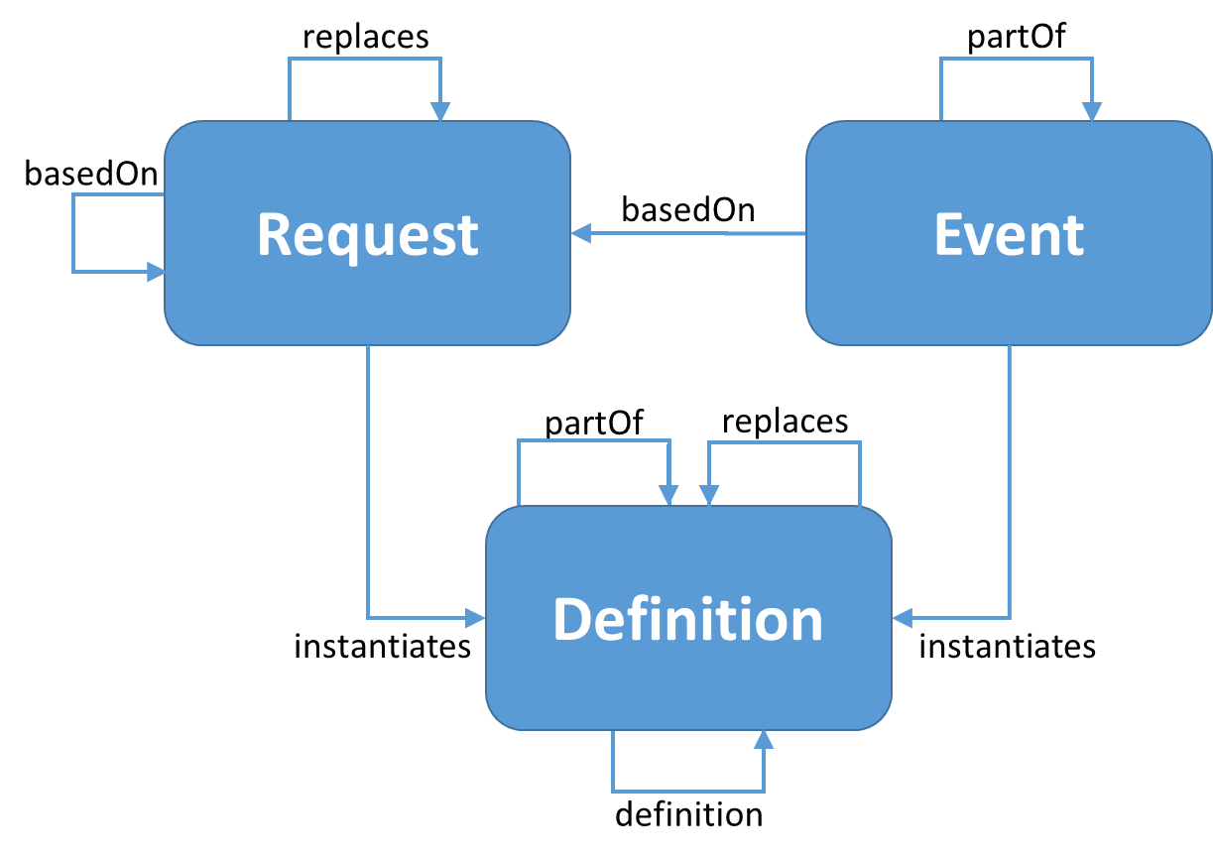
Workflow patterns
ServiceRequest
or
Task
Questionnaire Response
Questionnaire
From https://build.fhir.org/workflow

Slide 28
ServiceRequest vs. Task
ServiceRequest
Task
Constitutes a formal ‘order’
Requires workflow (likely Task) to initiate fulfillment
Uses servicerequest-questionnaireRequest
QR links to Request via basedOn
Can ask for the form to be completed multiple times
Not an order
Initiates fulfillment on its own
Uses Task.input
QR links to Task as Task.output
Can only seek one occurrence

Slide 29
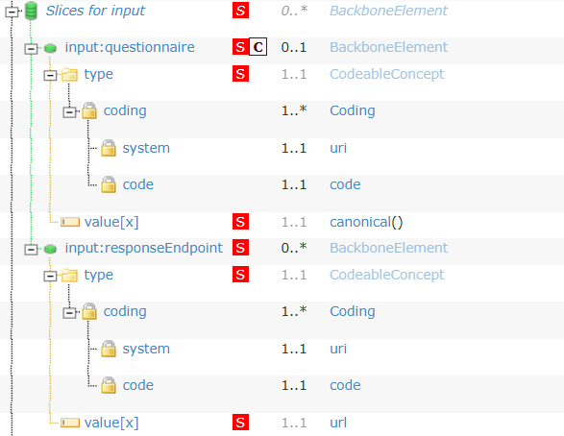
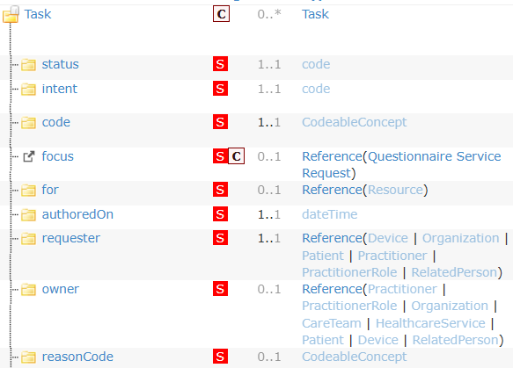
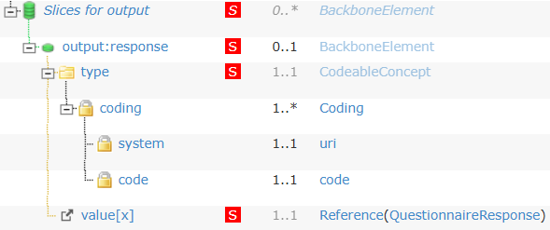
Soliciting forms

Slide 30
SDC Workflow Outline
SDC System Roles
Form Creation Workflow
Form Fulfillment Workflow
Form Rendering Workflow
Workflow Exercises

Slide 31
Workflow of form rendering
Rendering requires:
Retrieving the referenced Questionnaire
Retrieving referenced ValueSets and/or Libraries
Performing any pre-population
Dynamically adjusting form content based on answers
Validating answers (dynamically or on completion)

Slide 32
Finding forms
Hard-code form into system workflow
Point to the form in the protocol
PlanDefinition/ActivityDefinition
Point to the form with Task
Specify form ‘code’ in ServiceRequest
Retrieve via an operation (e.g. CRMI $package)
Let user search for the appropriate form to complete

Slide 33
Questionnaire identity
id
canonical
url
url + version
identifier
code

Slide 34
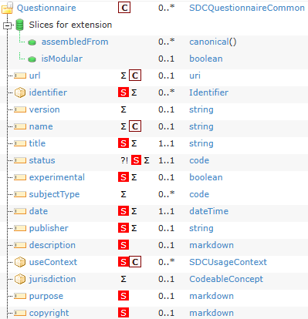
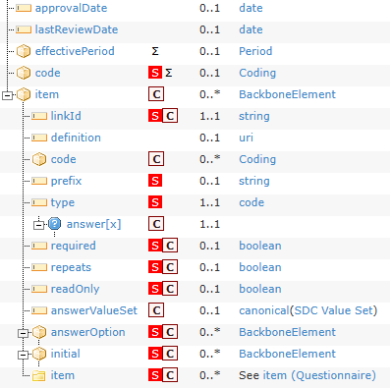
Notes:
Searching for questionnaires
Green = required search criteria
Orange = optional search criteria
Xs = can’t search by these

Slide 35
Local vs. operation
Operation candidates:
$populate
$validate
$expand
$extract
$assemble
terminology functionality
Local advantages
Performance, dynamic/interactive, better user experience

Slide 36
Terminology in Questionnaires
Terminology services
https://build.fhir.org/terminology-service.html
$expand
with ‘filter’
$validate-code
$translate

Slide 37
SDC Workflow Outline
SDC System Roles
Form Creation Workflow
Form Fulfillment Workflow
Form Rendering Workflow
Workflow Exercises

Slide 38
Quiz
What’s the name of a system used to complete Questionnaires?
Which three resources must a Form Designer support creating and maintaining?
What workflow pattern is Questionnaire? QuestionnaireResponse?
What two resources can be used to ask someone to fill out a form?
How many RESTful interactions does a Form Receiver support?

Slide 39
Answers
Form Filler
Questionnaire, ValueSet, CodeSystem
Definition, Event
ServiceRequest, Task
1 - $process-form

Slide 40
The SDC Collection
SDC Overview
SDC Workflow (you are here)
SDC Expressions
SDC Rendering & Behavior
SDC Population
SDC Extraction
SDC Adaptive Forms
SDC Modular & Derived Forms

Slide 41



Questions / Discussion
lloyd@dogwoodhealthconsulting.com http://hl7.org/fhir/uv/sdc
Or, better yet, include the community and ask/discuss on https://chat.fhir.org/#narrow/channel/179255-questionnaire

