Slide 1


Structured Data Capture (SDC)
Extraction
Lloyd McKenzie | February 2025

Slide 2

Who am I?
Name: Lloyd McKenzie
Company: Dogwood Health
Background:
One of FHIR’s 3 initial editors
Co-chair FHIR-Infrastructure, past chair FHIR Management Group
HL7 Fellow
Lead for both the ONC and international FHIR SDC projects
lloyd@dogwoodhealthconsulting.com

Slide 3
This presentation
Can be downloaded from the Ontario Health e-Learning site:
https://elearning.ontariohealth.ca/login/index.php
Is licensed for use under the Creative Commons, specifically:
Creative Commons Attribution 3.0 Unported License
Do with it as you wish, so long as you give credit

Slide 4

Credit
These slides include content from Brian Postlethwaite
With updates by Lloyd McKenzie

Slide 5

The SDC Collection
SDC Overview
SDC Workflow
SDC Expressions (essential prerequisite)
SDC Rendering & Behavior
SDC Population (recommended prerequisite)
SDC Extraction (you are here)
SDC Adaptive Forms
SDC Modular & Derived Forms

Slide 6

Objectives
You should be able to:
Describe the benefits and challenges of form extraction
List the 5 extraction mechanisms and explain the pros and cons of each
Be able to design questionnaires using both observation-based and expression-based extraction

Slide 7
SDC Extraction Outline
Extraction Overview
Observation-based
Definition-based
StructureMap-based
Extraction Exercises
CQL
Template-based

Slide 8
SDC Extraction Outline
Extraction Overview
Observation-based
Definition-based
StructureMap-based
Extraction Exercises
CQL
Template-based

Slide 9

Rationale for extraction
Questionnaires aren’t ‘standard’ / interoperable
QuestionnaireResponses aren’t very searchable
Relevant data should appear in ‘one’ place

Slide 10
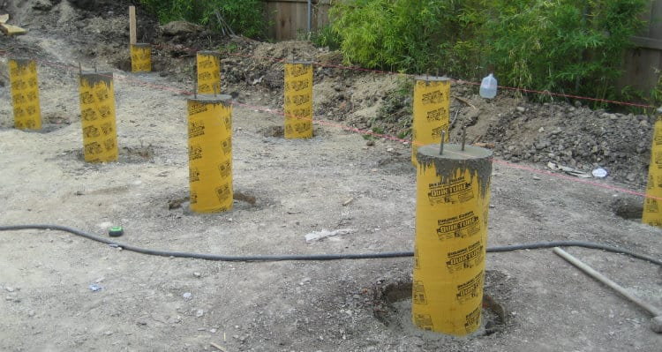
Extraction pre-requisites
Requires:
‘completed’ (and valid) QuestionnaireResponse
Mapping
Processing engine
Knowledge of target structures (particularly profiled scope)

Slide 11
Similarities with population
Choice of using $extract operation vs. native extraction
Only one option, and no continuous vs. initial decision
Challenges of alignment between Questionnaire and mapped resources (and profiles)
May need code mapping, unit conversion, other conversions
Those who maintain the Questionnaire might not be those who maintain the extraction logic
Look at derived Questionnaires
Need to check for modifiers
E.g. Quantity.comparator

Slide 12
Operation vs. local
Operation ($extract)
Simplifies things for the client
Doesn’t actually read or write FHIR data
i.e. no token or FHIR API needed
May still need access to a server to retrieve Questionnaire, profiles, StructureMaps
Can choose mix of operation & local

Slide 13
Creation vs. update
In general, ‘update’ requires the use of population
Need to know the ‘url’ of the resource to update to populate
If QuestionnaireResponse is revised post-extraction, it’s theoretically possible to re-extract and update originally extracted resources
Requires linkage between extracted resources and QuestionnaireResponse

Slide 14
Extraction results
Extraction process will create one of:
Single resource (to create or update)
Signaled by presence/absence of ‘id’
Transaction Bundle
Even if resources aren’t inter-linked
OperationOutcome (if the process fails)
Still up to the client to execute the create/update/transaction

Slide 15
Linking the QR to extracted resources
Three options:
Use a relationship in the produced resource
E.g. Observation.derivedFrom
Use Provenance
Don’t bother

Slide 16
Additional complexities
Narrative is hard to do
Failure is hard to communicate to users
If the subject changes, need to determine whether that changes the ‘patient’, or just the ‘focus’
Resources created by extraction are subject to different validation than those created by a UI

Slide 17
Current extraction options
Observation-based
Or combination there-of
Any can be combined
Definition-based
Template-based
StructureMap-based
CQL

Slide 18
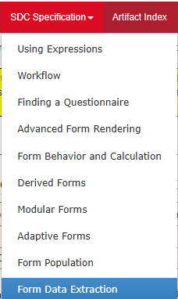
Extraction in the SDC Spec
Link

Slide 19
SDC Extraction Outline
Extraction Overview
Observation-based
Definition-based
StructureMap-based
Extraction Exercises
CQL
Template-based

Slide 20

Extraction – Observation based
Source
‘Completed’ QuestionnaireResponse
Mapping
Item.code for LOINC/SNOMED/other to populate Observation.code
questionnaire-observationExtract to indicate that extraction is needed
observation-extract-category can be used to indicate the needed category
Other Observation elements come from subject, encounter, author, authored, answer
Watch for questionnaireresponse-isSubject as the subject of some groups may differ
Groups and questions with child questions can be extracted as components or members
Only works with observations
Notes:
Need to take care with DataElements as this is changing in R4

Slide 21
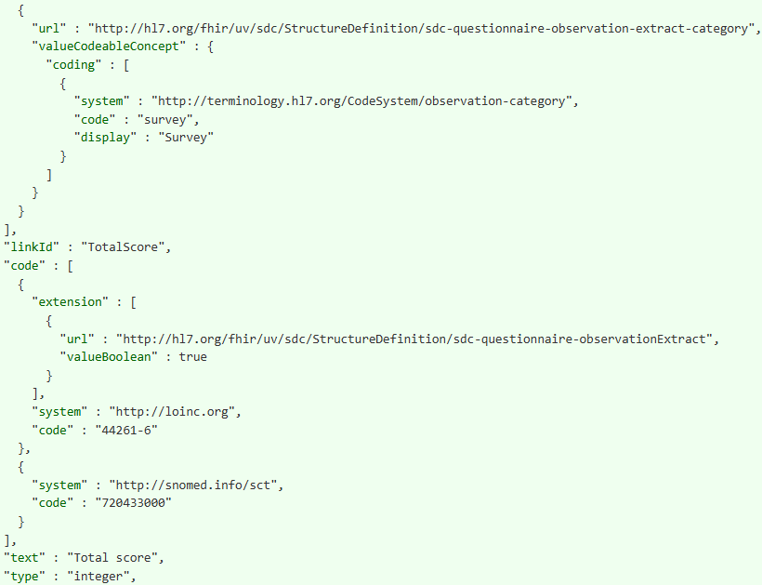
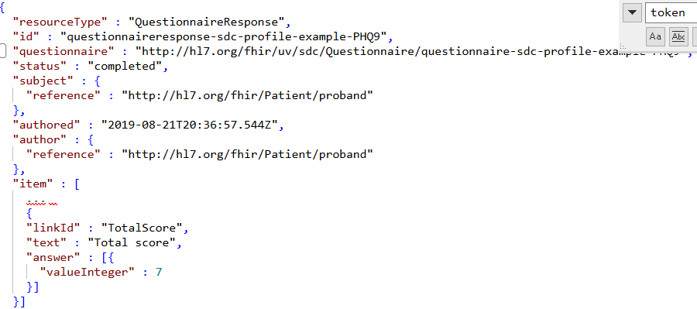
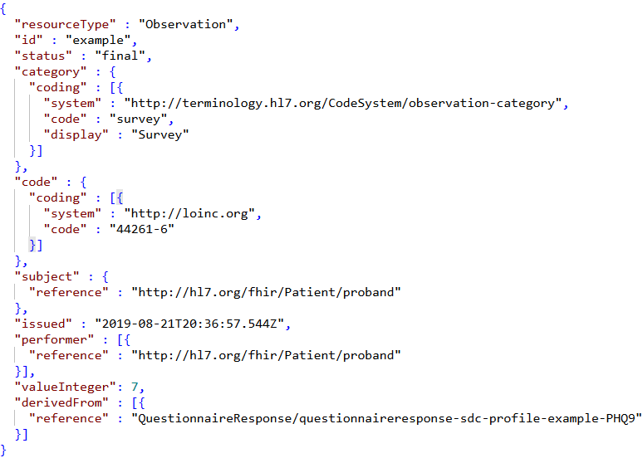

Slide 22
Observation-based considerations
Type conversion might be necessary
e.g. integer -> quantity
questionnaire-unit can be used to assist
Unit conversion may be necessary
If no answer, then no Observation
Multiple answers -> multiple Observations
No support for Observation.focus or dataAbsentReason

Slide 23
Let’s make one…
https://formbuilder.nlm.nih.gov

Slide 24
SDC Extraction Outline
Extraction Overview
Observation-based
Definition-based
StructureMap-based
Extraction Exercises
CQL
Template-based

Slide 25
Extraction – Definition-based
Source
‘Completed’ QuestionnaireResponse
Mapping
sdc-questionnaire-definitionExtract – resource to extract, fixedValue/patterns
sdc-questionnaire-definitionExtractValue – element to populate with fixed or calculated values
sdc-questionnaire-extractAllocateId – if needed for cross-resource referencing
Answers are mapped into the extracted resource based on item.definition
Can extract to any resource, but only one set of mappings per profile within a shared context

Slide 26
sdc-questionnaire-extractDefinition
On Questionnaire, extracts one resource instance for the QuestionnaireResponse
On a group, extracts one instance for each group repetition
Defines what resource to create (profile base resource)
URL can just be canonical of the resource
If it’s a profile, we will auto-extract fixed values and patterns
Can allow conditional creation
using Bundle.entry elements

Slide 27
sdc-questionnaire-extractDefinition
Element | Purpose
definition | What profile (and resource) to extract
fullUrl | What to put in entry.fullUrl (for cross-referencing)
ifNoneMatch | Conditional extraction Equivalent to same elements in entry Allows controlling whether resources should be created (and matching on existing content) as part of a transaction
ifModifiedSince
ifMatch
ifNoneExist

Slide 28
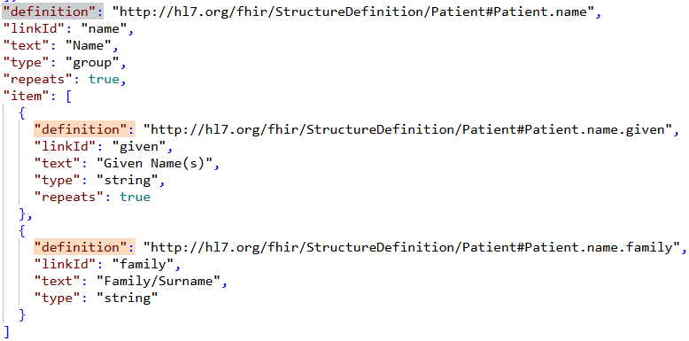
Questionnaire.item.definition
Indicates a given item matches the semantic of a data element in a profile/logical model
Definition canonical must match extractDefinition canonical
For extraction
For a group, indicates that the extracted resource should repeat the element in the definition for each group repetition
For a question, indicates that the answer(s) should go into the value of the definition element in the extracted resource

Slide 29
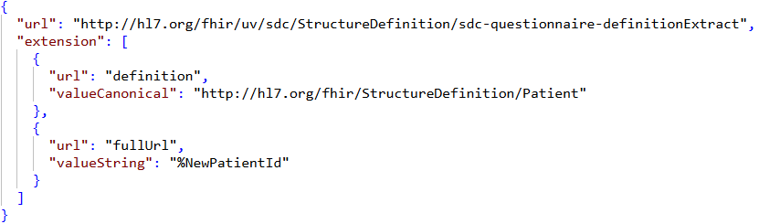
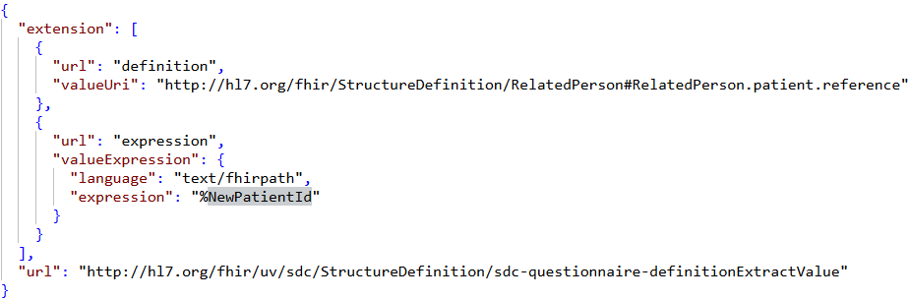
sdc-questionnaire-extractAllocateId
When we extract a resource, we may need to link to that resource from other extracted resources
In transaction, we need the same urn:uuid: value to appear as fullUrl of created resource and in Reference.reference pointing to it
If it appears on a group, then distinct UUID for each repetition
extractAllocateId generates a UUID and assigns it to a variable
Declare the variable to be the fullUrl of the new resource (in definitionExtract.fullUrl)
Declare the variable to be the reference value (via definitionExtractValue.expression)

Slide 30
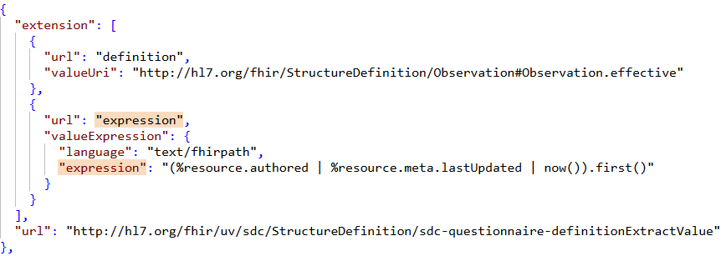
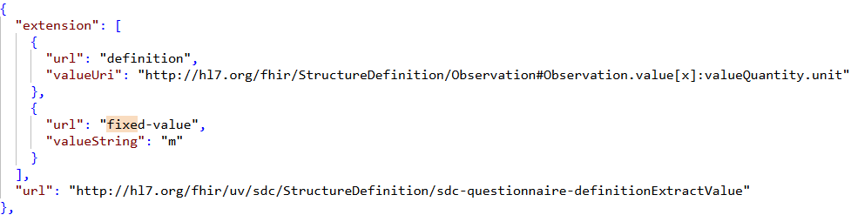
Sdc-questionnaire-extractValue
Indicates a value for an element within a structure to populate
Format: [profileCanonical]#[elementId]
Two options
‘expression’ – set the element to the result of the expression
‘fixed-value’ – set the element to specified value

Slide 31
Definition-based considerations
Mappings can be sparse
E.g. one definition for Patient.name, one definition for Patient.name.family.text
‘family’ will get generated automatically
If necessary, hidden questions can be used to help populate items not found in the QuestionnaireResponse
e.g. if population from context is needed
Using profile definitions also allows leveraging slices

Slide 32
Definition-based limitations
No significant transformation capability
Questions need to correspond to resource element definitions
Can use definitionExtractValue.expression for this, but note that launchContext and variable are not in scope for extraction
Can only extract to one instance for a given profile in a given context
No access to launchContext, variable, initialValue
Can put relevant information in answers to hidden questions

Slide 33
Testing definition-based extraction
https://fhirpath-lab.com/Questionnaire/tester
Sample instance:
https://build.fhir.org/ig/HL7/sdc/Questionnaire-extract-complex-defn3.json

Slide 34
SDC Extraction Outline
Extraction Overview
Observation-based
Definition-based
StructureMap-based
Extraction Exercises
CQL
Template-based

Slide 35
Extraction – Template-based
Source
‘Completed’ QuestionnaireResponse
Mapping
Contained resources that act as templates (and may include fixed values)
sdc-questionnaire-templateExtract or sdc-questionnaire-templateExtractBundle extensions that point to contained resource
Templates include:
sdc-questionnaire-templateExtractContext extensions to indicate questionnaire items that drive repetition
sdc-questionnaire-templateExtractValue extensions to indicate questionnaire items to populate the element
Easier to visualize expected output, no ability to perform complex transformation

Slide 36
Two approaches
templateExtract (0..*)
Points to a resource template (could be Bundle)
Results in an entry within a transaction Bundle
Context for extraction determined by location of extension (root or group)
Extension includes all elements to populate a Bundle.entry
resourceId can be controlled via parameter
templateExtractBundle (0..1)
Points to a transaction Bundle template
Always results in transaction Bundle
Always on root. Context for extraction handled by templateExtractContext
Bundle entry elements are defined in the template
Can set the resource id of each entry
Notes:
Template can’t make certain elements dynamic – specifically Element.id, Extension.url

Slide 37
Template extensions
sdc-questionnaire-templateExtractContext
Causes the appearance (and repetition) of the element to drive from a given Questionnaire item
Typically on group, though can also be Questionnaire root
Can be plain FHIRPath or expression containing FHIRPath
Latter allows assigning a name to be used in downstream elements

Slide 38
Template extensions (cont’d)
sdc-questionnaire-templateExtractValue
FHIRPath expression referring to a Questionnaire question
If the item has an answer, they become the value for the element
Multiple answers = multiple repetitions of the element
Multiple answers for non-repeating elements is an error
No answer, element will be removed

Slide 39
Testing template-based extraction
https://fhirpath-lab.com/Questionnaire/tester
Sample instance:
https://build.fhir.org/ig/HL7/sdc/Questionnaire-extract-complex-template.json.html

Slide 40
SDC Extraction Outline
Extraction Overview
Observation-based
Definition-based
StructureMap-based
Extraction Exercises
CQL
Template-based

Slide 41
Extraction – StructureMap based
Source
Completed QuestionnaireResponse
Mapping
StructureMap pointed to by questionnaire-targetStructureMap that converts to a resource or a transaction Bundle of resources
Can perform nearly any sort of transformation
Can invoke code translations, have complex logic
Requires knowledge of StructureMap

Slide 42
Pros and cons
Pros
Can map almost anything
StructureMaps can build from other StructureMaps
Can validate ‘correctness’ without instances
Cons
Can only drive from ‘what exists’ using if-exists and similar entry rules
If the StructureMap fails, there won’t be any extraction at all

Slide 43
Example StructureMap-extract Questionnaire
https://build.fhir.org/ig/HL7/sdc/Questionnaire-SDOHCC-QuestionnaireHungerVitalSign.json.html
Map: https://build.fhir.org/ig/HL7/sdc/StructureMap-SDOHCCHungerVitalSignMap.html

Slide 44
SDC Extraction Outline
Extraction Overview
Observation-based
Definition-based
StructureMap-based
Extraction Exercises
CQL
Template-based

Slide 45
Extraction – CQL
NOTE: Not (yet) defined in SDC
Source
‘Completed’ QuestionnaireResponse
Can be supplemented by data queried directly by CQL
Mapping
Will need an extension that points to the CQL to run on extraction
Instance selector on desired resource, then set various properties
Most flexible, requires knowledge of CQL to create the mappings
Can involve external libraries

Slide 46
Pros and cons
Pros
Most capable of all mechanisms
Can invoke operations (such as code translation)
Can perform queries to retrieve data not present in answers (e.g. following answer.valueReference)
Only approach that could practically create narrative
Can include complex algorithms and transformations
Can use Libraries to support code re-use
Syntax agnostic and platform-agnostic
Cons
Requires use of a language not many are familiar with
Not sure anyone’s actually done this…

Slide 47
CQL example
Don’t have one published
define "PatName" : HumanName { family: qr.item.where(linkId='5').answer.value given: qr.item.where(linkId='6').answer.value } define "Extract" : Patient { name: PatName }

Slide 48
SDC Extraction Outline
Extraction Overview
Observation-based
Definition-based
StructureMap-based
Extraction Exercises
CQL
Template-based

Slide 49
Extraction Exercise
Create a Questionnaire that uses a combination of observation-based, definition-based, and template-based extraction that includes questions for the following:
Patient’s birth date
Patient’s parent names
Patient’s most recent weight
Notes:
You might want to use Brian’s tool to author for help with FHIRPath debugging

Slide 50
The SDC Collection
SDC Overview
SDC Workflow
SDC Expressions (essential prerequisite)
SDC Rendering & Behavior
SDC Population (recommended prerequisite)
SDC Extraction (you are here)
SDC Adaptive Forms
SDC Modular & Derived Forms

Slide 51



Questions / Discussion
lloyd@dogwoodhealthconsulting.com http://hl7.org/fhir/uv/sdc
Or, better yet, include the community and ask/discuss on https://chat.fhir.org/#narrow/channel/179255-questionnaire

