Slide 1


Structured Data Capture (SDC)
Adaptive Forms
Lloyd McKenzie | February 2025

Slide 2

Who am I?
Name: Lloyd McKenzie
Company: Dogwood Health
Background:
One of FHIR’s 3 initial editors
Co-chair FHIR-Infrastructure, past chair FHIR Management Group
HL7 Fellow
Lead for both the ONC and international FHIR SDC projects
lloyd@dogwoodhealthconsulting.com

Slide 3
This presentation
Can be downloaded from the Ontario Health e-Learning site:
https://elearning.ontariohealth.ca/login/index.php
Is licensed for use under the Creative Commons, specifically:
Creative Commons Attribution 3.0 Unported License
Do with it as you wish, so long as you give credit

Slide 4

Credit
These slides include content by Lloyd McKenzie

Slide 5

The SDC Collection
SDC Overview
SDC Workflow
SDC Expressions
SDC Rendering & Behavior
SDC Population
SDC Extraction
SDC Adaptive Forms (you are here)
SDC Modular & Derived Forms

Slide 6

Objectives
You should be able to:
Explain some of the benefits for using adaptive forms instead of standard forms
Describe the workflow for completing an adaptive form
Understand the difference between a Questionnaire intended for searching for an adaptive form as opposed to one used for completing an adaptive form

Slide 7
Adaptive Forms

Slide 8
What is an adaptive Questionnaire?
No (published) pre-defined list of questions
Call a server endpoint to determine the ‘next question’
Keep calling until the server says you’re done

Slide 9

Rationale for adaptive forms
Protect IP
Less burden on fillers
Forms can get too big
Use a familiar language for logic
Use back-end functionality for logic

Slide 10
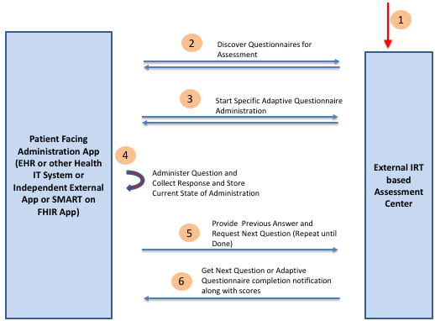
Adaptive forms
Q:What is your name?
A: Arthur
Q: What is your quest?
A: Holy Grail
Q: What is the air-speed velocity of an unladen swallow?
A:
54125-0
86505-5
86508-9
Notes:
The LOINC codes were added after the fact when Dan Vreeman pointed out that there are standard codes for these questions ☺

Slide 11
Key elements of an adaptive form
QuestionnaireResponse
questionnaire = #someQ
Separate Q for every QR
Q is ‘contained’
Contained Q points to ‘base’ Questionnaire canonical via derivedFrom
Contained Q has no url or version
Call $next-question to get updated list of items
Questionnaire
id = someQ derived=http://realQ#ver

Slide 12
$next-question
Adds new items to contained Questionnaire or marks it as ‘complete’
Can add 1 new item or multiple
For each item, can vary:
Allowed answer choices
Required/optional, repeating/not, formatting, question text, etc.
Population logic
(i.e. no FHIRPath or CQL for any of this)
Alternatively, can indicate that previous QR wasn’t valid and provide an OperationOutcome

Slide 13
What adaptive doesn’t avoid
Form filler still needs to:
Run population logic if server can’t
Handle the different ‘complex display’ capabilities
Ideally, perform some level of answer validation

Slide 14
What if the user changes a prior answer?
Can stop them from doing this with sdc-questionnaire-entryMode
Alternatively, throw away all answers after the answer changed and start from there

Slide 15
Searching for adaptive forms
Can’t be a contained Questionnaire when searching
Searchable adaptive form will have metadata, but no items
Will include sdc-questionnaire-questionnaireAdaptive
boolean or
List of servers that can support that Questionnaire with $next-question

Slide 16
Populating adaptive forms
Population could be done by $next-question
Server would need access to the relevant data, no token passed
Can’t do StructureMap-based
If doing expression-based or CQL, need to hold onto existing variables in memory
Might list all Libraries up-front, may add new ones as they become relevant, or mixture of both

Slide 17
Handling completed forms
When adaptive form is ‘complete’, that doesn’t mean it’s ‘submitted’
$submit is a separate process (as is $extract)

Slide 18
Other considerations
Can drive adaptive forms off a ‘standard’ form
i.e. API wrapper
Logic for questions can be driven by system’s innate knowledge
Logic for questions could be AI
Form mode is typically “one at a time”

Slide 19
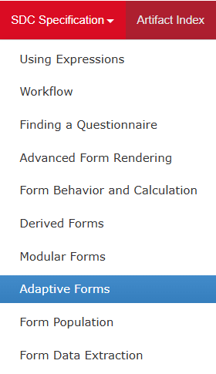
Adaptive Forms in the SDC Spec
Link

Slide 20
Adaptive Questions

Slide 21
Adaptive Questions
How many items will an adaptive search Questionnaire have?
How many items can $next-question add to an adaptive Questionnaire?
What population approach is incompatible with adaptive Questionnaires?
What value types can the sdc-questionnaire-questionnaireAdaptive extension have?

Slide 22
Adaptive Questions
5. Which of the following is not a common reason for using adaptive forms
Simpler for form fillers
Can extract resources earlier
Form logic includes sensitive IP
Form authors don’t want to write FHIRPath or CQL

Slide 23
Question answers
Usually none
As many as it likes, usually 1
StructureMap
boolean or uri
Can extract resources earlier

Slide 24
The SDC Collection
SDC Overview
SDC Workflow
SDC Expressions
SDC Rendering & Behavior
SDC Population
SDC Extraction
SDC Adaptive Forms (you are here)
SDC Modular & Derived Forms

Slide 25



Questions / Discussion
lloyd@dogwoodhealthconsulting.com http://hl7.org/fhir/uv/sdc
Or, better yet, include the community and ask/discuss on https://chat.fhir.org/#narrow/channel/179255-questionnaire

