Slide 1


Structured Data Capture (SDC)
Modular and Derived Forms
Lloyd McKenzie | February 2025

Slide 2

Who am I?
Name: Lloyd McKenzie
Company: Dogwood Health
Background:
One of FHIR’s 3 initial editors
Co-chair FHIR-Infrastructure, past chair FHIR Management Group
HL7 Fellow
Lead for both the ONC and international FHIR SDC projects
lloyd@dogwoodhealthconsulting.com

Slide 3
This presentation
Can be downloaded from the Ontario Health e-Learning site:
https://elearning.ontariohealth.ca/login/index.php
Is licensed for use under the Creative Commons, specifically:
Creative Commons Attribution 3.0 Unported License
Do with it as you wish, so long as you give credit

Slide 4

Credit
These slides include content by Lloyd McKenzie

Slide 5

The SDC Collection
SDC Overview
SDC Workflow
SDC Expressions
SDC Rendering & Behavior
SDC Population
SDC Extraction
SDC Adaptive Forms
SDC Modular & Derived Forms (you are here)

Slide 6

Objectives
You should be able to:
Differentiate modular and derived forms
Explain why authors might use modular forms or choose to derive forms
List the two types of form modularity
Describe how assembled and unassembled questionnaires are linked and how derived forms are linked to their parent
Identify how Questionnaire item elements map to ElementDefinition

Slide 7
Modular & Derived Outline
Modular Forms
Derived Forms
Questions

Slide 8
Modular & Derived Outline
Modular Forms
Derived Forms
Questions

Slide 9

Rationale for modular forms
More consistency
Better data quality
Leverage known ‘good’ questions
More user familiarity
Reduce maintenance effort
Including on population/extraction logic

Slide 10
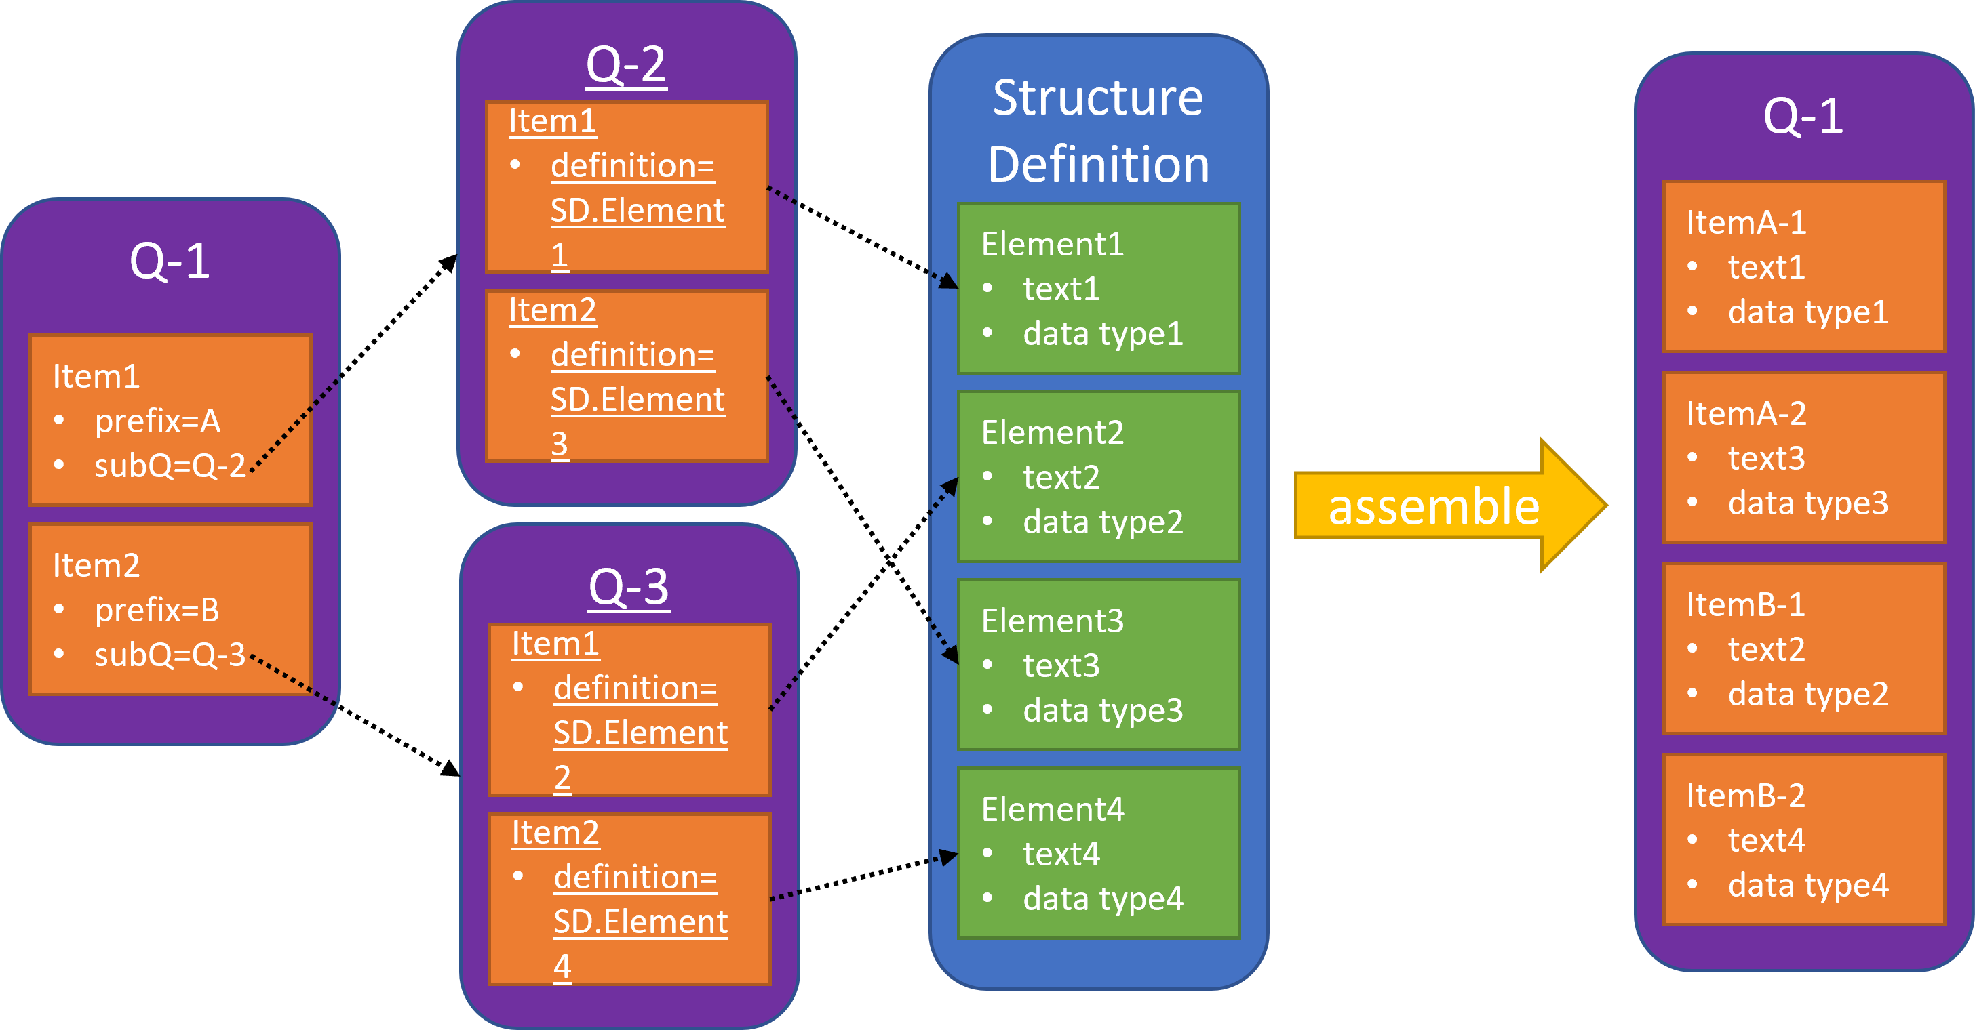

Slide 11
Extensions
Extension | Purpose
sdc-questionnaire-assemble-expectation | Indicates if the form is intended to be used as part of assembly root: Can form the base of a questionnaire child: Can be referenced from another questionnaire
sdc-questionnaire-subQuestionnaire | Appears on a ‘display’ item to be substituted for the content of a different questionnaire Indicates the canonical (and version) of the questionnaire to substitute
sdc-questionnaire-assembleContext | On a sub-form, indicates variables that must be made available by the parent

Slide 12
Mapping ElementDefinition to item
Questionnaire.item | ElementDefinition
text | label (or elementdefinition-question)
type | Type
required | min != 0
repeats | max != 1
answerValueSet | binding.valueSet (extensible = open)
concept | Code
maxLength | maxLength
extensions | carry across (and max & min get added)

Slide 13
$assemble
‘display’ items with ‘subQuestionnaire’ turn into ‘group’ items containing all items in the referenced Questionnaire
Items with definitions grab all data elements from the referenced Element
Contained resources and most extensions propagate from sub-forms
Duplicates are checked
Definitions for backbone elements turn into groups of questions

Slide 14
Managing linkIds
Same Questionnaire could appear in multiple places in a parent
Would result in duplicate linkIds
Solution:
Parent Questionnaire defines a %linkIdPrefix
Gets pre-pended to all linkIds and enableWhen.question elements in the imported sub-form
Also sets a variable that can be used in expressions in the sub-form

Slide 16
ElementDefinition libraries
Multiple approaches:
One StructureDefinition with all elements
Must maintain elements together, one version for everything
Different StructureDefinitions for different element ‘collections’
More control, but still must version elements together
Separate StructureDefinitions per element
Very heavy
Can version each element independently

Slide 17
Additional considerations
Modifiers are prohibited on sub-forms
Language must match across root and child forms (and StructureDefinitions)
If extracting child elements from a definition, match against item children if there are any, otherwise just create needed children
The canonical of an unassembled and assembled Questionnaire is the same
SDC is currently examining the issue that definition is used for both extraction and modular forms (and might need different values for each)
Watch for forthcoming guidance

Slide 18
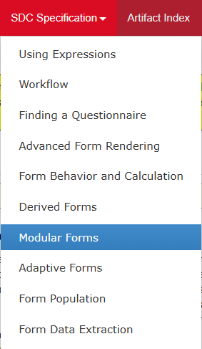
Modular Forms in the SDC Spec
Link

Slide 19
Assembly examples
modular-root
modular-name
modular-contact
question-library
modular-root-assembled

Slide 20
Modular & Derived Outline
Modular Forms
Derived Forms
Questions

Slide 21
Rationale for derived forms
Localization
Remove non-relevant questions/answers
Add new ones
Tweak item text, change language
Separation of responsibilities
Question authoring vs. population & extraction logic

Slide 22
derivedFrom questionnaire-derivationType
Relationship Type | QR is Instance of Questionnaire | QR Validates against original Questionnaire | QR Validates against derived Questionnaire
extends | original | yes | Possibly (if extended items are optional)
 | derived | Not usually | yes
compliesWith | original | yes | Possibly (depending on nature of constraints)
 | derived | yes | yes
inspiredBy | original | Yes | no
 | derived | no | yes
Notes:
Population and extraction would be added using “complies with”

Slide 23
Derivation and canonicals
A derived form cannot use the same canonical as the parent
However, if the derivationType is compliesWith, a QuestionnaireResponse may refer to the ‘original’ Questionnaire instead of the Questionnaire actually used
Useful if derivation was to inject population or extraction logic

Slide 24
Creating forms for localization
Some ‘optional’ questions are essential to instrument validity, others can safely be omitted
Differentiate using sdc-questionnaire-optionalDisplay

Slide 25
Modular vs. derived
New information can be injected in a base form using either modular forms or derived forms
With modular, place the additional information in an ElementDefinition or sub-form and have the parent point to that definition/form
With derived, copy the parent information and add the new information
Modular is easier to maintain, but requires control over parent.
Derived approach can be used even with no control of parent, but takes more maintenance & changes canonical
Modular is a single Q. Derivation creates a new Q (could be non-compatible)

Slide 26
A special case – language translation
Multiple options
Use modular forms to inject ‘translation’ extensions from definitions
Use derived forms to override the text
Whether a form ‘compliesWith’ depends on your rules
Use the new .po file IG publisher mechanism
Create .po files for text and answers, then use the IG publisher to integrate that content into the Questionnaire resource

Slide 27
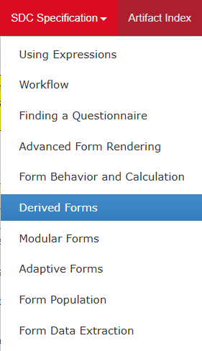
Derived Forms in the SDC Spec
Link

Slide 28
Modular & Derived Outline
Modular Forms
Derived Forms
Questions

Slide 29
Modular/Derived Questions
What are the two types of re-use in a modular form?
Where does the item.text come from in ElementDefinition?
What two elements get a linkIdPrefix auto-prepended?
Do canonicals change for modular forms, derived forms, or both?
If Q1 extends Q2, can a Q2 response be valid against Q1?

Slide 30
Modular/Derived Answers
Sub-forms and element definitions
ElementDefinition.label
EnableWhen.question and linkId
Derived forms
Not usually

Slide 31
The SDC Collection
SDC Overview
SDC Workflow
SDC Expressions
SDC Rendering & Behavior
SDC Population
SDC Extraction
SDC Adaptive Forms
SDC Modular & Derived Forms (you are here)

Slide 32



Questions / Discussion
lloyd@dogwoodhealthconsulting.com http://hl7.org/fhir/uv/sdc
Or, better yet, include the community and ask/discuss on https://chat.fhir.org/#narrow/channel/179255-questionnaire

