Slide 1
HL7® FHIR® Terminology
Rob Hausam MD
Part 3 – Further (Advanced) Topics

Slide 2
This presentation
Can be downloaded here:
https://github.com/FHIR/documents/blob/master/presentations/2022-11%20Webinars/HL7%20FHIR%20Terminology/FHIR-Terminology-Part-3-2022-12-01.pptx
Is licensed for use under the Creative Commons, specifically:
Creative Commons Attribution 3.0 Unported License
(Do with it as you wish – just give credit)
Acknowledgements: Grahame Grieve, Lloyd McKenzie
2

Slide 3
This presentation
Based on the current official version of HL7 FHIR
FHIR Release #4B (v4.3.0) http://hl7.org/fhir/R4B/
Relevant and significant changes introduced in the R5 ballot will be highlighted
3

Slide 4
Tutorial Learning Objectives covered
Part 1 – Introduction and Fundamentals
Understand how coded data is represented in data types and model elements and is exchanged in FHIR resources
Understand how code systems and value sets in FHIR are defined, identified and used
Understand terminology binding and how to specify and use it correctly in FHIR models (resources and profiles)

Slide 5
Tutorial Learning Objectives
Part 2 – Searching and Services
Understand and use FHIR terminology-based search capabilities
Understand and use FHIR Terminology Service capabilities

Slide 6
Tutorial Learning Objectives
Part 3 – Advanced Topics (potential)
Further exploration of primary FHIR terminology service operations ($expand, $lookup, $validate-code, $subsumes, $translate)
Advanced terminology searching techniques
FHIR implicit value sets (SNOMED CT and other)
SNOMED CT Expression Constraint Language (ECL) in value set definitions
Code system supplements
Using terminology content in THO (terminology.hl7.org)
Submitting and managing a UTG proposal
Requesting new external (non-HL7) terminology content

Slide 7
Part 3 Topics Further (Advanced) Topics
Using SNOMED CT Expression Constraint Language (ECL) in value set definitions
Using FHIR implicit value sets
Features and uses of code system supplements and fragments
FHIR R5 ConceptMap updates – initial look
UTG and THO
Other topics?

Slide 8
further (Advanced) topics

Slide 9
Using SNOMED CT Expression Constraint Language (ECL) in value set definitions

Slide 10
SNOMED CT Expression Constraint Language (ECL)
A SNOMED CT Expression Constraint is a computable rule that can be used to define a bounded set of clinical meanings represented by either precoordinated or postcoordinated expressions.
SNOMED CT ECL documentation
Not all FHIR servers support ECL!
Ontoserver, Snowstorm and Terminz servers do support ECL (possibly some others may, as well)

Slide 11
SNOMED CT Expression Constraint Language (ECL) (cont.)
Expressions
http://hl7.org/fhir/snomedct.html#4.3.1.0.5
ECL
See SNOMED CT Filters
See SNOMED CT Implicit Value Sets (fifth bullet)
SNOMED CT Browser
Expression Constraint Queries tab

Slide 12
SNOMED CT Expression Constraint Language (ECL) (cont.)
SNOMED ECL Builder (OntoServer)
https://ontoserver.csiro.au/shrimp/ecl/
CSIRO Value Set Comparison Tool
Includes several ECL queries and shows responses (or lack of response) from multiple FHIR servers
http://ontoserver.csiro.au/vstool

Slide 13
ECL Value Set Definition Example
https://build.fhir.org/ig/HL7/fhir-ips/ValueSet-procedures-snomed-ct-ips-free-set.html
https://snowstorm.ihtsdotools.org/fhir/ValueSet/$expand?url=http://snomed.info/sct/900000000000207008/version/20220731?fhir_vs=ecl/%28%3C%2071388002%20%7CProcedure%20%28procedure%29%7C%20AND%20%5E%20816080008%20%7CInternational%20Patient%20Summary%20%28fo [truncated]

Slide 14

ECL Value Set Definition Example (cont.)
POST the ValueSet resource to a server endpoint and invoke the $expand operation (show in Postman)

Slide 15
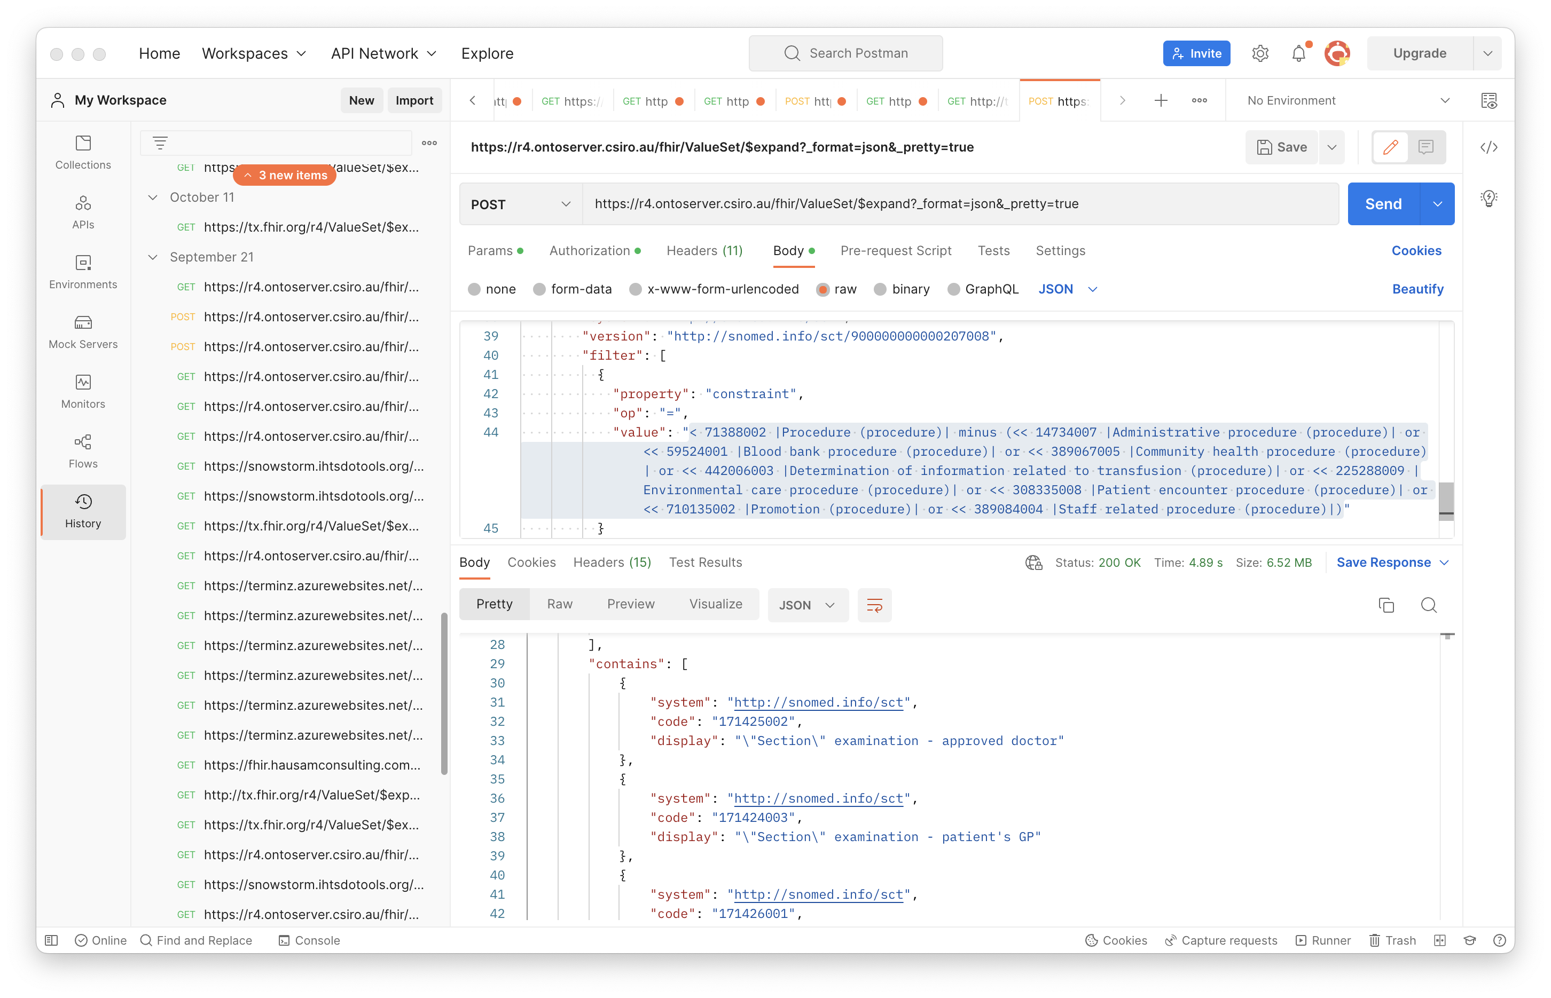

Slide 16
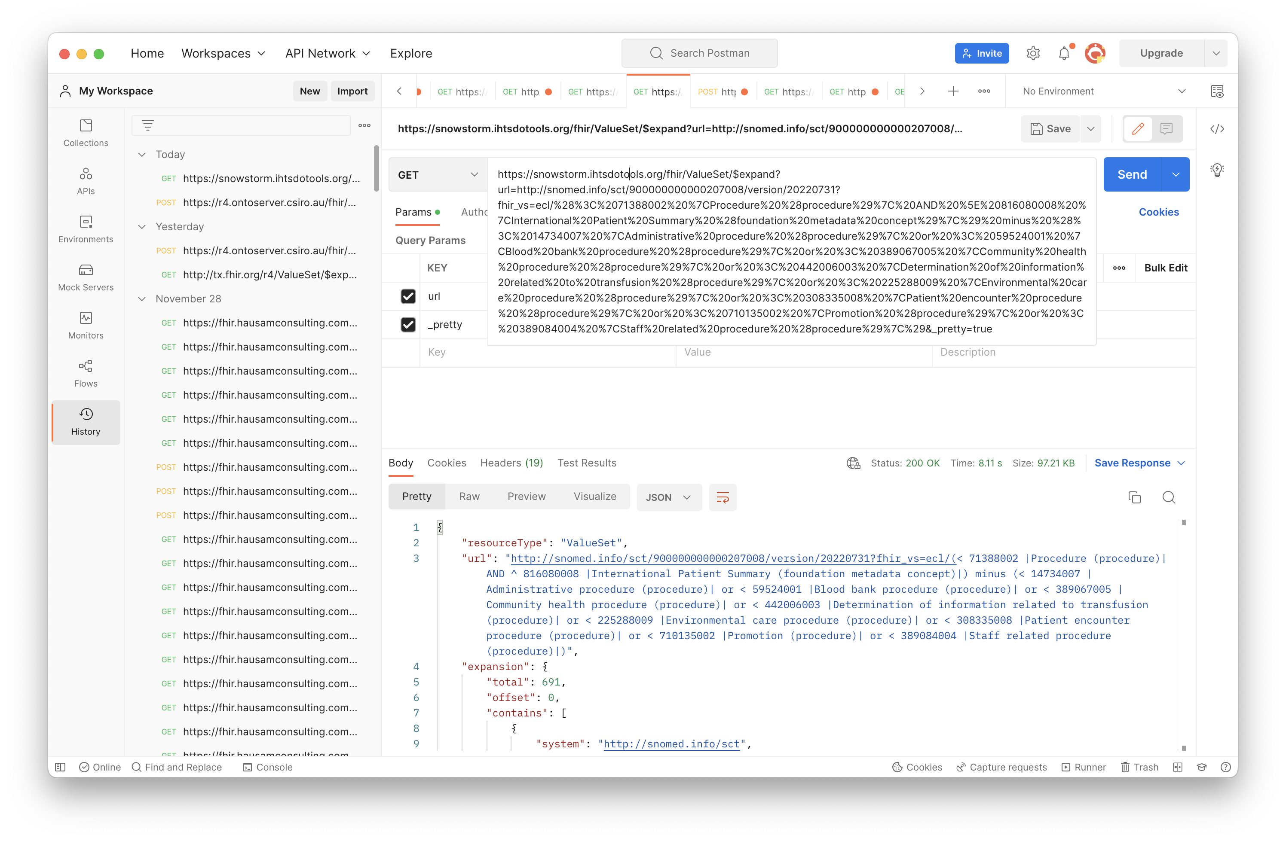

Slide 17
Using FHIR implicit value sets

Slide 18
Implicit Value Sets
Implicit value sets are those whose specification can be predicted based on the grammar of the underlying code system, and the known structure of the URL that identifies them
New documentation on this in ValueSet resource in R5 ballot
Note: This documentation will continue to be developed for R5 – feedback to Vocab WG is welcome!

Slide 19
Implicit Value Sets
Implicit value sets do not use complex queries
Allows a single URL to serve as a value set definition (without requiring an explicit ValueSet resource)
Can serve as the basis for the $expansion operation
Example - SNOMED CT has common sets of implicit value sets defined (more than any other code system at present):
By Subsumption, By Reference Set, etc.
See http://hl7.org/fhir/snomedct.html#implicit

Slide 20
Implicit Value Set $expand (isa)
SNOMED CT subtypes of “Pneumonia” (233604007)
https://r4.ontoserver.csiro.au/fhir/ValueSet/$expand?url=http%3A%2F%2Fsnomed.info%2Fsct%3Ffhir_vs=isa%2F233604007&_format=json&_pretty=true
http://tx.fhir.org/r4/ValueSet/$expand?url=http%3A%2F%2Fsnomed.info%2Fsct%3Ffhir_vs=isa%2F233604007
https://terminz.azurewebsites.net/fhir/ValueSet/$expand?url=http%3A%2F%2Fsnomed.info%2Fsct%3Ffhir_vs=isa%2F233604007&_format=json&_pretty=true

Slide 21
Implicit Value Set $expand (ECL expression)
SNOMED CT subtypes of “Pneumonia” (233604007) ECL expression: < 233604007 |Pneumonia (disorder)|
https://r4.ontoserver.csiro.au/fhir/ValueSet/$expand?url=http%3A%2F%2Fsnomed.info%2Fsct%2F900000000000207008%2Fversion%2F20220731%3Ffhir_vs%3Decl%2F%3C%20233604007%20%7CPneumonia%20%28disorder%29%7C&_format=json&_pretty=true

Slide 22
Features and uses of code system supplements and fragments

Slide 23
Code System Supplements and Fragments
Supplement
CodeSystem.content = ‘supplement’
http://hl7.org/fhir/codesystem.html#supplements
Fragment
CodeSystem.content = ‘fragment’
http://hl7.org/fhir/codesystem.html#fragments

Slide 24
Code System Supplement
CodeSystem.supplements SHALL have a value – the URL of the code system being supplemented
CodeSystem.url SHALL never appear in a Coding.system
CodeSystem.url must be under control of the authority creating or publishing the supplement (usually different from the original code system)

Slide 25
Code System Supplement
Cannot define any new CodeSystem.concept.code
All instances of CodeSystem.concept.code in the supplement must be a code from the "supplemented" code system
Note: If need to define new concepts/codes to use as property values, the supplement can be paired with a new (possibly contained) Code System and use the Coding type for the property values

Slide 26
Code System Supplement Example
CodeSystem
https://terminz.azurewebsites.net/fhir/CodeSystem/bundle-type?_format=json&_pretty=true
https://terminz.azurewebsites.net/fhir/CodeSystem/bundle-type-german?_format=json&_pretty=true
https://terminz.azurewebsites.net/fhir/CodeSystem?supplements=http://hl7.org/fhir/bundle-type&_format=json&_pretty=true

Slide 27
Code System Supplement Example
ValueSet
https://terminz.azurewebsites.net/fhir/ValueSet/Bundle-Type-supplemented?_format=json&_pretty=true
Value set expansion
https://terminz.azurewebsites.net/fhir/ValueSet/Bundle-Type-supplemented/$expand?_format=json&_pretty=true

Slide 28
Code System Supplement Discussions
FHIR Zulip chat
https://chat.fhir.org/#narrow/stream/179202-terminology/topic/Behaviour.20of.20CodeSystem.20operations.20with.20supplements
https://chat.fhir.org/#narrow/stream/179202-terminology/topic/Designations.20from.20code.20system.20supplements.20in.20Coding.2Edisplay.3F
https://chat.fhir.org/#narrow/stream/179202-terminology/topic/Designations.20vs.2E.20language-specific.20resources.20for.20VS.20and.20CS

Slide 29
Code System Fragment
Reasons for using a code system fragment
Different IP distribution rules for different parts of the code system
Special purpose modules for specific purposes
Distribution of proposed content for evaluation

Slide 30
Code System Fragment
Rules for code system fragments
SHALL have the same CodeSystem.url
Can only(?) be published by the code system authority, or according to a process defined by the authority, if they have defined one
Cannot contain codes, concepts or properties that are not found in a complete representation of the code system (if one exists)
Publishing a code system in multiple fragments can create confusion for terminology servers and terminology service consumers - need to be clear about the intent

Slide 31
Code System Fragment Examples and Discussion
Common UCUM units (?)
http://hl7.org/fhir/valueset-ucum-common.html (not CodeSystem)
But THO represents UCUM as ‘"content" : "not-present”’
SNOMED CT (?)
Each SNOMED CT edition could be considered as a fragment the entire SNOMED CT – but they aren’t represented that way
Recent and ongoing discussions on this topic
https://chat.fhir.org/#narrow/stream/179202-terminology/topic/Fragment.20.2F.20Example.20expansions

Slide 32
FHIR R5 ConceptMap updates – initial look

Slide 33
Summary of R5 ConceptMap changes
Element “equivalence” replaced by “relationship”
Was (10): relatedto | equivalent | equal | wider | subsumes | narrower | specializes | inexact | unmatched | disjoint
Now (5): related-to | equivalent | source-is-narrower-than-target | source-is-broader-than-target | not-related-to
The directional relationships have the direction made explicit in the code – should help avoid confusion!
group.element.target.equivalence = ‘unmatched’ replaced by group.element.noMap (boolean)
No longer necessary to create a ‘target’ when there is none!

Slide 34
Summary of R5 ConceptMap changes (2)
Now can do mappings from or to a valueSet, rather than only a single code per mapping (also in unmapped)
group.element.code OR group.element.valueSet
dependsOn and product now allow a choice of value types (not only string)
‘source’ and ‘target’ elements (references to uri or valueSet) are now renamed to ‘sourceScope’ and ‘targetScope’ to clarify their meaning and use
Other elements and descriptive text have been updated and (hopefully) clarified

Slide 35
Summary of R5 $translate changes
$translate operation parameters have also been renamed to be clearer and to match the corresponding resource elements
$translate ‘source’ and ‘target’ input parameters now can specify ‘code’, ‘Coding’ or ‘CodeableConcept’ (new parameters added)

Slide 36
Summary of R5 $translate changes (2)
‘dependency’ and ‘match.product’ values can now have a choice of value types (corresponding to the resource)
‘reverse’ input parameter removed
This was confusing
If both directions are needed, can make that explicit

Slide 37
R5 ConceptMap server support
CSIRO R5 endpoint
https://ontoserver-r5.australiaeast.cloudapp.azure.com/fhir
Example
https://ontoserver-r5.australiaeast.cloudapp.azure.com/fhir/ConceptMap/$translate?code=ADT_A04.MSH&system=http://hl7.org/fhir/ADT_A04
Zulip R5 terminology server discussion

Slide 38
UTG and THO

Slide 39
Unified Terminology Governance (UTG)
UTG is a process
How to add and maintain (modify, and in rare cases remove) content in THO (terminology.hl7.org)
Submit and vote (by registered UTG voters) on UTG proposals
UTG documentation
Additional slide deck available – time and interest permitting

Slide 40
terminology.hl7.org (THO)
https://terminology.hl7.org/
”Source of truth” for (most) HL7 terminology
Contains code systems (HL7 and external), identifier systems (normally external), value sets (some), concept maps (actually there are none at present)
THO is not a terminology service
But THO content is provided for the FHIR core and IG build ecosystem in tx.fhir.org

Slide 41
Questions?
Connect with the FHIR community: FHIR Zulip chat terminology stream
https://chat.fhir.org/#narrow/stream/terminology
Or ask me: Rob Hausam
rob@hausamconsulting.com rrhausam@gmail.com Or you can send a PM on the FHIR Zulip chat

