Slide 1
Advanced Terminology in HL7® FHIR®
Rob Hausam MD

Slide 2
This presentation
Can be downloaded here:
https://github.com/FHIR/documents/blob/master/presentations/2023-01-Tutorials/FHIR-Terminology-Advanced/FHIR-Terminology-Advanced-2023-01-18.pptx
Is licensed for use under the Creative Commons, specifically:
Creative Commons Attribution 3.0 Unported License
(Do with it as you wish – just give credit)
Acknowledgements: Grahame Grieve, Lloyd McKenzie
2

Slide 3
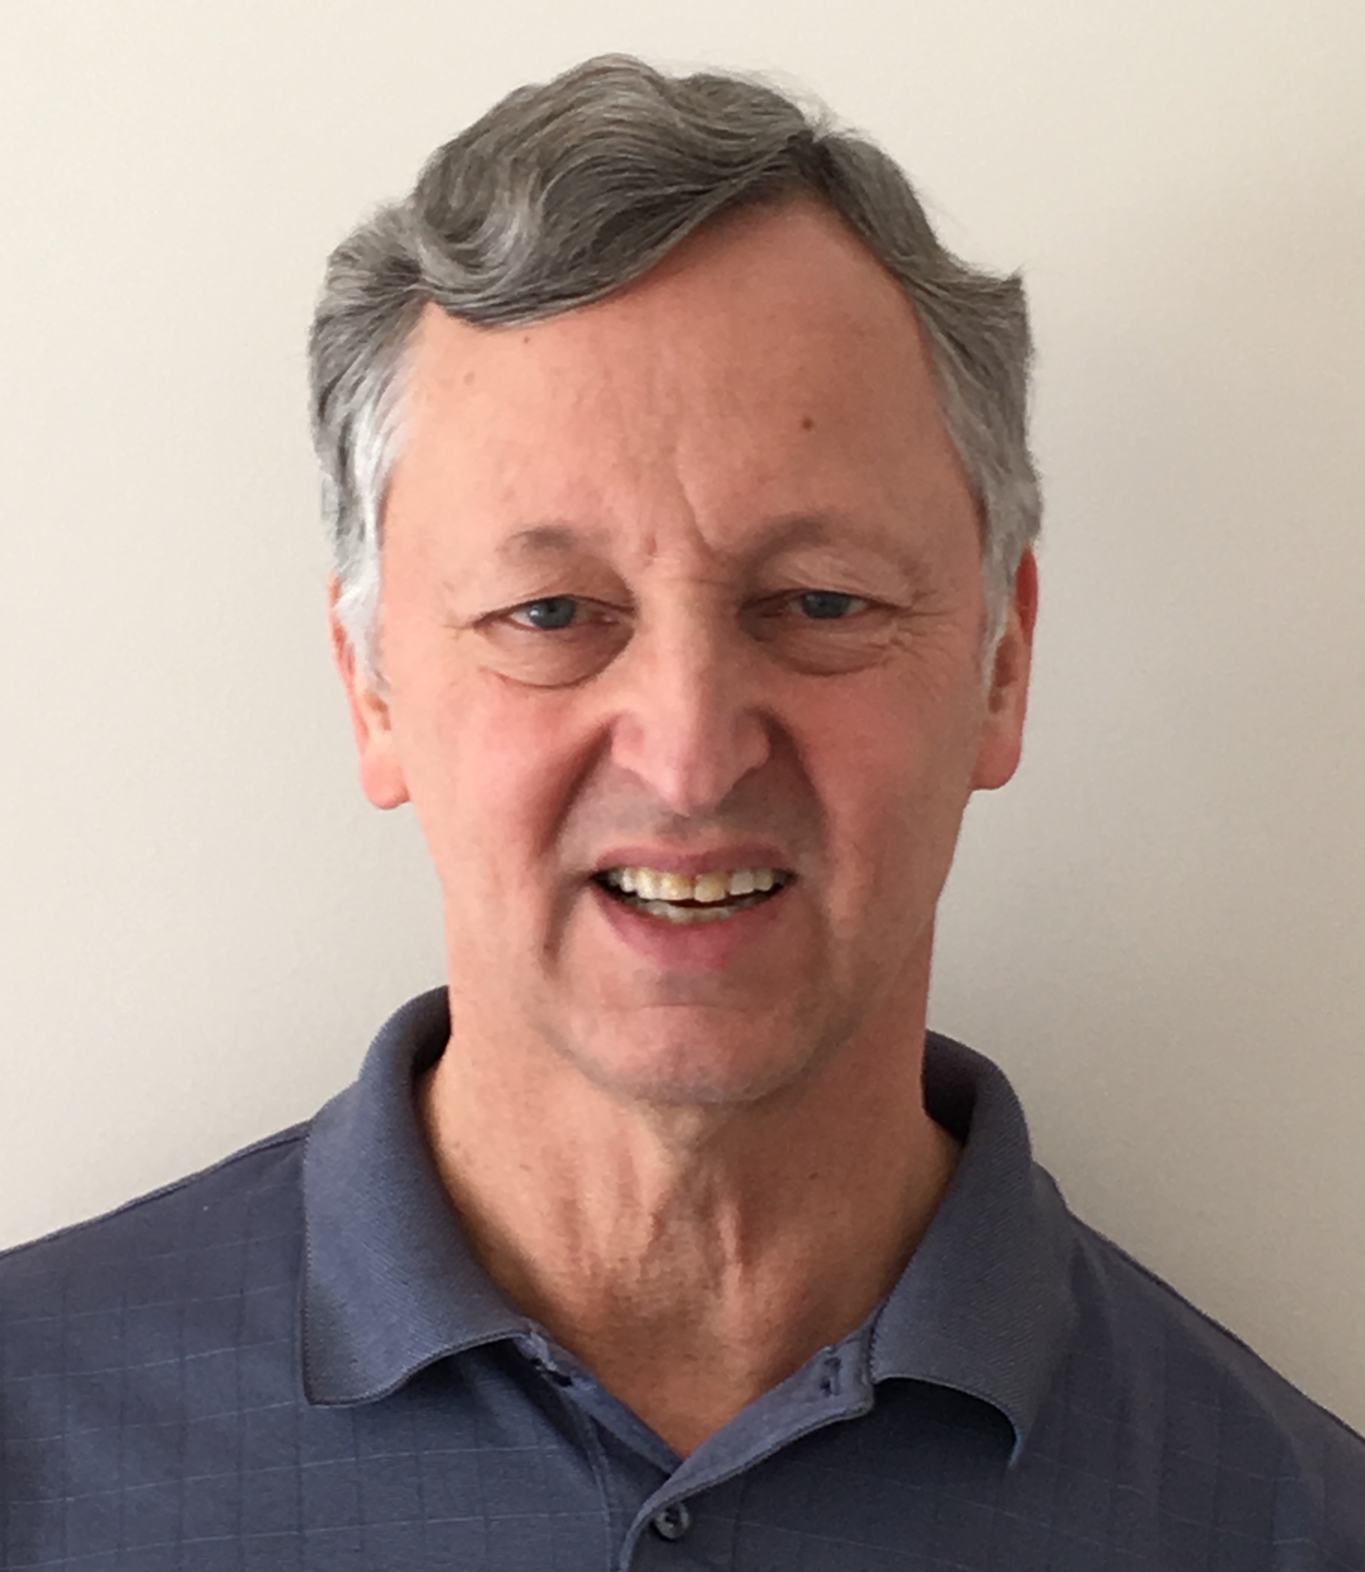
Who am I?
Name: Rob Hausam MD
Company: Hausam Consulting LLC
Background:
Co-chair of Vocabulary and Orders and Observations WGs
FHIR specification and Terminology Module editor
Actively involved in HL7 and terminology standards/development and modeling for 22+ years
SNOMED on FHIR project co-lead (joint project of HL7 and SNOMED International)

Slide 4
Tutorial Agenda
Brief Review – Finding terminology in FHIR
Exploration of primary FHIR terminology service operations
$expand, $validate-code, $lookup, $subsumes, $translate
Using SNOMED CT Expression Constraint Language (ECL) in value set definitions
Using FHIR implicit value sets (SNOMED CT and other) with terminology service operations

Slide 5
Tutorial Agenda (cont)
Some terminology-based searching techniques
Features and uses of code system supplements and fragments
FHIR R5 ConceptMap updates If sufficient time and interest:
Questions on Unified Terminology Governance (UTG) process and terminology.hl7.org (THO)
Your additional terminology topics?

Slide 6
Brief review – finding terminology in fhir

Slide 7
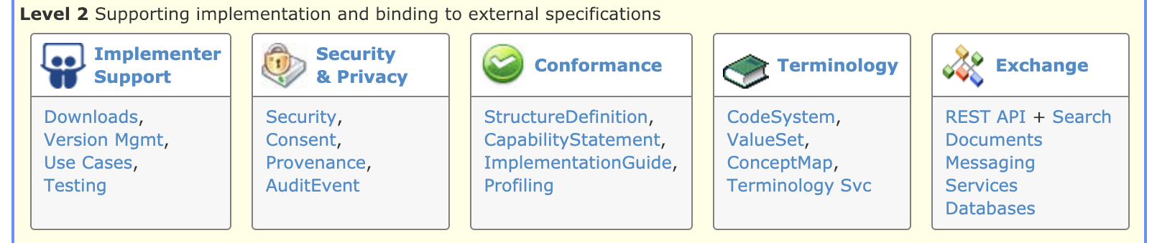
Terminology Module
Level 2 on the Home page
The primary organizing place in the FHIR specification for terminology specifications, guidance and content
http://hl7.org/fhir/terminology-module.html

Slide 8

Terminologies link
Terminologies link
The last link on the right in the top-level (red) navigation bar
The quick and easy way to get to the terminology content in the FHIR specification – code systems, value sets, concept maps

Slide 9
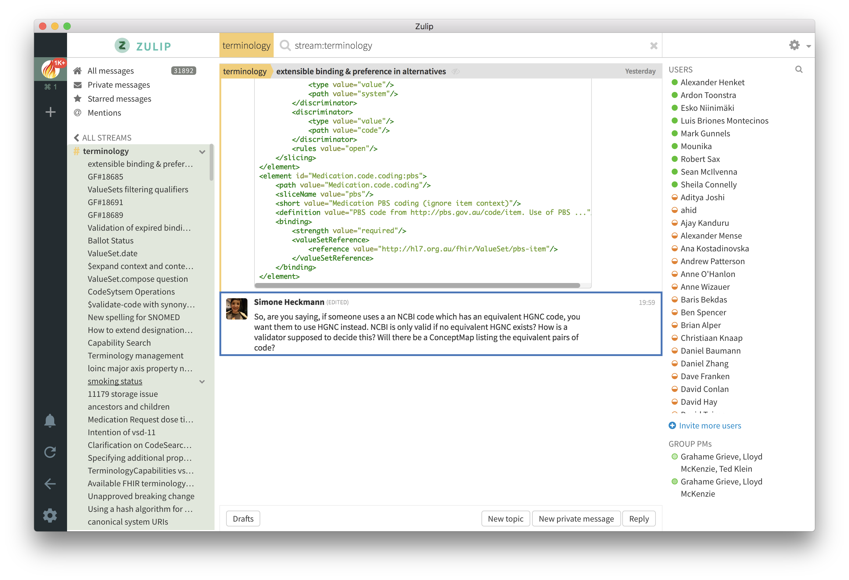
FHIR Zulip chat Terminology stream
https://chat.fhir.org/#narrow/stream/terminology

Slide 10
Exploration of primary FHIR terminology service operations

Slide 11
FHIR Terminology Service Usage Scenarios
Usage scenario | FHIR Terminology Service solution
Obtain a list of codes to populate user interface widget - e.g., a dropdown list. | Invoke the $expand operation with the value set (which contains the codes) as the input parameter
Obtain a list of codes based on what the user has typed in a user interface text box | Invoke the $expand operation with the value set (which contains the codes) and the text the user has entered as the value set and filter input parameters
Determine if a received code is valid. | Invoke the $validate-code operation with the received code as the input parameter
How do I obtain the display names (descriptions) for a code so that I can display it ? | Invoke the $lookup operation with the received code as the input parameter
Obtain a translation of a concept in one code system to a concept in another code system. | Invoke the $translate operation with the source code and a concept map as input parameters

Slide 12
$expand
Takes a ValueSet reference or resource and returns another ValueSet resource containing the expansion (code set)
Default is the current expansion (as of “now”)
Uses include populating a drop-down list, “type ahead” search, etc.

Slide 13
$expand examples
Extensional value set definition (enumerated list)
https://fhir.hausamconsulting.com/r4/ValueSet/procedure-category
https://fhir.hausamconsulting.com/r4/ValueSet/procedure-category/$expand

Slide 14
$expand examples (cont.)
Intensional value set definition (code system query based)
“All codes”
https://fhir.hausamconsulting.com/r4/ValueSet/observation-category
https://fhir.hausamconsulting.com/r4/ValueSet/observation-category/$expand
“is-a” hierarchy
https://fhir.hausamconsulting.com/r4/ValueSet/route-codes
284009009 = “Route of administration value”
https://fhir.hausamconsulting.com/r4/ValueSet/route-codes/$expand

Slide 15
$expand examples (cont.)
Paging (count and offset parameters)
https://fhir.hausamconsulting.com/r4/ValueSet/route-codes/$expand?count=10&offset=0
https://fhir.hausamconsulting.com/r4/ValueSet/route-codes/$expand?count=10&offset=10

Slide 16
$expand examples (cont.)
$expand + filter For type-ahead search (with large value sets)
https://fhir.hausamconsulting.com/r4/ValueSet/route-codes/$expand?filter=intra
https://fhir.hausamconsulting.com/r4/ValueSet/route-codes/$expand?filter=intrales

Slide 17
$validate-code
Takes a code/Coding/CodeableConcept and checks if it’s valid against a value set or a code system
Specify value set (same as for $expand)
Code to validate – either code+system (with or without version, display), Coding or CodeableConcept
date – date to validate as of
Outputs: true/false
message if not valid, display names if valid
The primary method for validating coded data

Slide 18
$validate-code example (ValueSet)
FHIR condition-category “problem-list-item”
https://fhir.hausamconsulting.com/r4/ValueSet?url=http://hl7.org/fhir/ValueSet/condition-category
https://fhir.hausamconsulting.com/r4/ValueSet/$expand?url=http://hl7.org/fhir/ValueSet/condition-category
https://fhir.hausamconsulting.com/r4/ValueSet/$validate-code?url=http://hl7.org/fhir/ValueSet/condition-category&system=http://terminology.hl7.org/CodeSystem/condition-category&code=problem-list-item

Slide 19
$validate-code example (CodeSystem)
SNOMED CT “Pneumonia” (233604007)
https://terminz.azurewebsites.net/fhir/CodeSystem/$validate-code?system=http://snomed.info/sct&code=233604007&_format=json&_pretty=true

Slide 20
$lookup
Takes a code+system(version) or Coding and returns additional details about the concept
Name, version, preferred display string, properties (including subproperties) and designations (additional representations for the concept)
Can also be used to determine whether a code exists in the CodeSystem
But returns an OperationOutcome (error) if the code does not exist

Slide 21
$lookup example
SNOMED CT “Pneumonia” (233604007)
Note: Different servers will display different details
https://fhir.hausamconsulting.com/r4/CodeSystem/$lookup?system=http://snomed.info/sct&code=233604007
http://tx.fhir.org/r4/CodeSystem/$lookup?system=http://snomed.info/sct&code=233604007
https://terminz.azurewebsites.net/fhir/CodeSystem/$lookup?system=http://snomed.info/sct&code=233604007&_format=json&_pretty=true

Slide 22
$subsumes
Test whether codeA / codingA subsumes (or is subsumed by) codeB / codingB
Based on the semantics of subsumption in the underlying code system (e.g. SNOMED CT)
Returns one of four possible codes:
equivalent, subsumes, subsumed-by, and not-subsumed
If unable to determine the relationship between codes, returns an error

Slide 23
$subsumes example
SNOMED CT “Viral hepatitis” (3738000), “Disorder of liver” (235856003)
https://fhir.hausamconsulting.com/r4/CodeSystem/$subsumes?system=http://snomed.info/sct&codeA=3738000&codeB=235856003
https://fhir.hausamconsulting.com/r4/CodeSystem/$subsumes?system=http://snomed.info/sct&codeA=235856003&codeB=3738000
“Malarial hepatitis” (83072009), “Viral hepatitis” (3738000)
https://fhir.hausamconsulting.com/r4/CodeSystem/$subsumes?system=http://snomed.info/sct&codeA=83072009&codeB=3738000

Slide 24
$subsumes example (cont.)
SNOMED CT “Viral hepatitis” (3738000), “Viral hepatitis” (3738000)
https://fhir.hausamconsulting.com/r4/CodeSystem/$subsumes?system=http://snomed.info/sct&codeA=3738000&codeB=3738000
https://terminz.azurewebsites.net/fhir/CodeSystem/$subsumes?system=http://snomed.info/sct&codeA=3738000&codeB=3738000 &_format=json&_pretty=true

Slide 25
$subsumes example (cont.)
SNOMED CT “Viral hepatitis” (3738000), “Viral hepatitis” (3738000)
http://tx.fhir.org/r4/CodeSystem/$subsumes?system=http://snomed.info/sct&codeA=3738000&codeB=3738000
https:///r4.ontoserver.csiro.au/fhir/CodeSystem/$subsumes?system=http://snomed.info/sct&codeA=3738000&codeB=3738000
https://snowstorm.ihtsdotools.org/fhir/CodeSystem/$subsumes?system=http://snomed.info/sct&codeA=3738000&codeB=3738000&_format=json&_pretty=true

Slide 26
$translate
Can you translate this code to another code system?
Uses ConceptMap to translate the code(s)
http://...ConceptMap/id$translate
code, Coding or CodeableConcept passed (as per $validate-code)
Output:
True if can be translated
Message if can’t be translated
Translated coding if it can be translated

Slide 27
$translate example
ConceptMap $translate tutorial example: FHIR address-use to V3 AddressUse value sets (Terminz)
ConceptMap resource used in the example: https://terminz.azurewebsites.net/fhir/ConceptMap?source=http://hl7.org/fhir/ValueSet/address-use&target=http://terminology.hl7.org/ValueSet/v3-AddressUse&_format=json&_pretty=true

Slide 28
$translate example (cont.)
ConceptMap $translate tutorial example: FHIR address-use to V3 AddressUse value sets (Terminz)
https://terminz.azurewebsites.net/fhir/ConceptMap/$translate?system=http://hl7.org/fhir/address-use&code=home&source=http://hl7.org/fhir/ValueSet/address-use&target=http://terminology.hl7.org/ValueSet/v3-AddressUse&_format=json&_pretty=true

Slide 29
$translate example (cont.)
ConceptMap $translate tutorial example: FHIR address-use to V3 AddressUse value sets (Terminz)
https://terminz.azurewebsites.net/fhir/ConceptMap/$translate?system=http://hl7.org/fhir/address-use&code=old&source=http://hl7.org/fhir/ValueSet/address-use&target=http://terminology.hl7.org/ValueSet/v3-AddressUse&_format=json&_pretty=true

Slide 30
Using SNOMED CT Expression Constraint Language (ECL) in value set definitions

Slide 31
SNOMED CT Expression Constraint Language (ECL)
A SNOMED CT Expression Constraint is a computable rule that can be used to define a bounded set of clinical meanings represented by either precoordinated or postcoordinated expressions.
SNOMED CT ECL documentation
Not all FHIR servers support ECL!
Ontoserver, Snowstorm and Terminz servers do support ECL

Slide 32
SNOMED CT Expression Constraint Language (ECL) (cont.)
Expressions
http://hl7.org/fhir/snomedct.html#4.3.1.0.5
ECL
See SNOMED CT Filters
See SNOMED CT Implicit Value Sets (fifth bullet)
This page has been moved to THO in R5
SNOMED CT Browser
Expression Constraint Queries tab

Slide 33
SNOMED CT Expression Constraint Language (ECL) (cont.)
SNOMED ECL Builder (OntoServer)
https://ontoserver.csiro.au/shrimp/ecl/
CSIRO Value Set Comparison Tool
Includes several ECL queries and shows responses (or lack of response) from multiple FHIR servers
http://ontoserver.csiro.au/vstool

Slide 34

ECL Value Set Definition Example
https://build.fhir.org/ig/HL7/fhir-ips/ValueSet-procedures-snomed-ct-ips-free-set.html
POST the ValueSet resource to a server endpoint and invoke the $expand operation (show in VS Code and Postman)

Slide 35
Using FHIR implicit value sets

Slide 36
Implicit Value Sets
Implicit value sets are those whose specification can be predicted based on the grammar of the underlying code system, and the known structure of the URL that identifies them
New documentation on this in ValueSet resource in R5 ballot
Note: There is current ongoing discussion in the Vocab WG about further revising this description/documentation to make it (hopefully!) more clear – feedback to the Vocab WG is welcome and encouraged!

Slide 37
Implicit Value Sets
Implicit value sets do not use complex queries
Allows a single URL to serve as a value set definition (without requiring an explicit ValueSet resource)
Can serve as the basis for the $expansion operation
Example - SNOMED CT has common sets of implicit value sets defined (more than any other code system at present):
By Subsumption, By Reference Set, etc.
See http://hl7.org/fhir/snomedct.html#implicit

Slide 38
Implicit Value Set $expand (isa)
SNOMED CT subtypes of “Pneumonia” (233604007)
https://r4.ontoserver.csiro.au/fhir/ValueSet/$expand?url=http%3A%2F%2Fsnomed.info%2Fsct%3Ffhir_vs=isa%2F233604007&_format=json&_pretty=true
http://tx.fhir.org/r4/ValueSet/$expand?url=http%3A%2F%2Fsnomed.info%2Fsct%3Ffhir_vs=isa%2F233604007
https://terminz.azurewebsites.net/fhir/ValueSet/$expand?url=http%3A%2F%2Fsnomed.info%2Fsct%3Ffhir_vs=isa%2F233604007&_format=json&_pretty=true

Slide 39
Implicit Value Set $expand (ECL expression)
SNOMED CT subtypes of “Pneumonia” (233604007) ECL expression: < 233604007 |Pneumonia (disorder)|
https://r4.ontoserver.csiro.au/fhir/ValueSet/$expand?url=http%3A%2F%2Fsnomed.info%2Fsct%2F900000000000207008%2Fversion%2F20220731%3Ffhir_vs%3Decl%2F%3C%20233604007%20%7CPneumonia%20%28disorder%29%7C&_format=json&_pretty=true

Slide 40
Some Terminology-based searching techniques

Slide 41
Search parameters
Value Set-based Modifiers
ValueSet used in example
https://fhir.hausamconsulting.com/r4/ValueSet/upper-respiratory-infection
https://fhir.hausamconsulting.com/r4/ValueSet/upper-respiratory-infection/$expand
Code in value set: in
https://fhir.hausamconsulting.com/r4/Condition?code:in=http%3A%2F%2Fexample.org%2Fvs%2Fupper-respiratory-infection

Slide 42
Search parameters
Value Set-based Modifiers
Code not in value set: not-in
https://fhir.hausamconsulting.com/r4/Condition?code:not-in=http%3A%2F%2Fexample.org%2Fvs%2Fupper-respiratory-infection
Not sufficiently supported with current server implementations (most or all?)

Slide 43
Search parameters
Subsumption-based Modifiers
Code in a resource subsumes the specified search code (e.g. is-a* relationship): below “Diabetes mellitus” (73211009)
https://fhir.hausamconsulting.com/r4/Condition?code:below=http://snomed.info/sct|73211009
Code in a resource is subsumed by the specified search code (e.g. is-a* relationship): above “Diabetes mellitus type 2 without retinopathy” (1481000119100)
https://fhir.hausamconsulting.com/r4/Condition?code:above=http://snomed.info/sct|1481000119100
*’is-a’ relationship includes the code itself

Slide 44
Search Paging
Search results can be paged
http://hl7.org/fhir/search.html#count
Search paging example:
https://fhir.hausamconsulting.com/r4/Condition?code:below=http://snomed.info/sct|73211009&_count=5

Slide 45
Features and uses of code system supplements and fragments

Slide 46
Code System Supplements and Fragments
Supplement
CodeSystem.content = ‘supplement’
http://hl7.org/fhir/codesystem.html#supplements
Fragment
CodeSystem.content = ‘fragment’
http://hl7.org/fhir/codesystem.html#fragments

Slide 47
Code System Supplement
CodeSystem.supplements SHALL have a value – the URL of the code system being supplemented
CodeSystem.url SHALL never appear in a Coding.system
CodeSystem.url must be under control of the authority creating or publishing the supplement (usually different from the original code system)

Slide 48
Code System Supplement
Cannot define any new CodeSystem.concept.code
All instances of CodeSystem.concept.code in the supplement must be a code from the "supplemented" code system
Note: If need to define new concepts/codes to use as property values, the supplement can be paired with a new (possibly contained) Code System and use the Coding type for the property values

Slide 49
Code System Supplement Example
CodeSystem
https://terminz.azurewebsites.net/fhir/CodeSystem/bundle-type?_format=json&_pretty=true
https://terminz.azurewebsites.net/fhir/CodeSystem/bundle-type-german?_format=json&_pretty=true
https://terminz.azurewebsites.net/fhir/CodeSystem?supplements=http://hl7.org/fhir/bundle-type&_format=json&_pretty=true

Slide 50
Code System Supplement Example
ValueSet
https://terminz.azurewebsites.net/fhir/ValueSet/Bundle-Type-supplemented?_format=json&_pretty=true
Value set expansion
https://terminz.azurewebsites.net/fhir/ValueSet/Bundle-Type-supplemented/$expand?_format=json&_pretty=true

Slide 51
Code System Supplement Discussions
FHIR Zulip chat
Behaviour of CodeSystem operations with supplements
Designations from code system supplements in Coding.display?
Designations vs. language-specific resources for VS and CS

Slide 52
Code System Fragment
Reasons for using a code system fragment
Different IP distribution rules for different parts of the code system
Special purpose modules for specific purposes
Distribution of proposed content for evaluation

Slide 53
Code System Fragment
Rules for code system fragments
SHALL have the same CodeSystem.url
Can only(?) be published by the code system authority, or according to a process defined by the authority, if they have defined one
Cannot contain codes, concepts or properties that are not found in a complete representation of the code system (if one exists)
Publishing a code system in multiple fragments can create confusion for terminology servers and terminology service consumers - need to be clear about the intent

Slide 54
Code System Fragment Examples and Discussion
Common UCUM units (?)
http://hl7.org/fhir/valueset-ucum-common.html (not CodeSystem)
But THO represents UCUM as ‘"content" : "not-present”’
SNOMED CT (?)
Each SNOMED CT edition could be considered as a fragment the entire SNOMED CT – but they aren’t represented that way
Recent and ongoing discussions on this topic
Fragment / Example expansions

Slide 55
FHIR R5 ConceptMap updates

Slide 56
Summary of R5 ConceptMap changes
Element “equivalence” replaced by “relationship”
Was (10): relatedto | equivalent | equal | wider | subsumes | narrower | specializes | inexact | unmatched | disjoint
Now (5): related-to | equivalent | source-is-narrower-than-target | source-is-broader-than-target | not-related-to
The directional relationships have the direction made explicit in the code – should help avoid confusion!
group.element.target.equivalence = ‘unmatched’ replaced by group.element.noMap (boolean)
No longer necessary to create a ‘target’ when there is none!

Slide 57
Summary of R5 ConceptMap changes (2)
Now can do mappings from or to a valueSet, rather than only a single code per mapping (also in unmapped)
group.element.code OR group.element.valueSet
dependsOn and product now allow a choice of value types (not only string)
‘source’ and ‘target’ elements (references to uri or valueSet) are now renamed to ‘sourceScope’ and ‘targetScope’ to clarify their meaning and use
Other elements and descriptive text have been updated and (hopefully) clarified

Slide 58
Summary of R5 ConceptMap changes (3)
Late-breaking addition approved on Monday this week (1/16)
Added ConceptMap.property
With the same structure/elements as CodeSystem.property
Jira FHIR-39151
For use in:
ConceptMap.group.element.target.dependsOn.property
ConceptMap.group.element.target.product.property
To support capabilities like priority, order, weight, score, etc.

Slide 59
Summary of R5 $translate changes
$translate operation parameters have also been renamed to be clearer and to match the corresponding resource elements
$translate ‘source’ and ‘target’ input parameters now can specify ‘code’, ‘Coding’ or ‘CodeableConcept’ (new parameters added)

Slide 60
Summary of R5 $translate changes (2)
‘dependency’ and ‘match.product’ values can now have a choice of value types (corresponding to the resource)
‘reverse’ input parameter removed
This was confusing
If both directions are needed, can make that explicit

Slide 61
R5 ConceptMap server support
CSIRO R5 endpoint
https://ontoserver-r5.australiaeast.cloudapp.azure.com/fhir
Example
https://ontoserver-r5.australiaeast.cloudapp.azure.com/fhir/ConceptMap/$translate?code=ADT_A04.MSH&system=http://hl7.org/fhir/ADT_A04
Zulip discussion on R5 Terminology Servers

Slide 62
UTG and THO

Slide 63
Unified Terminology Governance (UTG)
UTG is a process
How to add and maintain (modify, and in rare cases remove) content in THO (terminology.hl7.org)
Submit and vote (by registered UTG voters) on UTG proposals
UTG documentation
Additional slides available – time and interest permitting

Slide 64
terminology.hl7.org (THO)
https://terminology.hl7.org/
”Source of truth” for (most) HL7 terminology
Contains code systems (HL7 and external), identifier systems (normally external), value sets (some), concept maps (actually there are none at present)
THO is not a terminology service
But THO content is provided for the FHIR core and IG build ecosystem in tx.fhir.org

Slide 65
References for Servers and tools

Slide 66
Some Publicly Available Terminology Servers
Health Intersections (Grahame Grieve)
http://tx.fhir.org/ (FHIR build terminology server)
HAPI (University Health Network – James Agnew)
http://hapi.fhir.org/
OntoServer (CSIRO – Australia – Michael Lawley)
https://ontoserver.csiro.au/
https://r4.ontoserver.csiro.au/fhir (Ontoserver Sandbox - R4)

Slide 67
Some Publicly Available Terminology Servers
Value Set Authority Center (VSAC) – US National Library of Medicine (NLM)
https://cts.nlm.nih.gov/fhir/
Requires a UMLS account
Terminz (Patients First – New Zealand – Peter Jordan)
https://terminz.azurewebsites.net/fhir
Link to other publicly available FHIR servers (general and terminology)
https://confluence.hl7.org/display/FHIR/Public+Test+Servers

Slide 68
Some Useful Tools
clinFHIR (David Hay)
CodeSystem builder
http://clinfhir.com/codeSystem.html
ValueSet explorer
http://clinfhir.com/valuesetCreator.html
Query Tool
http://clinfhir.com/query.html
Postman
https://www.getpostman.com/

Slide 69
Some Useful Tools (cont.)
Shrimp SNOMED CT browser (CSIRO)
http://ontoserver.csiro.au/shrimp
CSIRO Value Set Comparison Tool
http://ontoserver.csiro.au/vstool
FHIR Tools release page (has been moved to GitHub)
https://github.com/HealthIntersections/fhirserver/releases

Slide 70
Questions?
Connect with the FHIR community: FHIR Zulip chat terminology stream
https://chat.fhir.org/#narrow/stream/terminology
Or ask me: Rob Hausam
rob@hausamconsulting.com rrhausam@gmail.com Or you can send me a PM on the FHIR Zulip chat

